Slide 1
Sales Data Analysis Dashboard
Name: Bathin Shravya
Date: March 2026
Task: Exploratory Data Analysis & Business Intelligence

Slide 2
Project Objective
• Analyze sales dataset to identify trends and patterns
• Perform Exploratory Data Analysis (EDA)
• Use SQL to answer business questions
• Identify key performance indicators (KPIs)
• Design a simple business dashboard mock-up

Slide 3
Key KPIs
Total Sales
Total Profit
Total Orders
Average Order Value
Top Category

Slide 4
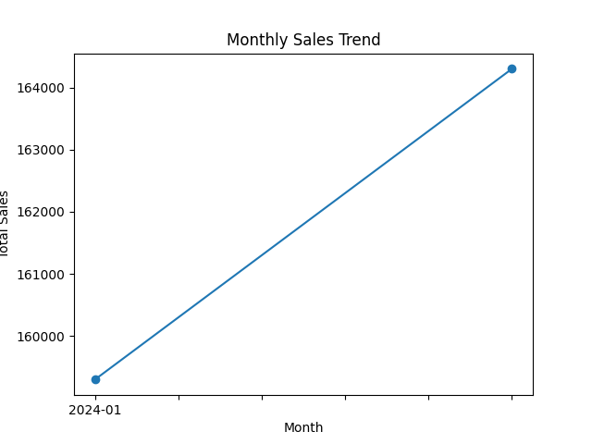
Monthly Sales Trend

Slide 5
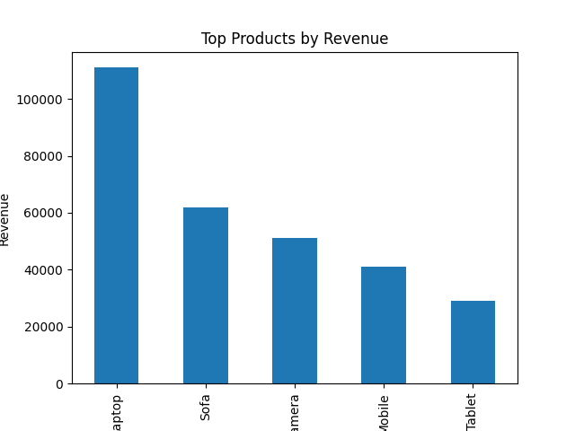
Top 5 Products by Revenue

Slide 6
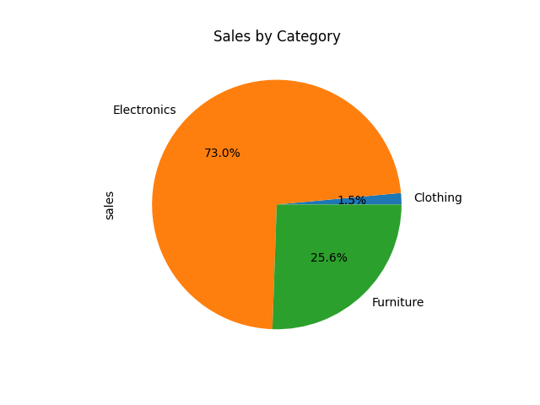
Sales by Category

Slide 7
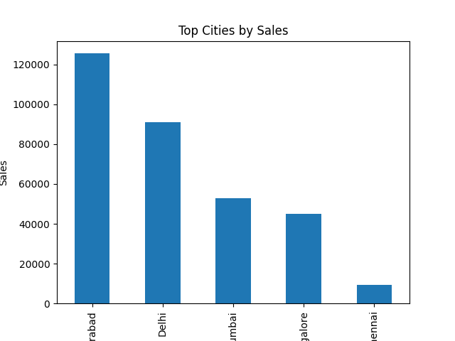
Top Cities by Sales

Slide 8
Insights
Electronics generates the highest sales.
Laptop is the highest revenue product.
Hyderabad and Delhi generate strong sales.
Sales increased from January to February.

Slide 9
Tools & Technologies
SQL
Python
Excel
PowerPoint

