Slide 1

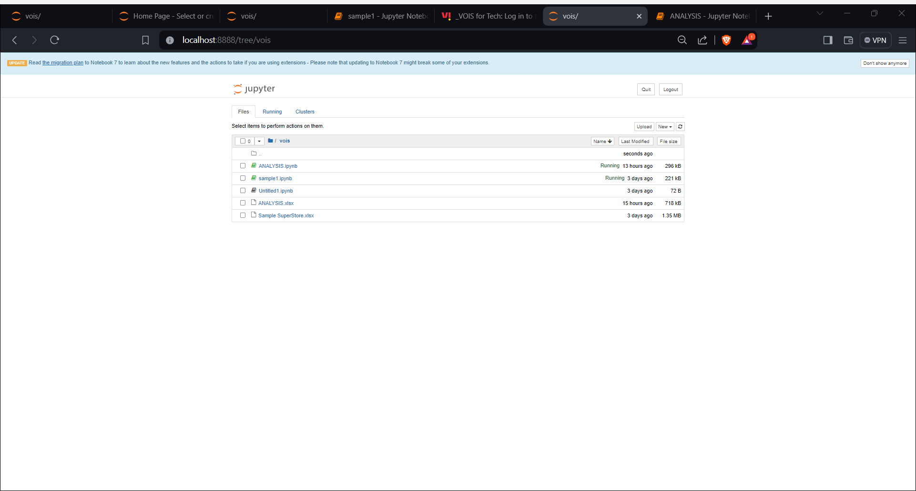
Project Title – Sales Analysis and Visualization for Business Insights
Name: Shravya Sari
AICTE No: STU659a3ccd8fd3c1704606925

Slide 2


PROBLEM STATEMENTS
1. Identify top-selling products
2. Analyze profitability
3. Distribution of sales across different regions
4. Calculate total sales and profit for each segment
5. Analyze the relationship between quantity sold and discount
6. Identify the correlation between sales and profit
7. Identify the most profitable cities
8. Identify the products with the highest and lowest profit margins
9. Identify the most common combinations of categories and sub-categories in orders
10. Identify the top-selling categories in each region
11. Identify the top-selling categories in each region

Slide 3
PROBLEM STATEMENTS
12. Total number of null values in the dataset
13. Analyze the distribution of sales and profit by customer segment
14. Identify the correlation between sales and quantity sold
15. Identify the correlation between sales and quantity sold
16. Visualize the distribution of sales across different regions using a pie chart
17. Visualize the top-selling products using a horizontal bar graph
18. Visualize the relationship between quantity sold and discount using a scatter plot
19. Visualize the distribution of profit margins using a histogram
20. Visualize the correlation between sales and profit using a scatter plot
21. Visualize the distribution of discounts for different quantities sold using a box plot

Slide 4
Description
This project utilizes Python libraries such as NumPy, Pandas, Matplotlib, Seaborn, and Scikit-learn for in-depth analysis and visualization of sales data sourced from 'ANALYSIS.xlsx'. The dataset undergoes rigorous preprocessing to ensure data quality and consistency. Analysis tasks include identifying top-selling products, analyzing profitability across product categories, and examining regional sales trends. Correlation analysis is conducted to understand relationships between sales metrics like sales and profit. Visualizations, including pie charts, bar graphs, scatter plots, histograms, and box plots, effectively present findings. Insights cover ship modes, discount-quantity relationships, profitable cities, product profit margins, common order combinations, and segment-wise sales and profit analysis, aiding stakeholders in data-driven decision-making. This project emphasizes leveraging data analytics for meaningful insights to improve business performance and customer satisfaction.
.
.

Slide 5

WHO ARE THE END USERS?
Business Executives: Executives can use the analysis to make strategic decisions, such as identifying top-selling products, profitable regions, and areas for expansion. This helps in maximizing revenue and profitability while minimizing risks.
Sales and Marketing Teams: These teams can leverage the insights to refine marketing strategies, target specific customer segments effectively, and optimize sales tactics. Understanding sales trends and customer preferences enhances the effectiveness of marketing campaigns, leading to increased sales and market share.
Finance Department: The finance department can benefit from profitability analysis to optimize cost structures, improve pricing strategies, and allocate resources efficiently. Insights into profit margins, cost of goods sold, and revenue trends enable better financial planning and budgeting.
Supply Chain Management: Supply chain professionals can use sales data to forecast demand, manage inventory levels, and streamline distribution channels. By aligning production with demand, they can reduce stockouts, minimize excess inventory, and improve overall supply chain efficiency.
Customer Service: Insights into sales patterns and customer behavior can help customer service teams anticipate customer needs, address issues proactively, and enhance the overall customer experience. This leads to higher customer satisfaction and loyalty.
Data Analysts and Scientists: Data analysts and scientists play a crucial role in extracting actionable insights from the sales data. By employing advanced analytics techniques, they uncover hidden patterns, identify correlations, and develop predictive models that drive business decisions.
External Stakeholders: External stakeholders, such as investors, partners, or regulatory bodies, may also benefit indirectly from the analysis by gaining confidence in the company's performance and prospects.
Overall, each user group stands to benefit from the analysis in different ways, ranging from strategic decision-making and operational efficiency to customer satisfaction and financial performance.

Slide 6

Technology Used
Python: The programming language in which the code is written.
NumPy: A fundamental package for scientific computing in Python, used for numerical operations and array manipulation.
Pandas: A powerful data manipulation and analysis library used for handling structured data, such as reading and writing data from various file formats, data cleaning, manipulation, and analysis.
Matplotlib: A comprehensive plotting library used for creating static, interactive, and animated visualizations in Python.
Seaborn: A statistical data visualization library built on top of Matplotlib, used for creating attractive and informative statistical graphics with higher-level functions.

Slide 7
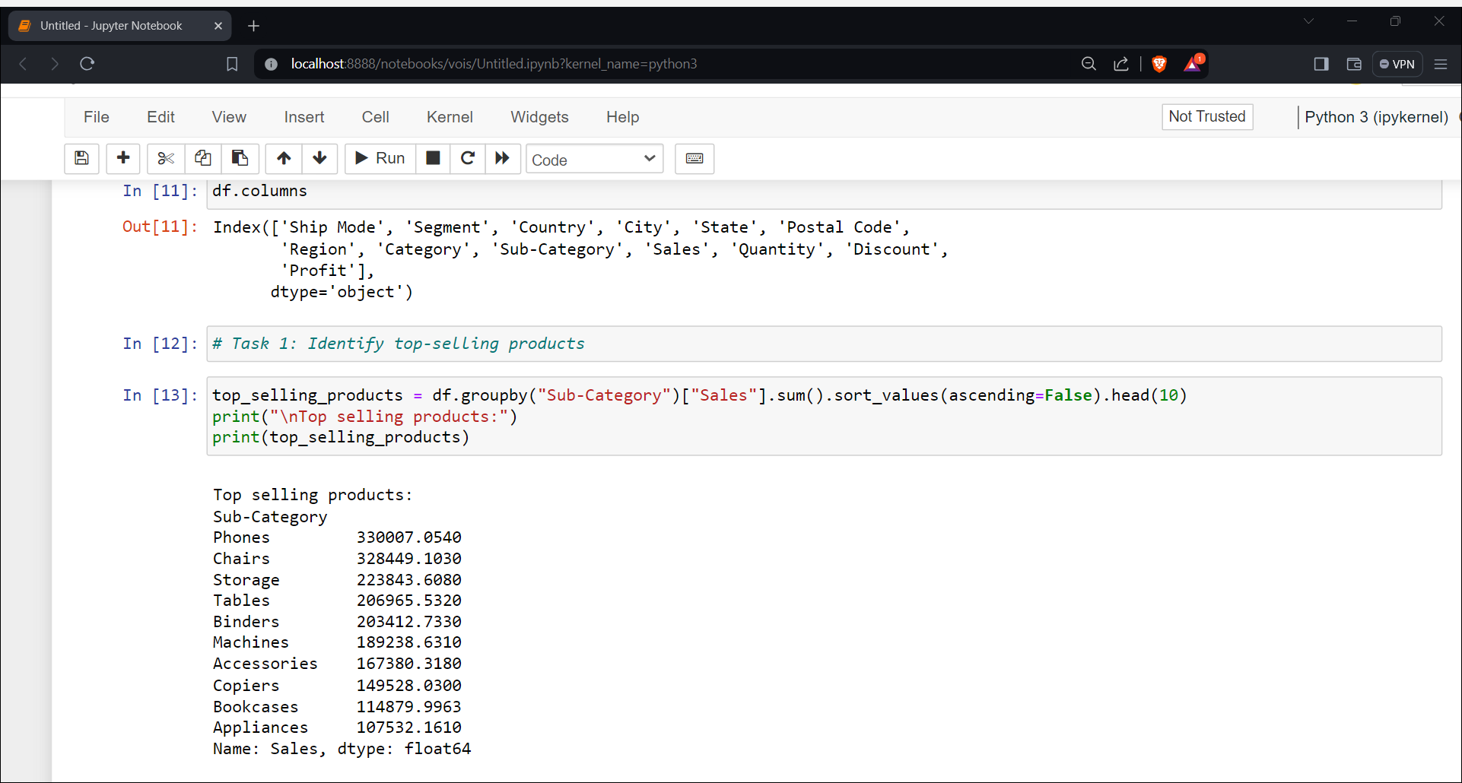
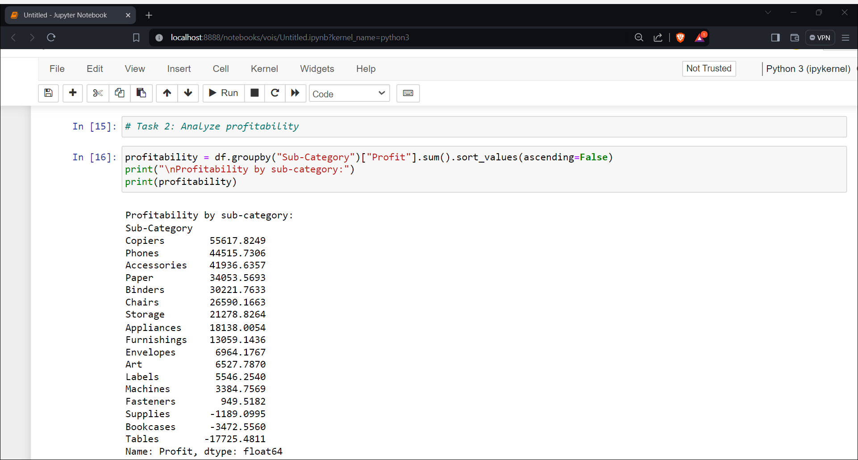
Results

Slide 8
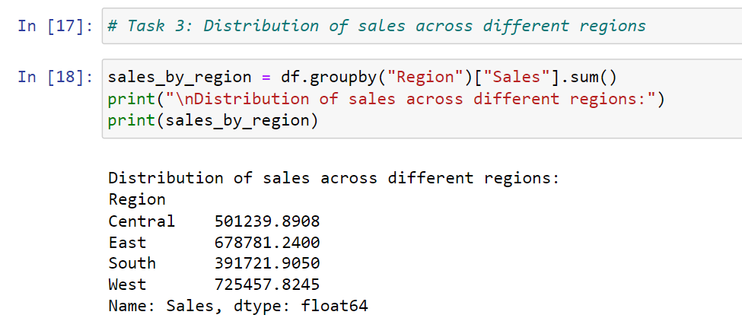
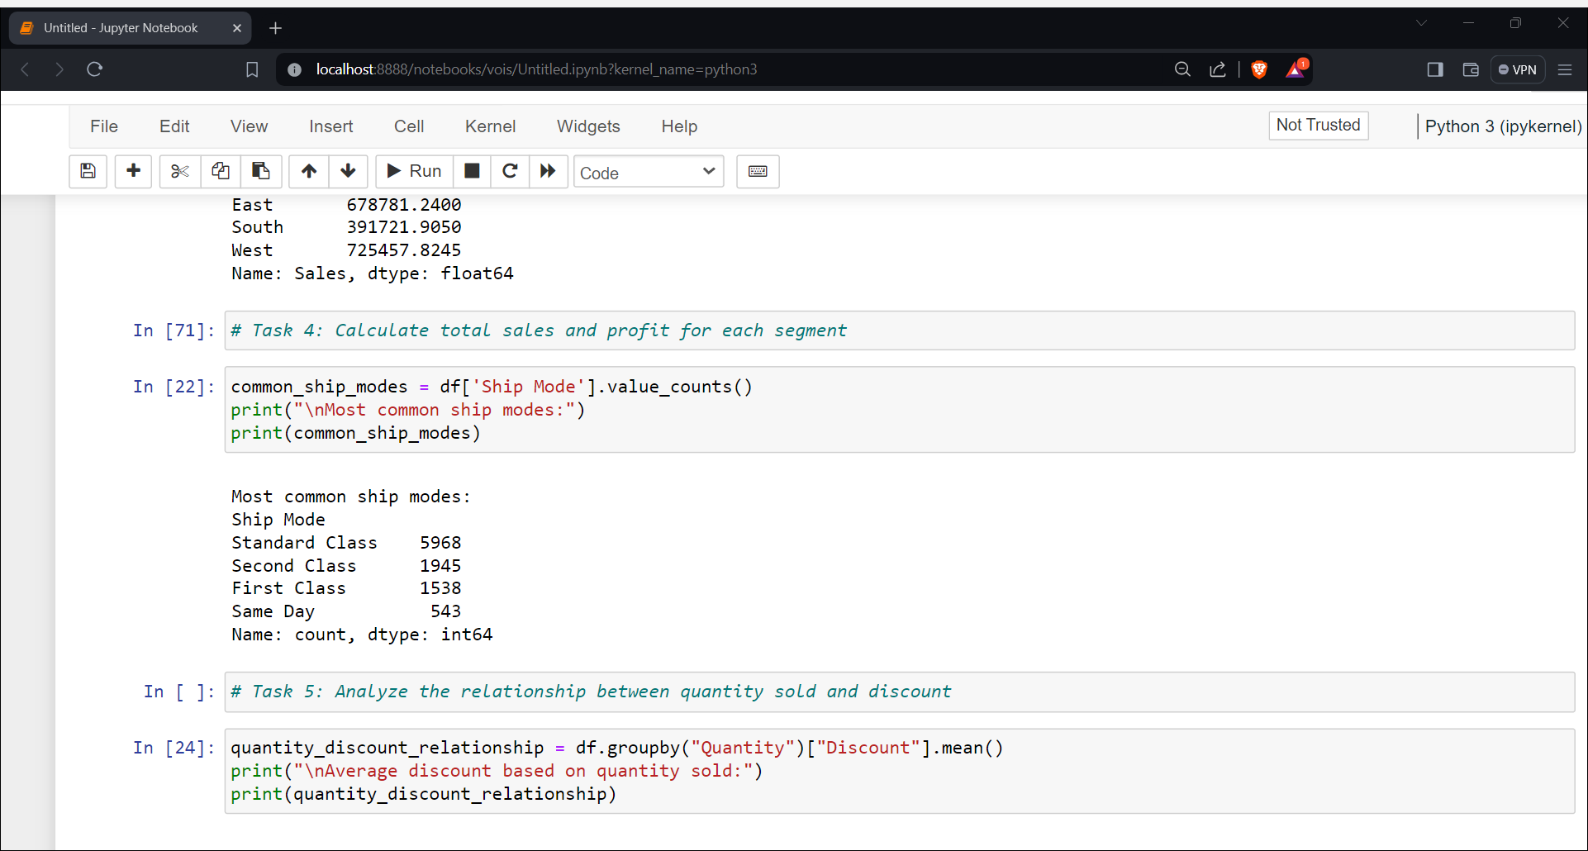

Slide 9
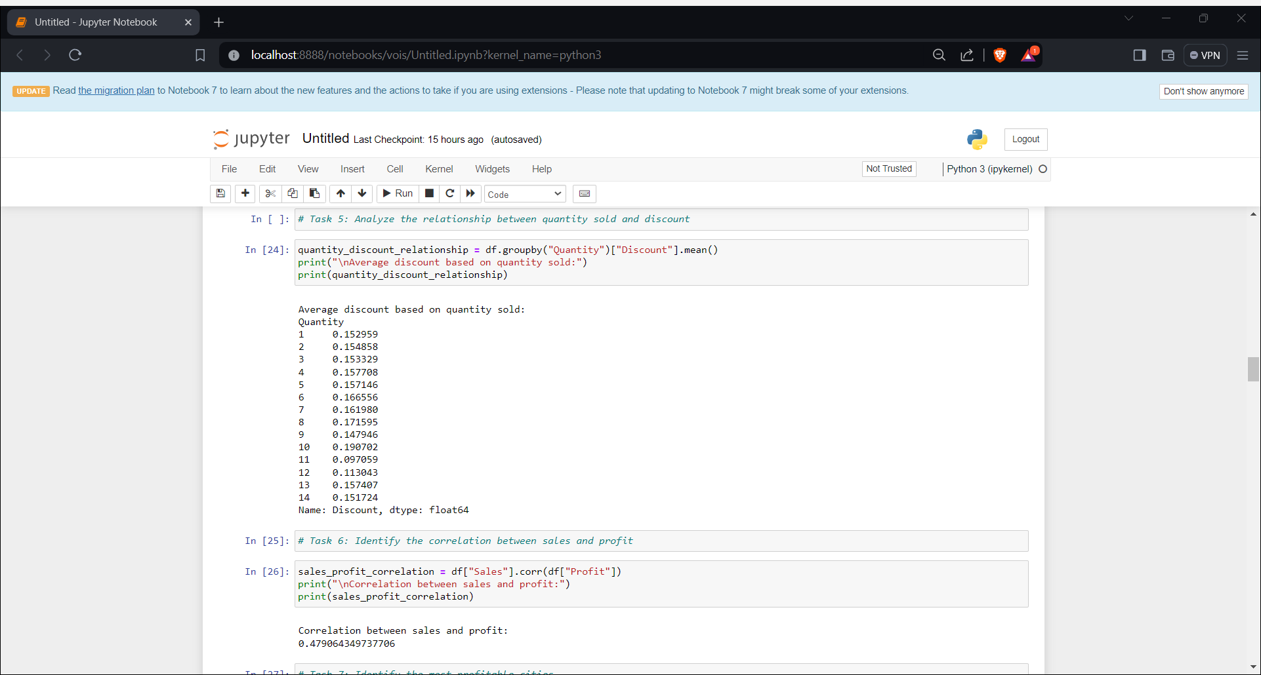
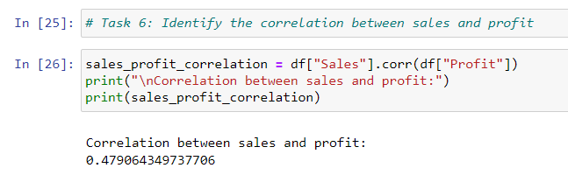

Slide 10
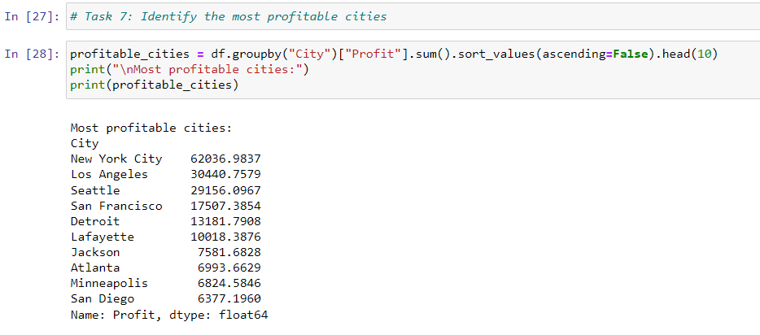
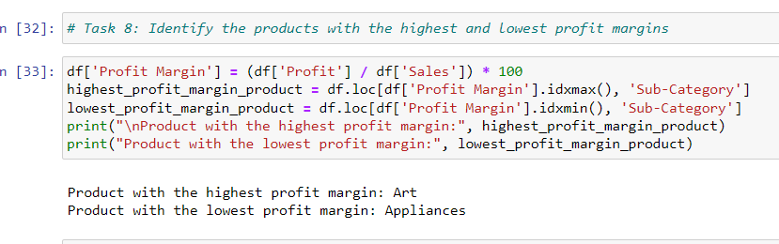

Slide 11
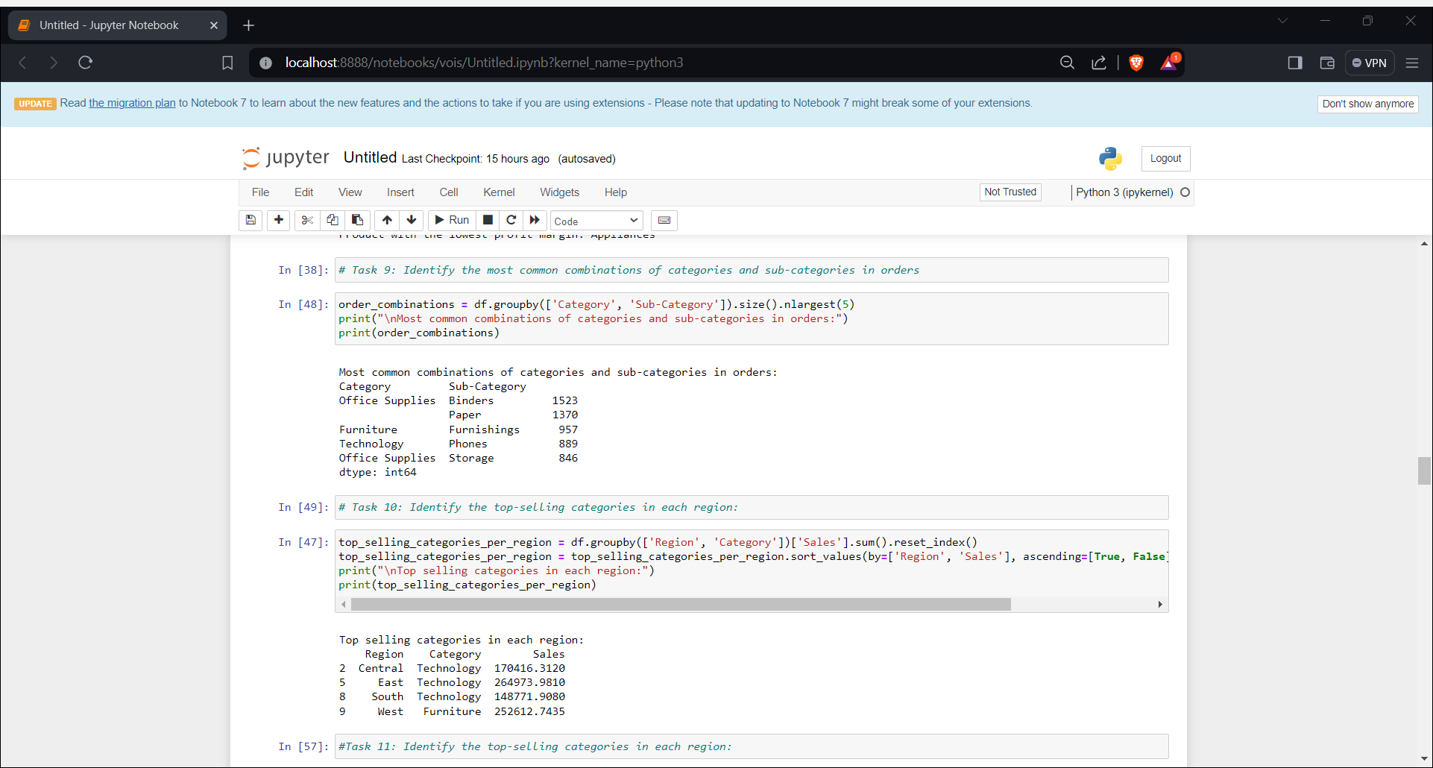

Slide 12
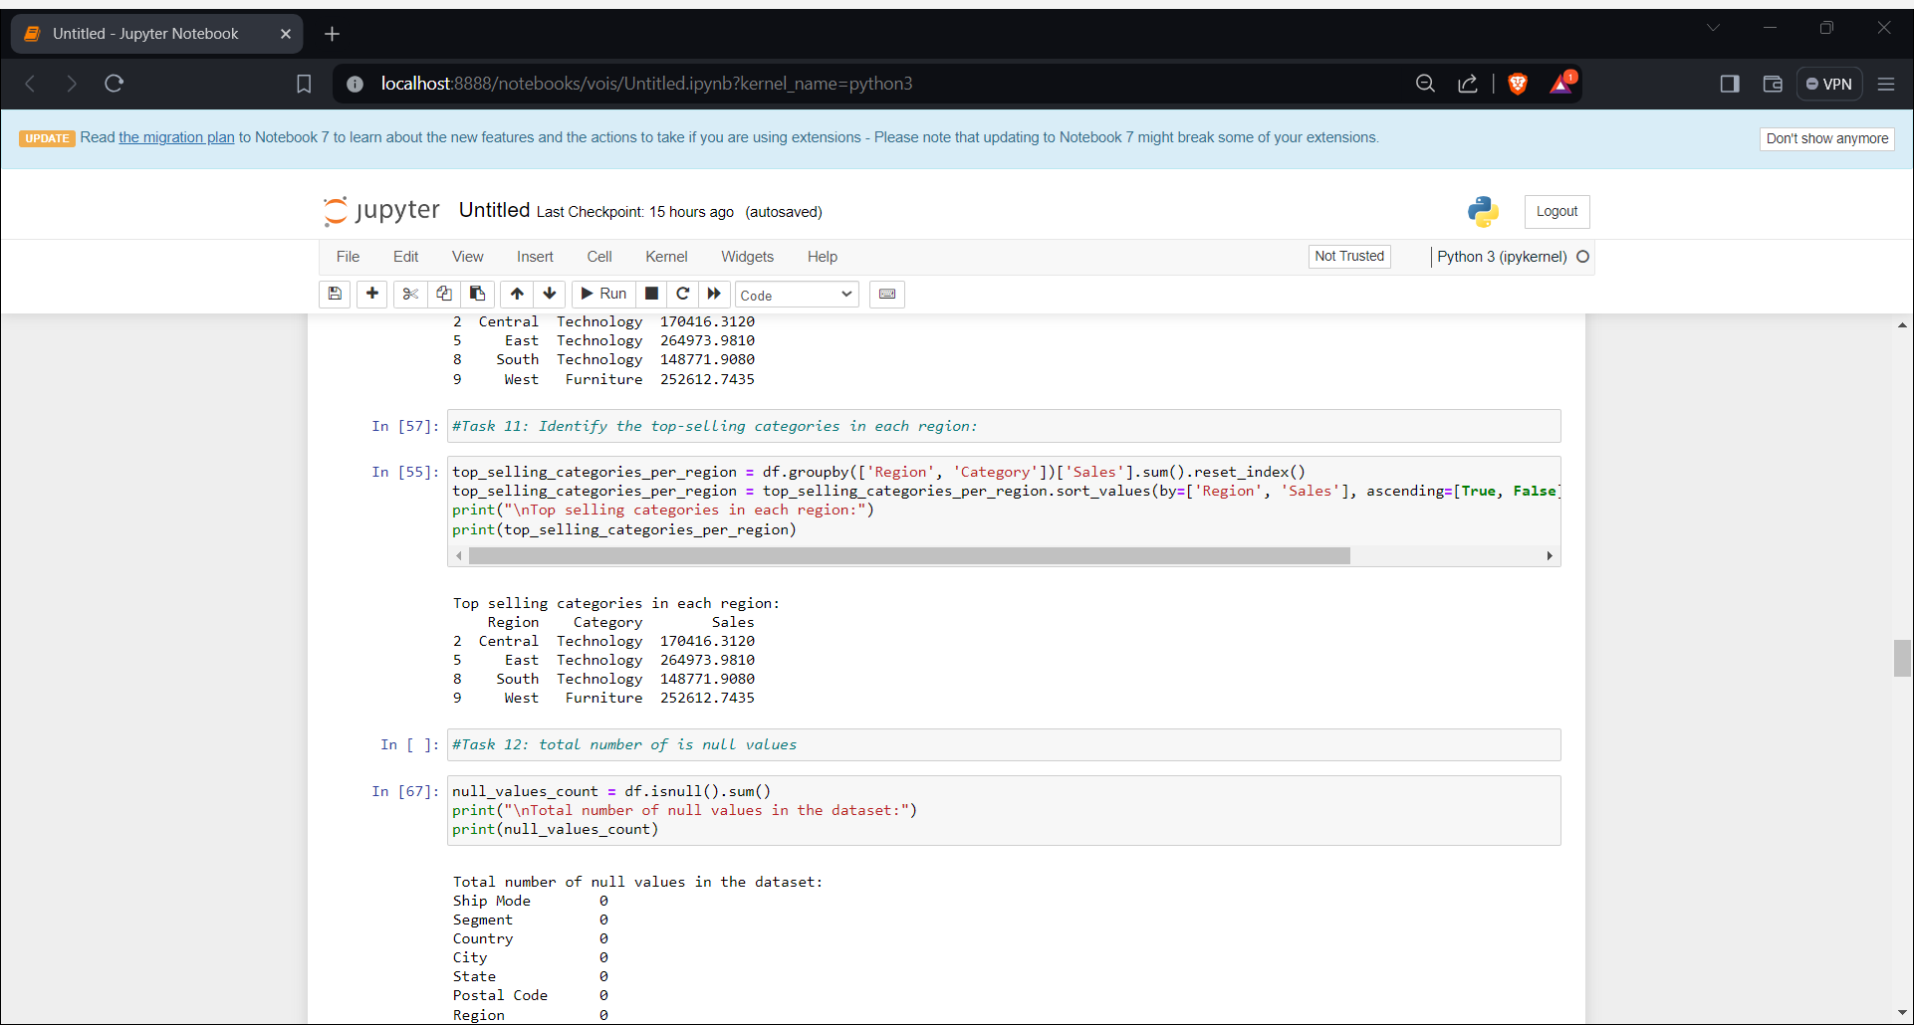
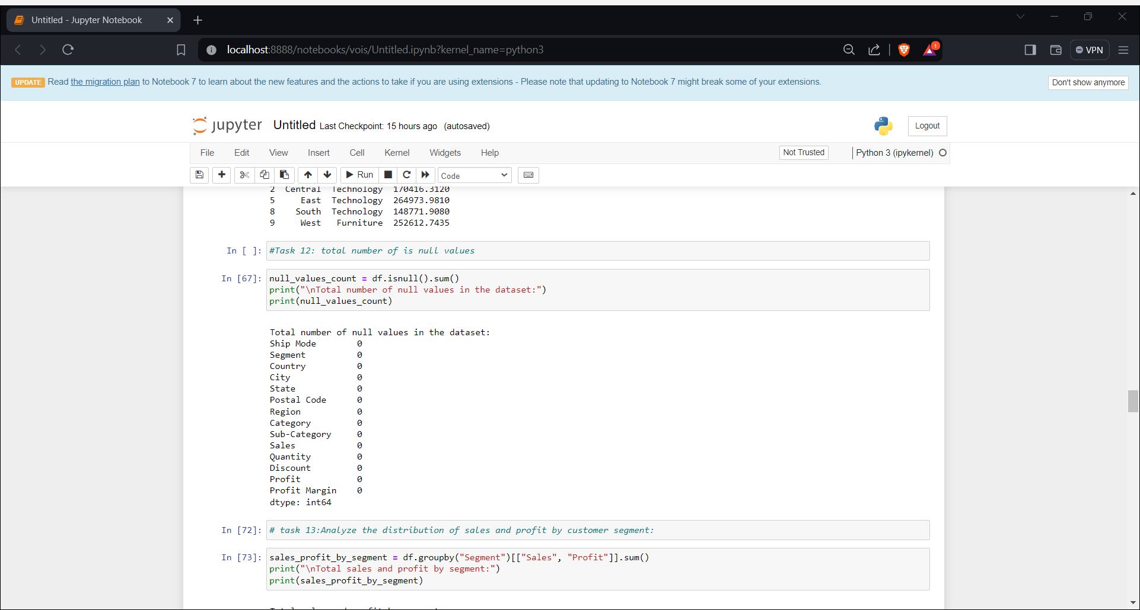

Slide 13
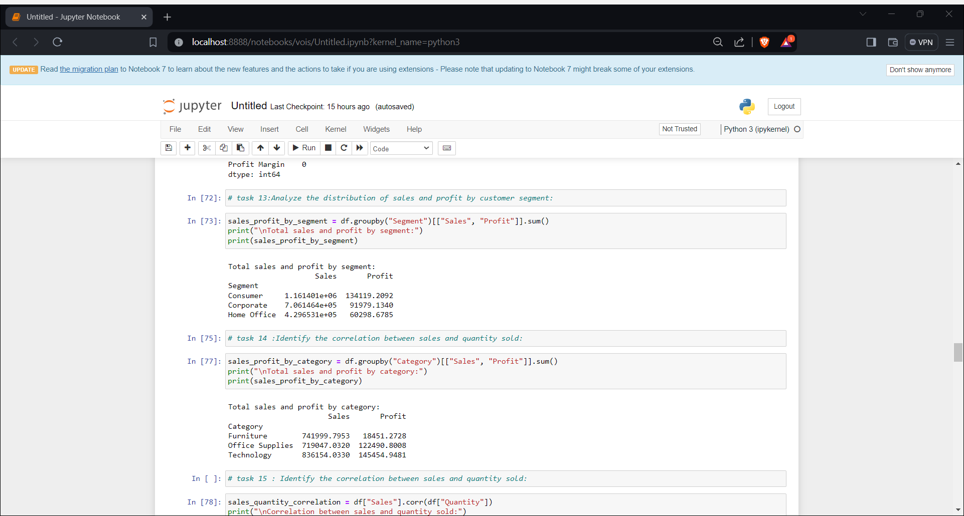
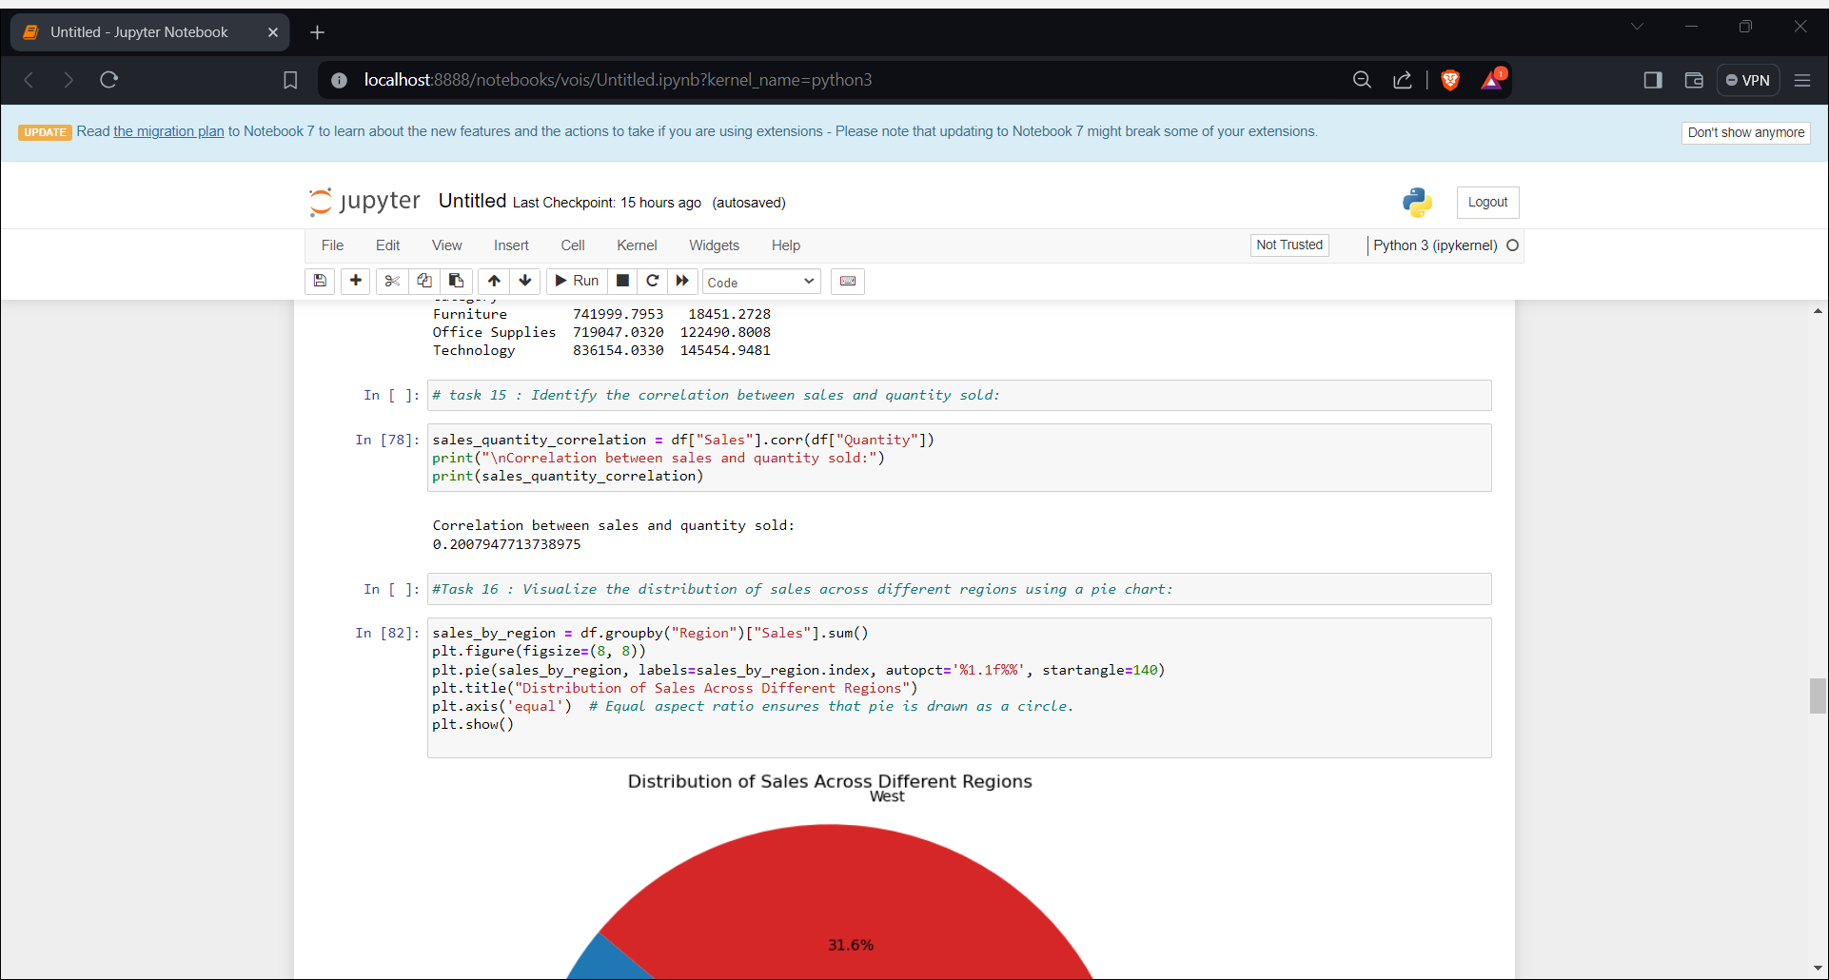

Slide 14
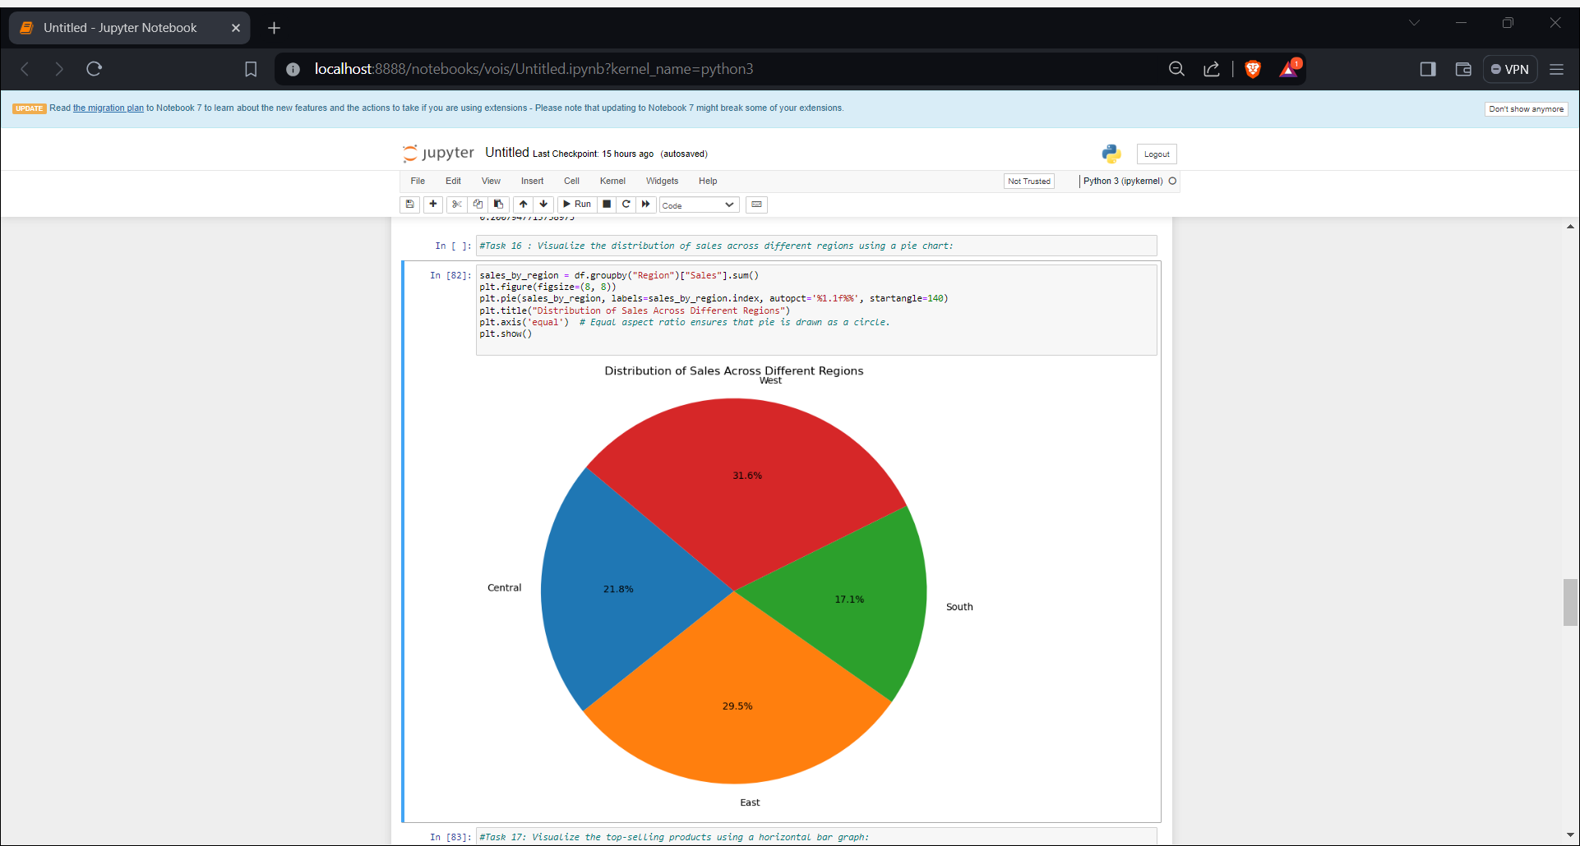

Slide 15
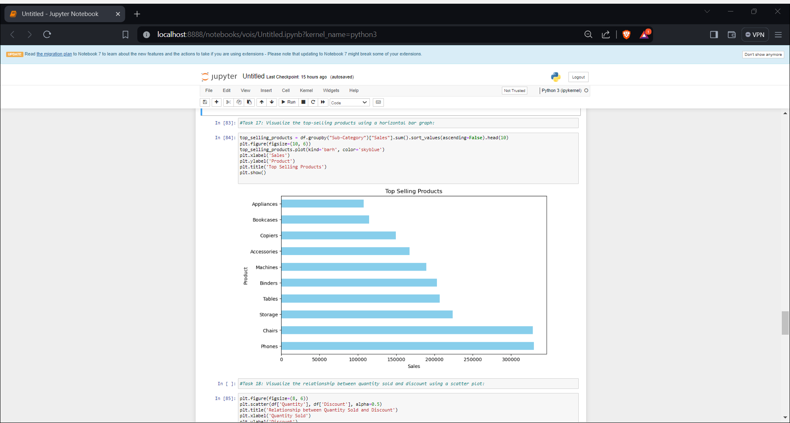

Slide 16
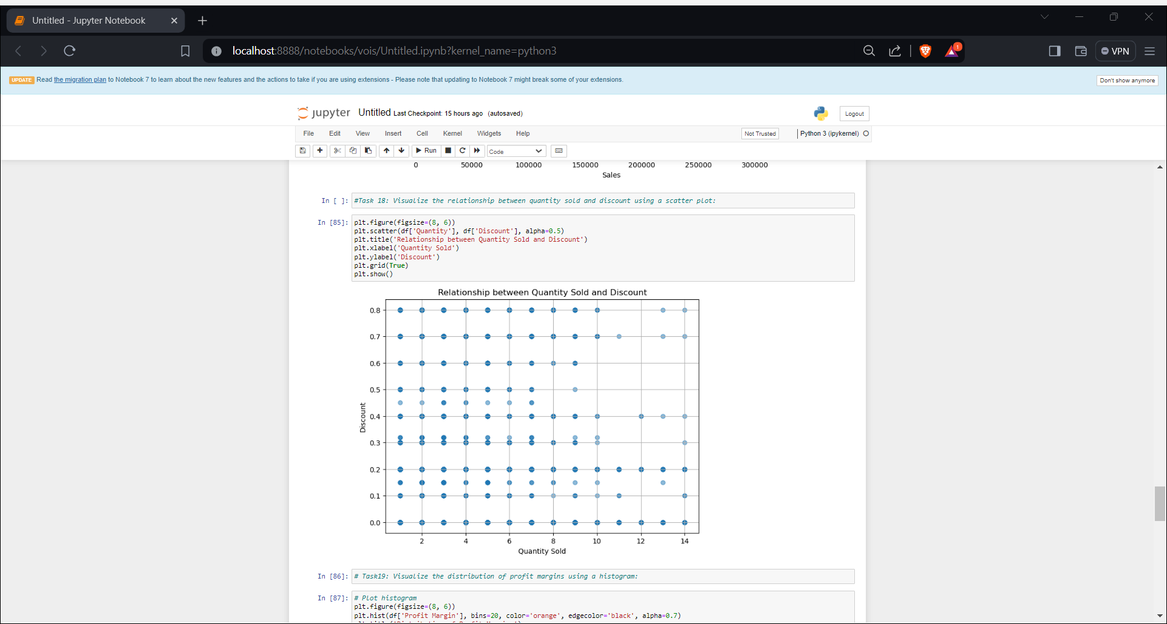

Slide 17
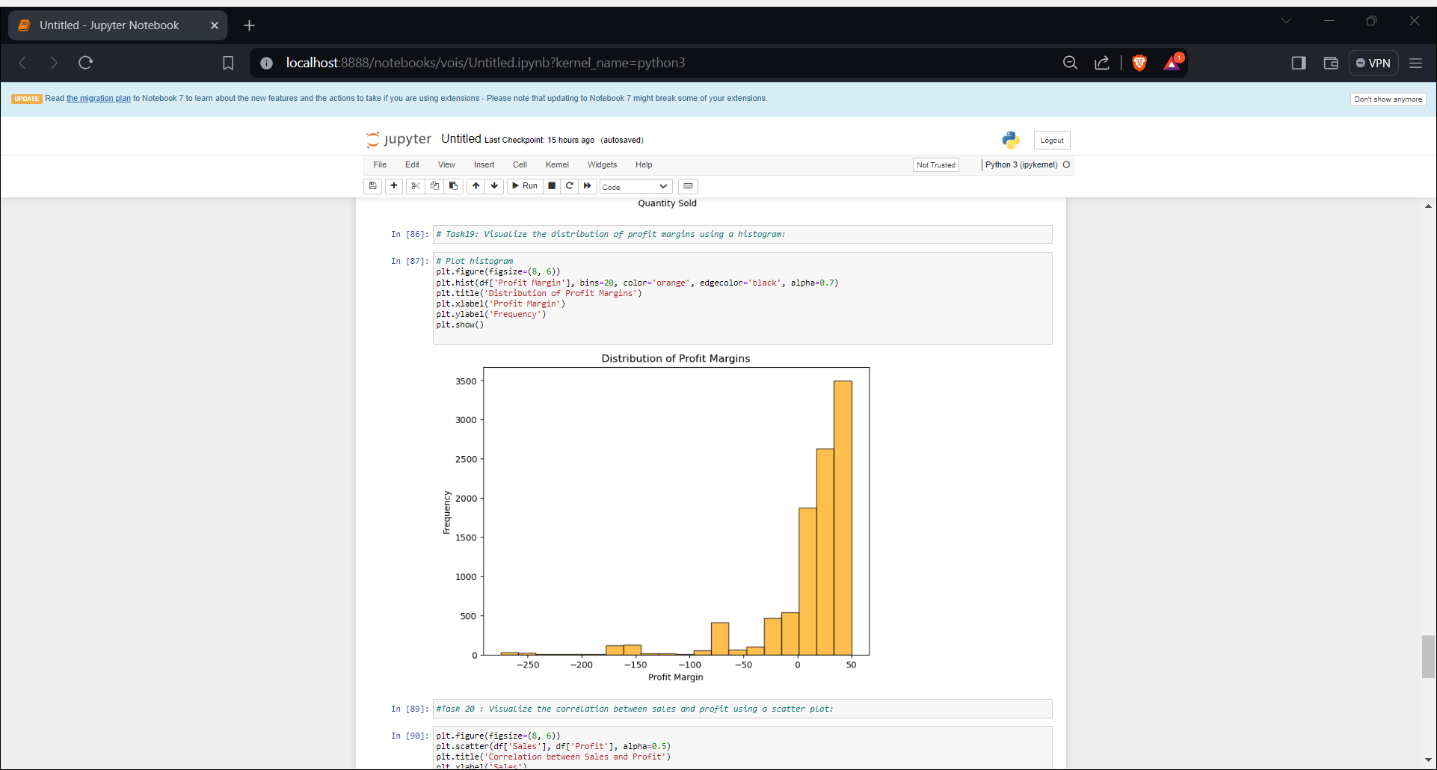

Slide 18
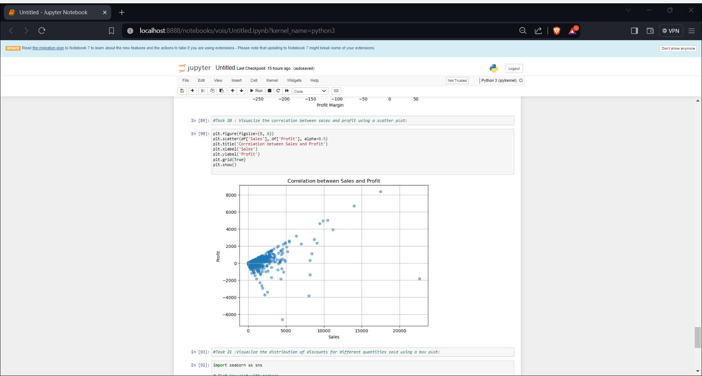

Slide 19
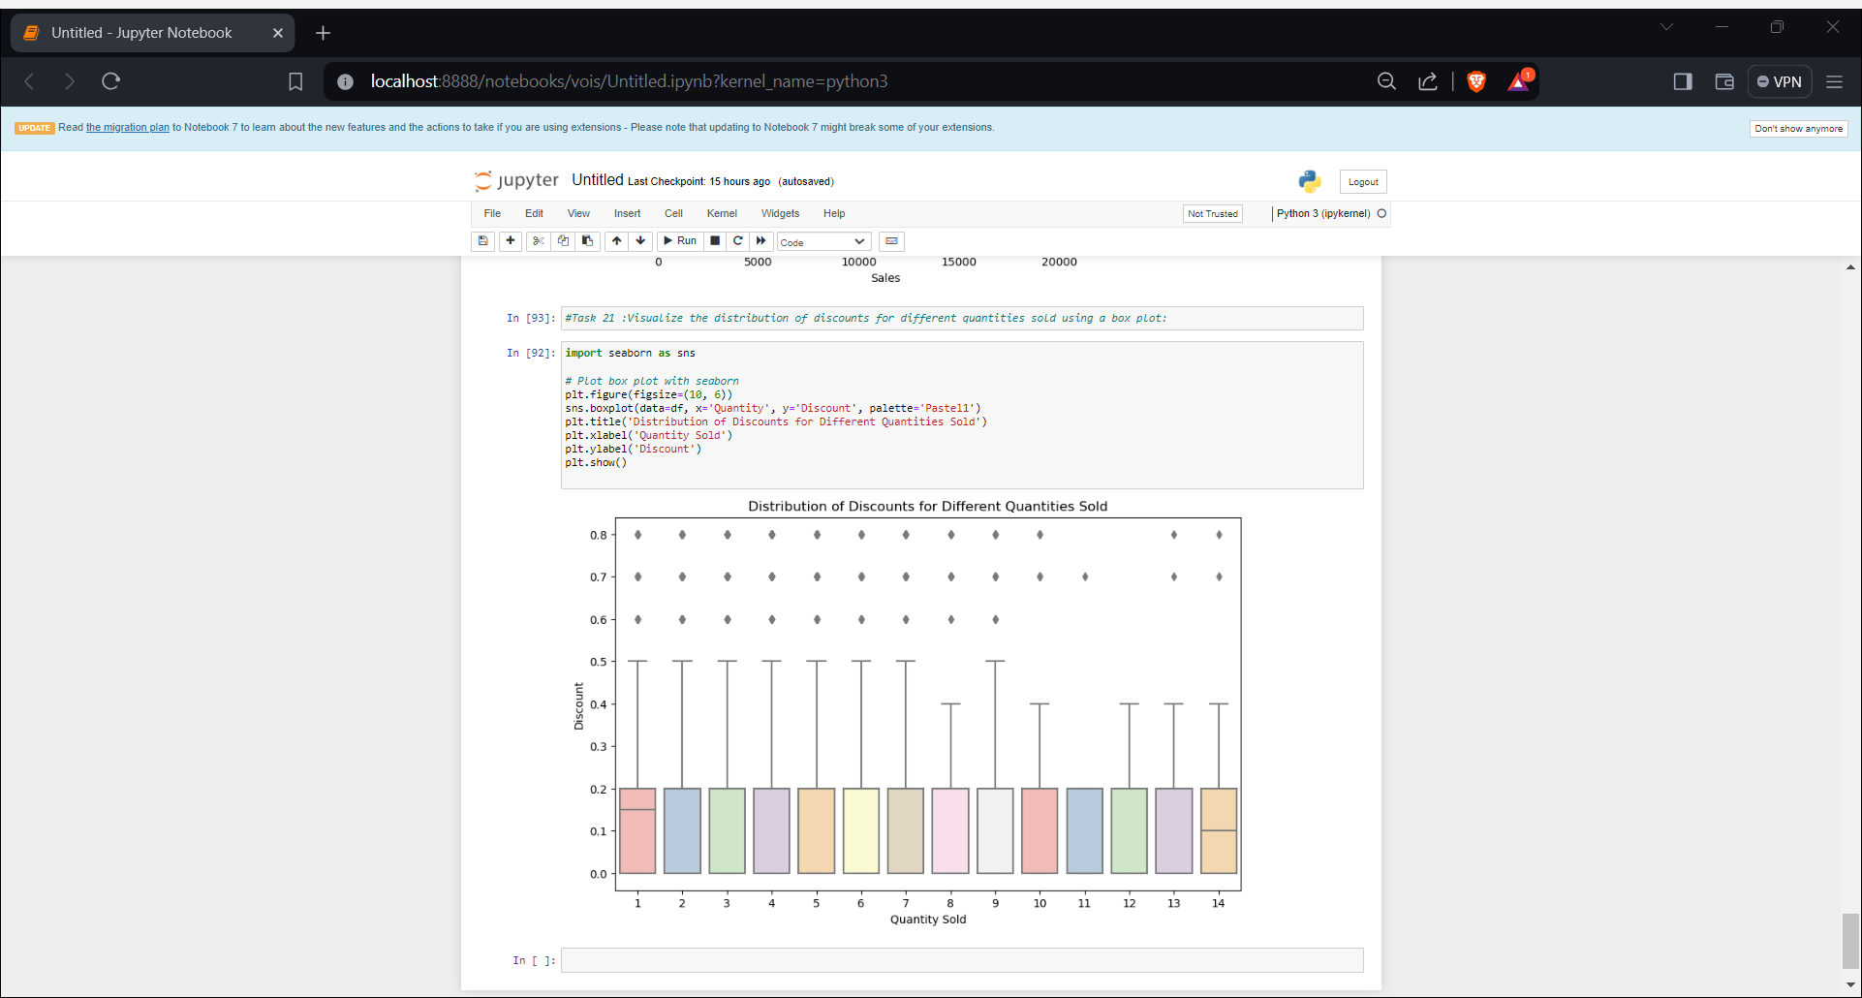

Slide 20
Conclusion
In conclusion, this project demonstrates the power of data analytics in uncovering actionable insights from sales data. By leveraging advanced analytical techniques and visualizations, we have gained valuable insights into customer preferences, regional sales trends, profitability, and various other aspects of the sales landscape. These insights enable stakeholders to make informed decisions, optimize business strategies, and drive growth.
Moving forward, it is imperative for organizations to continue investing in data analytics capabilities to stay competitive in today's dynamic business environment. By harnessing the power of data, companies can identify opportunities, mitigate risks, and enhance overall business performance. This project underscores the importance of data-driven decision-making and highlights the transformative impact it can have on organizational success.
.
.

Slide 21

.
.
Github Project Link:
https://github.com/Shravyasari/VOIS_1

