Slide 1

Bank Loan Performance Dashboard
Overview:
The Loan Performance Dashboard is an end-to-end data analytics solution designed to help financial institutions monitor, analyze, and optimize their loan operations. Using SQL for data processing and Power BI for visualization, the project provides actionable insights into loan applications, funding, repayments, and borrower characteristics — enabling data-driven decision-making for improved operational efficiency.
Objective:
To develop interactive dashboards that give stakeholders a clear view of loan performance metrics, borrower trends, and financial efficiency indicators.
Tools Used:
SQL | Power BI | DAX | Excel

Slide 2

Problem Statement
Bank is facing challenges in:
- Tracking loan performance and repayment trends in real time.
- Identifying high-risk (bad) loans versus low-risk (good) loans.
- Understanding regional, demographic, and purpose-based lending patterns.
- Lacking a centralized reporting system to analyze Month-to-Date (MTD) and Month-over-Month (MoM) performance.
Problem Statement:
The bank lacked an integrated system to analyze loan performance, repayment patterns, and borrower profiles, making it difficult to assess loan health and take proactive measures to reduce defaults and improve profitability.

Slide 3

Business Requirements
Dashboard 1: Summary Dashboard (KPI View)
- Total Loan Applications, Funded Amount, and Amount Received (with MTD & MoM trends)
- Average Interest Rate and Average Debt-to-Income (DTI) Ratio
- Good vs Bad Loan KPIs (Applications, Funded Amount, Received Amount)
- Loan Status Grid View for detailed category-level insights
Dashboard 2: Overview Dashboard (Visual Insights)
- Monthly Loan Trends (Line Chart)
- Regional Lending by State (Filled Map)
- Loan Term Distribution (Donut Chart)
- Employment Length vs Loan Metrics (Bar Chart)
- Loan Purpose Breakdown (Bar Chart)
- Home Ownership Impact (Tree Map)
Dashboard 3: Details Dashboard
- Consolidated grid of all loan-level details
- Comprehensive view of borrower profiles, loan attributes, and repayment data

Slide 4

Solution Approach- SQL+Power BI
Firing sql queries to solve the business problems
Connected SQL database to Power BI and design the interactive dashboard
comparing result with Power BI
Imported CSV files into SQL Server and created relational database tables.

Slide 5



BANK LOAN REPORT | SUMMARY
Total Loan Applications
select count(id) AS Total_Loan_Applications from [Bank Loan Data]
MTD_Total_Applications
select count(id) AS MTD_Toatal_Applications from [Bank Loan Data]
where month (issue_date) =12 And year(issue_date) =2021
PMTD_Total_Applications
select count(id) AS PMTD_Toatal_Applications from [Bank Loan Data] where month (issue_date) =11 And year(issue_date) =2021

Slide 6



BANK LOAN REPORT | SUMMARY
Total Funded Amount
select SUM(loan_amount) as Total_funded_Amount from [Bank Loan Data
MTD_Total_Funded_Amount
select SUM(loan_amount) as MTD_Total_Funded_Amount from [Bank Loan Data]
where month (issue_date) =12 And year(issue_date) =2021
PMTD_Total_Funded_Amount
select SUM(loan_amount) as PMTD_Total_Funded_Amount from [Bank Loan Data
where month (issue_date) =11 And year(issue_date) =2021

Slide 7



BANK LOAN REPORT | SUMMARY
total amount received from borrower
select SUM(total_payment) as Total_Amount_Received from [Bank Loan Data]
MTD_Total_Amount_Received
select SUM(total_payment) as MTD_Total_Amount_Received from [Bank Loan Data
where month (issue_date) =12 And year(issue_date) =2021
PMTD_Total_Amount_Received
select SUM(total_payment) as PMTD_Total_Amount_Received from [Bank Loan Data
where month (issue_date) =11 And year(issue_date) =2021

Slide 8




BANK LOAN REPORT | SUMMARY
Average Interest Rate
select AVG(int_rate)*100 as Average_Interest_Rate from [Bank Loan Data]
select ROUND(AVG(int_rate),4) * 100 as Average_Interest_Rate from [Bank Loan Data] ---to get round off the % to two decimal
MTD_Average_Interest_Rate
select AVG(int_rate)*100 as MTD_Average_Interest_Rate from [Bank Loan Data]
where month (issue_date) =12 And year(issue_date) =2021
PMTD_Average_Interest_Rate
select AVG(int_rate)*100 as PMTD_Average_Interest_Rate from [Bank Loan Data]
where month (issue_date) =11 And year(issue_date) =2021

Slide 9




BANK LOAN REPORT | SUMMARY
Average DTI
select AVG(dti)*100 as Average_Dti from [Bank Loan Data]
select ROUND(AVG(dti),4) * 100 as Average_Dti from [Bank Loan Data
MTD_Average_Dti
select AVG(dti)*100 as MTD_Average_Dti from [Bank Loan Data]
where month (issue_date) =12 And year(issue_date) =2021
PMTD_Average_Dti
select AVG(dti)*100 as PMTD_Average_Dti from [Bank Loan Data]
where month (issue_date) =11 And year(issue_date) =2021

Slide 10




BANK LOAN REPORT | SUMMARY
Good Loan Issued
Good_Loan_percentage
select (count(case when loan_status ='Fully Paid' or loan_status ='Current' then id end)*100) / count(id) As Good_Loan_percentage from [Bank Loan Data]
Good_Loan_Application
select count(id) As Good_Loan_Application from [Bank Loan Data]
where loan_status ='Fully Paid' or loan_status ='Current’
Good_Loan_Funded_Amount
select Sum(loan_amount) As Good_Loan_Funded_Amount from [Bank Loan Data]
where loan_status ='Fully Paid'or loan_status ='Current’
Good_Loan_Funded_Amount
select Sum(total_payment) As Good_Loan_Total_Received_Amount from [Bank Loan Data]
where loan_status ='Fully Paid'or loan_status ='Current'

Slide 11




BANK LOAN REPORT | SUMMARY
Bad Loan Issued
Bad_Loan_percentage
select (count(case when loan_status ='Charged Off' then id end)*100)/
count(id) As Bad_Loan_percentage from [Bank Loan Data]
Bad_Loan_Application
select count(id) As Bad_Loan_Application from [Bank Loan Data]
where loan_status ='Charged Off’
Bad_Loan_Funded_Amount
select Sum(loan_amount) As Bad_Loan_Funded_Amount from [Bank Loan Data
where loan_status ='Charged Off’
Bad_Loan_Total_Received_Amount
select Sum(total_payment) As Bad_Loan_Total_Received_Amount from [Bank Loan Data]
where loan_status ='Charged Off’

Slide 12
BANK LOAN REPORT | SUMMARY
Loan Status Grid
Bad_Loan_percentage
select (count(case when loan_status ='Charged Off' then id end)*100)/
count(id) As Bad_Loan_percentage from [Bank Loan Data]
Bad_Loan_Application
select count(id) As Bad_Loan_Application from [Bank Loan Data]
where loan_status ='Charged Off’
Bad_Loan_Funded_Amount
select Sum(loan_amount) As Bad_Loan_Funded_Amount from [Bank Loan Data
where loan_status ='Charged Off’
Bad_Loan_Total_Received_Amount
select Sum(total_payment) As Bad_Loan_Total_Received_Amount from [Bank Loan Data]
where loan_status ='Charged Off’

Slide 13

BANK LOAN REPORT | SUMMARY Loan Status Grid View
select
loan_status,
count(id) as Total_Applications,
sum(loan_amount) as Total_Amount_Funded,
sum(total_payment) as Total_Amount_Recieved,
AVG (int_rate*100) as Average_Interest_Rate,
AVG(dti *100) as Average_Dti
from [Bank Loan Data]
group by loan_status
SELECT ---loan status for MTD
loan_status,
SUM(total_payment) AS MTD_Total_Amount_Received,
SUM(loan_amount) AS MTD_Total_Funded_Amount
FROM [Bank Loan Data]
WHERE MONTH(issue_date) = 12
GROUP BY loan_status

Slide 14

BANK LOAN REPORT | SUMMARY Loan Status Grid View-MTD
SELECT
loan_status,
SUM(total_payment) AS MTD_Total_Amount_Received,
SUM(loan_amount) AS MTD_Total_Funded_Amount
FROM [Bank Loan Data]
WHERE MONTH(issue_date) = 12
GROUP BY loan_status

Slide 15
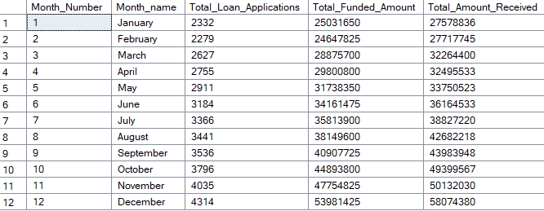
BANK LOAN REPORT | Overview Monthly Report
SELECT
MONTH(issue_date) AS Month_Number,
DATENAME(MONTH, issue_date) AS Month_name,
COUNT(id) AS Total_Loan_Applications,
SUM(loan_amount) AS Total_Funded_Amount,
SUM(total_payment) AS Total_Amount_Received
FROM [Bank Loan Data]
GROUP BY MONTH(issue_date), DATENAME(MONTH, issue_date)
ORDER BY MONTH(issue_date)

Slide 16
BANK LOAN REPORT | Overview State
SELECT
address_state AS State,
COUNT(id) AS Total_Loan_Applications,
SUM(loan_amount) AS Total_Funded_Amount,
SUM(total_payment) AS Total_Amount_Received
FROM bank_loan_data
GROUP BY address_state
ORDER BY address_state

Slide 17
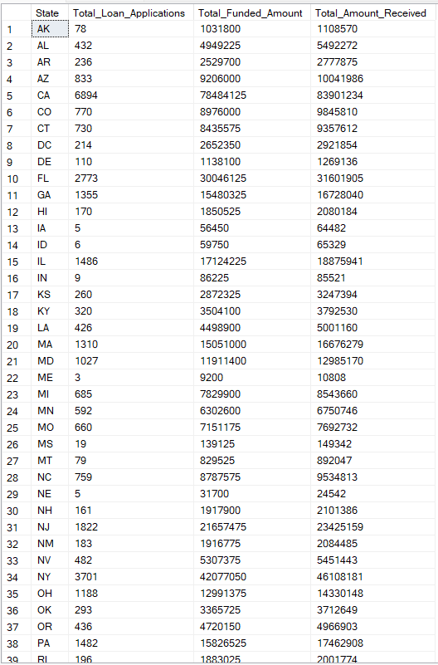

Slide 18

BANK LOAN REPORT | OVERVIEW Term
SELECT
term,
COUNT(id) AS Total_Loan_Applications,
SUM(loan_amount) AS Total_Funded_Amount,
SUM(total_payment) AS Total_Amount_Received
FROM [Bank Loan Data]
GROUP BY term
ORDER BY term

Slide 19
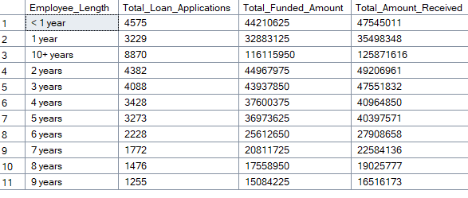
BANK LOAN REPORT | OVERVIEW EMPLOYEE LENGTH
SELECT
emp_length AS Employee_Length,
COUNT(id) AS Total_Loan_Applications,
SUM(loan_amount) AS Total_Funded_Amount,
SUM(total_payment) AS Total_Amount_Received
FROM [Bank Loan Data]
GROUP BY emp_length
ORDER BY emp_length

Slide 20
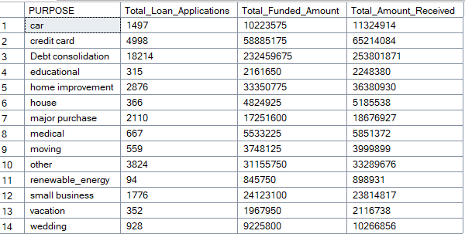
BANK LOAN REPORT |OVERVIEW Purpose
SELECT
purpose AS PURPOSE,
COUNT(id) AS Total_Loan_Applications,
SUM(loan_amount) AS Total_Funded_Amount,
SUM(total_payment) AS Total_Amount_Received
FROM [Bank Loan Data]
GROUP BY purpose
ORDER BY purpose

Slide 21
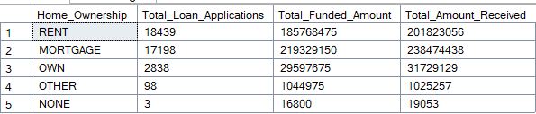
BANK LOAN REPORT | OVERVIEW Home Ownership
SELECT
home_ownership AS Home_Ownership,
COUNT(id) AS Total_Loan_Applications,
SUM(loan_amount) AS Total_Funded_Amount,
SUM(total_payment) AS Total_Amount_Received
FROM [Bank Loan Data]
GROUP BY home_ownership
ORDER BY count(id) desc

Slide 22
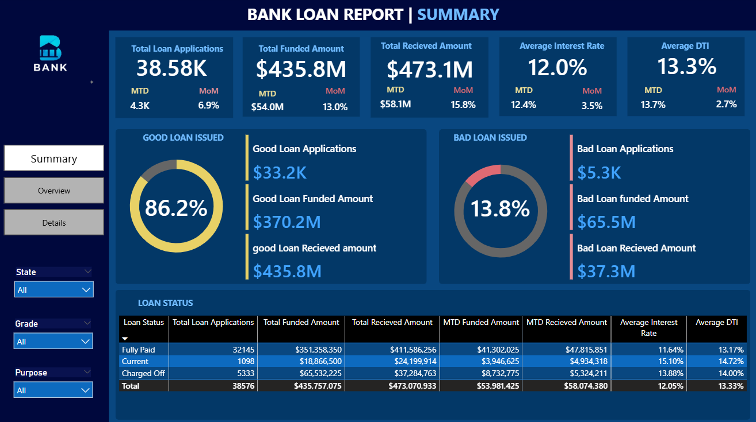

Slide 23
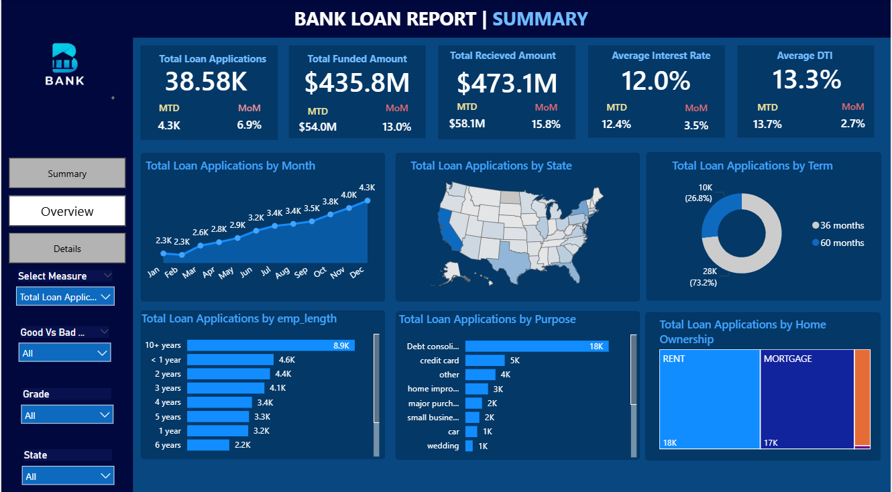

Slide 24
