Slide 1

Problem Statement - KPI’s Requirement
We need to analyze key indicators for our pizza sales data to gain insights into our business performance. Specifically, we want to calculate the following metrics:
1. Total Revenue: The sum of the total price of all pizza orders.
2. Average Order Value: The average amount spent per order, calculated by dividing the total revenue by the total number of orders.
3. Total Pizzas Sold: The sum of the quantities of all pizzas sold.
4. Total Orders: The total number of orders placed.
5. Average Pizzas Per Order: The average number of pizzas sold per order, calculated by dividing the total number of pizzas sold by the total number of orders.

Slide 2
Charts Requirement - Part 1
We would like to visualize various aspects of our pizza sales data to gain insights and understand key trends. The following charts are required:
1. Daily Trend for Total Orders: Create a bar chart that displays the daily trend of total orders over a specific period to identify patterns or fluctuations in order volumes.
2. Hourly Trend for Total Orders: Create a line chart illustrating the hourly trend of total orders throughout the day to identify peak hours or high activity periods.
3. Percentage of Sales by Pizza Category: Create a pie chart showing the distribution of sales across different pizza categories to understand their contribution to overall sales.

Slide 3
Charts Requirement - Part 2
4. Percentage of Sales by Pizza Size: Generate a pie chart representing the percentage of sales attributed to different pizza sizes to understand customer preferences.
5. Total Pizzas Sold by Pizza Category: Create a funnel chart presenting the total number of pizzas sold for each category for performance comparison.
6. Top 5 Best Sellers by Total Pizzas Sold: Create a bar chart highlighting the top 5 best-selling pizzas based on total pizzas sold.
7. Bottom 5 Worst Sellers by Total Pizzas Sold:
Create a bar chart showcasing the bottom 5 worst-selling pizzas based on total pizzas sold to identify underperforming options.

Slide 4
Dashboard

Slide 5
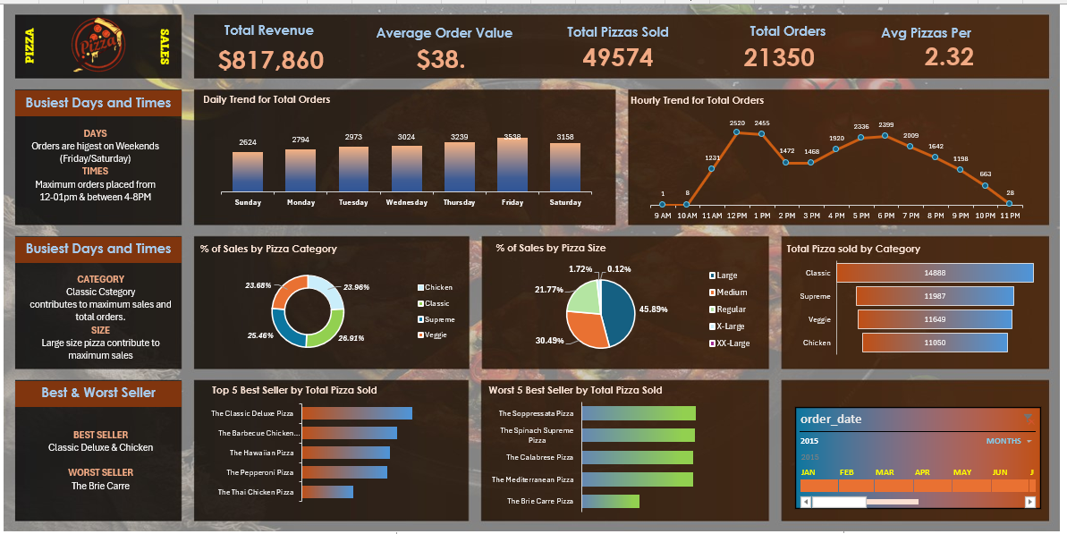

Slide 6
Insights

Slide 7
Pizza Sales Performance Overview
Total Revenue: $817,860
Total Orders: 21,350
Total Pizzas Sold: 49,574
Average Order Value: $38.3
Average Pizzas per Order: 2.32
Key Insight: Strong weekend and lunch/dinner rush sales, driven by large pizza orders.

Slide 8
Key Insights
Orders peak on weekends (Friday & Saturday).
Highest activity between 12–1 PM and 4–8 PM.
Classic category contributes most to sales (26.9%).
Large pizzas dominate (45.9% of sales).
Top Sellers: Classic Deluxe, BBQ Chicken, Hawaiian.
Weak Sellers: Brie Carre, Mediterranean, Calabrese.

Slide 9
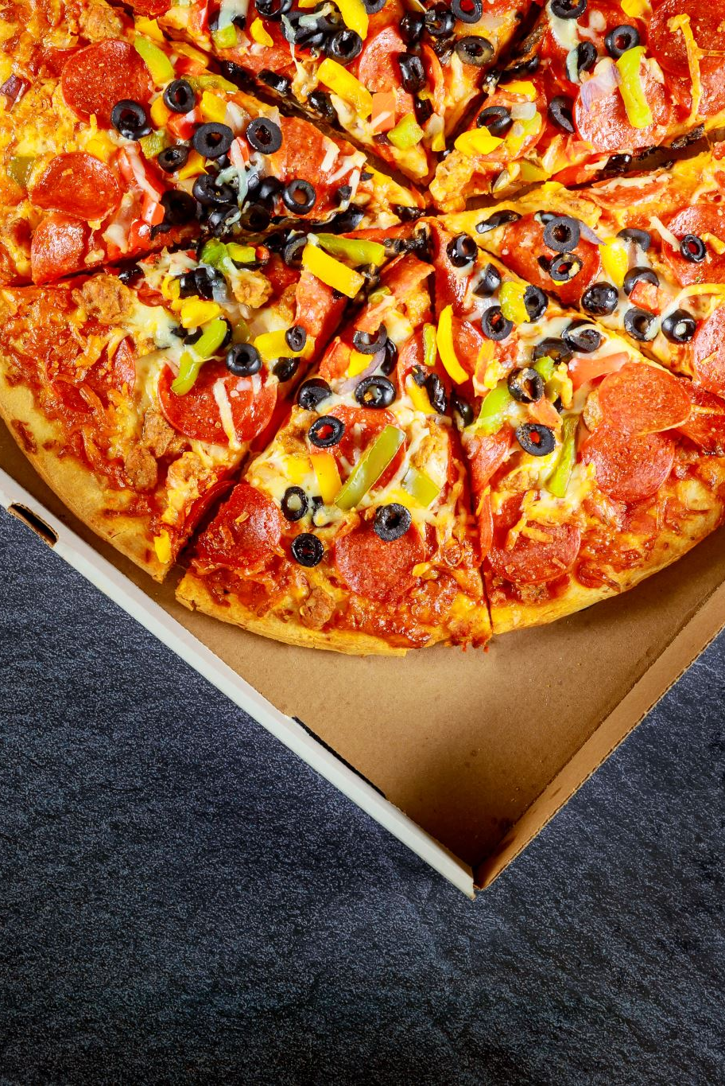
Recommendations
Launch weekend combo offers and weekday lunch promotions.
Focus marketing on Classic & Chicken pizzas.
Reduce staff after 9 PM; focus resources on peak hours.
Bundle Large pizzas with sides/drinks for upselling.
Introduce loyalty program for frequent weekend buyers.
Reformulate or replace low-performing pizzas.

Slide 10
SQL Queries

Slide 11



SQL Queries- A. KPI’s
select * from pizza_sales
Total_Revenue :
select sum(total_price) As Total_Revenue from pizza_sales
2. Average Order Value
SELECT (SUM(total_price) / COUNT(DISTINCT order_id)) AS Avg_order_Value FROM pizza_sales
3. Total Pizzas Sold
SELECT SUM(quantity) AS Total_pizza_sold FROM pizza_sales

Slide 12



4. Total Orders
SELECT COUNT(DISTINCT order_id) AS Total_Orders FROM pizza_sales
5. Average Pizzas Per Order
SELECT CAST(CAST(SUM(quantity) AS DECIMAL(10,2)) / CAST(COUNT(DISTINCT order_id) AS DECIMAL(10,2)) AS DECIMAL(10,2))
AS Avg_Pizzas_per_order
FROM pizza_sales
OR SELECT
ROUND(SUM(quantity) * 1.0 / COUNT(DISTINCT order_id), 2) AS Avg_Pizzas_per_order
FROM pizza_sales

Slide 13
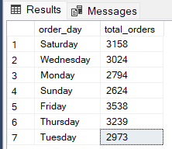
SQL Queries- B. Daily Trend for Total Orders
SELECT DATENAME(DW, order_date) AS order_day, COUNT(DISTINCT order_id) AS total_orders
FROM pizza_sales
GROUP BY DATENAME(DW, order_date)
Output:
*This query shows how many unique pizza orders were placed on each day of the week

Slide 14
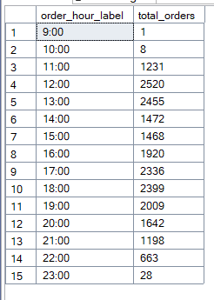
SQL Queries- C. Hourly Trend for Orders
SELECT
CONCAT(DATEPART(HOUR, order_time), ':00') AS order_hour_label,
COUNT(DISTINCT order_id) AS total_orders
FROM pizza_sales
GROUP BY DATEPART(HOUR, order_time)
ORDER BY DATEPART(HOUR, order_time)Output
*This query shows how many unique orders were placed during each hour of the day. It helps you find peak order times — e.g., lunch or dinner rush hours

Slide 15
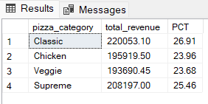
SQL Queries- D. % of Sales by Pizza Category
SELECT pizza_category, CAST(SUM(total_price) AS DECIMAL(10,2)) as total_revenue,
CAST(SUM(total_price) * 100 / (SELECT SUM(total_price) from pizza_sales) AS DECIMAL(10,2)) AS PCT
FROM pizza_sales
GROUP BY pizza_category
*This query shows total revenue and revenue percentage for each pizza category. It tells you which category contributes most to overall sales.

Slide 16
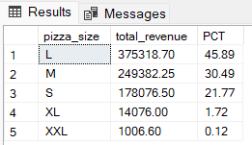
SQL Queries- E. % of Sales by Pizza Size
SELECT pizza_size, CAST(SUM(total_price) AS DECIMAL(10,2)) as total_revenue,
CAST(SUM(total_price) * 100 / (SELECT SUM(total_price) from pizza_sales) AS DECIMAL(10,2)) AS PCT
FROM pizza_sales
GROUP BY pizza_size
ORDER BY pizza_size
*This query shows total revenue and revenue percentage for each pizza Size. It tells you which pizza size contributes most to overall sales.

Slide 17
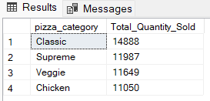
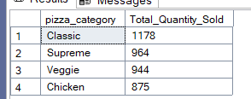
SQL Queries- F. Total Pizzas Sold by Pizza Category
SELECT pizza_category, SUM(quantity) as Total_Quantity_Sold
FROM pizza_sales
WHERE MONTH(order_date) = 2
GROUP BY pizza_category
ORDER BY Total_Quantity_Sold DESC
SELECT pizza_category,
SUM(quantity) as Total_Quantity_Sold
FROM pizza_sales
GROUP BY pizza_category
ORDER BY Total_Quantity_Sold DESC
*This shows which pizza category sold the most — ranked from highest to lowest.

Slide 18
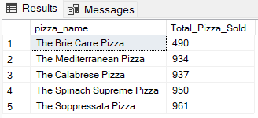
SQL Queries- G. Top 5 Best Sellers by Total Pizzas Sold
SELECT TOP 5 pizza_name, SUM(quantity) AS Total_Pizza_Sold
FROM pizza_sales
GROUP BY pizza_name
ORDER BY Total_Pizza_Sold ASC

Slide 19
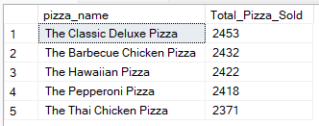
SQL Queries- H.Bottom 5 Best Sellers by Total Pizzas Sold
SELECT TOP 5 pizza_name, SUM(quantity) AS Total_Pizza_Sold
FROM pizza_sales
GROUP BY pizza_name
ORDER BY Total_Pizza_Sold ASC

