Slide 1

House Rental Database System
Submitted By-
Group 2
Ayush Mishra | 002772710
Manogna Pallapothu | 002776168
Padma Prasad Anaokar | 002727445
Raushan Kumar Jha | 002707535
Shrawani Karpe | 002194600

Slide 2


Objective
To create a rental property management platform that enables landlords, management companies, and broker firms to list and manage properties. The project aims to streamline the rental property management process and facilitate communication between all stakeholders involved to make the rental experience more convenient and efficient for all parties.
Difficulty in finding suitable rental properties for customers, due to limited access to property listings and lack of user-friendly interfaces for searching and filtering properties.
Problems Addressed
Limited access to property management services for landlords who want to delegate all management responsibilities to management companies or broker firms.
Difficulty for broker firms to access a diverse range of property listings, leading to limitations in providing suitable options for customers.

Slide 3

Design
Users must create an account by providing their name and selecting a user type: Landlord, Management Company, or Broker Firm.
Landlords must provide property details to list their properties and are assigned a unique ID number. Landlords can choose to manage their property themselves or connect with a management company to handle property management tasks.
Management companies must provide their name, property ID, price, and company ID to use the app, and take on all property management responsibilities.
Broker firms have a unique firm ID, name, Property ID, and brokerage rates. They have a network of brokers located throughout the city, each with their own broker ID, name, and work address.
Primary brokers may have an assistant, and a brokerage firm can have one or more primary brokers associated with it.
Customers seeking rentals can approach broker firms or management companies.
These entities have access to properties and their details listed by landlords on the app and assist customers in finding a suitable accommodation.

Slide 4
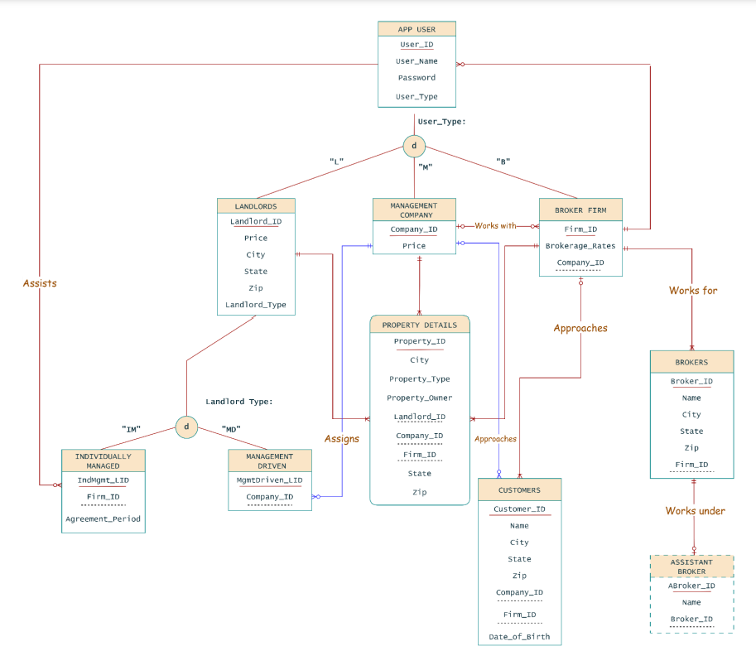
ERD

Slide 5
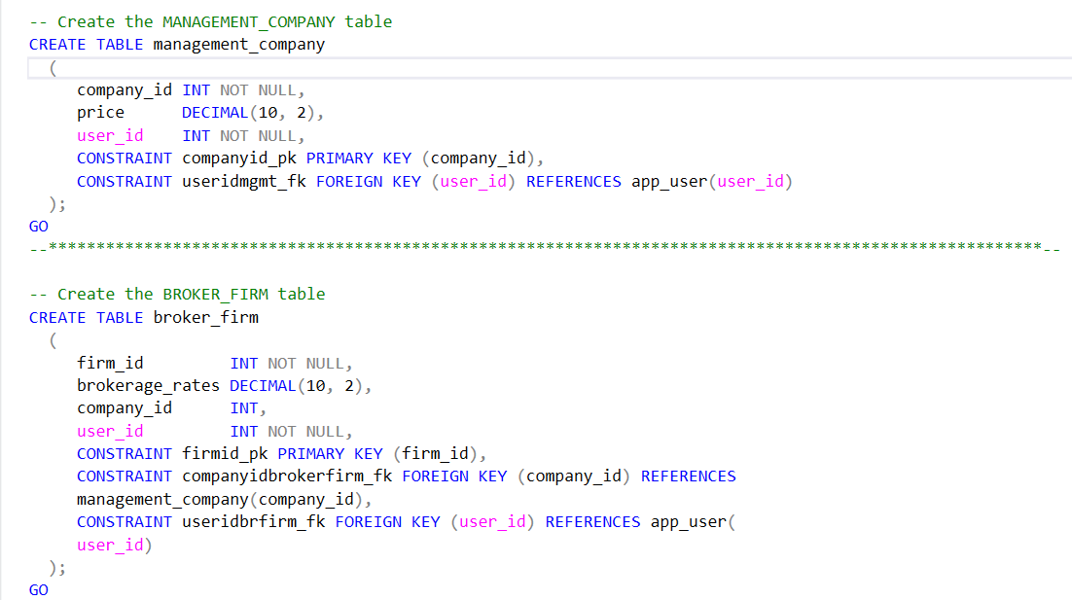
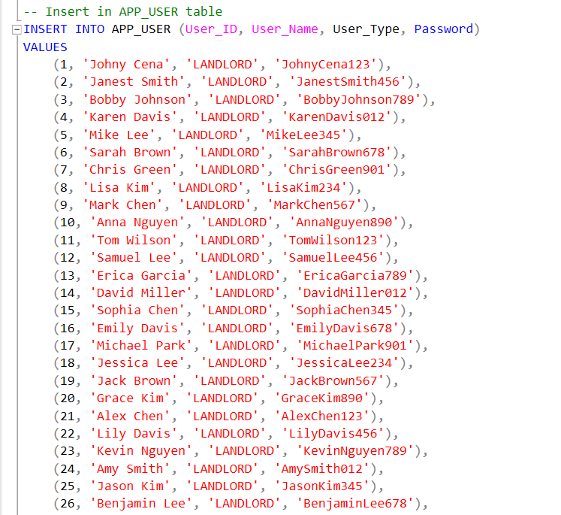
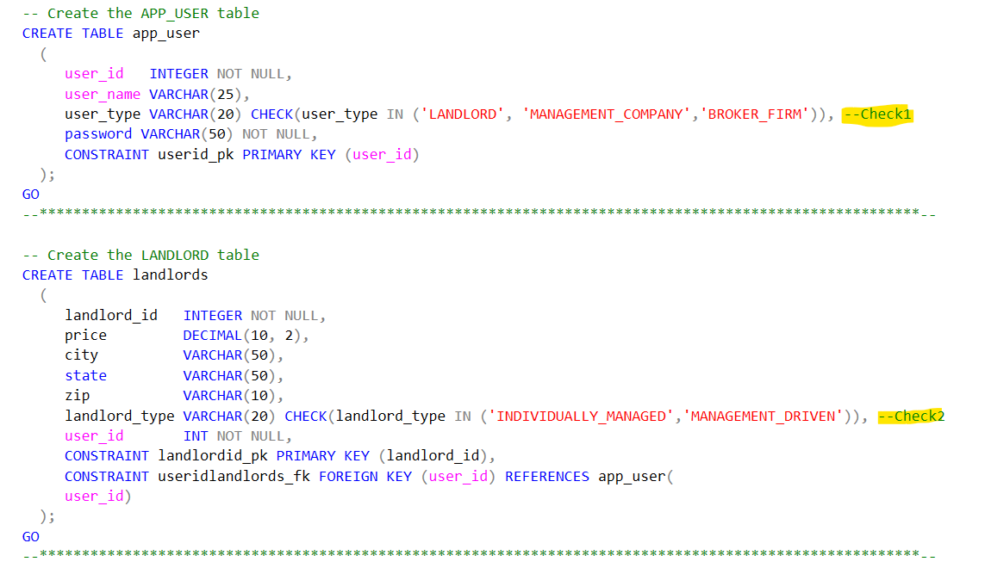
Database Objects

Slide 6
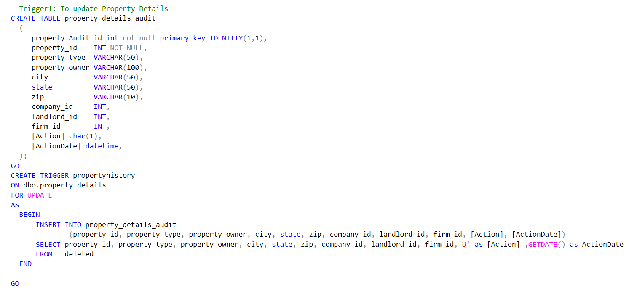
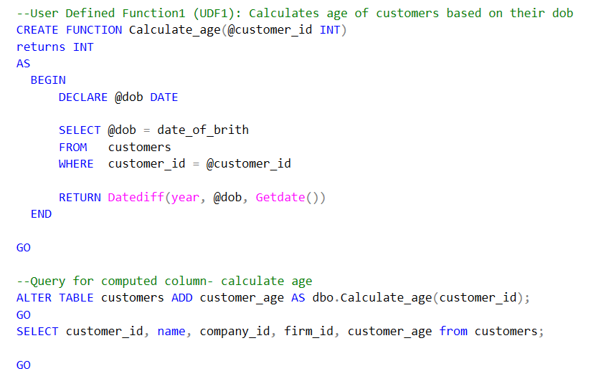
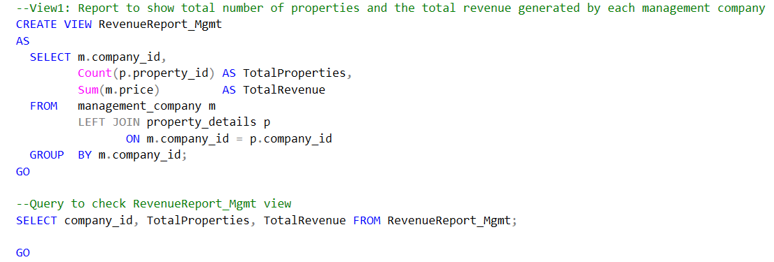
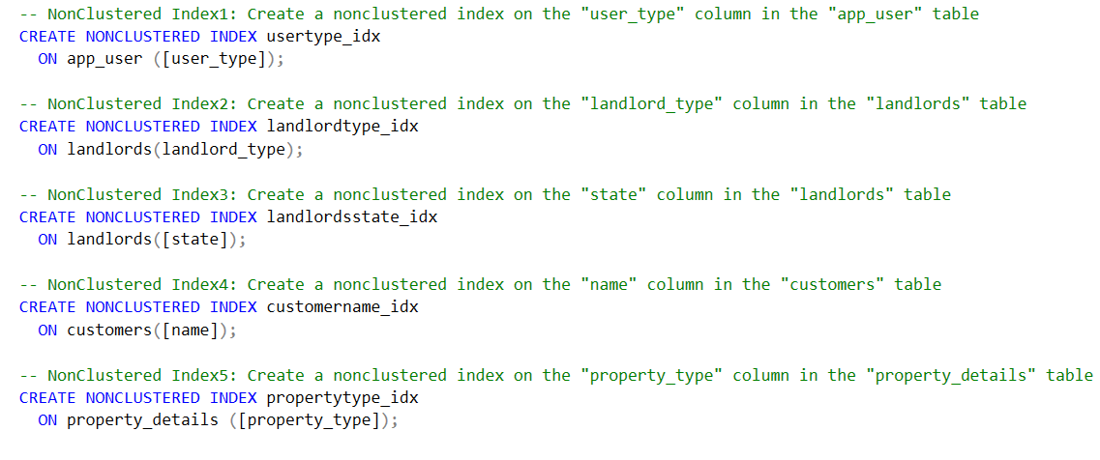

Slide 7
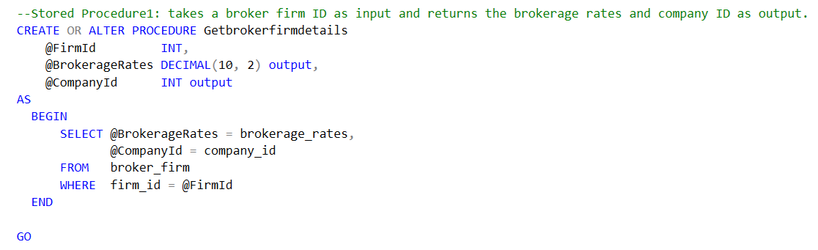
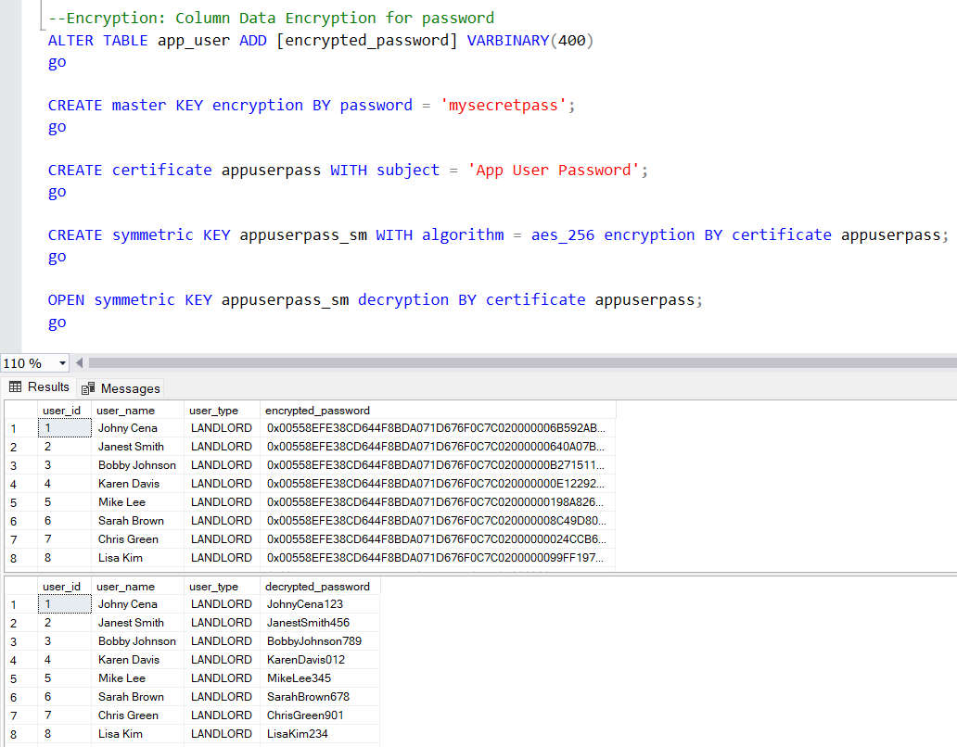

Slide 8

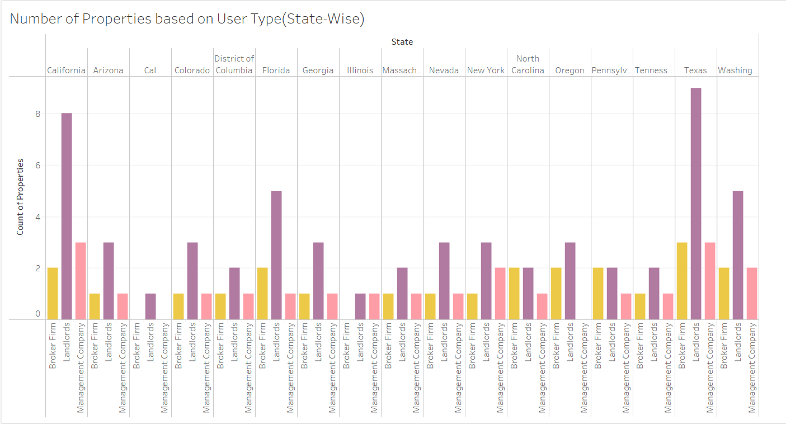
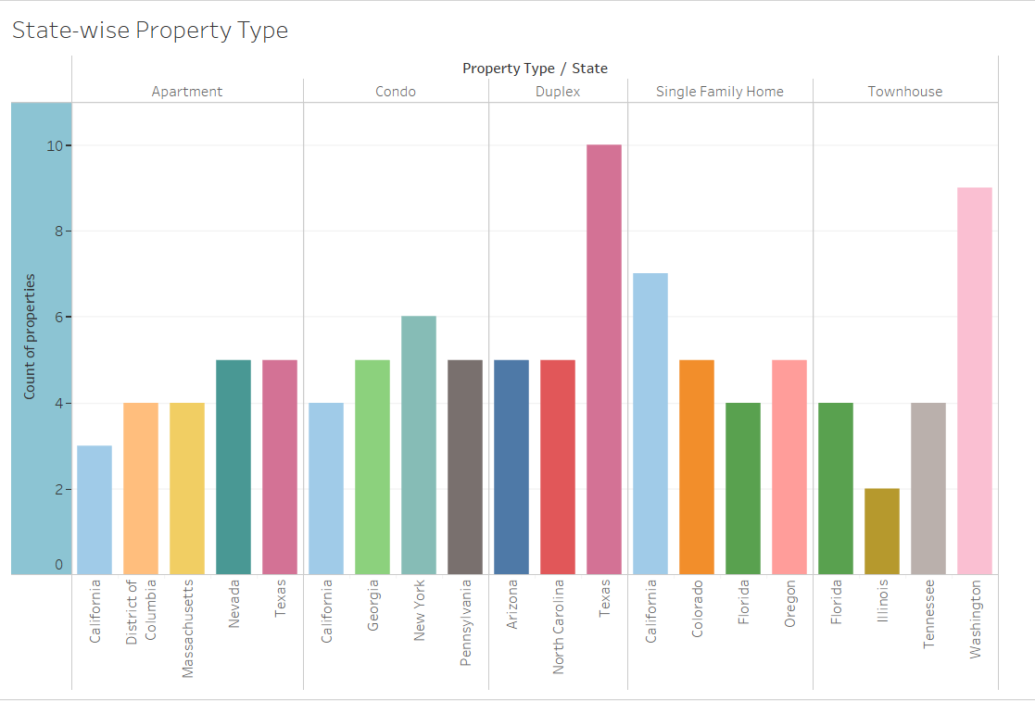
Tableau Reports
Thank you!

