Slide 1
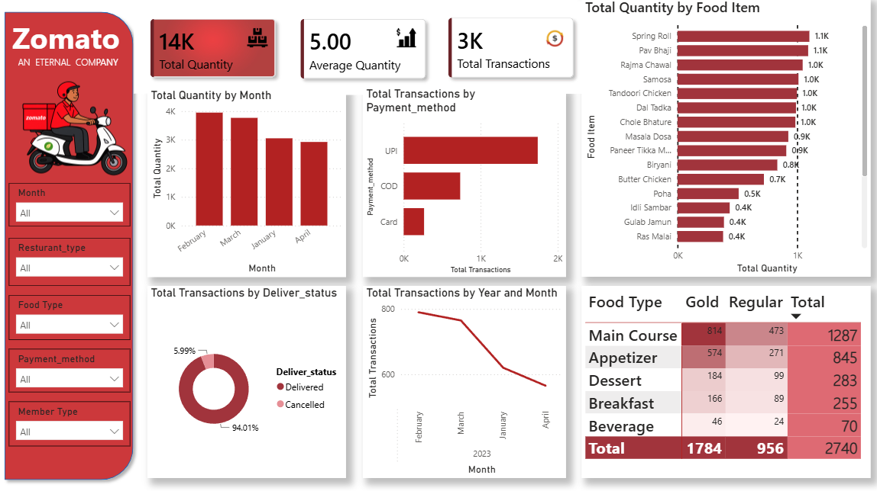
Zomato Dashboard Analysis

Slide 2
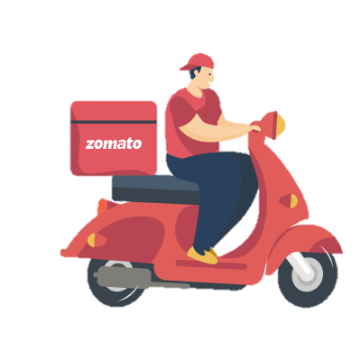
Zomato Analysis
STEPS IN PROJECT
Requirement Gathering / Business Requirements
Data Walkthrough
Data Connection (Excel to Power BI)
Data Cleaning & Quality Check
Data Modeling
DAX Calculations
Dashboard Layout Designing
Charts Development & Formatting
Dashboard Development
Insights Generation
Business Recommendations

Slide 3
Zomato Analysis
Business Requirements
The dashboard helps restaurant owners and business managers understand sales trends, identify top-performing restaurants and outlets, evaluate customer preferences, and make data-driven decisions to improve profitability.
KPI REQUIREMENTS
1. Total Quantity: Sum of all item quantities ordered.
2. Average Quantity: Average quantity per transaction.
3.Total Transactions: Count of distinct customer orders.

Slide 4
Zomato Analysis
Business Requirements
Chart’s Requirements
Total Quantity by Month
Objective: Track order volume trend across months.
Additional Details: Axis: Month, Value: Quantity.
Chart Type: Column Chart
2. Total Transactions by Payment_method
Objective: Compare transaction volume across UPI, COD, Card.
Additional Details: Axis: Payment_method
Chart Type: Bar Chart
3. Total Quantity by Food Item
Objective: Identify top-selling food items.
Additional Details: Top 10 filter applied
Chart Type: Horizontal Bar Chart

Slide 5
Zomato Analysis
4. Total Transactions by Deliver_status
Objective: Measure delivery success vs. cancellation rate.
Additional Details: Delivered vs. Cancelled
Chart Type: Donut Chart
5. Total Transactions by Year and Month
Objective: Evaluate transaction trend over time
Additional Details: Axis: Month/Year
Chart Type: Line Chart
6. Transaction by Food Type & Member Type
Objective: Compare Gold vs. Regular member ordering behavior across food categories.
Additional Details: member ordering behavior across food categoriesRows: Food Type, Columns: MembeR Type, with subtotals.
Chart Type: Matrix Table

