Slide 1
Superstore Sales Dashboard
Interactive Dashboard Summary for Business Stakeholders

Slide 2
Objective & Dataset
Objective:
Create an interactive dashboard to provide sales and financial insights.
Dataset:
Used the Superstore Sales dataset (cleaned version) including metrics like Sales, Profit, Orders, and Customer information from 2014–2017.

Slide 3
Key KPIs & Metrics Tracked
- Total Sales
- Total Profit
- Number of Orders
- Number of Customers
- Sales and Profit by Region, Category, Sub-category, Product
- Time-series trend analysis by Year

Slide 4
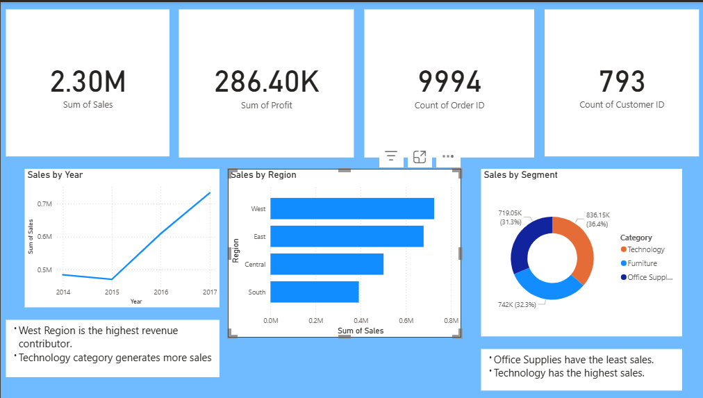
Dashboard View 1

Slide 5
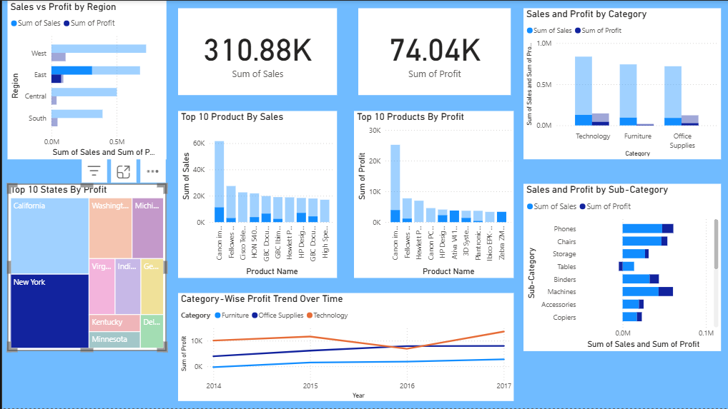
Dashboard View 2

Slide 6
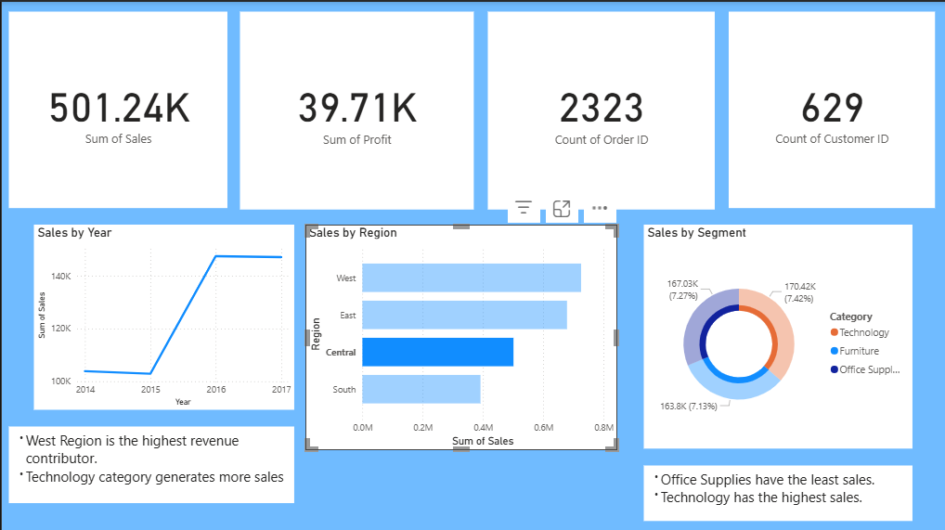
Dashboard View 3

Slide 7
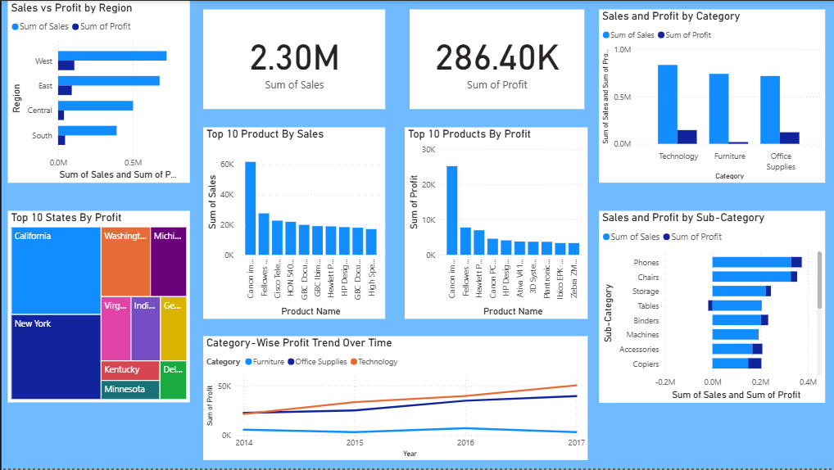
Dashboard Overview

Slide 8
Key Business Insights
- West Region is the highest revenue contributor
- Technology category generates the most sales
- Office Supplies generate the least sales
- Certain sub-categories like Tables show negative profit
- Steady increase in Sales from 2014 to 2017

Slide 9
Conclusion & Learnings
This dashboard effectively provides stakeholders with a snapshot of business performance.
Learnings:
- Hands-on experience with Power BI visuals
- KPI identification
- Business storytelling through data
- Dashboard design principles
Next Steps:
Add slicers, drill-downs, and forecasting for enhanced interactivity.

