Slide 1
Emergency Department Visit Prediction
By Shray Mishra

Slide 2
Brief Overview
Research Question
Methodology
Data Set Description
EDA
Initial Results
Future Work
Tools Used

Slide 3
Research Question
Predicting daily emergency department visits based on factors like convenient care visit count, weather, patient advisory nurse data and calendar data
Change in research question:
Convenient care visits are now considered as a dependent variable for predicting visits to emergency department. At first, ED and CC visits were counted together for total hospital visits prediction in the county.

Slide 4
Methodology
Data Acquistion
Collate data from different sources
Read files from AWS S3
EDA
Aggregate data on different factors like time, ICD10, location
Create visualizations for analysis
Time Series Modeling
Experiment with different models to find the best fit

Slide 5
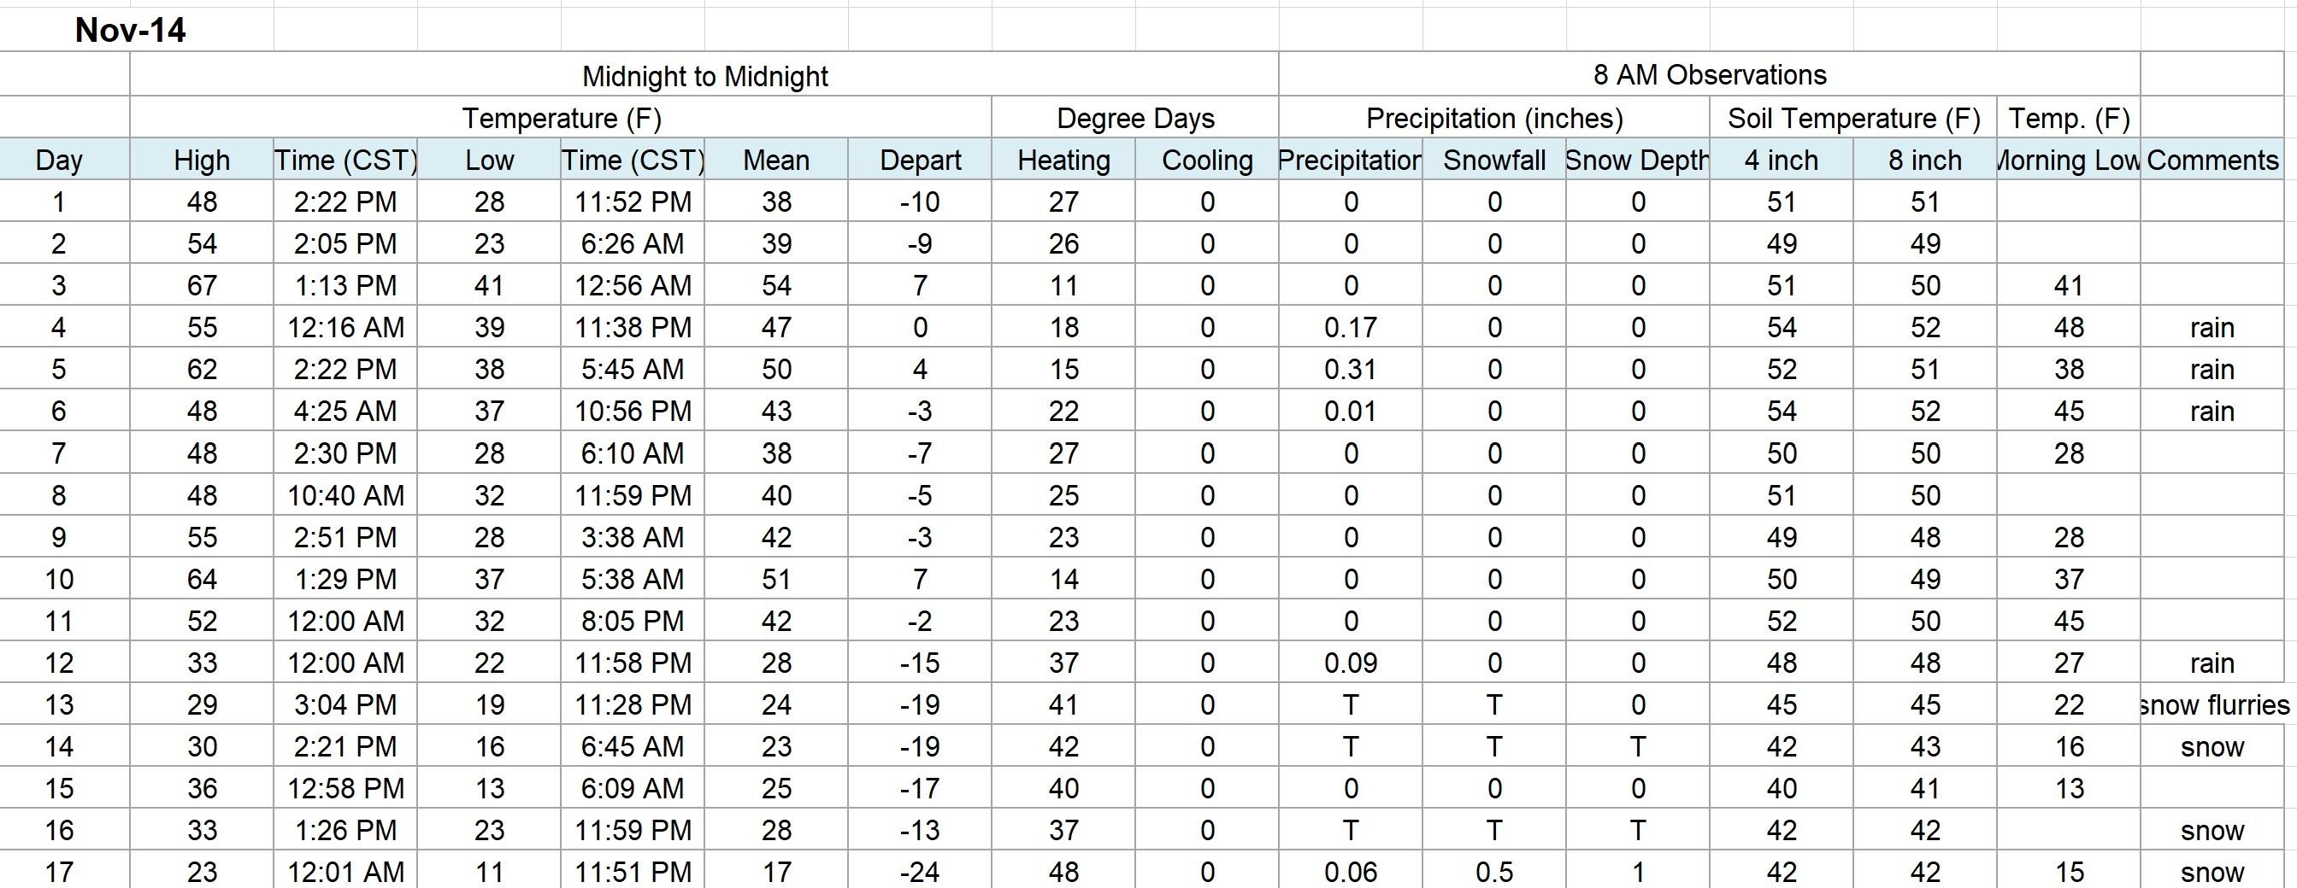
Weather Data : Data Description
Daily Weather data for Champaign, IL
Data Sources:
State Climatologist Office
National Oceanic and Atmospheric Administration
Record Period: 2010 - 2019

Slide 6
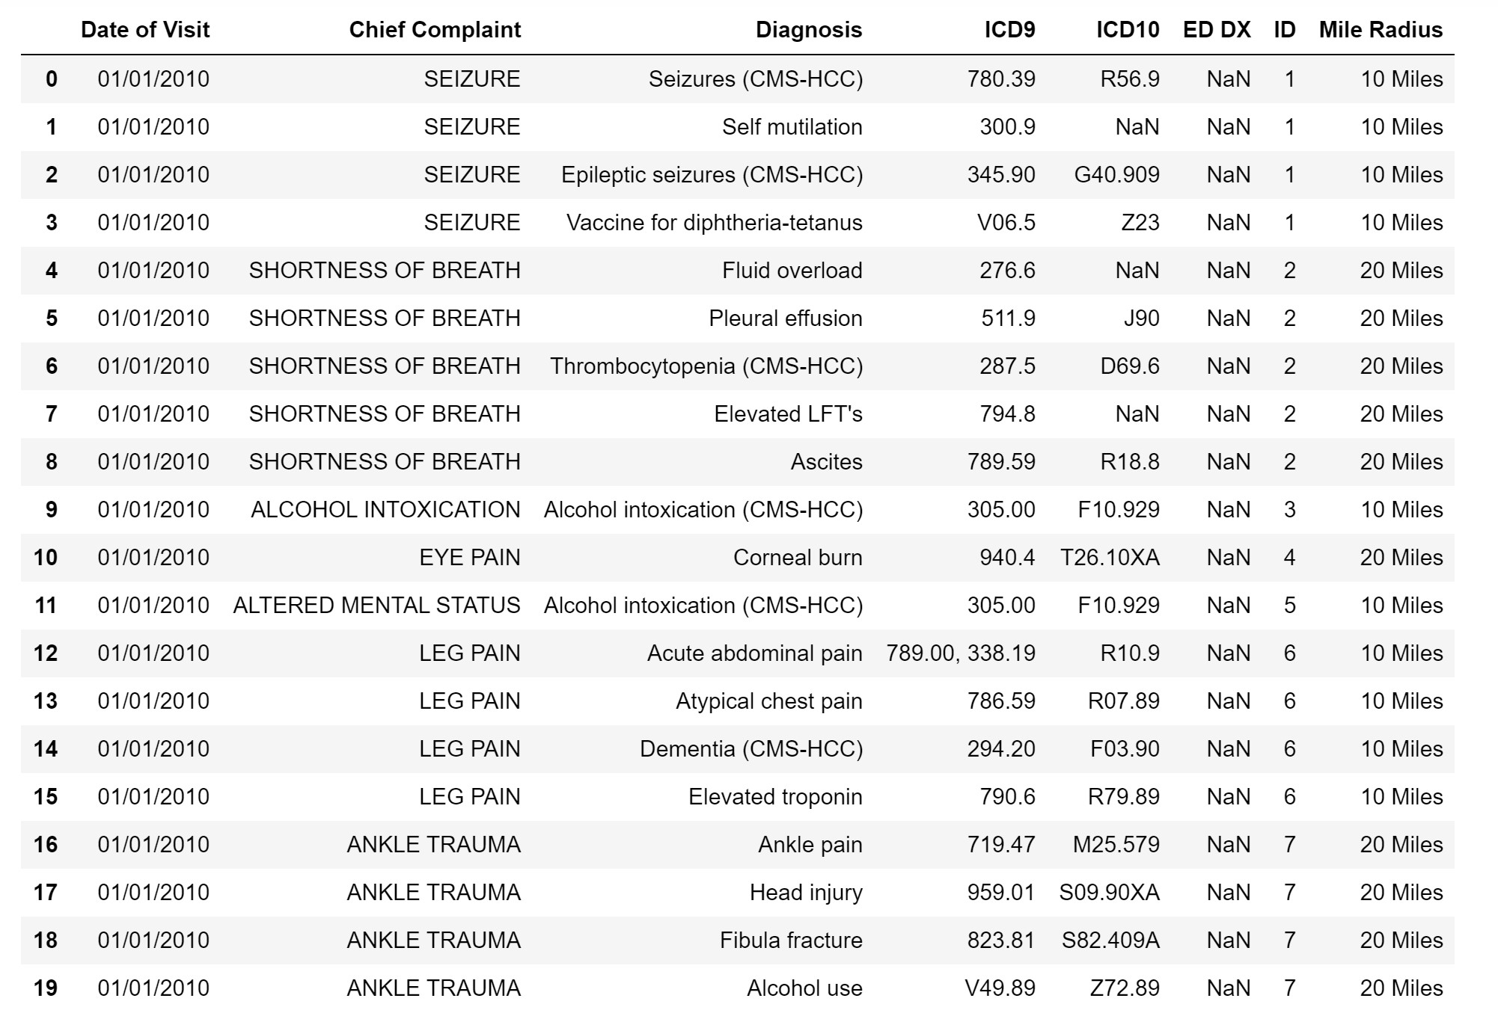
Emergency Department: Data Description
Total Columns: 8
Total Rows: 2.3 million
Records from January 2010 to November 2019

Slide 7
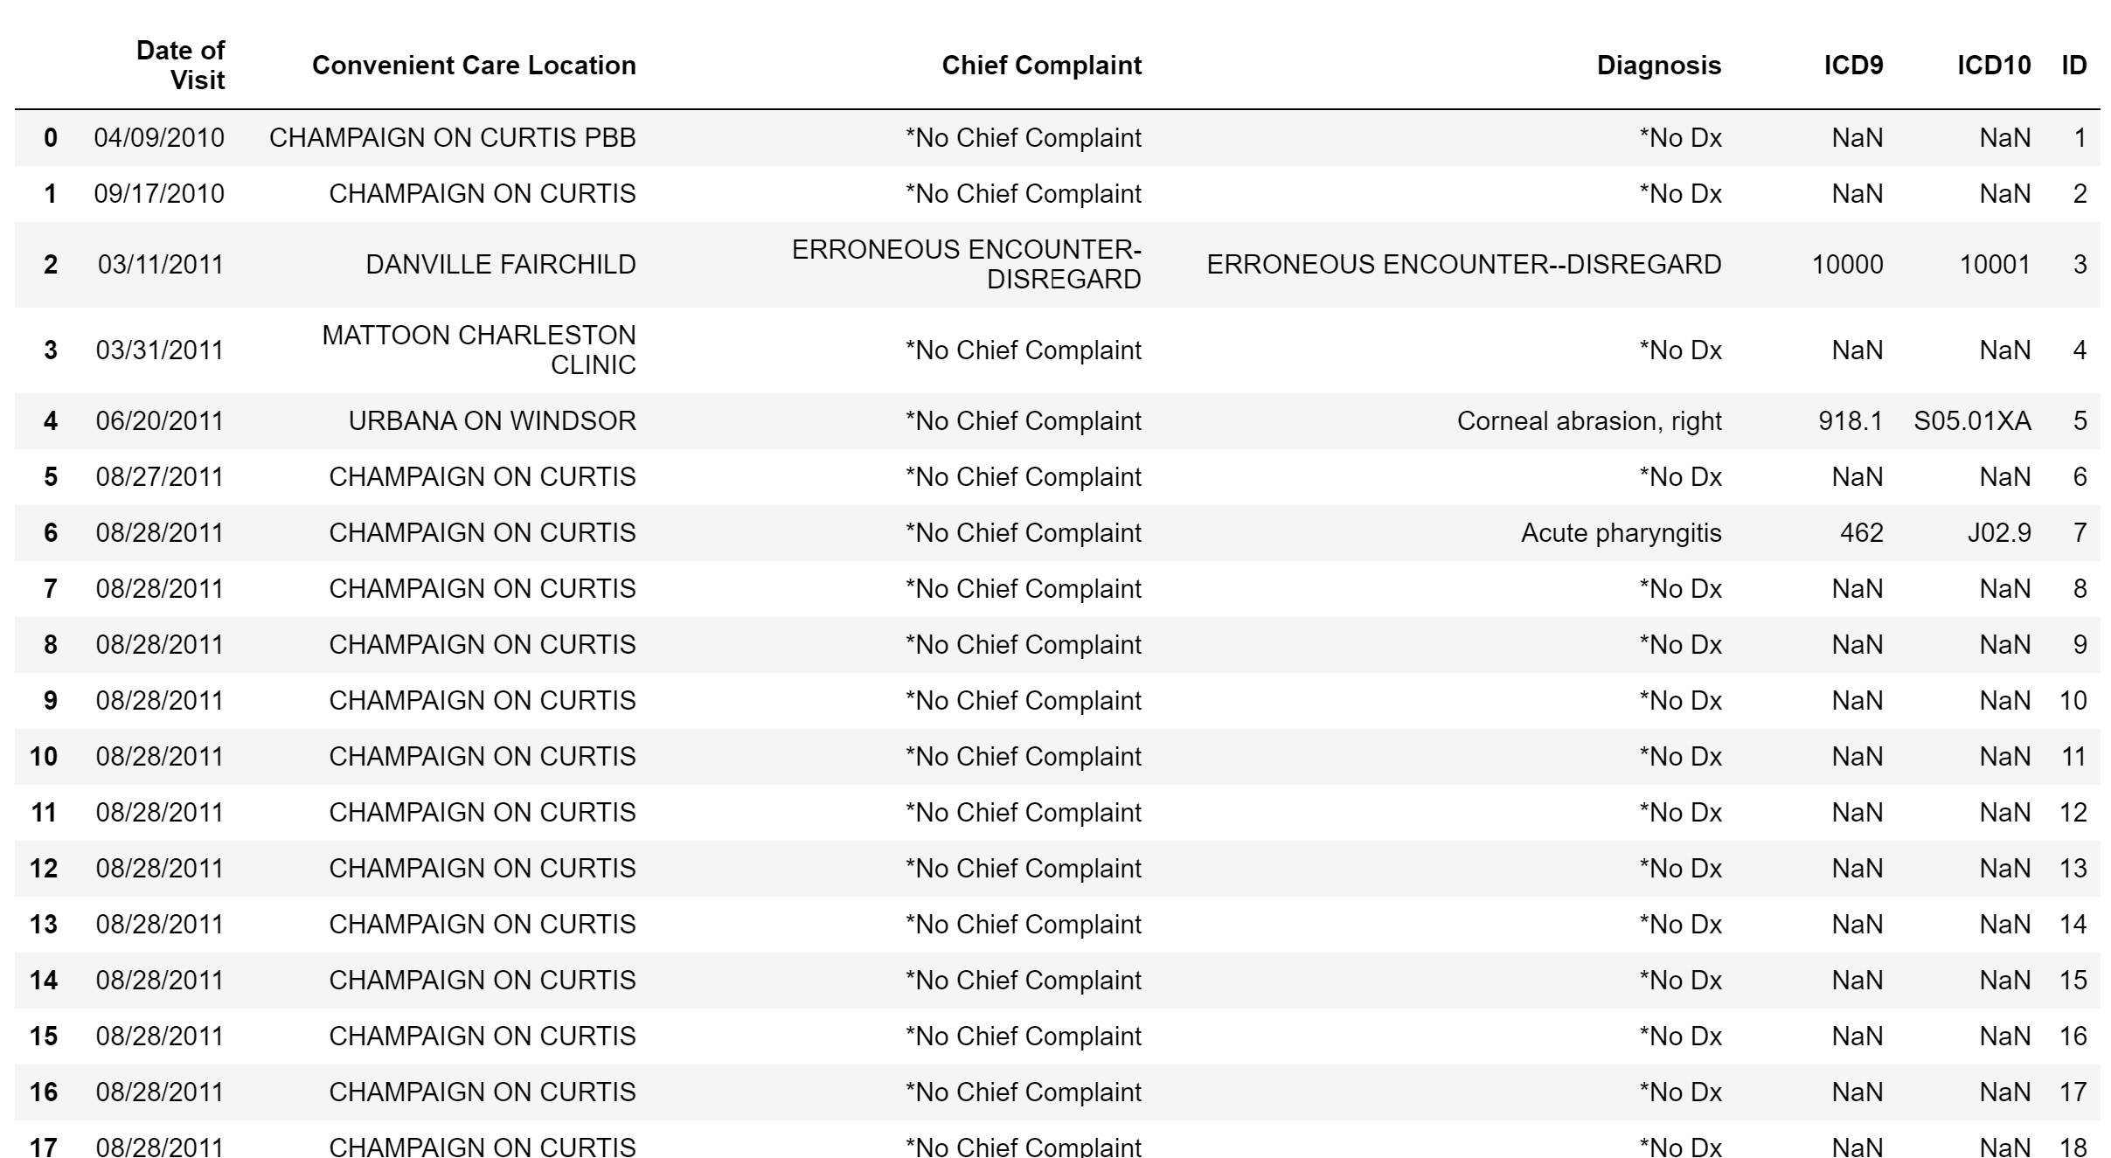
Convenient Care : Data Description
Total Columns: 7
Total Rows: 2.5 million
First Record from April 2010
Consistent Records from August 2011 to November 2019

Slide 8
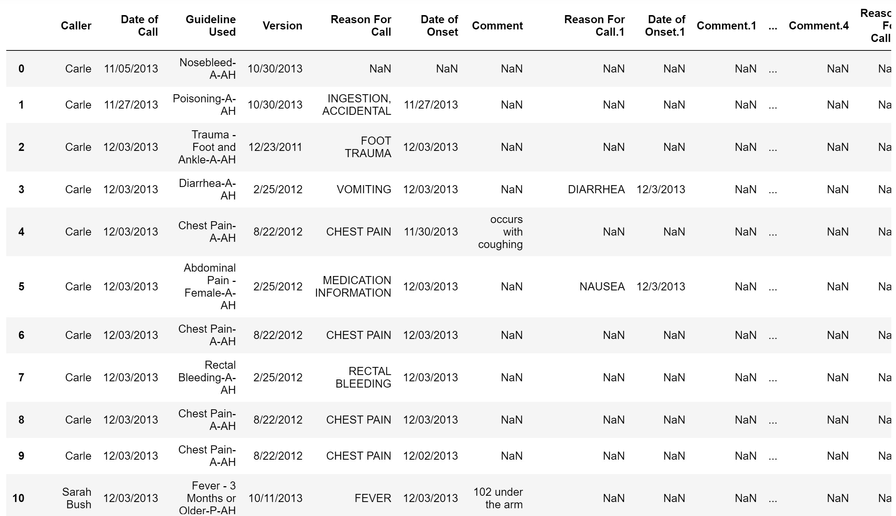
Patient Advisory Nurse: Data Description
Total Columns: 28
Total Rows: 232578
First Record from November 2013
Consistent Records from December 2013 to November 2019

Slide 9
Exploratory Data Analysis

Slide 10
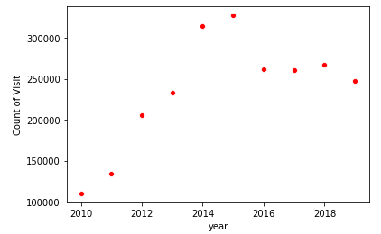
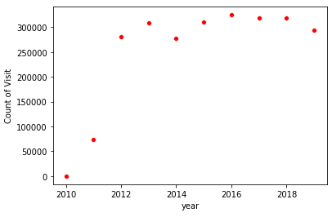
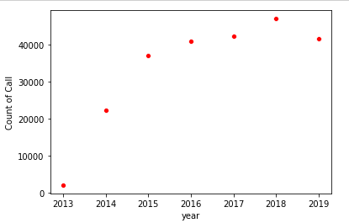
Yearly Count of Visits/Calls
Emergency Department
Convenient Care
Patient Advisory Nurse

Slide 11
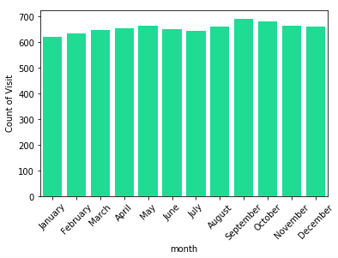
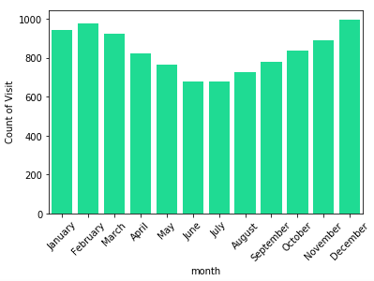
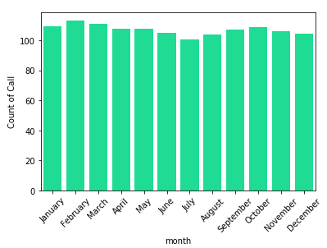
Average Monthly Frequency of Visits/Calls
Emergency Department
Convenient Care
Patient Advisory Nurse

Slide 12
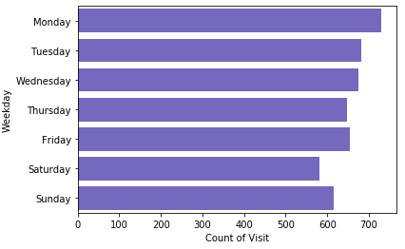
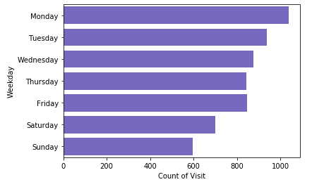
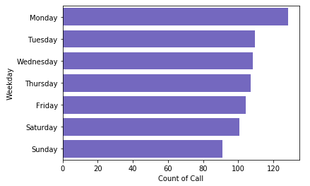
Weekly Average of Visits/Calls
Emergency Department
Convenient Care
Patient Advisory Nurse

Slide 13
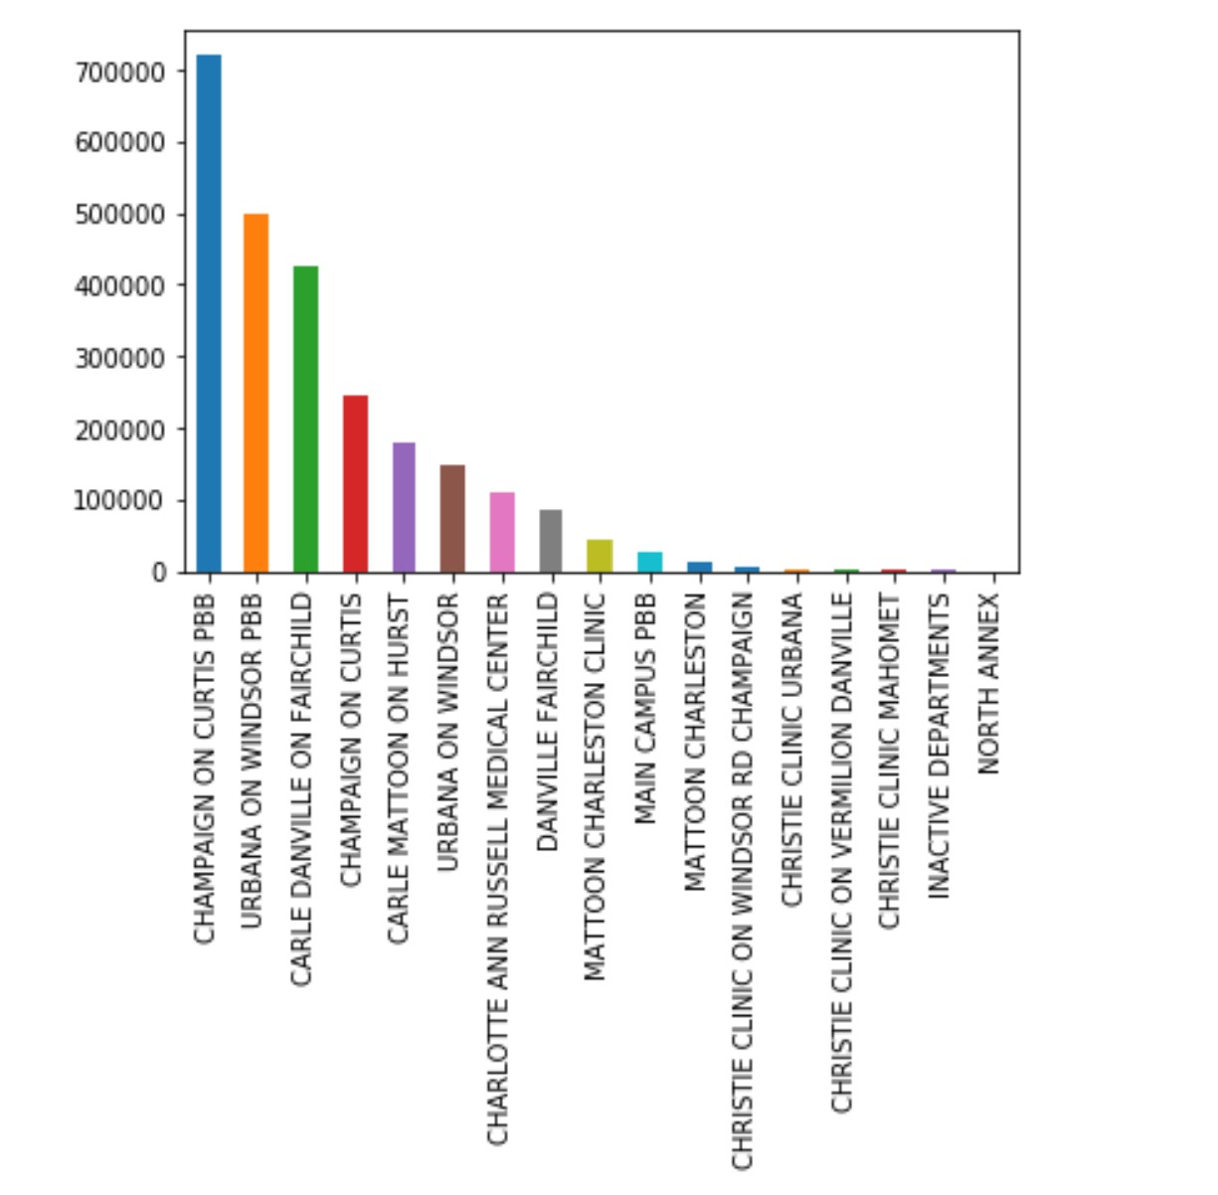
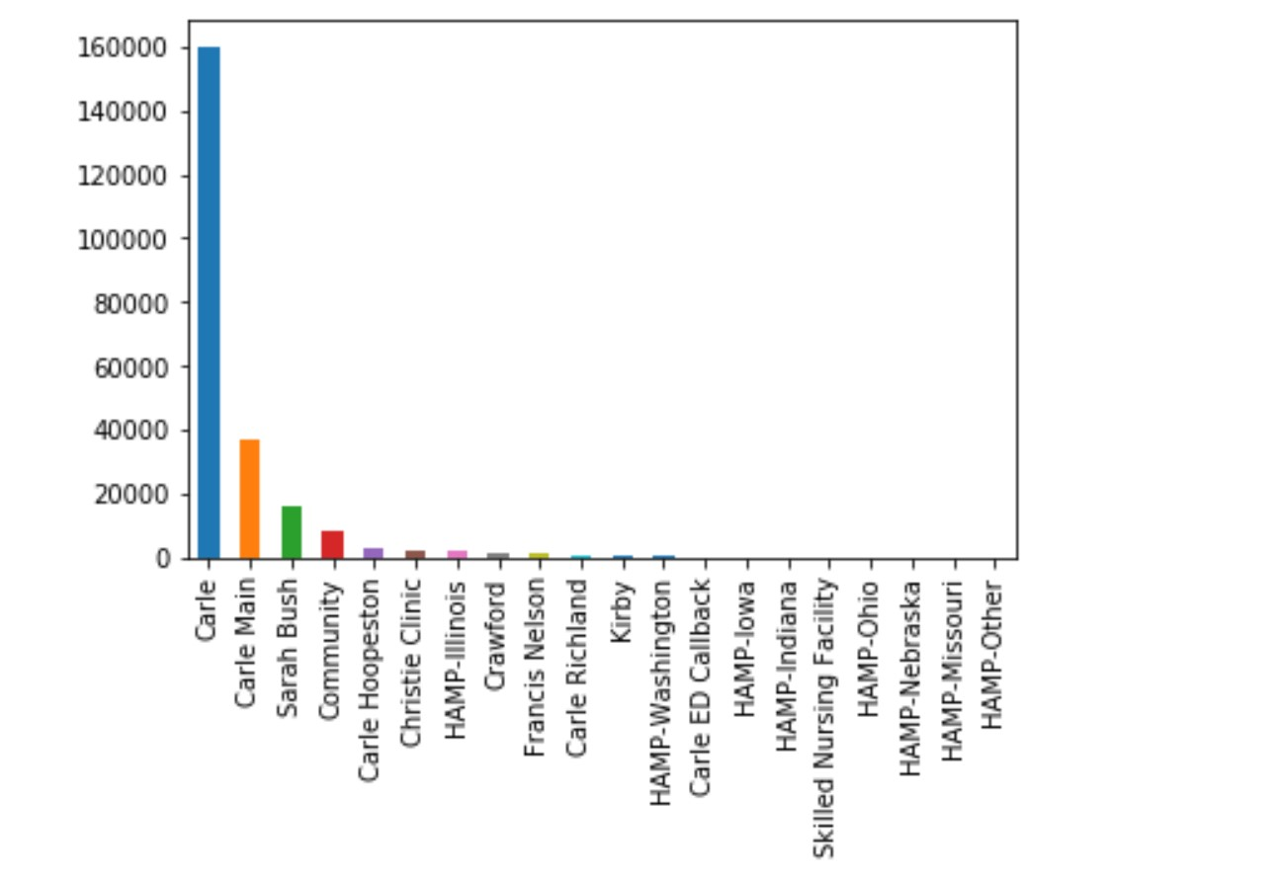
Frequency of visits/calls by location
X-axis: Convenient Care location
Y-axis: Count of visits
X-axis: PAN location
Y-axis: Count of calls

Slide 14
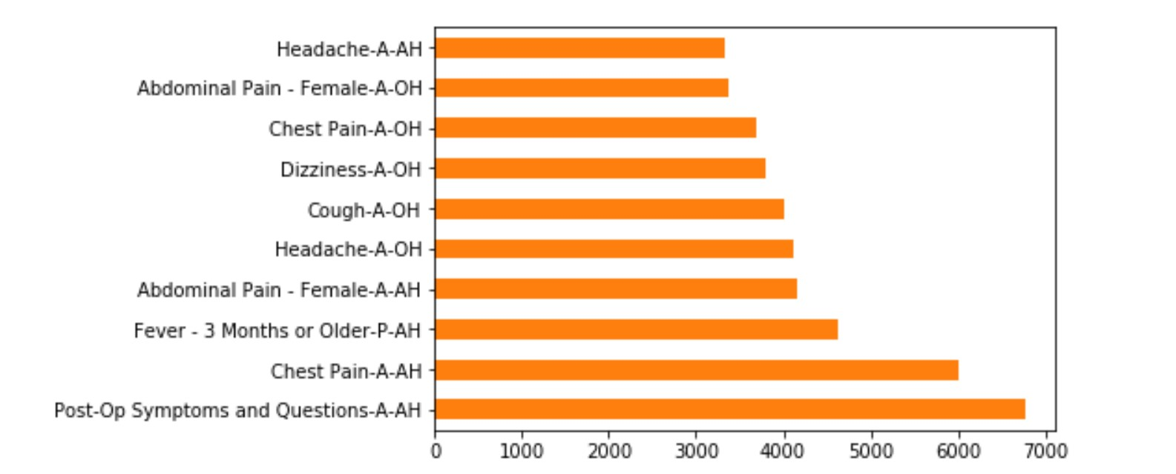
Top 10 “Guideline Used” on PAN Calls
Count of Distinct Guidelines Used: 1143

Slide 15
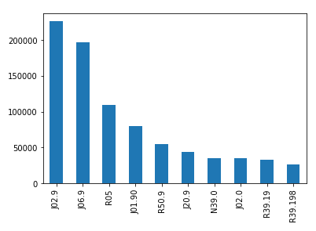
10 most frequent ICD10 codes for Convenient Care
ICD10 Codes
J02.9: Acute Pharyngitis
J06.9: Acute Upper Respiratory Infection
R05: Cough
J01.90: Acute Sinusitis
R50.9: Fever
J20.9: Acute Bronchitis
N39.0: Urinary Tract Infection
J02.0: Streptococcal Pharyngitis
R39.19: Other Difficulties with Micturition
R39.198: Other Difficulties with Micturition

Slide 16
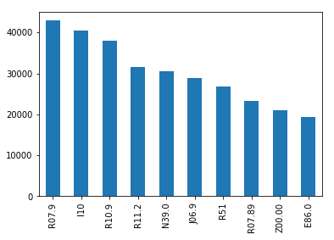
10 most frequent ICD10 codes for Emergency Department
ICD10 Codes
R07.9: Chest Pain
I10: Essential Hypertension
R10.9: Unspecified Abdominal Pain
R11.2: Nausea with Vomiting
N39.0: Urinary Tract Infection
J06.9: Acute Upper Respiratory Infection
R51: Headache
R07.89: Other Chest Pain
Z00.00: General Adult Medical Examination without Abnormal Finding
E86.0: Dehydration

Slide 17
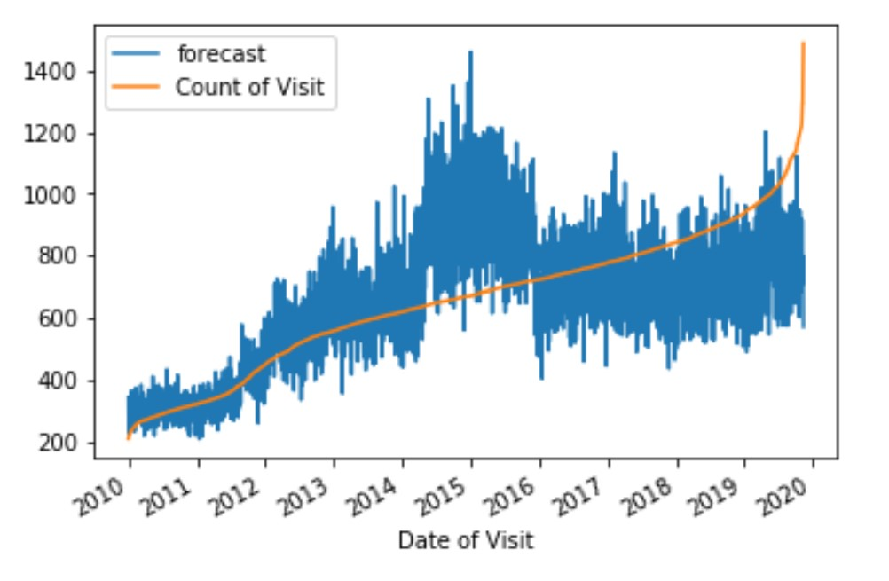
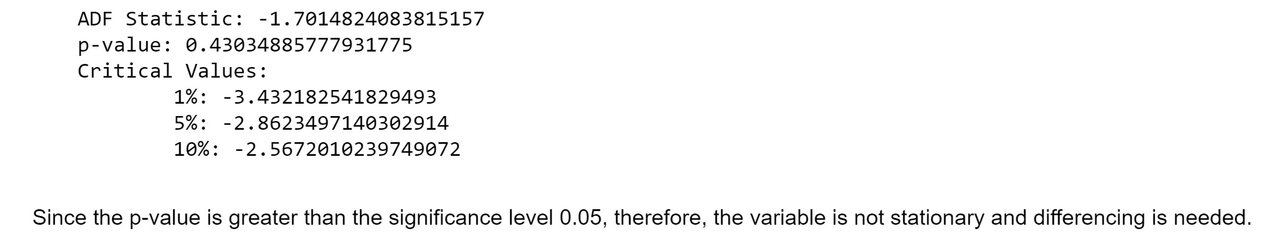
Result for Base Forecasting Model
Model Used: ARIMA
What is being predicted?
Daily visit count for emergency department
ADF Test Results:

Slide 18



Future Work
Integrating different data points into the time series model
Using different models to predict counts and find the most efficient model
Tools

Slide 19
Thank You!

