Slide 1



ANUDIP FOUNDATION • IN ASSOCIATION WITH ACCENTURE
TATA MOTORS
SALES PERFORMANCE & DELIVERY TRACKING DASHBOARD
A Project Report on Automotive Sales Analytics and Business Intelligence with KPI CARDs
PREPARED BY
Tandrima Nandy (MCA) · Vivek Kumar (BCA) · Shrayan Biswas (BSC IT)
PROJECT TYPE
Excel Data Analytics / Business Intelligence Project
REPORTED ON
December 2025
BATCH / YEAR
Batch 3, 2026
Dataset: car_sale_final.xlsx | 65 records
MENTORS
Sayan Sau & Arpita Gupta

Slide 2



TEAM MEMBERS :
The group behind the project
Tandrima Nandy
Vivek Kumar
Shrayan Biswas
Course: MCA
Course: BCA
Course: BSC IT
Mentored by Sayan Sau & Arpita Gupta • Anudip Foundation, in association with Accenture
TATA MOTORS SALES PERFORMANCE & DELIVERY TRACKING DASHBOARD
2

Slide 3
TATA Sales &
Delivery Dashboard :
65
VEHICLE ORDERS TRACKED
KPI cards, built for automotive retail — tracking revenue, delivery, and regional performance for Tata Motors.
13
UNIQUE CAR MODELS
3
CITY TIERS ANALYZED
86%
DELIVERY SUCCESS RATE
Excel-Powered · Pivot-Driven · Data-Backed

Slide 4
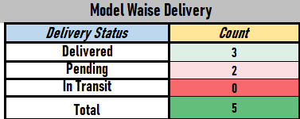
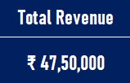
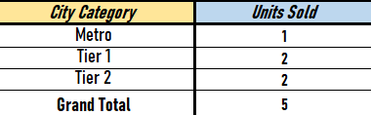
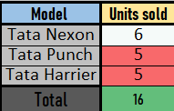
PROJECT OBJECTIVES :
Data-driven decision-making for automotive sales & delivery
Track Delivery Statuses
Analyze Sales Performance
01
02
Monitor Delivered, Pending, and In-Transit outcomes across 65 vehicle orders.
Evaluate revenue generation across 13 unique Tata car models.
Evaluate Regional Performance
Build a Central Dashboard
03
04
Compare Metro, Tier 1, and Tier 2 city markets side by side.
Deliver a single interactive view to support operational monitoring.
TATA MOTORS SALES PERFORMANCE & DELIVERY TRACKING DASHBOARD
4

Slide 5
DATASET DESCRIPTION :
Field | Description | Type | Business Relevance
Product_ID | Unique identifier for each vehicle | Text | Inventory tracking
City_Category | Market classification (Metro, Tier 1, Tier 2) | Text | Regional sales analysis
Batch | Manufacturing / shipping batch code | Text | Supply chain tracking
Model Name | Name of the Tata vehicle (e.g., Tata Nexon) | Text | Product performance tracking
Delivery Status | Current status (Delivered, Pending, In Transit) | Text | Fulfillment monitoring
Product Cost | Base price of the vehicle | Currency | Revenue calculation
Taxation & Delivery | Additional logistics and tax fees | Currency | Cost breakdown analysis
Final Cost | Final billed amount to customer | Currency | Total revenue tracking
TATA MOTORS SALES PERFORMANCE & DELIVERY TRACKING DASHBOARD
5

Slide 6
DATA PREPARATION & EXCEL TECHNIQUES :
Ensuring accuracy in the pivot engine and final dashboard
DATA CLEANING & PREPARATION
EXCEL FUNCTIONS & TECHNIQUES USED
Handling Nulls
Technique | Purpose
Pivot Tables | Aggregated city-wise, model-wise & delivery-status summaries
Pivot Charts | Generated dynamic charts for the dashboard
Data Validation | Ensured uniform entries in categorical columns
Calculated Sheets | Isolated raw data from calculations to protect integrity
1
Identified and bypassed blank columns generated during raw data export.
2
Standardization
Validated Delivery Status entries — 35 Delivered, 8 Pending, 7 In Transit.
3
Pivot Preparation
Built dedicated calc sheets (city_wise_analysis, Delivered pivot, Sale_analysis).
TATA MOTORS SALES PERFORMANCE & DELIVERY TRACKING DASHBOARD
6

Slide 7
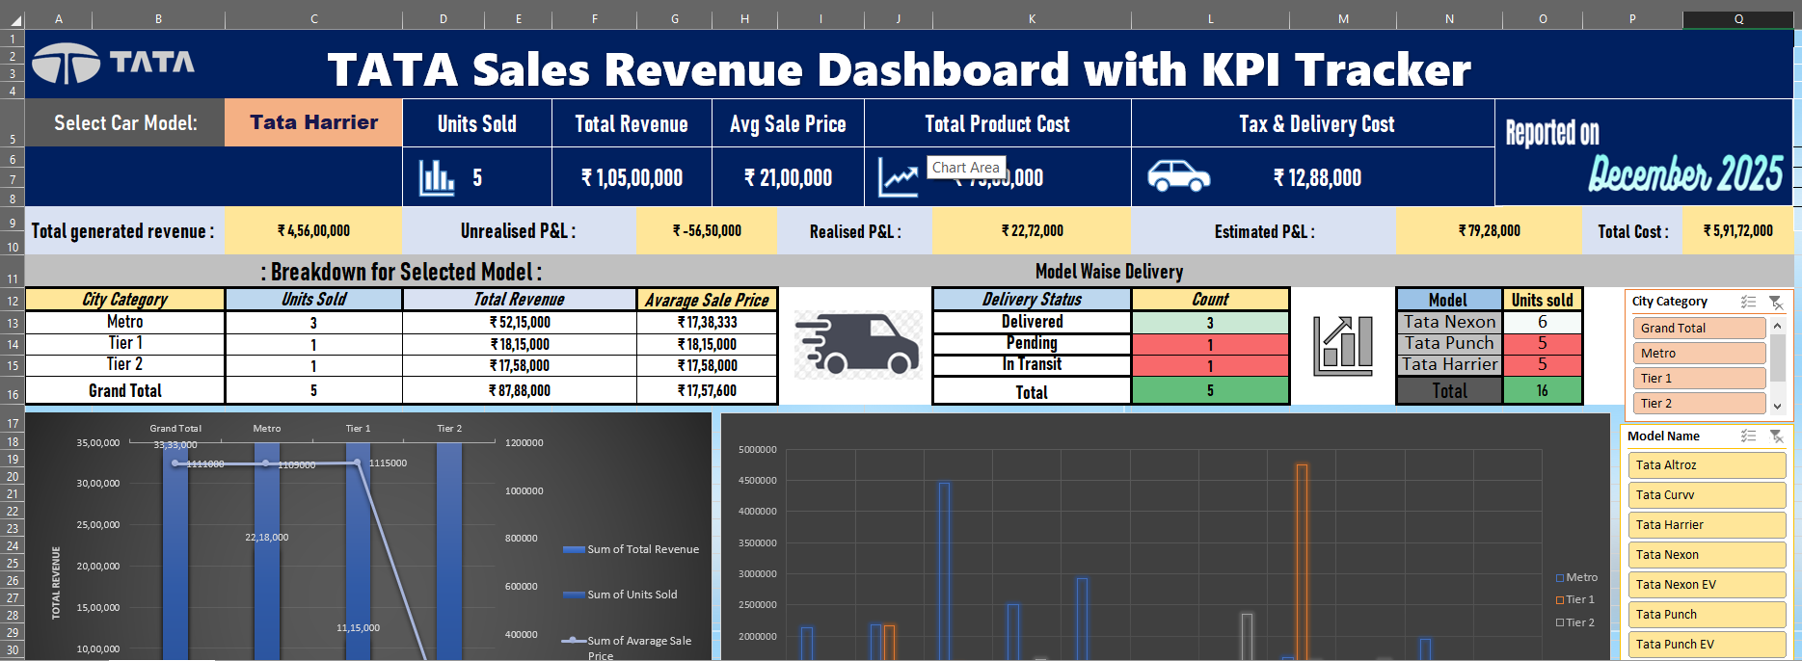
DASHBOARD OVERVIEW
Main KPI Tracker & Delivery Breakdown :
Figure 1 — TATA Sales Revenue Dashboard: model selector, units sold, revenue, P&L, and delivery breakdown
TATA MOTORS SALES PERFORMANCE & DELIVERY TRACKING DASHBOARD
7

Slide 8
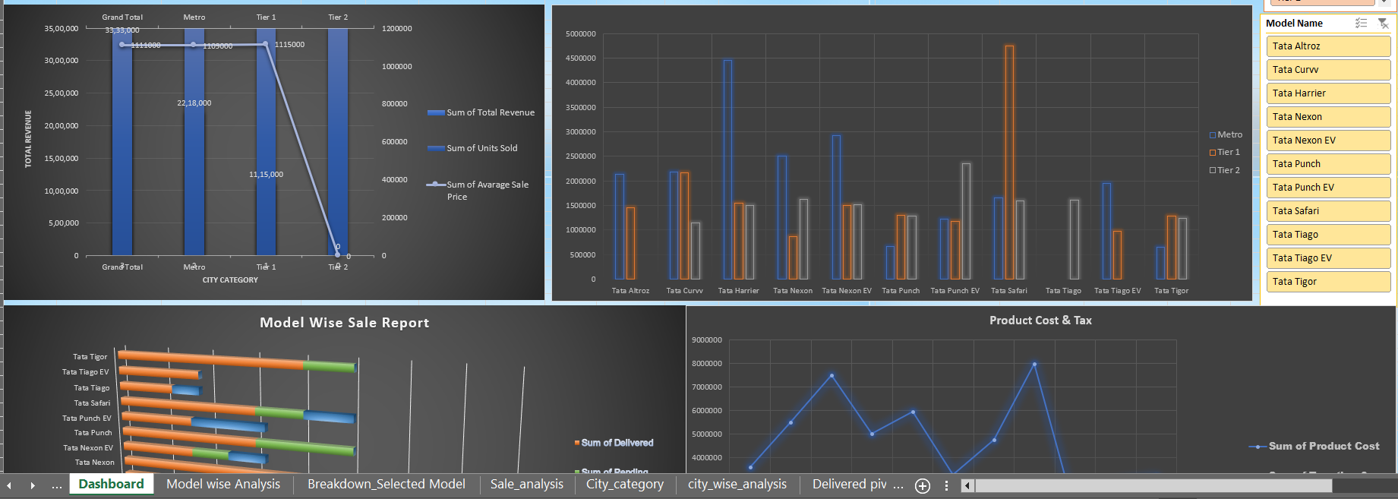
DASHBOARD OVERVIEW
Revenue Distribution & Model-Wise Delivery Status :
Slicers : A clickable filter panel listing all 13 Tata car models connected to every pivot chart on the dashboard.
Figure 2 — City-category revenue trend, model comparison by tier, delivery status by model, and product cost vs. tax
TATA MOTORS SALES PERFORMANCE & DELIVERY TRACKING DASHBOARD
8

Slide 9
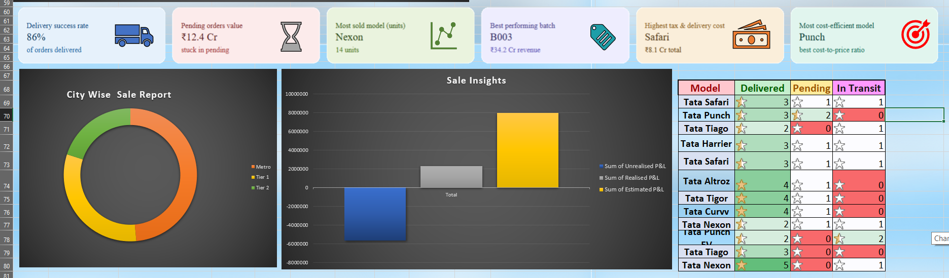
DASHBOARD OVERVIEW
Key Sales Insights & City-Wise Distribution:
Figure 3 — Delivery success rate, pending order value, top model & batch, city-wise sale split, and P&L estimation
TATA MOTORS SALES PERFORMANCE & DELIVERY TRACKING DASHBOARD
9

Slide 10
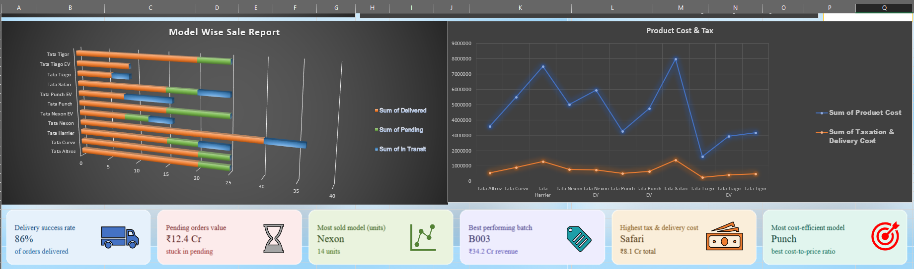
DASHBOARD OVERVIEW
Model-Wise Sale Report & Product Cost:
Figure 4 — Delivered / Pending / In-Transit units by model, plotted against product cost & tax-and-delivery cost
Business relevance: This breakdown helps separate the base vehicle cost from logistics/tax overhead, so management can see which models carry disproportionately high tax & delivery costs relative to their base price — useful for pricing strategy and identifying where delivery costs might be eating into margins.
TATA MOTORS SALES PERFORMANCE & DELIVERY TRACKING DASHBOARD
10

Slide 11
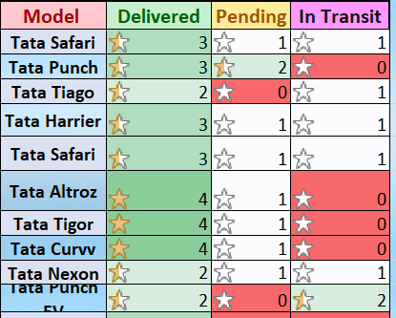
CHART ANALYSIS & INTERPRETATION:
What the dashboard visuals reveal about the business
City-Wise Sales Performance
M
Metro areas are the primary revenue drivers — marketing spend should be weighted toward urban centers.
Delivery Status Breakdown
D
Out of 65 documented orders, 86% were successfully delivered, while a distinct portion remains pending or in transit.
P
Model-Wise Sales & Product Cost
Tata Nexon is the most sold model (14 units), while Tata Punch offers the best cost-to-price ratio.
TATA MOTORS SALES PERFORMANCE & DELIVERY TRACKING DASHBOARD
11

Slide 12




KEY BUSINESS INSIGHTS & FINDINGS:
Critical patterns from the quantitative analysis
Nexon
Punch
TOP PERFORMING MODEL
BEST COST EFFICIENCY
14 units sold — most frequently ordered of 13 available models.
Identified as the model with the best cost-to-price ratio.
86%
₹4.0 Cr
DELIVERY SUCCESS RATE
REVENUE REALIZED
Solid fulfillment — though ₹12.4 Cr in value remains stuck in pending orders.
Recognized revenue from delivered units, with unrealized P&L tied to delayed logistics.
TATA MOTORS SALES PERFORMANCE & DELIVERY TRACKING DASHBOARD
12

Slide 13
FUTURE PLAN & DASHBOARD SCOPE
From a static tracker to a comprehensive predictive system
→
Customer ID & Demographics
→
Sale / Booking Date
Enable loyalty tracking, customer segmentation, and repeat-buyer analysis.
Unlock Month-over-Month and Year-over-Year revenue trend charts.
→
Salesperson Information
→
Dynamic Slicers & Automation
Introduce a Salesman Leaderboard for performance & commission analysis.
Integrate Power Query for automated, seamless CRM database exports.
TATA MOTORS SALES PERFORMANCE & DELIVERY TRACKING DASHBOARD
14

Slide 14
APPENDIX — PIVOT ENGINE EXTRACT:
Sample aggregation output feeding the dashboard (city_wise_analysis tab)
City | Cars Sold | Total Sales (₹) | Average Sale Price (₹)
Metro | 17 | 2,09,84,000 | 12,34,353
Tier 1 | 11 | 1,22,29,000 | 11,11,727
Tier 2 | 7 | 67,97,000 | 9,71,000
Grand total: 35 delivered · 8 pending · 7 in transit across 65 vehicle orders and 13 Tata models.
Techniques applied: Pivot Tables · Pivot Charts · Data Validation · Calculated Sheets — isolating raw data from the dashboard UI for integrity.
TATA MOTORS SALES PERFORMANCE & DELIVERY TRACKING DASHBOARD
15

Slide 15
CONCLUSION & REFERENCES:
This project successfully transformed raw sales data into a structured, functional Excel dashboard. By processing automotive sales records, aggregating the data through Pivot Tables, and visualizing the results, the project highlights crucial operational metrics — most notably the revenue dominance of Metro regions and the fulfillment rates of specific car models. Implementing the proposed future scope will further enhance the dashboard's capacity to drive agile, data-driven decisions for automotive retail management.
REFERENCES :
• Dataset: car_sale_final.xlsx
• Microsoft Excel Support Documentation & Pivot Table Aggregation Guides
TATA MOTORS SALES PERFORMANCE & DELIVERY TRACKING DASHBOARD
16

Slide 16
PROJECT HIGHLIGHTS
Interactive dashboard tracking 65 vehicle orders across 13 Tata models
Pivot-table-driven revenue, delivery & regional performance analysis
THANK YOU
86% delivery success rate with ₹12.4 Cr identified in pending orders
TATA Motors Sales Dashboard
Tata Nexon: top seller (14 units) · Tata Punch: best cost efficiency
Clear roadmap for customer analytics, trend tracking & automation
Vivek Kumar · Tandrima Nandy · Shrayan Biswas

