Slide 1


Comparison Between Likelihood Ratio Tests and Some Non-Parametric Tests in Two Sample Problems
Sampled Population is Normal and Exponential
Name: Shrayan Roy
Roll No: 19-300-4-07-0407
Registration No: A01-1112-0811-19
Supervisor: Prof. Pallabi Ghosh
DEPARTMENT OF STATISTICS
ST. XAVIER’S COLLEGE (AUTONOMOUS), KOLKATA

Slide 2

ABSTRACT
We will use simulations to compare the tests obtained from likelihood ratio tests with non-parametric tests in two-sample problem of equality of means when sampled populations are either normal or exponential. We will assess the penalty of using non-parametric tests instead of using the corresponding LRT (parametric test) when we have sufficient knowledge about the type of population sampled (Here, normal and exponential only).
Likelihood Ratio Test
Non-Parametric Tests

Slide 3


Two Sample Problem
It is basically hypothesis tests two Independent population distribution. The important thing is, here the populations
considered are Independent. We may be interested in tests related mean, median, location parameter, scale parameter
etc.
Independent
X
Population
Y
Population
Test for Equality
of Mean
To test $H_{0}$: $μ_{X}=μ_{Y}$

Slide 4
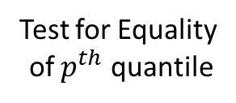

Two Sample Problem
It is basically hypothesis tests two Independent population distribution. The important thing is, here the populations
considered are Independent. We may be interested in tests related mean, median, location parameter, scale parameter
etc.
Independent
X
Population
Y
Population
To test $H_{0}$: $=$ $ξ_{p}^{\left(X\right)}=ξ_{p}^{\left(Y\right)}$
Test for Equality
of $p^{th}$ quantile

Slide 5



Our Hypothesis of Interest
Our Hypothesis of interest is to test equality of means of two independent populations.
X
Population
Independent
Y
Population
To test $H_{0}$: $μ_{X}=μ_{Y}$
Test for Equality
of Mean
Against
To test $H_{1}$: $μ_{X}>μ_{Y}$
Alternative Hypothesis
And we want to test this hypothesis, when both X and Y population are Normal Population and both X and Y population are Exponential Population Separately.

Slide 6




Sampled Populations are Normal
$$X \sim Normal(μ_{1},σ_{1}^{2})$$
Mean is Location Parameter
Y$\sim Normal(μ_{2},σ_{2}^{2})$
X
Population
Independent
Y
Population
To test $H_{0}$: $μ_{1}=μ_{2}$
Test for Equality
of Mean
Against
Alternative Hypothesis
To test $H_{1}$: $μ_{1}>μ_{2}$

Slide 7



Sampled Populations are Exponential
Mean is Scale Parameter
$$X \sim Exponential(Mean = μ_{1})$$
Y$\sim Exponential(Mean = μ_{2})\text{.}$
X
Population
Independent
Y
Population
To test $H_{0}$: $μ_{1}=μ_{2}$
Test for Equality
of Mean
Against
Alternative Hypothesis
To test $H_{1}$: $μ_{1}>μ_{2}$

Slide 8

Parametric Tests:
Likelihood Ratio Test

Slide 9
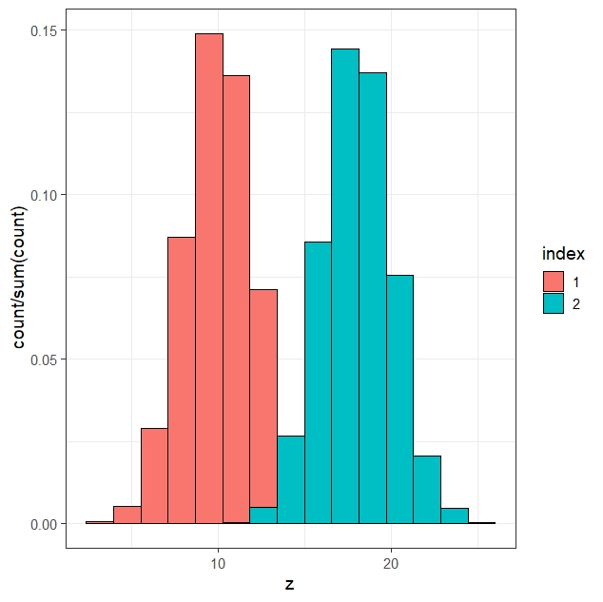

When Sampled Populations are Normal
Let, $X \sim Normal(μ_{1},σ_{1}^{2})$ and Y$\sim Normal(μ_{2},σ_{2}^{2})$ independently distributed. We assume $σ_{1}^{2}$ = $σ_{2}^{2}$. i.e. Homogeneity of variances. Then, the LRT of size $α$ for testing $H_{0}$: $μ_{1}=μ_{2}$ against $H_{1}$: $μ_{1}>μ_{2}$ is given by –
Reject $H_{0}$ iff $T = \frac{\overline{X}−\overline{Y}}{ s\sqrt{\frac{1}{n_{1}}+\frac{1}{n_{2}}}}$ > $t_{{α;n}_{1}+n_{2}−2}$
Where, $t_{{α;n}_{1}+n_{2}−2}$ is the upper $100\left(1−α\right)\%$ point of $t_{n_{1}+n_{2}−2}$ distribution.
$\overline{X} = \frac{1}{n_{1}}\sum_{i = 1}^{n_{1}}{X_{i}}$ and $\overline{Y} = \frac{1}{n_{2}}\sum_{i = 1}^{n_{2}}{Y_{i}}$ be respectively the sample means of X and Y and
$s^{2} =$ $\frac{\left(n_{1}−1\right)S_{x}^{2}+\left(n_{2}−1\right)S_{y}^{2}}{n_{1}+n_{2} − 2}$ is the pooled variance.
Fisher t Test

Slide 10
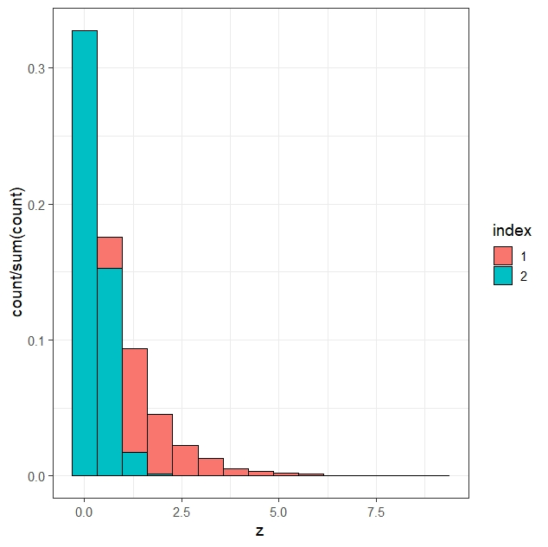
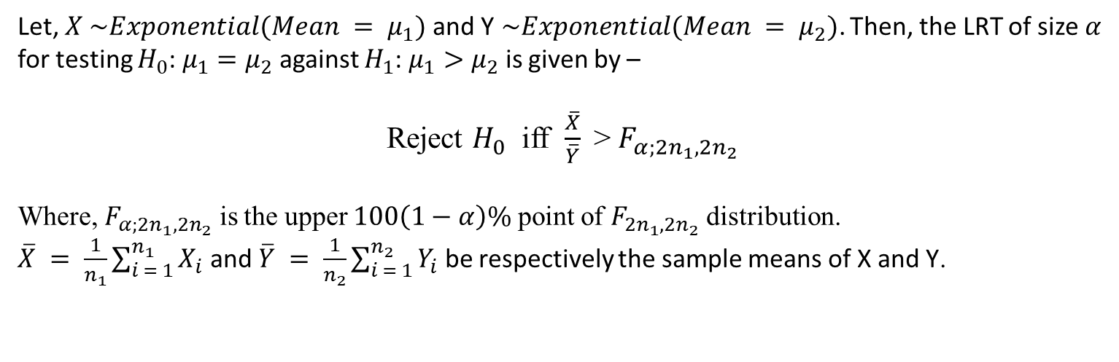
When Sampled Populations are Exponential
Let, $X \sim Exponential(Mean = μ_{1})$ and Y$\sim Exponential(Mean = μ_{2})\text{.}$ Then, the LRT of size $α$ for testing $H_{0}$: $μ_{1}=μ_{2}$ against $H_{1}$: $μ_{1}>μ_{2}$ is given by –
Reject $H_{0}$ iff $\frac{\overline{X}}{\overline{Y}}$> $F_{α;2n_{1},2n_{2}}$
Where, $F_{α;2n_{1},2n_{2}}$ is the upper $100\left(1−α\right)\%$ point of $F_{2n_{1},2n_{2}}$ distribution.
$\overline{X} = \frac{1}{n_{1}}\sum_{i = 1}^{n_{1}}{X_{i}}$ and $\overline{Y} = \frac{1}{n_{2}}\sum_{i = 1}^{n_{2}}{Y_{i}}$ be respectively the sample means of X and Y.
Two Sample Exponential LRT

Slide 11

Non-Parametric Tests
But Before that …….

Slide 12



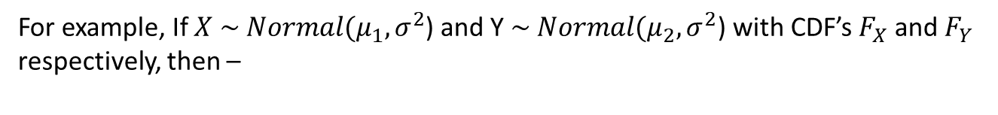
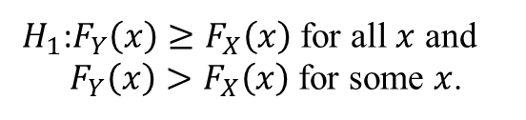
Equivalence Between Parametric and Non-Parametric Hypothesis
In non-parametric setup we generally write hypothesis in terms of CDF. Here, we will find the non-parametric equivalence of the testing problem $H_{0}$: $μ_{1}=μ_{2}$ against $H_{1}$: $μ_{1}>μ_{2}$
For example, If $X \sim Normal(μ_{1},σ^{2}$) and Y $\sim Normal(μ_{2},σ^{2}$) with CDF’s $F_{X}$ and $F_{Y}$ respectively, then –
Similarly For Exponential
$H_{0}$: $μ_{1}=μ_{2}$
$${H_{0}\text{:} F}_{X}\left(x\right)=F_{Y}\left(x\right) ∀x ∈ ℝ$$
Against
Against
${H_{1}\text{:}F}_{Y}\left(x\right)≥F_{X}\left(x\right)$ for all $x$ and ${ F}_{Y}\left(x\right)>F_{X}\left(x\right)$ for some $x$.
$H_{1}$: $μ_{1}>μ_{2}$

Slide 13


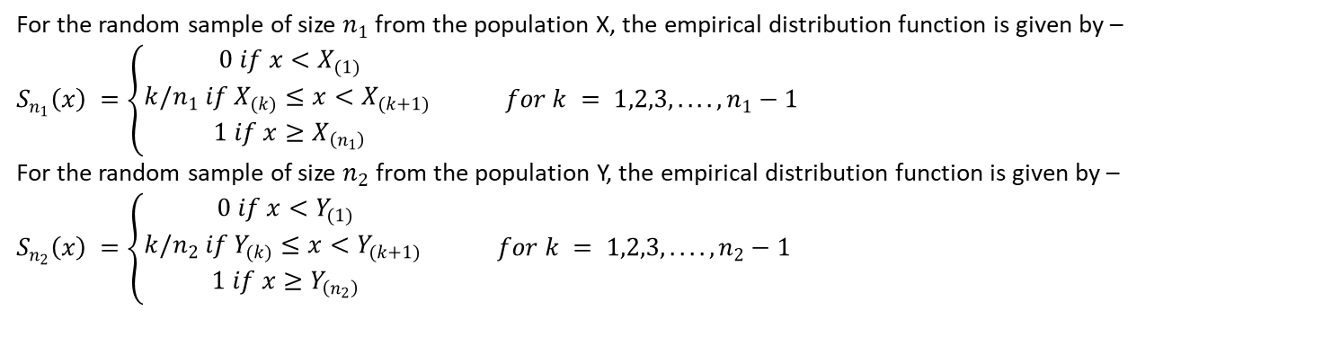
Kolmogorov-Smirnov Two Sample Test
For the random sample of size $n_{1}$from the population X, the empirical distribution function is given by –
$S_{n_{1}}\left(x\right) =\left\{\begin{aligned}0 if x<X_{(1)} \\ k/n_{1} if X_{(k)}≤x<X_{(k+1)} \\ 1 if x≥X_{\left(n_{1}\right)}\end{aligned}\right.$ $for k = 1,2,3,....,n_{1}−1$
For the random sample of size $n_{2}$ from the population Y, the empirical distribution function is given by –
$S_{n_{2}}\left(x\right) =\left\{\begin{aligned}0 if x<Y_{(1)} \\ k/n_{2} if Y_{(k)}≤x<Y_{(k+1)} \\ 1 if x≥Y_{\left(n_{2}\right)}\end{aligned}\right.$ $for k = 1,2,3,....,n_{2}−1$
The Kolmogorov-Smirnov test statistic for our one-sided alternative is given by –
$$D_{n_{1},n_{2}} = \max_{x}(S_{n_{2}}\left(x\right)−S_{n_{1}}\left(x\right))$$
We reject $H_{0}$ iff $D_{n_{1},n_{2}} ≥ c_{α}$. Here, $P_{r}(D_{n_{1},n_{2}} ≥ c_{α }|H_{0}) ≤ α$. ($α$ is our chosen level of significance)
The asymptotic distribution of the test statistic may be obtained under $H_{0}$ (Due to Gilvenko-Cantelli Theorem)
$$\lim_{n_{1},n_{2}→∞}{P\left(\sqrt{\frac{n_{1}n_{2}}{n_{1}+n_{2}}}D_{n_{1},n_{2}} ≤d\right) = 1−ⅇ^{−2d^{2}}}$$
Asymptotic Distribution

Slide 14
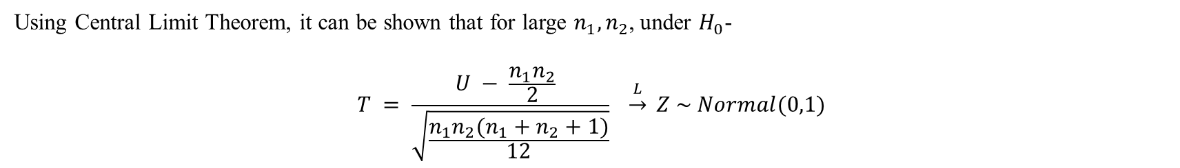
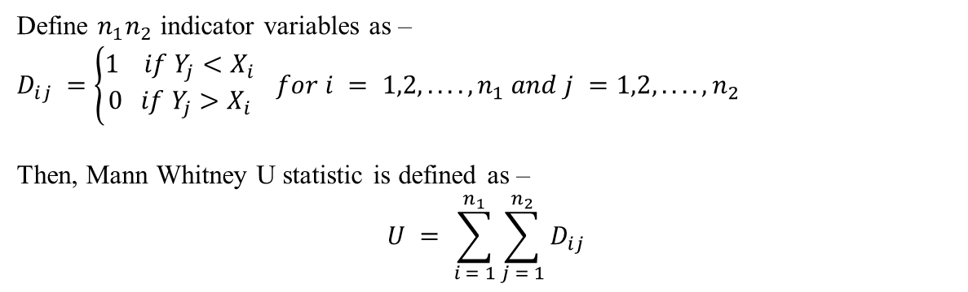
Mann Whitney U Test
Define $n_{1}n_{2}$ indicator variables as –
$D_{ⅈj} =\left\{\begin{aligned}1 if Y_{j}<X_{i} \\ 0 if Y_{j}>X_{i}\end{aligned}\right.$ $for i = 1,2,....,n_{1} and j =1,2,....,n_{2}$
Then, Mann Whitney U statistic is defined as –
$$U = \sum_{ⅈ = 1}^{n_{1}}{\sum_{j = 1}^{n_{2}}{D_{ⅈj}}}$$
A logical rejection would be ‘Reject $H_{0}$ iff $U >c_{α}′.$Where, $c_{α}$ is so chosen that- $P_{r}(U ≥ c_{α }|H_{0}) ≤ α$. ($α$ is our chosen level of significance).
Using Central Limit Theorem, it can be shown that for large $n_{1},n_{2}$, under $H_{0}$-
$$T = \frac{U − \frac{n_{1}n_{2}}{2} }{\sqrt{\frac{n_{1}n_{2}(n_{1}+n_{2}+1)}{12}}} \underset{→}{L} Z \sim Normal(0,1)$$
Asymptotic Distribution

Slide 15
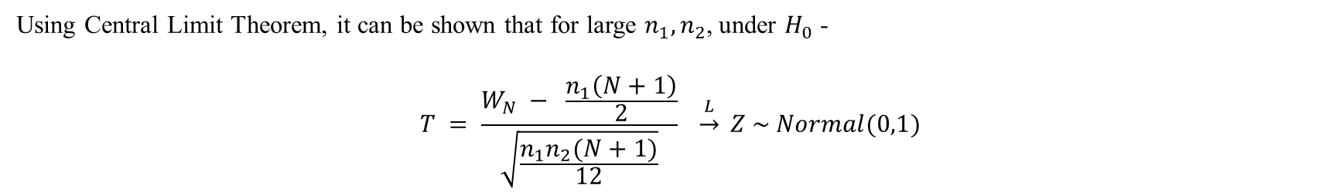
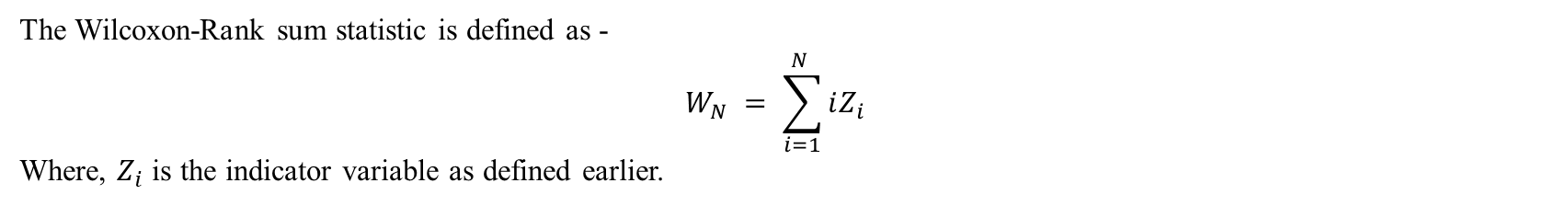
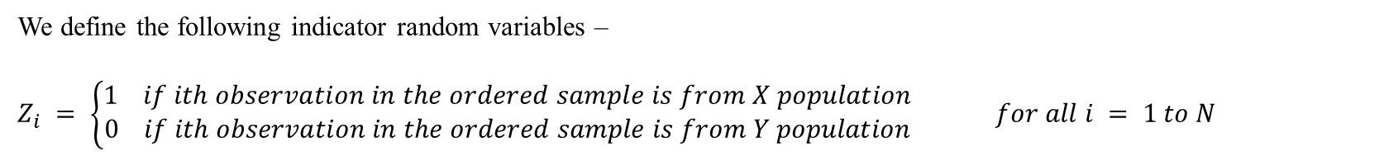
Wilcoxon Rank Sum Test
Firstly, we have combined the samples and arrange them in increasing order. we have $N=n_{1}+n_{2}$ observations.
We define the following indicator random variables –
$Z_{i} = \left\{\begin{aligned}1 if ith observation in the ordered sample is from X population \\ 0 if ith observation in the ordered sample is from Y population\end{aligned}\right.$ $for all i = 1 to N$
The Wilcoxon-Rank sum statistic is defined as -
$$W_{N} = \sum_{ⅈ=1}^{N }{ⅈZ_{i}}$$
Where, $Z_{i}$ is the indicator variable as defined earlier.
A logical rejection would be ‘Reject $H_{0}$ iff $W_{N} >c_{α}′.$Where, $c_{α}$ is so chosen that- $P_{r}(W_{N} ≥ c_{α }|H_{0}) ≤ α$. ($α$ is our chosen level of significance).
Using Central Limit Theorem, it can be shown that for large $n_{1},n_{2}$, under $H_{0}$ -
$$T = \frac{W_{N} − \frac{n_{1}\left(N+1\right)}{2}}{\sqrt{\frac{n_{1}n_{2}(N+1)}{12}}} \underset{→}{L} Z \sim Normal(0,1)$$
Asymptotic Distribution

Slide 16

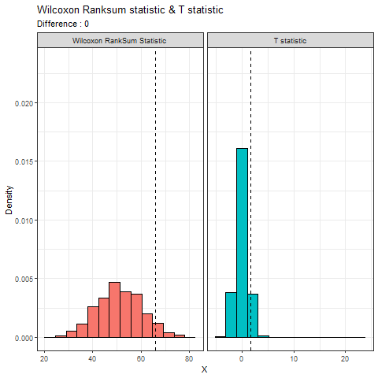
Simulations, Results and Observations

Slide 17

Simulation and It’s use in our discussion
By Simulation statisticians mean Monte Carlo Simulation. It is a computer experiment involving random sampling from probability distributions.
In this article we have used simulation to find empirical distribution of test statistics and empirical size & power of the tests discussed before.
Simulation to find empirical distribution of test-statistic
Simulation to find empirical size and power of tests

Slide 18


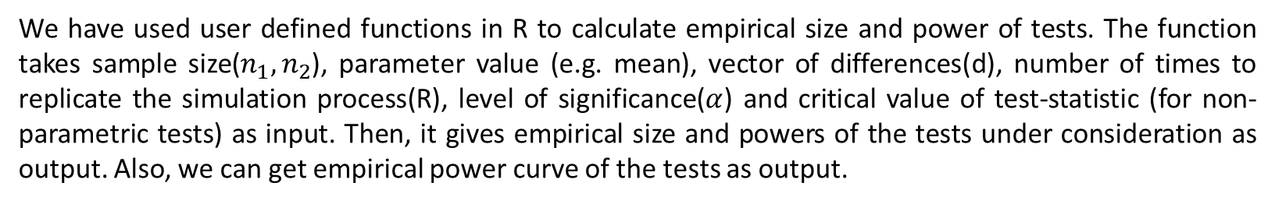
General Introduction
We have used user defined functions in R to calculate empirical size and power of tests. The function takes sample size($n_{1},n_{2}$), parameter value (e.g. mean), vector of differences(d), number of times to replicate the simulation process(R), level of significance($α$) and critical value of test-statistic (for non-parametric tests) as input. Then, it gives empirical size and powers of the tests under consideration as output. Also, we can get empirical power curve of the tests as output.
Sample Size
Number of Times to Replicate
R = 3000,2000
User Defined Function
Parameter Value
Level of Significance
$α=$0.10,0.05
Vector of Differences
Critical Value

Slide 19


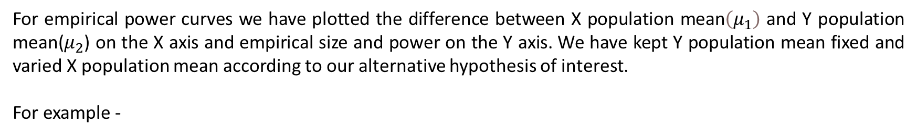
Empirical Power Curve
For empirical power curves we have plotted the difference between X population mean$\left(μ_{1}\right)$ and Y population mean($μ_{2}$) on the X axis and empirical size and power on the Y axis. We have kept Y population mean fixed and varied X population mean according to our alternative hypothesis of interest.
For example -
Y Population Mean
$μ_{2}= μ_{0}$
$μ_{1}= μ_{0}+d$
X Population Mean
Taken as Input
The argument is d
Taken as Input
e.g. mu, lamda

Slide 20

SIMULATION 01:
Simultaneous Comparison of Empirical Size and Power of
Two sample T Test and Different Non-Parametric Tests When Sampled Population is Normal

Slide 21
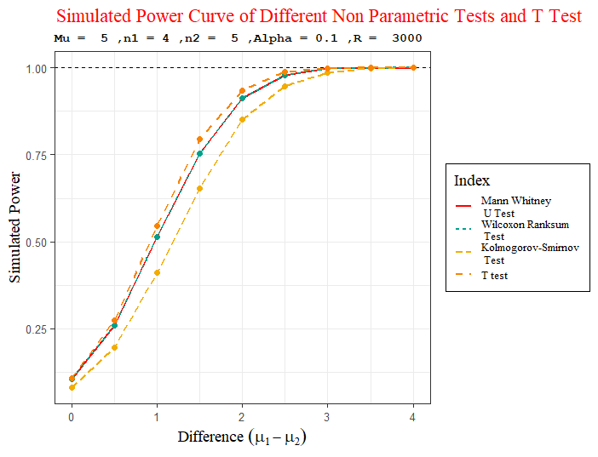
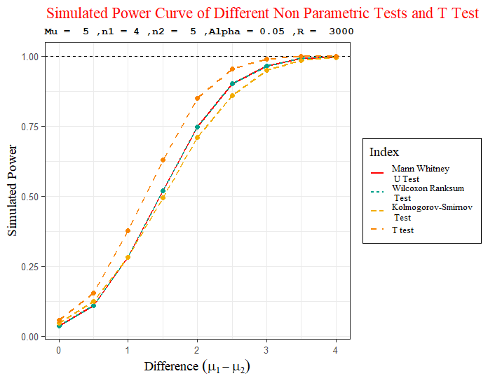
Y population mean is fixed at $Mu=5$ and Sample Sizes are (4,5)
Alpha = 0.10
Alpha = 0.05

Slide 22
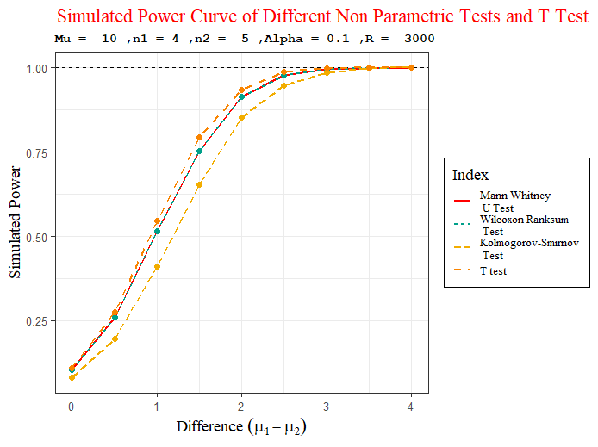
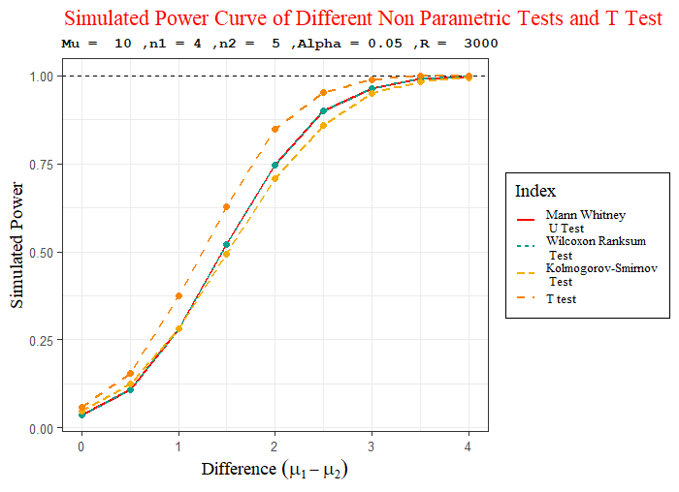
Y population mean is fixed at $Mu=10$ and Sample Sizes are (4,5)
Alpha = 0.10
Alpha = 0.05

Slide 23
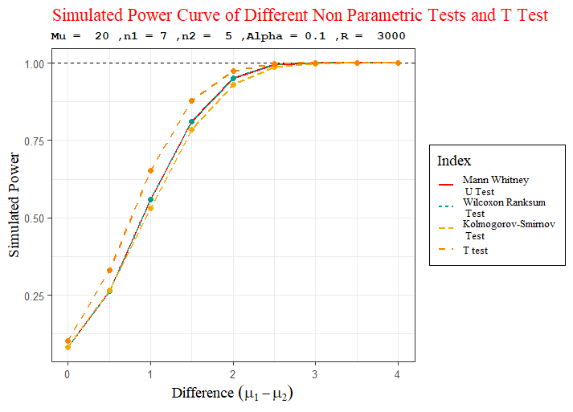
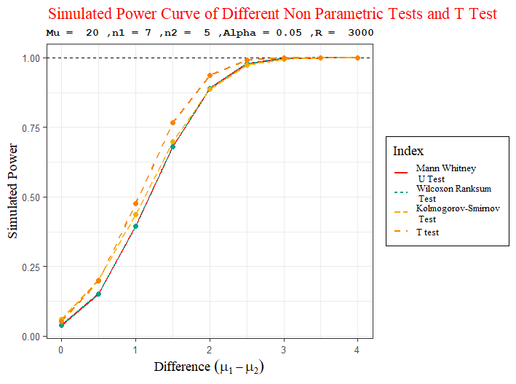
Y population mean is fixed at $Mu=20$ and Sample Sizes are (7,5)
Alpha = 0.10
Alpha = 0.05

Slide 24
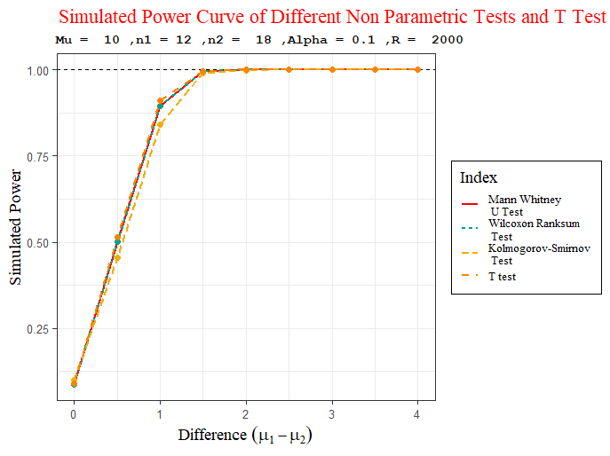
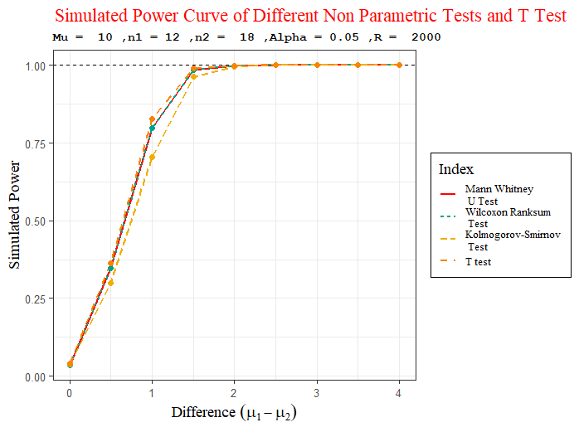
Y population mean is fixed at $Mu=10$ and Sample Sizes are (12,18)
Alpha = 0.10
Alpha = 0.05

Slide 25
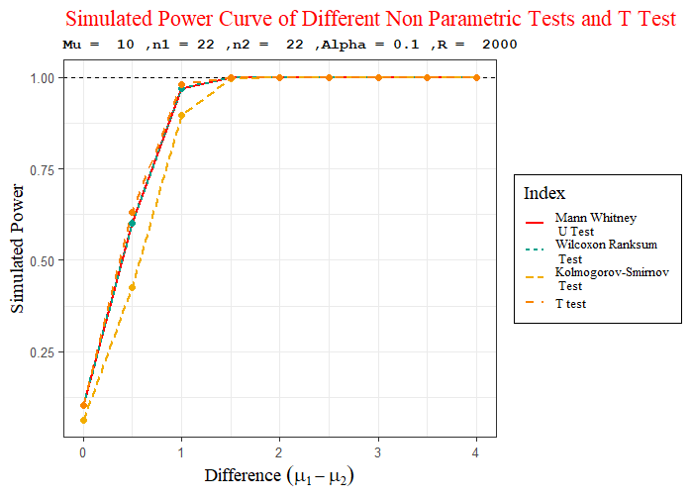
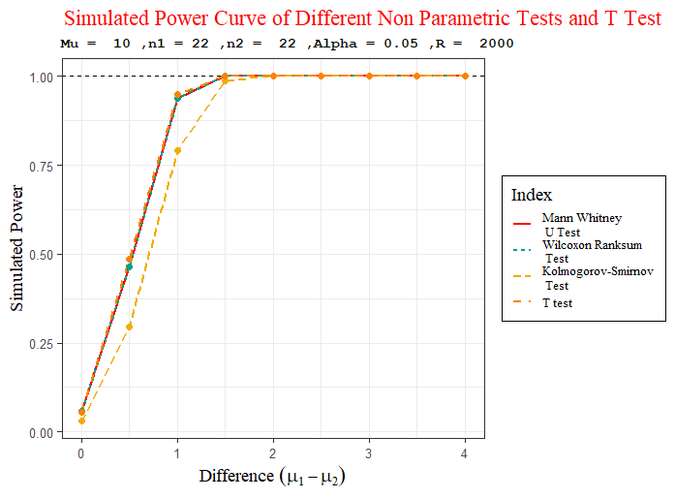
Y population mean is fixed at $Mu=10$ and Sample Sizes are (22,22)
Alpha = 0.10
Alpha = 0.05

Slide 26
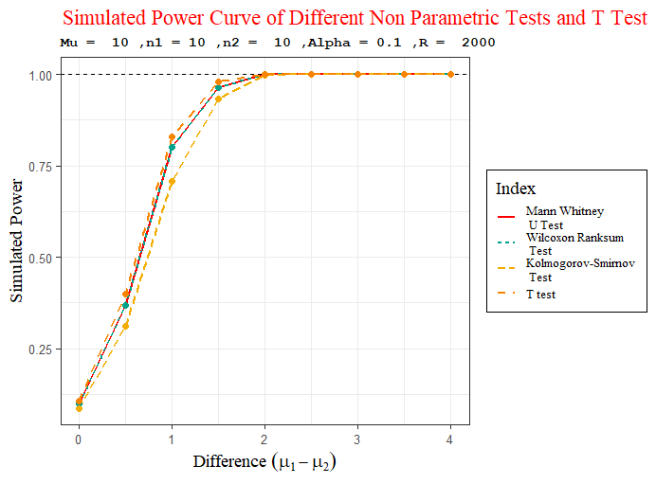
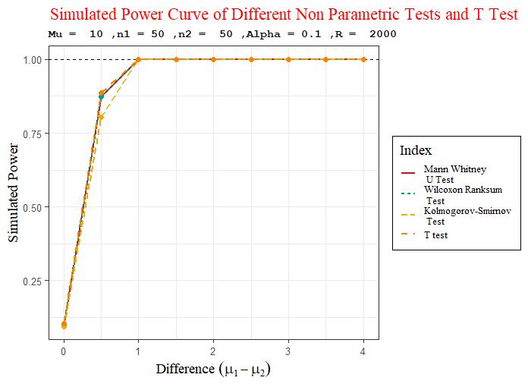
All Tests are consistent
Sample Size increases

Slide 27
SIMULATION 02:
Simultaneous Comparison of Empirical Size and Power of Two sample Exponential LRT and Different Non-Parametric Tests When Sampled Population is Exponential

Slide 28
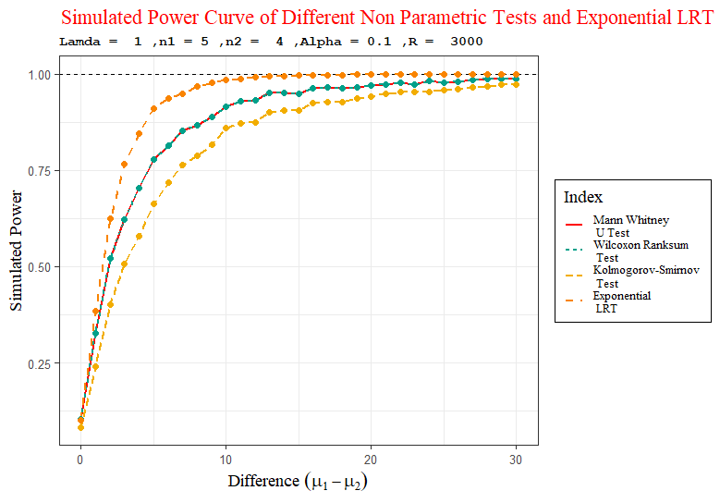
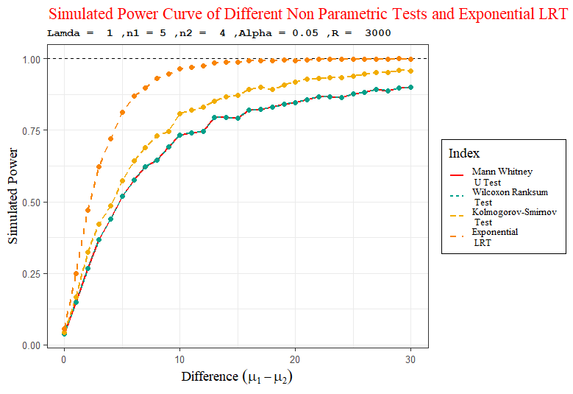
Y population mean is fixed at $lamda=1$ and Sample Sizes are (5,4)
Alpha = 0.10
Alpha = 0.05

Slide 29
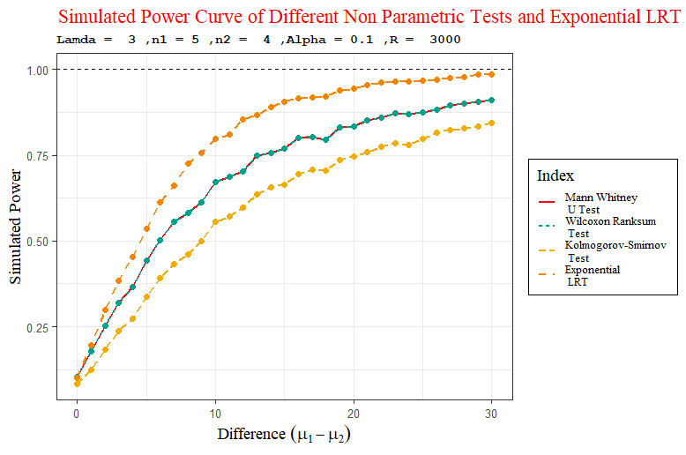
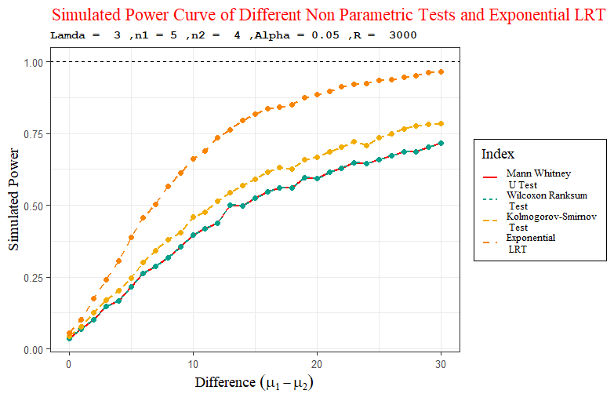
Y population mean is fixed at $lamda=3$ and Sample Sizes are (5,4)
Alpha = 0.10
Alpha = 0.05
Here, It takes much time to reach power 1.

Slide 30
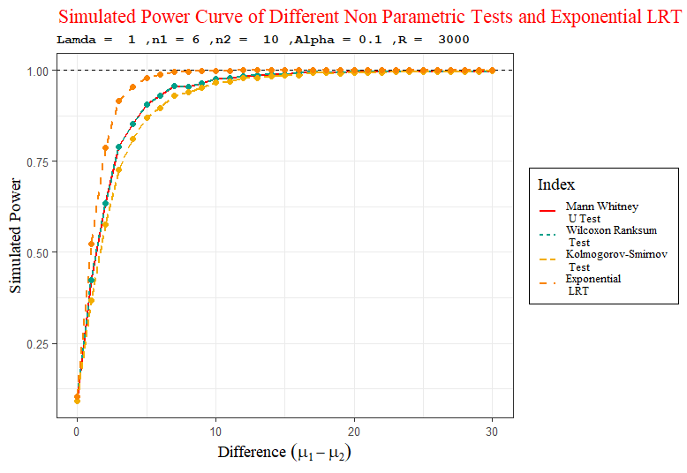
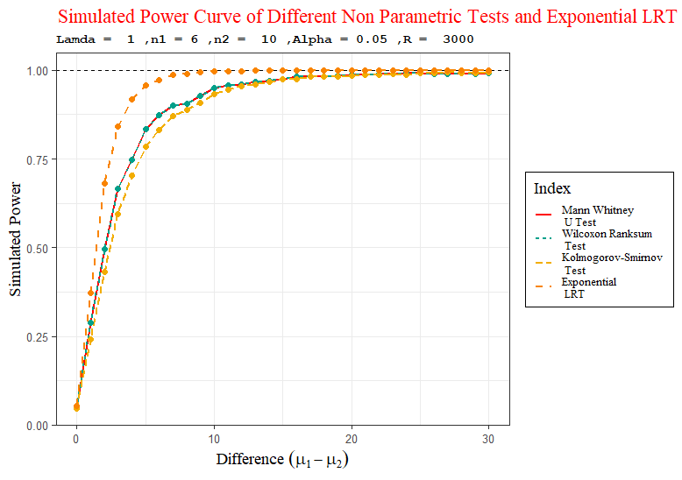
Y population mean is fixed at $lamda=1$ and Sample Sizes are (6,10)
Alpha = 0.10
Alpha = 0.05

Slide 31
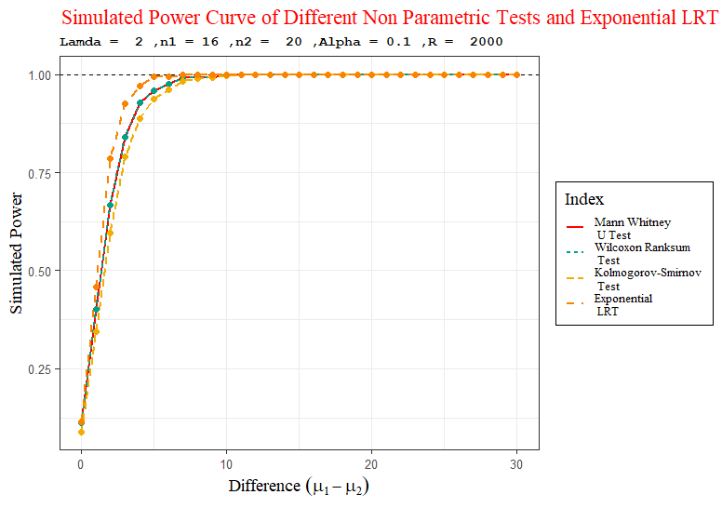
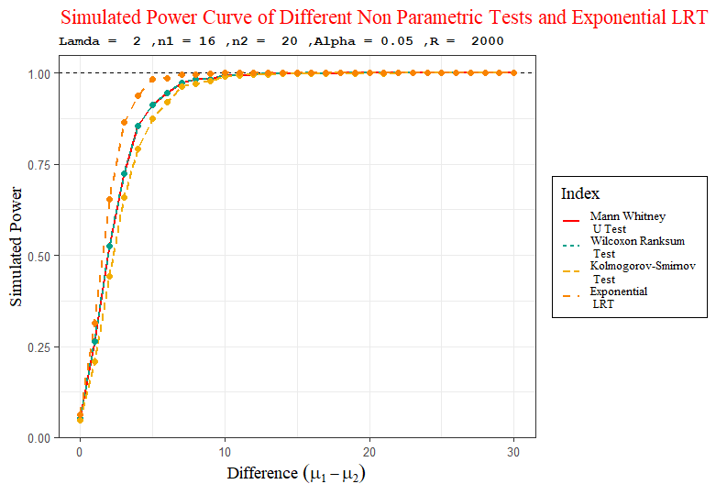
Y population mean is fixed at $lamda=2$ and Sample Sizes are (16,20)
Alpha = 0.10
Alpha = 0.05

Slide 32
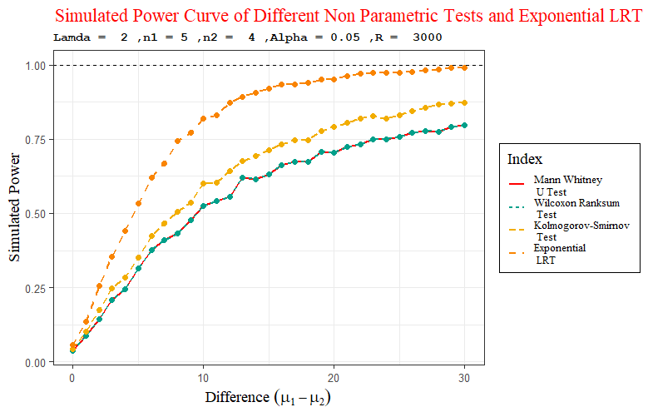
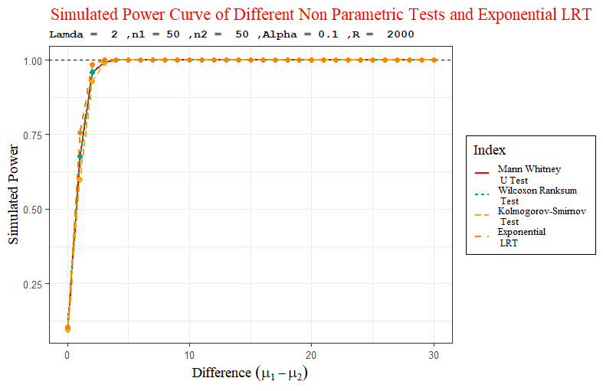
All Tests are consistent
Sample Size increases

Slide 33
Some Observations
For all sample sizes parametric tests are uniformly better than other non-parametric tests.
Among non-parametric tests Mann Whitney and Wilcoxon Rank sum test performs similarly in terms of power.
For small sample sizes Kolmogorov-Smirnov test sometimes performs better than other non-parametric tests. But as sample size increases, we see that among non-parametric tests (that we have considered here) Mann Whitney and Wilcoxon Rank Sum Tests performs better.
From the empirical power curves we see that as when sampled population is normal, power increases more rapidly than when sampled population is exponential. When sampled population is normal power is attains at very small differences (3.5,4 etc.). But when sampled population is exponential, for the same non-parametric tests it takes much time (e.g. difference 30) to attain power 1.

Slide 34

SIMULATION 03:
Study of Probability Distributions of Test Statistics of Different
Non-parametric Tests using Simulation

Slide 35




What we will do ?
Both are Normally distributed
X
Population
Independent
Y
Population
Mean $μ_{1}$
Mean $μ_{2}$
Both are Exponentially distributed
Generate
Simulated distribution of test-statistics
For different values of difference $μ_{1}−μ_{2}$

Slide 36
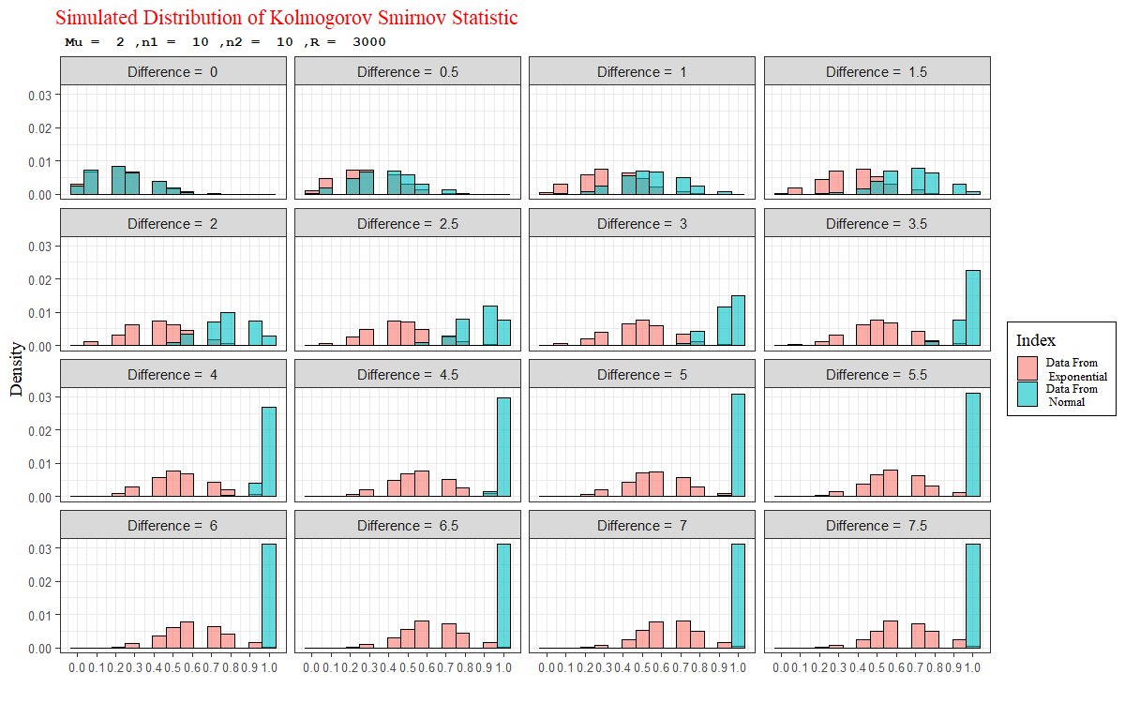
Simulated Distribution of Kolmogorov-Smirnov Statistic for $mu= lamda= 1, n_{1} =10,n_{2} =10$

Slide 37
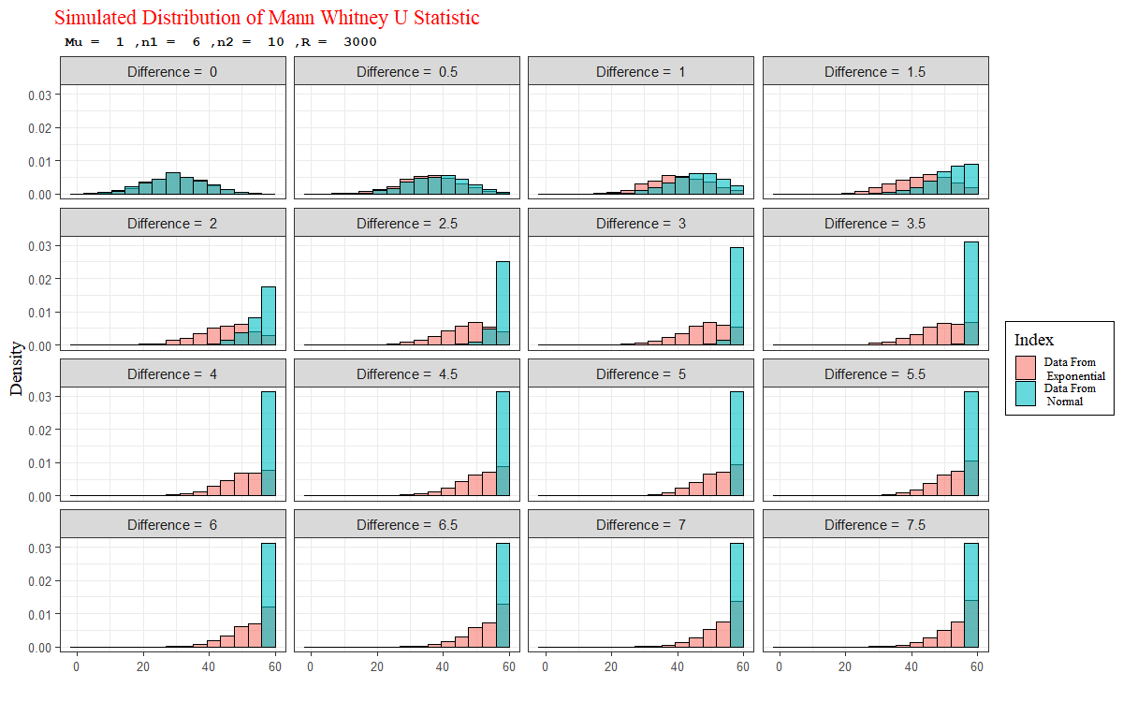
Simulated Distribution of Mann Whitney U Statistic for $mu =lamda= 1, n_{1} = 6,n_{2} = 10$

Slide 38
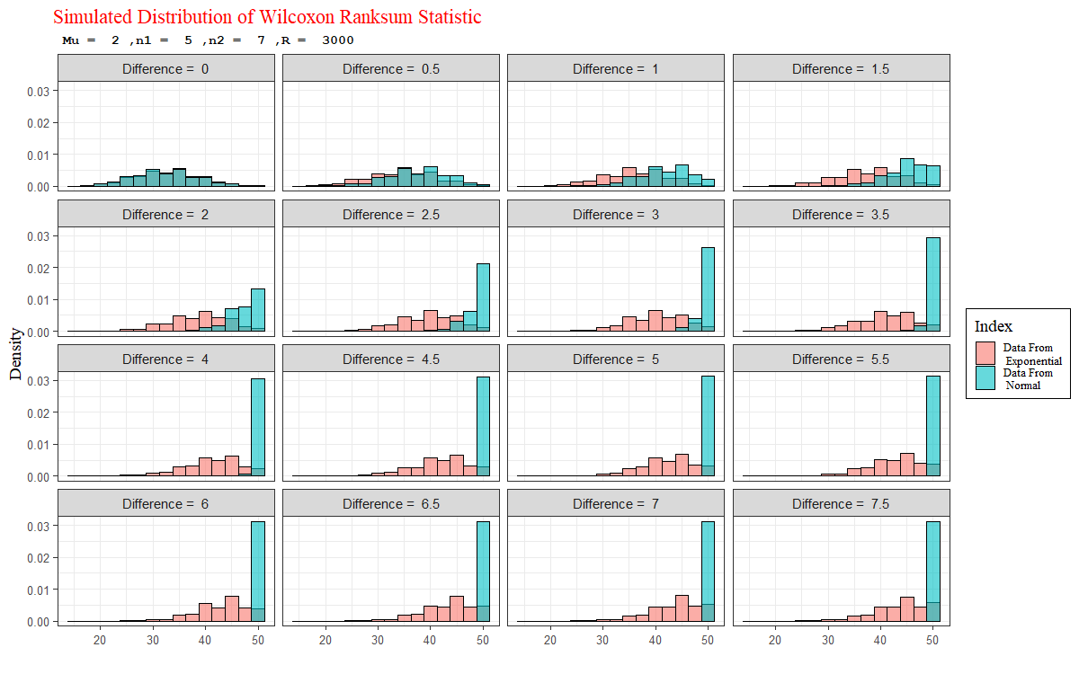
Simulated Distribution of Wilcoxon Rank Sum Statistic for $mu =lamda= 2 n_{1} = 5,n_{2} = 7$

Slide 39

Animated Graphs

Slide 40
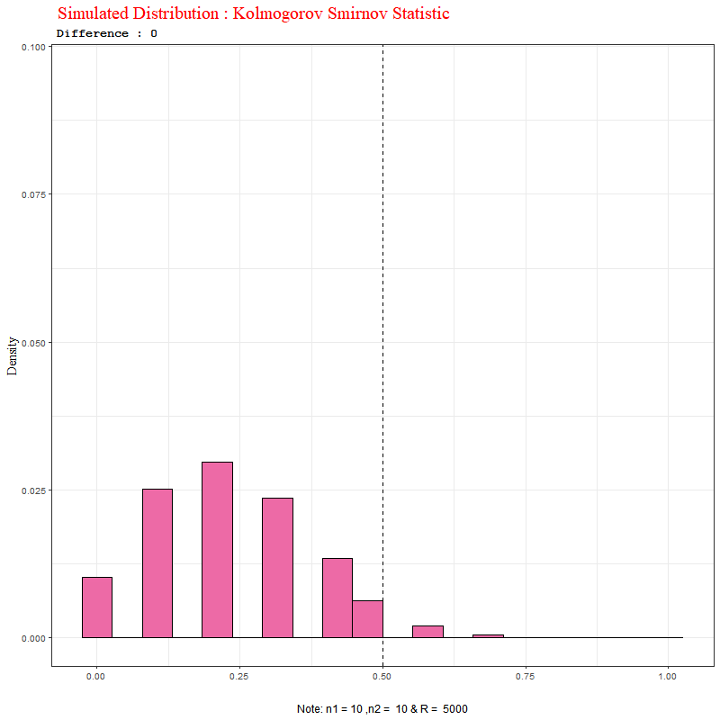
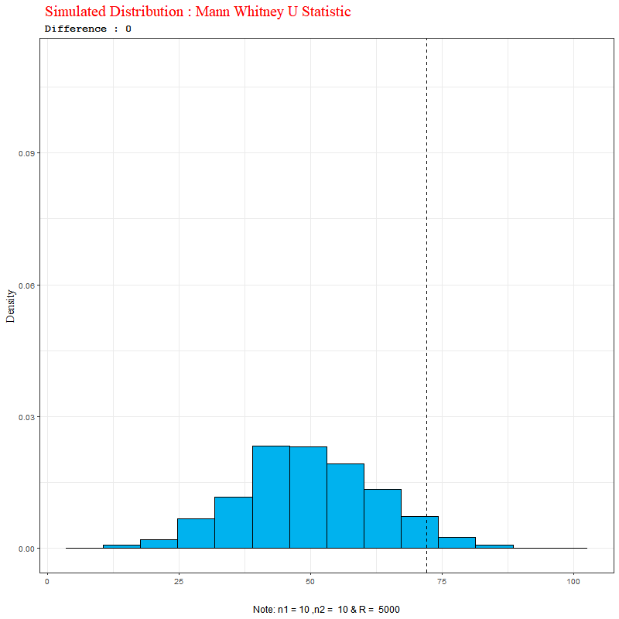
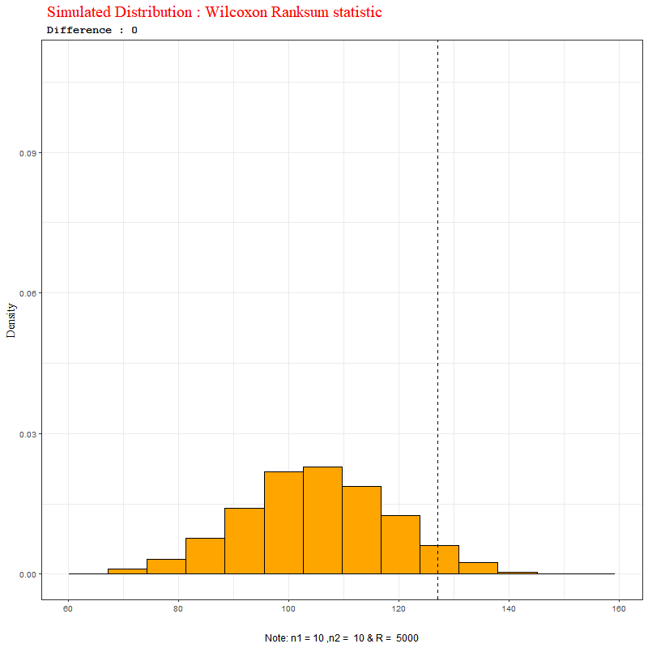

Empirical Distribution of Test-Statistic of Different Non-Parametric Tests for sampled population Normal and $n_{1}=10,n_{2}=10,α=0.05$
Kolmogorov-Smirnov Statistic
Mann Whitney U Statistic
Wilcoxon Rank Sum Statistic

Slide 41
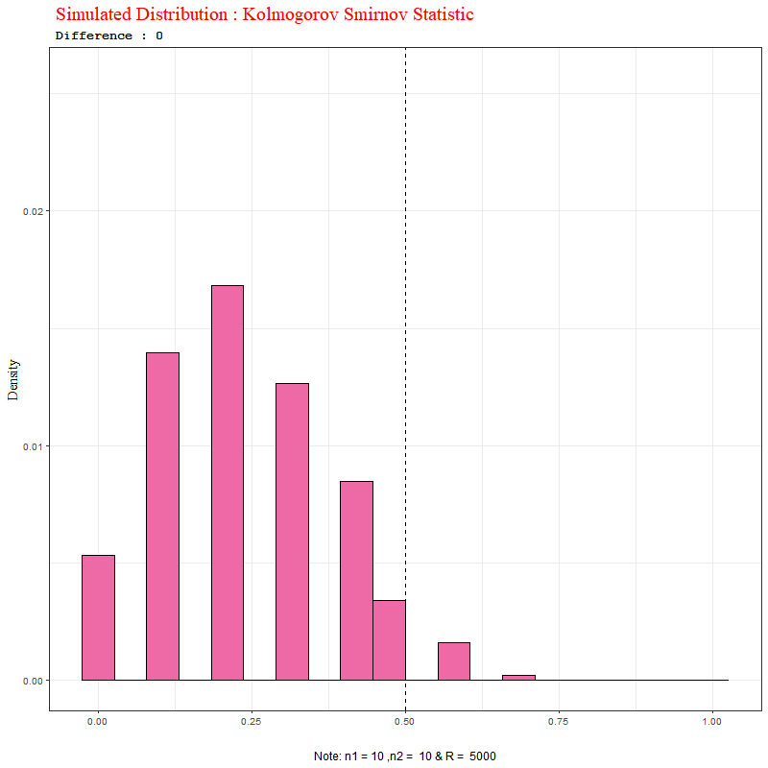
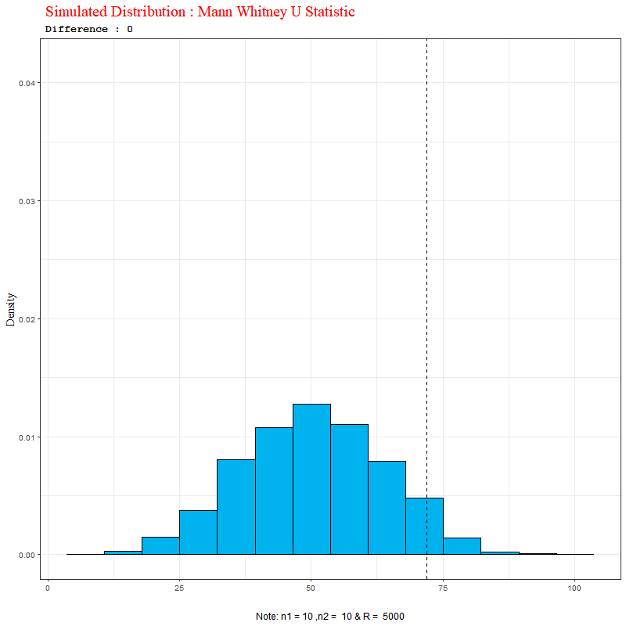
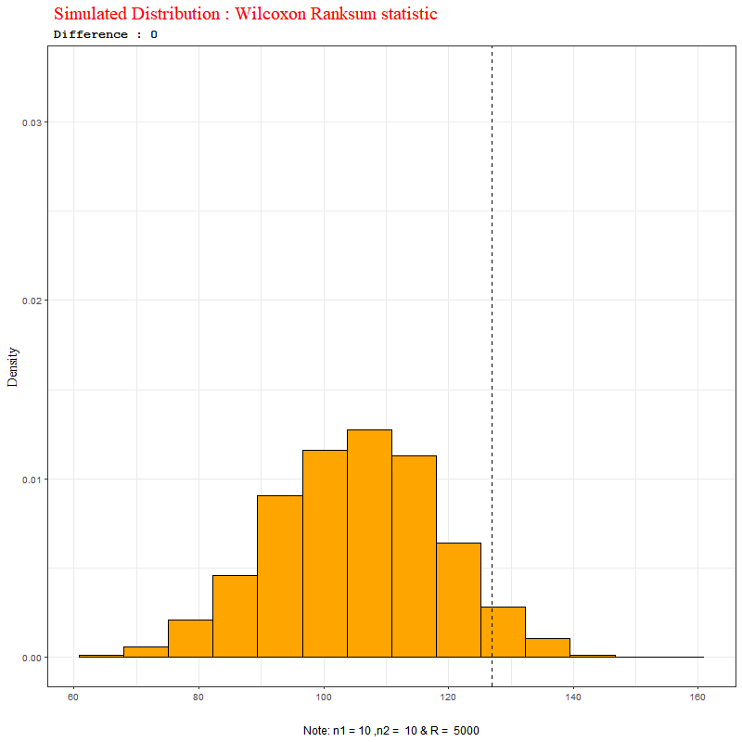

Empirical Distribution of Test-Statistic of Different Non-Parametric Tests for sampled population Exponential and $n_{1}=10,n_{2}=10,α=0.05$
Kolmogorov-Smirnov Statistic
Mann Whitney U Statistic
Wilcoxon Rank Sum Statistic

Slide 42

Conclusion
From the above analysis of empirical size and power of different parametric and non-parametric tests for two sample problem of equality of means of two independent populations, when sampled populations are normal or exponential, we have understood that, whatever be the situations, if the assumptions of parametric tests (here LRT) hold good, then parametric test is always better in terms of power than the non-parametric tests, which we have discussed. We have seen that Mann Whitney U test and Wilcoxon Rank Sum test is better than Kolmogorov-Smirnov test in almost every case. Although for small sample sizes, we have seen some exceptions.
Also, using simulated distributions of the test-statistic of different non-parametric tests, we have seen that the same non-parametric test is able to detect the same difference less frequently (i.e., power is less) when sampled population is exponential than when sampled population is normal. This may happen, because the Mann-Whitney U test and Wilcoxon Rank Sum test are particularly useful for location alternatives.

Slide 43

BIBLIOGRAPHY:
‘$An Introduction to Probability and Statistics$’ Book by $A. K. Md. Ehsanes Salah$ and $V. K. Rohatgi$.
‘$Introduction to the Theory of Statistics$’ Book by $Alexander M. Mood, Duane C. Boes$, and $Franklin A. Graybill$
‘$Nonparametric Statistical Inference$’ Book by $Jean D. Gibbons$ and $Subhabrata Chakraborti$
$‘Statistical Inference’$ Book by $George Casella and Roger Lee Berge$
http://www.ru.ac.bd/wp-content/uploads/sites/25/2019/03/308_03_Rubinstein_Simulation-and-the-Monte-Carlo-Method-Wiley-2017.pdf
http://onlinelibrary.wiley.com/doi/10.1002/9781118799635.oth1/pdf
(Table of Critical Values)

Slide 44


Acknowledgement
I would like to thank my supervisor Prof. Pallabi Ghosh for helping me throughout my entire research work. Without her proper guidance and resourceful insights, it was not possible to do my research work with full motivation.
Also, I would like to thank all my other respected Professors of Department of Statistics in St. Xavier’s College, Kolkata, Prof. Dr. Surabhi Dasgupta, Prof. Dr. Ayan Chandra, Prof. Dr. Surupa Chakrabarty, Prof. Dr. Durba Bhattacharya, Prof. Debjit Sengupta, Prof. Madhura Dasgupta.
Thank You !!

