Slide 1
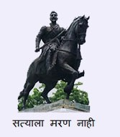
All India Shri Shivaji Memorial Society’s College of Engineering University of Pune TRNMF algorithm (Topic Modeling for Short Texts via Word Embedding and Document Correlation)
Shrayesha N. Kukade
Guided by:
Assistant Prof. M. M. Swami

Slide 2
Overview
Introduction.
Problem Statement.
Motivation.
Description.
Mechanism.
Algorithm.
Advantages & Disadvantages.
Conclusion.

Slide 3

Introduction
Recent years have witnessed the increased development and popularity of various kinds of Web applications such as online social networks, recommender systems and Q&A systems.
These data provides an opportunity to mine user’s topic interests and understand the mechanisms of individual decisions.

Slide 4


Identifying the topic semantic information from large amounts of short texts is fundamental and challenging task in many applications, such as context analysis, user interest proﬁle and text classiﬁcation.

Slide 5

Problem Statement
Conventional topic modeling methods have been widely used to good success in discovering the hidden semantic structure from a large corpus of documents.
These models, work on the principle of topic modeling based on document-topic and topic-word probabilistic distributions from the co-occurrence of words within documents.
The main problem is that data sparsity under short texts scenario seriously creates difficulties in the process of ﬁnding document-topic distributions.
As a result, conventional topic modeling methods can not achieve satisfactory performance in short text topic modeling domain.

Slide 6



Motivation
As we know Google uses our search history to provide us relevant future search topics and gives us suggestion while typing our search.
Similarly, on social media like Twitter, Instagram, Facebook, etc. hashtags(“#”), suggestions, daily feeds are suggested depending on the user’s topic interests.
For each user different suggestions are provided.

Slide 7
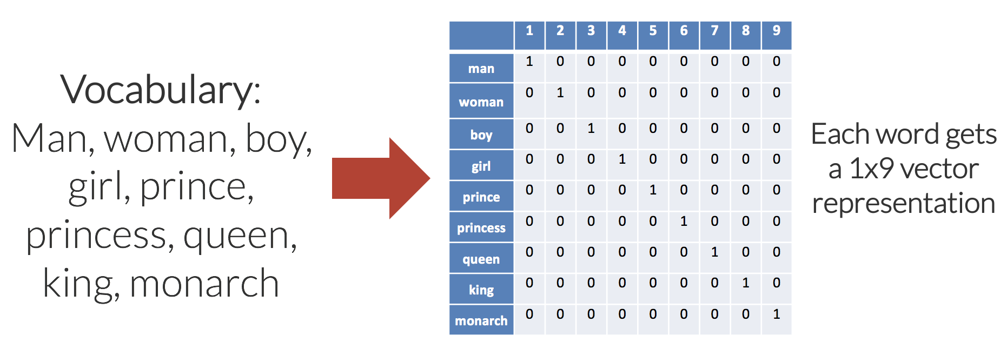
Description
TRNMF is a topic modeling method over short text based on regularized non-negative matrix factorization.
TRNMF is designed to extract the word vector representation learning during the topic inference process to deal with the data sparsity problem.
Word2vec is a particularly computationally-efﬁcient predictive model for learning word embeddings from raw text.

Slide 8
It comes in two ﬂavors, the Continuous Bag-of-Words model (CBOW) and the Skip-Gram model.
Algorithmically, these models are similar, except that CBOW predicts target words (e.g. ’mat’) from source context words (’the cat sits on the’), while the skip-gram does the inverse and predicts source context-words from the target words.
TRNMF uses GloVe model, which tabulates how frequently words co-occur with one another in a given corpus.
Similar words being close together allow us to generalize from one sentence to a class of similar sentences.

Slide 9
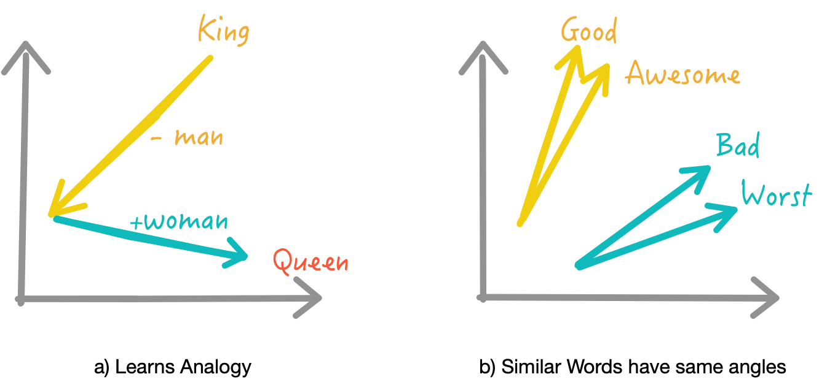
Mechanism
TRNMF extends the non-negative matrix factorization model by introducing topic regularization from large text corpus in the term of topic word distribution and document regularization by employing clustering mechanism to cluster short texts in the term of document-topic, respectively.
TRNMF exploits GloVe model to get the global semantically relevant words for target words under the entire corpus.

Slide 10

Like this, TRNMF links the semantically relevant words together to alleviate the data sparsity problem, even if they share very limited or no co-occurrences in the current collection of short texts being modeled.
Besides, TRNMF model uses clustering algorithm to organize a large short texts into several semantic clusters and helping topic inference efﬁciently.

Slide 11
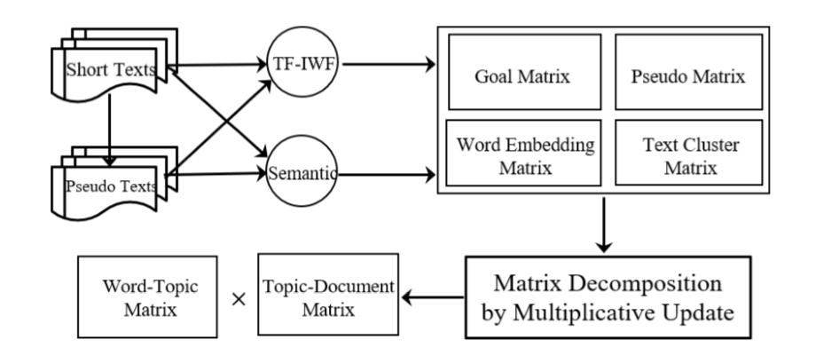
Framework of TRNMF model
TF-IWF : ratio of Term frequency-inverse word frequency
Pseudo texts : unreal/predicted text
Semantic : meaning in the language/logic

Slide 12
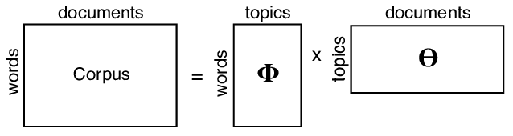
The learning algorithm for TRNMF
Require : X, U, V, K: number of topics.
X: word-document matrix, X ∈ R₊^{MxN} ;
U: word-topic matrix, U ∈ R₊^{MxN} ;
V^{T}: topic-document matrix, V ∈ R₊^{NxK} ;
X ≈ UV^{T}, K << min(M,N);
Parameters controlling word: α, β, γ, λ;
α, β: co-occurrence regularization and clustering regularization on U and V respectively.
S(w_{i},w_{j}): semantic relatedness between two words wi and wj.
S: word semantic relation matrix.

Slide 13

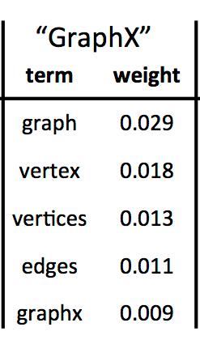
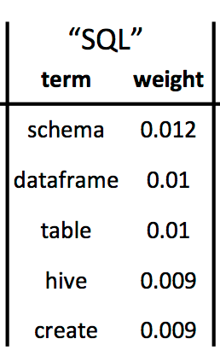
Ensure : For matrix U and V
1: Randomly initialize U and V;
2: for i = 1 : M do
3: for j = 1 : M do
4: calculate S(i,j) with ( )
5: end for
6: end for
{A word semantic relation matrix S can be constructed, consisting of all word pairs whose semantic relatedness score is higher than 0.}

Slide 14
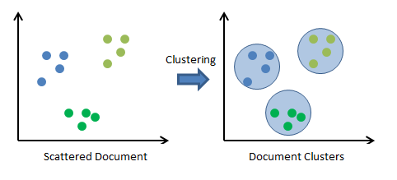
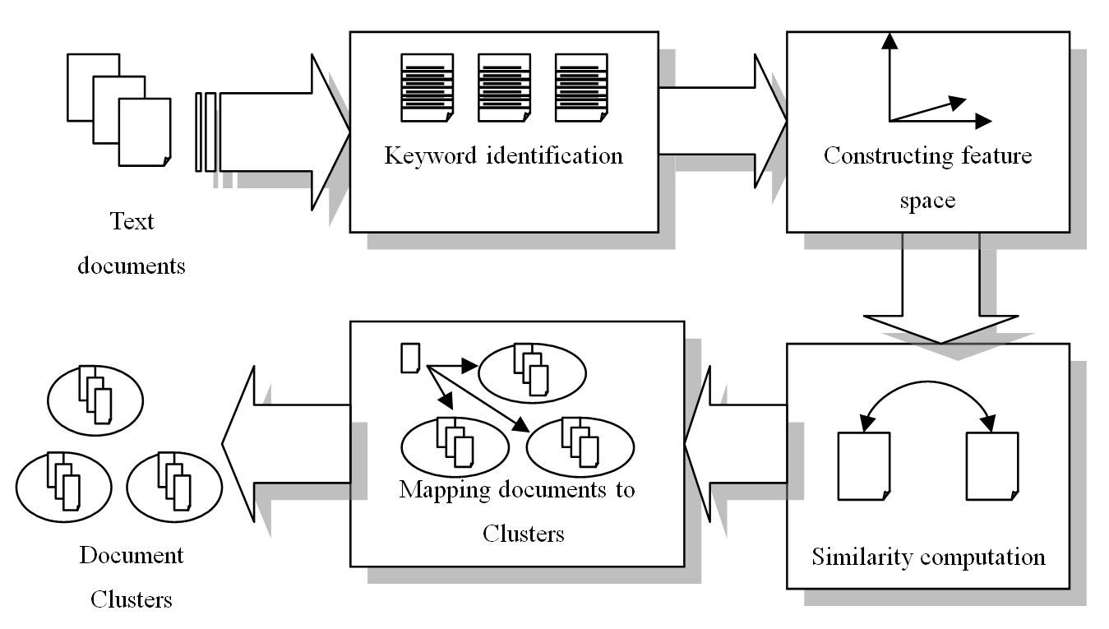
7: for i = 1 : 2N do
8: for j = 1 : 2N do
9: calculate G(i,j) with GSDMM model;
10: end for
11: end for
{GSDMM model(Generalized Polya Urn with Dirichlet Multinomial Mixture ) is basically used for clustering.}

Slide 15
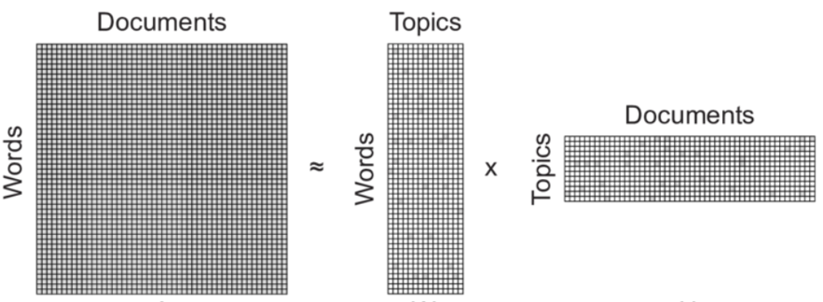
12: for k = 1 : K do
13: U_{k} ← Update U(X,V_{k−1}); //K: number of topics
14: V_{k} ← Update V(X, U_{k});
15: end for
16: return U, V;

Slide 16
EXPERIMENT
3 data sets are taken
TMNews
Snippet
Twitter
BASELINE METHODS
We compare TRNMF model against the following various state-of-the-art topic models speciﬁc to short texts.
Bi-term Topic Model (BTM).
BTM explicitly learns the word co-occurrence patterns in the whole corpus for learning latent topics to solve the problem of sparse word co-occurrence patterns. However, a bi-term for this model is an unordered word pair co-occurred in a short context.

Slide 17
Word Network Topic Model (WNTM).
WNTM constructs a word co-occurrence network to discover latent word group and learns distribution over topics for words rather than topics for documents. The model successfully enhances the semantic density of data space, and makes topic inference less sensitive to the document length or heterogeneity of the topic distribution.
Latent Feature model with DMM (LF-DMM).
LFDMM integrates latent feature word representations into Dirichlet Multinomial Mixture by replacing the topic-to-word Dirichlet multinomial component with a mixture of two components: a Dirichlet multinomial component and a word embedding component.
Generalized Polya Urn with DMM(GPU-DMM).
GPUDMM also extends the Dirichlet Multinomial Mixture model by incorporating the pre-trained word embeddings learned from large text corpus through the generalized Polya urn model in topic inferences. This model can promote the semantically relevant words together, even if they share very limited or no co-occurrences in the current corpus.

Slide 18
Pseudo-document-based Topic Model (PTM).
PTM assumes huge volume of short texts are generated from much less yet regular- sized latent documents, and introduces the concept of pseudo document to implicitly aggregate short texts against data sparsity without using auxiliary contextual information.
Regarding these topic models, BTM, WNTM, and GPUDMM share two main hyper-parameters: α = 50/K, β = 0.01. Speciﬁcally, we set to 10 with length of the sliding window for WNTM.
For LF-DMM, we use the authors recommended settings with λ = 0.6, α = 0.1, β = 0.01.
For PTM, we set α = 0.1, λ = 0.1 and β = 0.01.
For model TRNMF, we use cross-validation method to the optimize parameters. Through extensive evaluations, we set α = 0.1, β = 0.1, λ = 0.01 and γ = 0.01 in the following comparison experiments.

Slide 19
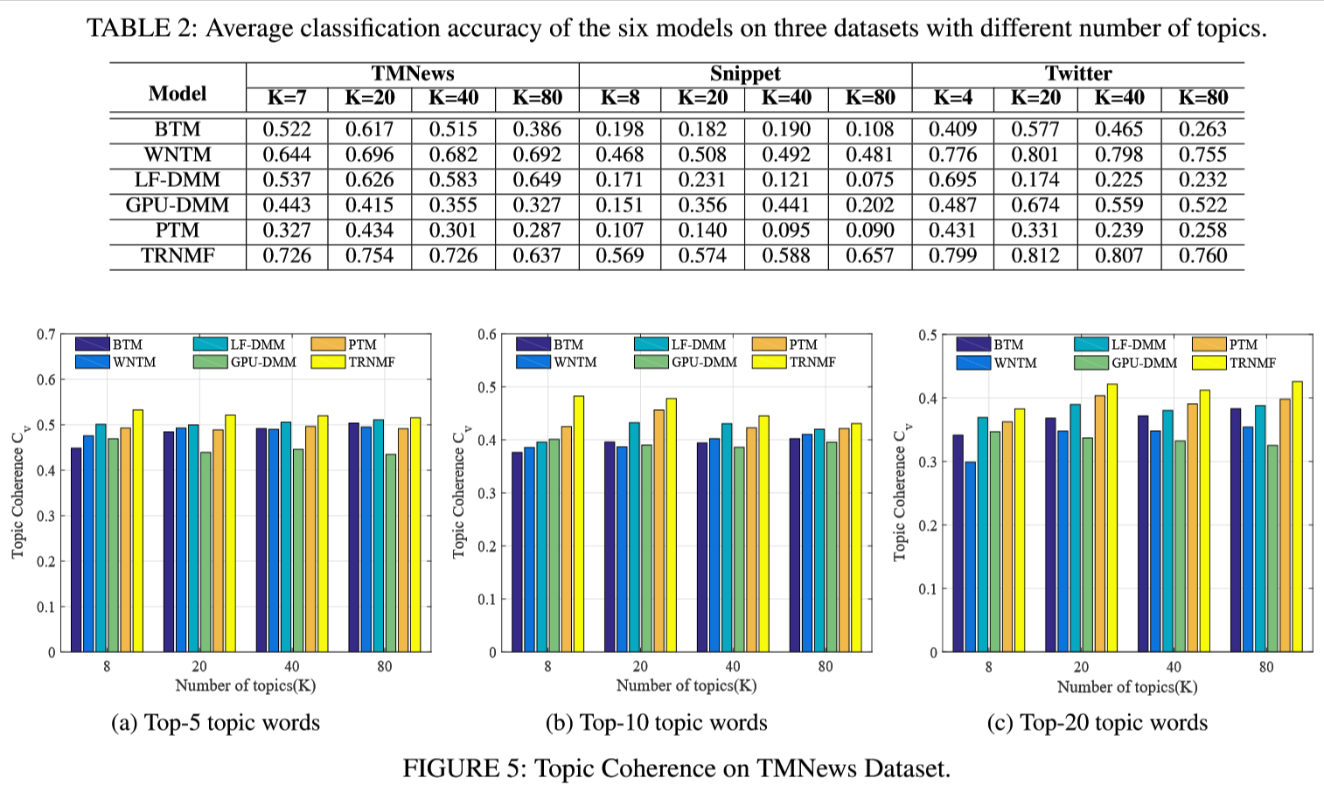

Slide 20
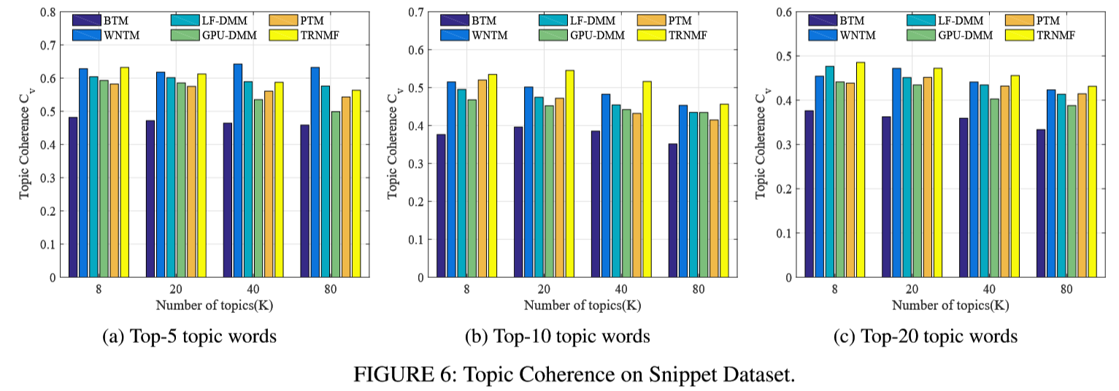
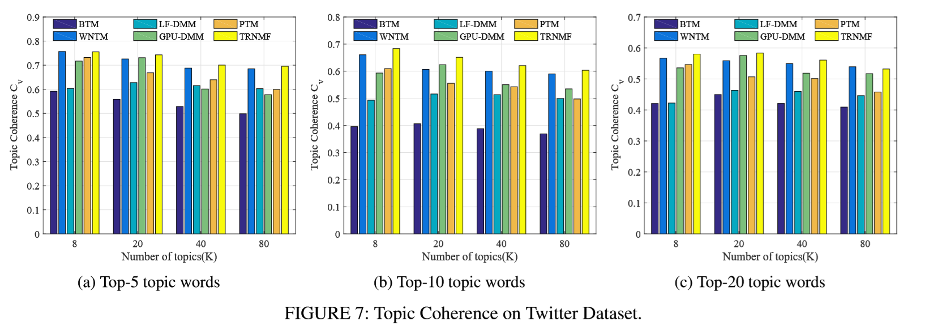

Slide 21
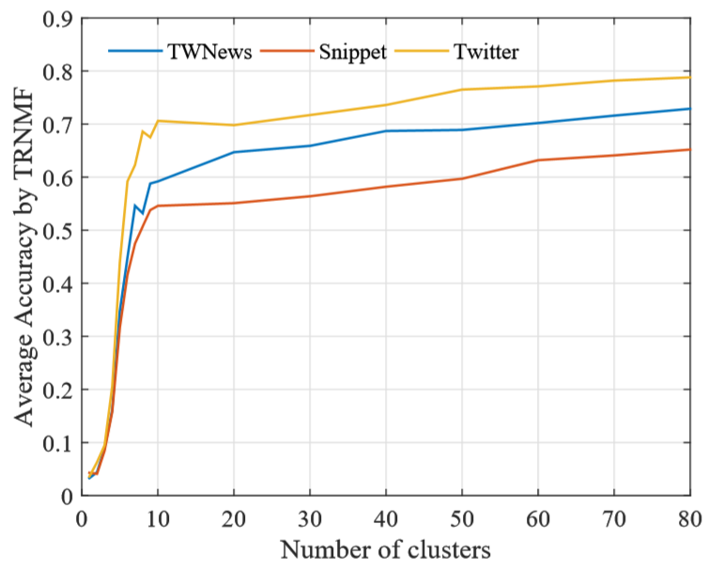
FIGURE 8: Average accuracy achieved by TRNMF with different values of K on the three datasets.

Slide 22
Advantages
TRNMF method consistently outperform all other baseline methods on all datasets.
It can discover more readable topics and solves data sparsity problem.
This model can better discover the hidden semantic structure of short text collections.
It shows more prominent topics and achieves better classiﬁcation accuracy than existing state-of-the-art alternatives.
It has a good convergence property when increasing the number of clusters.
Disadvantages
In some cases, for small number of topics its accuracy is less whereas for increasing number of topics its accuracy is increases.

Slide 23
Conclusion
Proposed new method based on non-negative matrix factorization model for latent topic inference, aiming at short texts under data sparseness. By leveraging global word-word co-occurrence knowledge to help extract better topics over short texts, TRNMF gains advantages in learning topic distributions using auxiliary contextual information. On the other hand, the proposed model alleviate the sparsity problem and improve the performance of topic modeling by exploiting document clustering relationship. The experimental results show that TRNMF model outperforms existing conventional alternatives in terms of effectiveness and efﬁciency.
Future Scope
The TRNMF model can also be improved by using the graph-based word embedding technique in future.

Slide 24
THANK YOU! Any Question? ☺
Presentation By : - Shrayesha N. Kukade
Roll No. : - 17CO028
Guided by: - Assistant Prof. M. M. Swami

Slide 25
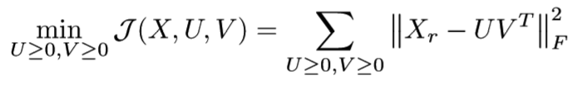
BASE NMF FOR TOPIC MODELING
Given a non-negative matrix X_{r} ∈ R₊^{MxN} , and an integer K << min(M,N), Non-negative Matrix Factorization (NMF) ﬁnds a lower-rank approximation given by
X_{r} ≈ UV^{T} ………………(1)
Where U ∈ R₊^{MxN} and V ∈ R₊^{NxK} are non-negative factors. NMF is typically formulated in terms of the Frobenius norm as
…………………….(2)
where ≥ applies to every element of the given matrix in the left-hand side.
In the topic modeling context, x_{i} ∈ R₊^{M×N} , the i-th column of X, corresponds to the bag-of-words representation of document i with respect to m words, possibly with some preprocessing.
In general, each entry of X can be represented by tf-idf which is a weighting scheme that assigns each term in a document a weight based on its term frequency (tf) and inverse document frequency (idf).

Slide 26
K corresponds to the number of topics. The k-th column vector of term-topic matrix U, represents the k-th topic as a weighted combination of m words. A large value indicates a close relationship of the topic to the corresponding word. The j-th column vector of topic-document matrix V^{T}, represents document j as a weighted combination of k topics.
As we know, the purpose of tf-idf is to highlight important words and suppress minor words but the simple structure of idf cannot effectively reﬂect the importance of words and the distribution of feature words, so that they cannot achieve the right weight adjustment function, so the accuracy of tf-idf is not very high.
Therefore, in order to learn better quality of word semantic information, we choose more important words in collection of short texts to learn high quality of topic representation.
A variation of the tf-idf weighting scheme term frequency-inverse word frequency namely TF-IWF to measure the importance of a term in the given document collection.

Slide 27

The actual TF-IWF formula we used is
…………………………………..(3)
Where,
w represents a word,
d represents a document,
I(w,d) is the indicator function that whether word ‘w’ appears in document collection ‘d’ or not,
N is the sum of counting the number of times each word occurs in each document in the collection, and
WF(w) is the number of times word ‘w’ occurs in the collection.

Slide 28
MODELING PSEUDO-DOCUMENT MATRIX
Topic modeling over short texts always suffers from the effect of data sparseness as only a few words appear in each text.
For example, given a collection of 10,000 short texts in our case, only 0.04% entries of X_{r} have values. Statistical results demonstrate that the word-document matrix X_{r} is over sparse. Thus, decomposing directly X_{r} only based on its own non-zero entries is not accurate enough for topic modeling on short texts.
Based on the above observations, aggregating short texts into long pseudo documents based on distributed vector representations for short texts maybe useful.
It is important that the strategy of aggregating short texts into long pseudo documents can alleviate the problem of data sparseness, and learning distributed vector representations of short texts can capture the semantics information to overcome many weaknesses of bag-of-words models.
So, we construct another word-document matrix X_{o} based on these long pseudo documents.

Slide 29
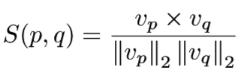
Building long pseudo document matrix X_{o} has the following three steps.
We ﬁrstly apply paragraph vector, an unsupervised algorithm that can model rich semantic information, to learn the ﬁxed length vector representations from variable-length pieces of short texts. After obtaining vector representation of each text, the similarity score in the distributed vector space is then calculated as the cosine similarity between short text vectors v_{p} and v_{q} as follows:
…………………….(4)
Once the similarity between short texts have been measured, we aggregate top-N (e.g., N: 2 - 5) short texts into a long pseudo document in term of similarity ranking for each text.

Slide 30
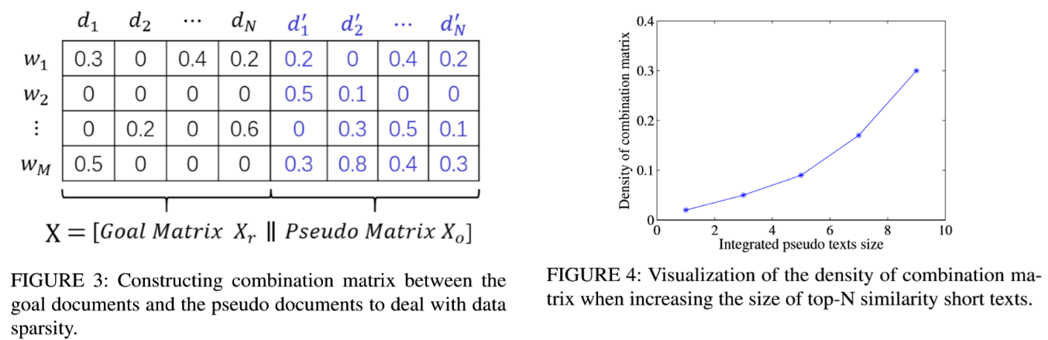
As shown in Figure 3, pseudo word-document matrix X_{o} ∈ R^{M×N} has the same structure as matrix X_{r}, while an entry X_{o}(i,j) = x’ represents the weight of a word w_{i} that occurs in a document d_{j}. Here, we also use the above-mentioned TF-IWF method to compute the weights between words and pseudo documents. Intrinsically, X_{o} is much denser than X_{r}, denoting the distributional similarity based on vector representations between short texts on the entire corpus.
Figure 4 illustrates the impacts of the different size of windows on density. For instance, choosing top-N size to 3, then on-zero entries of X_{o} is about 0.5%. Therefore, decomposing X_{r} and X_{o} together can reduce the error of supplementing X_{r}.

Slide 31
MODELING WORD EMBEDDINGS SEMANTIC
MATRIX Studies reveal that short texts usually have shorter length than 100 characters. This cause the high semantic relatedness between two words less frequently co-occur in the context of short texts. On the other hand, word embeddings have been successfully applied in language models and many natural language process tasks. Conceptually, word embeddings involve a mathematical embedding from a space with one dimension per word to a continuous vector space with much lower dimension. Hence, we use word embeddings vector representation method to learn the linguistic and semantic similarity of the corresponding words (e.g., king - man + women = queen).
Formally, given pretrained word embeddings, a word w_{i} is presented by a word occurrence vector (v_{i},1,...,v_{i},D), where D is the dimension of vector, and v_{i,j} is decided by the co-occurrence of words w_{i} and w_{j}. We then measure the semantic relatedness between two words wi and w_{j} by the cosine similarity between their vector representations in the latent space (i.e., the word embeddings of the two words). The semantic relatedness between the pair of words is denoted by s(w_{i},w_{j}). Then a word semantic relation matrix S can be constructed, consisting of all word pairs whose semantic relatedness score is higher than 0, that is estimated with empirical probabilities as follows:
………………..(5)

Slide 32

After representing each word by the word co-occurrence vector, we then apply cosine similarity algorithm to measure the semantic correlation between any two words, resulting in the ﬁnal word correlation matrix S = [s_{ij}] ∈ R^{M×M}. Motivated by previous works about graph clustering, we formulate this topic learning problem as ﬁnding a word-topic matrix U to minimize the following objective function:
…………………….(6)
where each column of the word-topic matrix U represents a topic by a vector of weighted words. This special formulation of non-negative matrix factorization is referred as the symmetric non-negative matrix factorization, which is suggested to be equivalent to kernel k-means clustering and spectral clustering.

Slide 33
MODELING DOCUMENT CLUSTERING MATRIX
The algorithm has some good property for short text clustering problem, such as
(1) fast to converge;
(2) cope with the sparse and high dimensional problem of short texts;
(3) obtain the representative words of each cluster.
Therefore, we opt for this method as the clustering algorithm form document clustering matrix. The code used are publicly available. More speciﬁcally, we ﬁrst cluster short documents into different groups by exploiting GSDMM algorithm. Documents that are similar to one another within the same cluster and are dissimilar to documents in other clusters. We believe that if document d_{j} is grouped to cluster C_{k} in observed spaces, it should be consistent with the latent space. Hence, once the clusters are created, in latent document feature space, a document should be more closed to the centroid of that cluster to which it belongs. In TRNMF model, we represent document-document clustering matrix as G ∈R^{2N×2N}, which (i,j)-th entry deﬁned as

Slide 34


……….…….(7)
where C_{di} and C_{dj} are the clustering labels of documents d_{i} and d_{j}, respectively. This document clustering matrix G plays a role of making similar semantic documents to become more close each other. Each column of G corresponds to a K-dimensional topic distribution vector g_{k} for each document by performing the vector representation algorithm of short texts. Under this scenario, assume that the given document corpus consists of K document clusters, we may arrive at the following document similarity cluster regularizer
………………….(8)
where V ∈ R^{2N×K} is low rank latent factor matrix for document representations in the topic space.

Slide 35
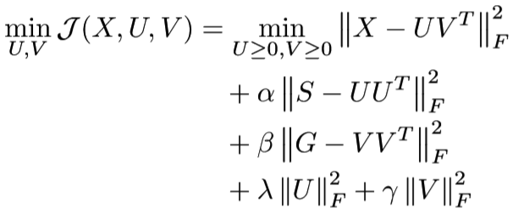
UNIFIED SHORT TEXT TOPIC MODEL
Based on the above discussion, we demonstrate how to construct word co-occurrence matrix, word embeddings semantic matrix regularization and document-document similarity clustering matrix regularization, respectively. Now, we solve the optimization problem by combining J₁, J₂ with J:
…………………(9)
where X ∈ R^{M×2N} and V ∈ R^{2N×K}; α ≥ 0 and β ≥ 0 are the parameters controlling word co-occurrence regularization and message clustering regularization on U_{i} and V_{j}, respectively.

Slide 36



MODEL OPTIMIZATION
Easily observed in Eq. (9), where if V is ﬁxed, J is a convex optimization problem with respect to U and if U is ﬁxed, J is a convex optimization problem with respect to V. However, when both and are not ﬁxed, J is not convex. Therefore, the global optimal solutions of the objective function are difﬁcult to formalize.
Nevertheless, local optimal solutions can be obtained by multiplicative update method. Solving the Word-Topic Matrix U. Hold document-topic matrix V = [v₁,··· ,v_{N}] ﬁxed, the updating rule of U equivalent to the following optimization problem:
………………(10)
And then we take the gradient of (10) with respect to U and setting it to zero:
…………….(11)
By multiplying (11) by U, (11) can be written as

Slide 37




Where each element in X, S is non-negative and α, λ are non-negative as well, moreover, the initial values U and V are both non-negative; consequently, UV^{T}V , XV , UU^{T}U and SU are non-negative. Thus (12) can be written as follows
…………….(13)
So the updating rules of U is deﬁned as follows:
…………………(14)
Solving the Document-Topic Matrix V. After learning matrix U, we then solve the document-topic matrix V . Similarly, the objective function based on matrix V is shown as follows:
….……(15)
And the gradient of (15) with respect to V and setting it to zero:
…………(16)

Slide 38

And the updating rules of V is deﬁned as follows:
……………(17)

