Slide 1

Privacy-Enhancing Machine Learning for Effective Language Detection in Job Interviews
Team 9:
Ambati A
Ayushi S
Shreyash S
Yuanyuan W

Slide 2

Motivation
Importance of effective communication for increasing the chance of success in job interviews
Traditional interview preparation methods lack scalability and actionable feedback
Developing machine learning models for detecting the degree of explanation by the candidates
Mitigate the influence of language features concerning the speaker’s identity to enhance privacy and fairness

Slide 3
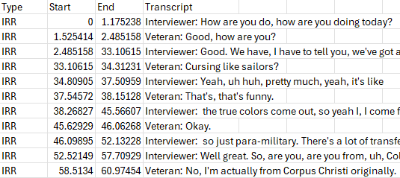
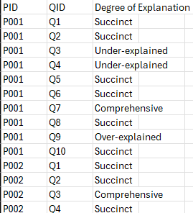
Dataset Used
Veteran Transcripts
Behavioral Annotations

Slide 4

Feature Extraction
TF-IDF: Term Frequency - Inverse Document Frequency
POS (Part-Of-Speech) Tags
Sentiment Scores
Advanced Features (BERT Embeddings)

Slide 5
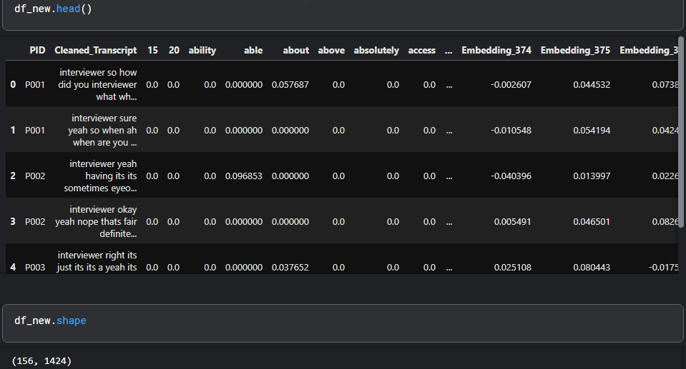
Feature Extraction

Slide 6

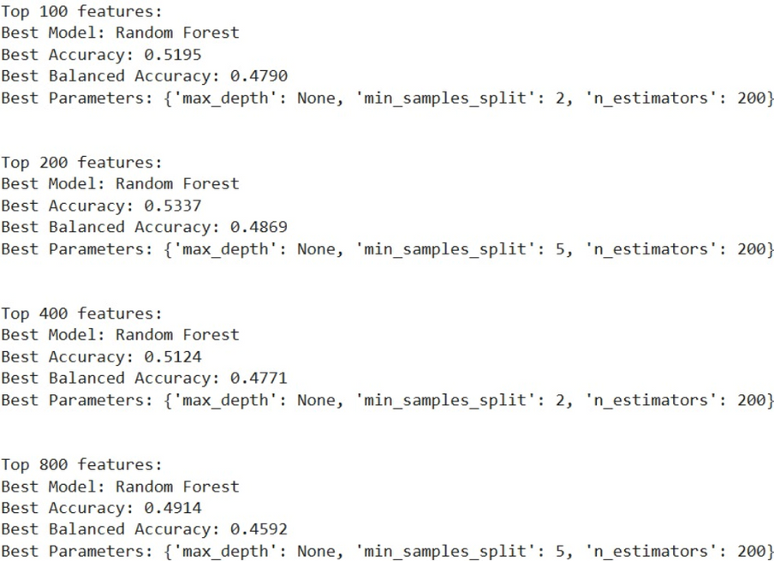
Classifying Speaker Identity
After labeling, total samples (Q&A pairs) obtained = 286
Top ‘k’ features taken into consideration for training each model
Evaluation of tree models
Hyperparameter tuning using parameter grid

Slide 7
Classifying Speaker Identity

Slide 8

Classifying Speaker Identity
Best ML Model: Random Forest
Number of top ‘k’ features: 100
Balanced Accuracy: 47.90%
Accuracy: 51.95%
Best DL Model: Conv1D
Number of top ‘k’ features: 100
Balanced Accuracy: 66.67%
Accuracy: 84.62%

Slide 9
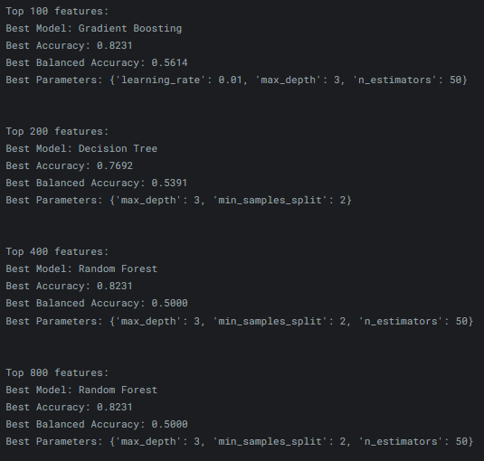
Classifying Degree of Explanation: Under-explained vs. Succinct
After labeling, total samples (Q&A pairs) obtained = 130
Top ‘k’ features taken into consideration for training each model
Evaluation of tree models
Hyperparameter tuning using parameter grid

Slide 10
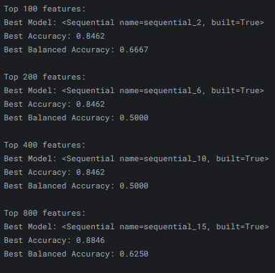
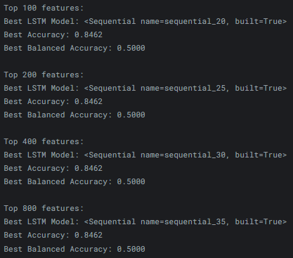
Classifying Degree of Explanation: Under-explained vs. Succinct
Conv1D Results
LSTM Results

Slide 11
Classifying Degree of Explanation: Under-explained vs. Succinct
Best ML Model: Gradient Boosting
Number of top ‘k’ features: 100
Balanced Accuracy: 56.14%
Accuracy: 82.31%
Maximum depth: 3
Best DL Model: Conv1D
Number of top ‘k’ features: 100
Balanced Accuracy: 66.67%
Accuracy: 84.62%

Slide 12
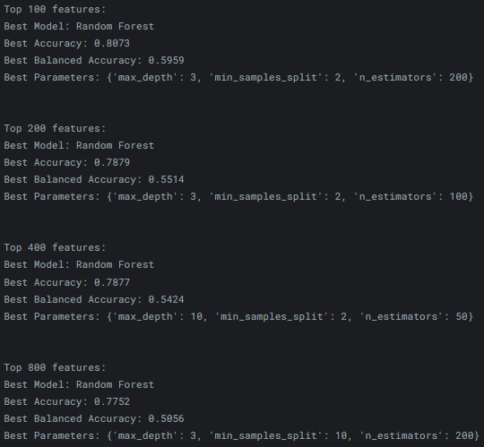
Classifying Degree of Explanation: Over-explained vs. Comprehensive
After labeling, total samples (Q&A pairs) obtained = 156
Top ‘k’ features taken into consideration for training each model
Evaluation of tree models
Hyperparameter tuning using parameter grid

Slide 13
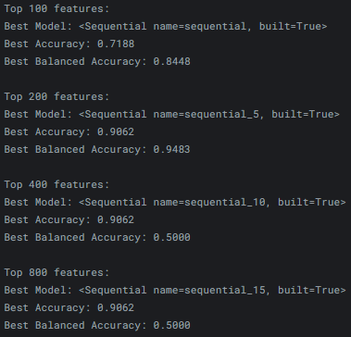
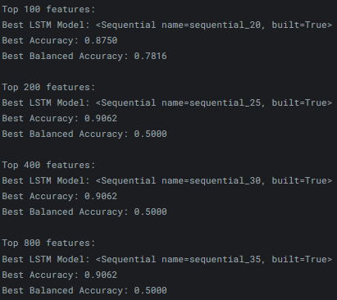
Classifying Degree of Explanation: Over-explained vs. Comprehensive
Conv1D Results
LSTM Results

Slide 14
Classifying Degree of Explanation: Over-explained vs. Comprehensive
Best ML Model: Random Forest
Number of top ‘k’ features: 100
Balanced Accuracy: 59.59%
Accuracy: 80.73%
Maximum depth: 3
Best DL Model: Conv1D
Number of top ‘k’ features: 200
Balanced Accuracy: 94.83%
Accuracy: 90.62%

Slide 15

Future Work
01
Reducing Speaker Identity Dependencies:
Future work will aim to remove speaker-specific biases by eliminating the most informative features of speaker identity and applying fairness-aware in-processing methods. This will ensure that classification relies on the content of responses rather than speaker characteristics, improving fairness and generalizability. Results will be analyzed to evaluate the impact of these methods on model performance and robustness.
02
Incorporating Transformer-Based Models:
Pre-trained transformer models like quantized Llama or minGPT will be explored for classifying the degree of explanation. Through task-specific prompt engineering and integrating labeled examples, these models will estimate explanations and provide textual reasoning for their decisions. Comparative analysis will assess their accuracy and interpretability against traditional ML and DL methods.

Slide 16

THANK YOU

