Slide 1
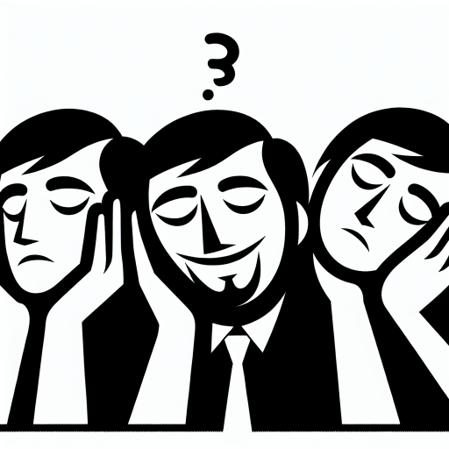
DISSERTATION VIVA
1 · Visualising Emotion · Sheffield
Visualising Emotion: A Similarity-Based Analysis of Emotional Fidelity in Text-to-Image Generation
Measuring agreement between a written feeling and an AI-generated drawing
“tired but happy”
Shre Hari Prem Anandh
Drawing no. 201 · one of 1,025 from the festival
MSc Artificial Intelligence · School of Computer Science
University of Sheffield · Supervisor: Dr Chaona Chen
4 September 2026
Notes:
Good afternoon. This is a similarity-based analysis of emotional fidelity in text-to-image generation — 1,025 real self-reports collected at a festival, and what an automatic reader recovers from the drawings made from them.

Slide 2
THE PROBLEM
2 · Visualising Emotion · Sheffield
Object prompts can be checked. Feelings cannot.
“a red car”
“tired but happy”
The prompt names objects, so existing metrics can score it.
No object to find, no answer key, and the feeling is mixed.
RESEARCH QUESTION
To what extent does an automatic image-emotion reader agree with prompt-derived emotion labels for AI-generated monochrome drawings, and how does that agreement vary by visual content and by repeated prompts?
i ·
does agreement exceed a random-pairing baseline?
iii ·
how stable is the image reading when the same prompt is drawn again?
ii ·
does it differ for face-classified and scene-classified drawings?
iv ·
does describe-then-extract agree more than reading emotion from the image directly?
The question is deliberately narrower than “does the drawing convey the feeling”.
Notes:
An object prompt has an answer key: the picture either contains a red car or it does not. A feeling has none — no object to find, and the feeling itself is mixed. So the research question is deliberately narrow: agreement between two automatic readers, not whether a drawing conveys a feeling to a person.

Slide 3
LITERATURE
3 · Visualising Emotion · Sheffield
Four established areas, and the space between them
GENERATE
EVALUATE
Text-to-image generation
CLIPScore · VQAScore — does the picture contain what the prompt named?
Objects
Well established
Well established for objects
Emotional image generation — colour is reported as the principal carrier of affect
Evaluate emotion recovered from a generated line drawing
Emotion
Well established
Empty — this project
Reading emotion from an image is weak: vision-language models are positively biased and order-sensitive readers of affect.
97 papers screened · 23 excluded · 74 retained across twelve themes. Colour is cited as motivation only — this study has no colour-control condition.
Notes:
Three of the four quadrants are well established. Generation of objects, generation of emotional imagery, and object-level evaluation. The empty cell is evaluating the emotion recovered from a generated line drawing — that is where this project sits.

Slide 4
CONTRIBUTION
4 · Visualising Emotion · Sheffield
Similarity, not matching
CONVENTIONAL · ONE-TO-ONE
THIS PROJECT · A FOUR-LEVEL SIMILARITY LADDER
Same emotion family
“happy” / “excited” — scored high
“happy” / “excited”
✕
Adjacent family
Scored as a miss
Same valence sign
Valence–arousal distance
chance — every rung against its own 300-shuffle null
This is the novel element: the field reports one-to-one accuracy; this study reports graded, chance-referenced similarity.
Notes:
The conventional score treats happy against excited as a miss. This project replaces the binary with a four-level ladder, and every rung is read against its own 300-shuffle null. That graded, chance-referenced measure is the contribution.

Slide 5
METHODOLOGY
5 · Visualising Emotion · Sheffield
Describe the image, then read the feeling from the description
Drawing
→
BLIP-VQA
→
BART-MNLI
→
Image reading
1,025 monochrome line drawings
five factual questions → one neutral sentence
zero-shot over seven emotion families
top-3 emotions
Prompt
→
GoEmotions
Prompt reading
the visitor's own words
28 labels collapsed to the same seven families
→
top-3 emotions
Compare
valence–arousal distance · valence-sign agreement · emotion-family agreement · top-3 overlap — every level against a 300-shuffle null
The image model is asked only factual questions. Caveat stated in the write-up: “what is the facial expression?” often returns a feeling word, so the separation is weaker than it appears.
Notes:
The drawing is never asked how it feels. BLIP-VQA answers five factual questions, those answers become one neutral sentence, and BART-MNLI reads emotion from the sentence. The prompt is read separately through GoEmotions. Only then are the two readings compared.

Slide 6
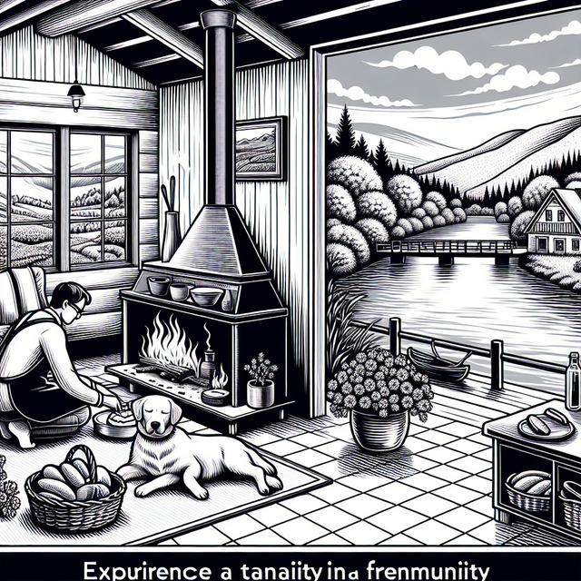

DATA
6 · Visualising Emotion · Sheffield
1,025 real self-reports, and what it took to use them
1,025 drawings
13 pre-festival tests
1,012 analysed
Cut A · does the prompt carry a feeling?
607 emotional
405 non-emotional
Cut B · what did the reader find in the drawing?
591 face-classified
421 scene-classified
87 repeated prompts, covering 336 records
Data engineering — three incompatible filename schemes in one folder; a naive loader resolves under 20%.
Data pre-processing — eight records contained names of private individuals; replaced with a placeholder. Verified inert.
No. 38, face-classified · no. 774, scene-classified
Notes:
1,025 drawings, 1,012 analysed after the pre-festival tests are removed. Two cuts matter: whether the prompt carries a feeling at all, and what the reader found in the drawing — a face or a scene. Getting there took real data engineering.

Slide 7

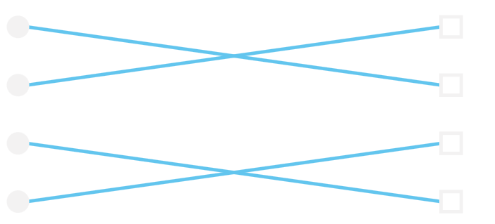
EVALUATION DESIGN
7 · Visualising Emotion · Sheffield
Two checks that decide whether any number means anything
passes a naive threshold, fails against chance
admissible — above chance
41
71
76
84
100
metric floor
random pairings
observed
1 · A random-pairing null
2 · A specificity check
true pairing
shuffled
405 prompts carry no feeling — “pigs”, “mickey mouse”. On these the valence-arousal metric returns 76.6% against a null of 76.6%, z = +0.3.
× 300, fixed seed.
Consequence: a valence-arousal score of 71 reads as a pass but is below chance. Reporting therefore leads with valence-sign and family agreement, which the metric cannot substitute for.
Notes:
Two checks decide whether any number here means anything. First, a random-pairing null run three hundred times. Second, a specificity check on the prompts that carry no feeling. A valence–arousal score of 71 passes a naive threshold and still sits below chance.

Slide 8
RESULTS
8 · Visualising Emotion · Sheffield
Agreement is above chance, and strongest for face-classified drawings
SUBSET
VALENCE-SIGN AGREEMENT
EMOTION-FAMILY AGREEMENT
Emotional prompts
(n=607)
64.0% vs null 45.6%
z +11.1
53.1% vs null 38.8%
z +10.3
Face-classified
(n=402)
73.9% vs null 53.5%
z +10.4
61.9% vs null 45.8%
z +10.3
Scene-classified
(n=205)
42.9% vs null 29.6%
z +5.8
35.6% vs null 26.2%
z +4.4
Non-emotional
(n=405)
Valence–arousal 76.6% vs null 76.6%
z +0.3
— sign and family degenerate
Hollow marker: the null. Filled: the observed figure. The rule between them is the effect; lanes run 0–100%.
Repeated prompts — 68.8% within a group vs a null of 59.1% (z +4.9).
Method comparison — describe-then-extract 49.3% family agreement vs direct-CLIP 25.3%.
Robustness — on 763 distinct prompts overall and face hold (z +9 to +11); scene weakens to 37.3%.
No formal significance test of the face–scene difference has been run; both rates are reported against their own nulls instead.
Notes:
Agreement is well above chance on every metric, and substantially stronger for face-classified drawings. On the non-emotional prompts the metric degenerates — the observed figure equals its own null.

Slide 9
DEMONSTRATION
9 · Visualising Emotion · Sheffield
The pipeline, running live
1
Choose a drawing
from the festival dataset, or upload an image
2
Watch it described
the five factual answers, then the emotion read from them
3
Compare
both readings, and the score against the chance line
Every figure the interface shows is referenced to the measured chance line, and nothing a visitor types is stored.
Notes:
Now the interface. Choose a drawing, watch it described, then compare both readings against the chance line. If the demo stalls, the next slide carries the same output for record 201.

Slide 10
CONCLUSION
10 · Visualising Emotion · Sheffield
What this establishes, and what it does not
ESTABLISHED
NOT ESTABLISHED
Agreement well above chance on every metric.
Substantially higher for face-classified drawings.
The same prompt does not reliably yield the same recovered emotion (69% vs 59% null).
Describe-then-extract agrees more than reading the image directly.
What a human viewer perceives.
That the face–scene gap is statistically significant.
Any effect of colour.
Any positive-versus-negative direction; that claim was withdrawn.
The contribution is a chance-referenced similarity measure for emotional agreement — not a new classifier.
Thank you — questions welcome
Future work: human validation of both readers · sketch-trained describers · a formal test and confidence intervals for the face–scene difference
Notes:
What is established: agreement above chance on every metric, higher for faces, unstable across repeats of the same prompt, and describe-then-extract beating a direct read. What is not: human perception, the significance of the face–scene gap, any effect of colour, and any valence-direction claim.

Slide 11
BACKUP · IF THE DEMONSTRATION STALLS
11 · Visualising Emotion · Sheffield
The same pipeline, on record no. 201
→
Five answers
→
One sentence
→
Image reading
smile · smiling · standing · 3 · three faces
“A drawing of 3 showing three faces. The person is smiling, standing. The facial expression is smile.”
joy 42% · surprise 29% · neutral 25%
Drawing no. 201
“tired but happy”
Prompt reading
→
joy 97% · surprise 2% · neutral 0%
Valence-sign agreement
Emotion-family agreement
84
chance 45.6%
chance 38.8%
41
null 76
100
Per-record output for no. 201; the chance rates and the valence–arousal figure are the emotional-prompt subset's published nulls.
Notes:
Backup, in case the demonstration stalls. Record 201: five factual answers, one neutral sentence, joy 42% from the image against joy 97% from the prompt — 84 on the scale, against a null of 76.

