Slide 1
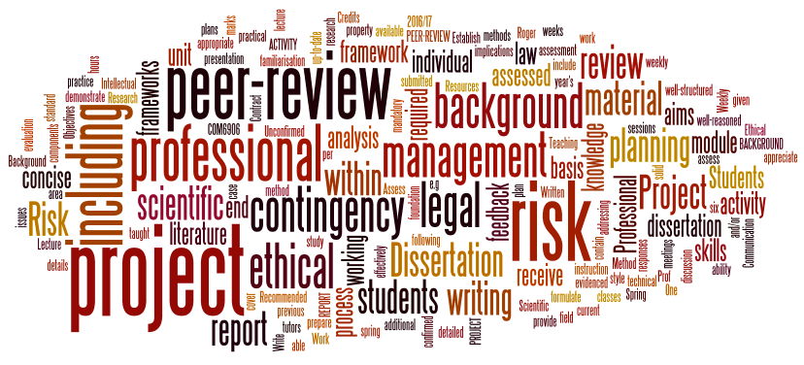
Dissertation Project
Lecture 2: Literature Review
Mark Stevenson
(mark.stevenson@sheffield.ac.uk)

Slide 2
Outline
Writing a Literature Review
Avoiding academic misconduct

Slide 3
Role of Literature Review / Background
Why include a literature review / background chapter?
Demonstrates understanding of your topic
Helps the reader place what you are doing within a wider context
Clarify which parts of your project are original and which are already known

Slide 4
What to Include
A good literature review/background should cover the background necessary for a reader to understand your project
  You can assume that the reader has a general background in Computer Science so you don’t need to explain every concept
  A good level to aim for would be someone else on your course
  An important reader (from your point of view) is the second marker. They will be a member of staff but probably with different research interests to your supervisor
Only include background information
  Do not include requirements, choice of approaches etc. There are better places for these.

Slide 5
Finding Background Information
Start with suggestions from your supervisor, but don’t just rely on them to provide everything
The web makes it easy to find potentially useful background information
  This is both a blessing and a curse
  Be realistic about how much you can read
Aim to focus on material that is both high-quality and relevant to your project
Keep a note of everything you read, even if you don’t think it will be useful.

Slide 6
Common Academic Publication Types
Conference Paper
  Normally short (< 10 pages)
  Often first publication of results (publication often driven by conference deadline)
  Often highly condensed
Journal Paper
  Normally longer (may be > 20 pages)
  Often summarise results / findings of one or more previous papers
  More detailed but still condensed
Book
  Often background material aimed towards students and researchers
Book Chapter
  Often teaching material for practising scientists
  Not a common format in many areas of Computer Science

Slide 7
How do you know if something is worth reading?
Difficult to give a clear guide over whether a paper will be worth the time you will need to invest to read it
Supervisor may be able to give advice
Some (quite noisy) indicators of quality:
  Venue (good conference/journal? peer-reviewed?)
  Authors
  Citation count
But these won’t tell you whether the paper is relevant to your project

Slide 8
Reading a Paper: The Three Pass Approach
Keshav, Srinivasan. "How to read a paper." ACM SIGCOMM Computer Communication Review 37.3 (2007): 83-84.
● Read a paper in (up to) three passes
● Each pass takes progressively longer, allowing you to go into the paper in more depth
● Choose the appropriate level depending on how important the paper is to you

Slide 9
Pass 1
Should take about 5-10 minutes
● Approach:
○ Read the title, abstract and introduction
○ Read the headings and sub-headings (ignore everything else)
○ Read the conclusion
● By the end of this pass you should have a good idea about the type of paper, its contributions and where it fits in the literature
If you think it’s worth understanding the paper in more detail then continue to Pass 2, otherwise stop.

Slide 10
Pass 2
Should take about 1 hour
● Read the whole paper (possibly ignoring detailed parts such as derivations or proofs)
● By the end of this you should be able to grasp the content of and summarize the paper.
● Sometimes you still might not understand it, e.g. if it uses approaches that you are not familiar with, or is just badly written.

Slide 11
Pass 3
Can take up to 4 or 5 hours
Read the paper very carefully
Identify and challenge every assumption
Think about whether the experimental results support the claims
Virtually re-implement the paper: Think about how you might carry out the same research if you were to do it
Unlikely to need to read many papers to this level of detail

Slide 12
Organising Your Literature Review
Should be focussed around your project’s topic
Aim to synthesize and summarise what you have read
  Synthesis: combine elements of different sources
  Summarise: identify and report the important points
Avoid writing a list of what you have read
End by identify the open areas
  Ideally these will form a natural link to what you do during your project

Slide 13
Structuring Your Literature Review
Two main options:
Chronological
  Present background material in order it appeared (e.g. publication date)
Thematic
  Organise review around the main themes / approaches
Thematic approach is normally best, since easier to synthesize and summarise, but might also include some chronological elements

Slide 14
Citing Previous Work
Citations have multiple functions
  Demonstrate how your work is relates to previous contributions
  Provide evidence for a claim
  Strengthen your argument
  Acknowledge previous contributions
Always provide enough information for someone else to be able to find the source you’re citing (if they want to)
Avoid citing web pages
  Ask yourself whether this is the best citation you can find
  Footnote normally more appropriate

Slide 15
Citation Styles
Many different styles, e.g.
  Harvard: Smith (2025) / (Smith, 2025)
    “The algorithm was introduced by Smith (2025).”
    “Previous approaches included greedy algorithms (Smith, 2025; Jones, 2023).”
  IEEE: [1] (references organised in order of appearance in bibliography)
    “Previous approaches included greedy algorithms [1,2].”
  Vancouver: [1] (references organised alphabetically)
    “Previous approaches included greedy algorithms [2,1].”
  If using IEEE/Vancouver then don’t use citations as proper nouns, e.g “[1] introduced the algorithm.”
Particular style is less important than using one style consistently
  Easiest way to do this is to use tool designed for academic writing (e.g. LaTeX)

Slide 16
Quotations
Probably only need a few direct quotations (if any)
Avoid directly quoting long chunks of text (e.g. more than one or two sentences), a summary is more appropriate
A quotation may be appropriate for a short phrase where this is a technical term or an unusual phrase and you want to acknowledge the source (e.g. “distributional hypothesis” (Harris, 1954)) but not required for a common phrase (e.g. algorithm, neural network)

Slide 17
Plagiarism
Plagiarism is the unacknowledged use of someone else’s work
Examples of plagiarism:
  Cutting/pasting text without using quotation marks
  Closely paraphrasing or summarising
  Claiming ideas or arguments as your own
  Taking drawings, graphs, or graphical material
The source (article, student submission, website, etc.) is not relevant

Slide 18
Unintentional Plagiarism
It is surprisingly easy to plagiarise others’ work when writing a literature review
Best way to avoid this is to separate reading background material and writing your literature review:
  Read the material that you might include in your literature review and take notes
  Use the notes to organise your literature review
  Write the review based on your notes
  Don’t look at the original material again until after you’ve written the review
Try to avoid reading the background material at the same time as writing parts of your literature review

Slide 19
Summary
Writing a good literature review is difficult
Aim to synthesise and summarise the most important previous work
Next time
Ethical approval

