Slide 1

Dissertation Project
Lecture 4: Preparing Your Dissertation
Mark Stevenson
(mark.stevenson@sheffield.ac.uk)

Slide 2
Outline
Today we’ll look at the LaTeX document preparation system which you may find useful for the final dissertation.
Topics covered:
LaTeX
  Getting started with the School’s LaTeX template
  Some key commands
  Bibtex

Slide 3
LaTeX
Document preparation system designed specifically for academic documents, such as dissertations, particularly within technical fields such as Computer Science
Based on TeX, a typesetting program developed by Donald Knuth from Stanford University while writing “The Art of Computer Programming”
Leslie Lamport extended TeX to develop LaTeX which provides macros for common formatting requirements.
LaTeX is a markup language (like HTML) and not “what you see is what you get” (WYSIWYG) (like Word or Google Docs).

Slide 4
LaTeX: Advantages and Disadvantages
Advantages
  Well suited to writing academic documents like dissertations
  Good support for equations, structuring documents, cross-referencing …
  BibTeX makes citations much easier to use and format correctly – it does the formatting for you
Disadvantages
  Need to invest some time to learn to use it effectively
(note) There is no formal support for LaTeX users available within the department but your supervisor may be able to provide some advice.

Slide 5
Running LaTeX
Overleaf (www.overleaf.com) is a widely used online LaTeX editor
  Deals with compiling source into PDF output
  Good editor
  Allows online collaboration (e.g. share documents with your supervisor)
  Note: everything held remotely - good idea to make occasional local backups
You can also install LaTeX on your own machine, but normally more difficult to use

Slide 6
School Dissertation Template
It can be hard to get started with LaTeX, and difficult to get it to produce documents in exactly the format you would like
The School provides a LaTeX template for dissertations that can be used with minimal customisation
Available as COMDissertationTemplate_1.0.zip on Blackboard

Slide 7
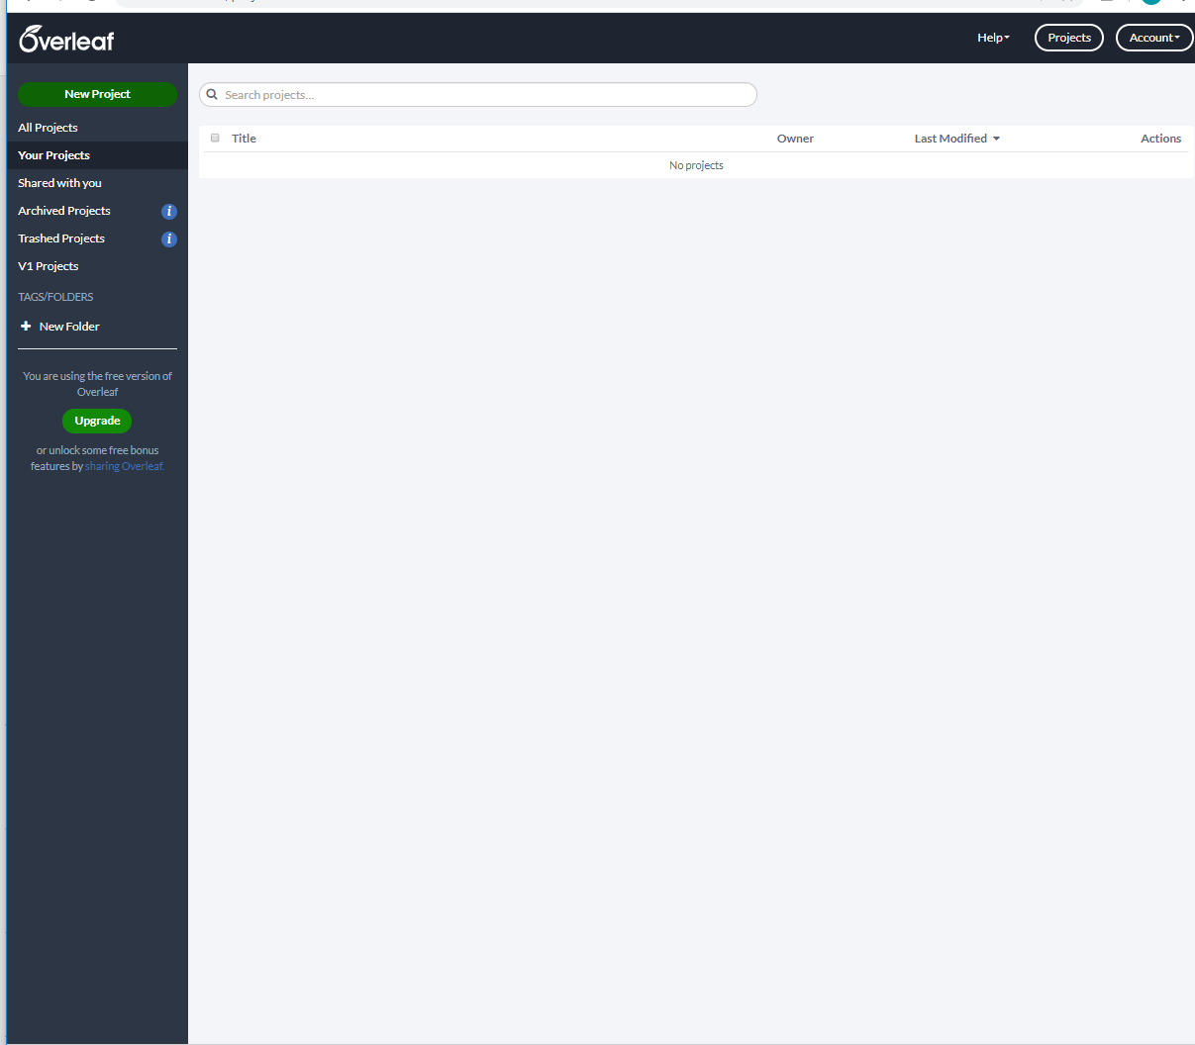
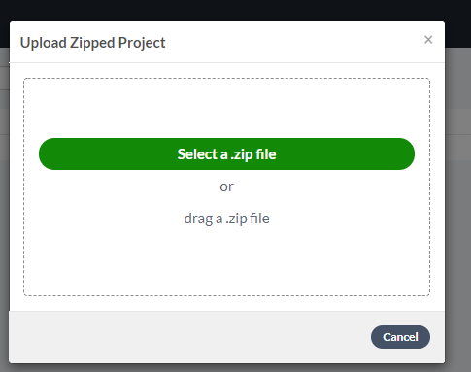
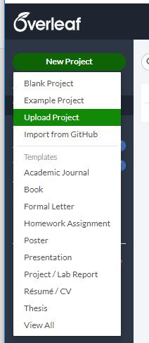
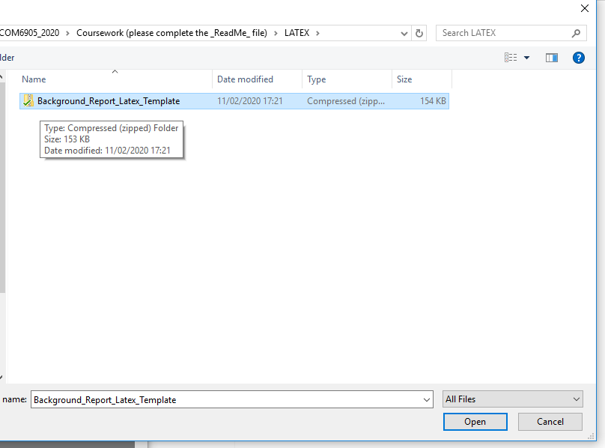
Using Template in Overleaf
Upload Zipped Project
Press
‘New Project’
Choose
‘Upload Project’

Slide 8
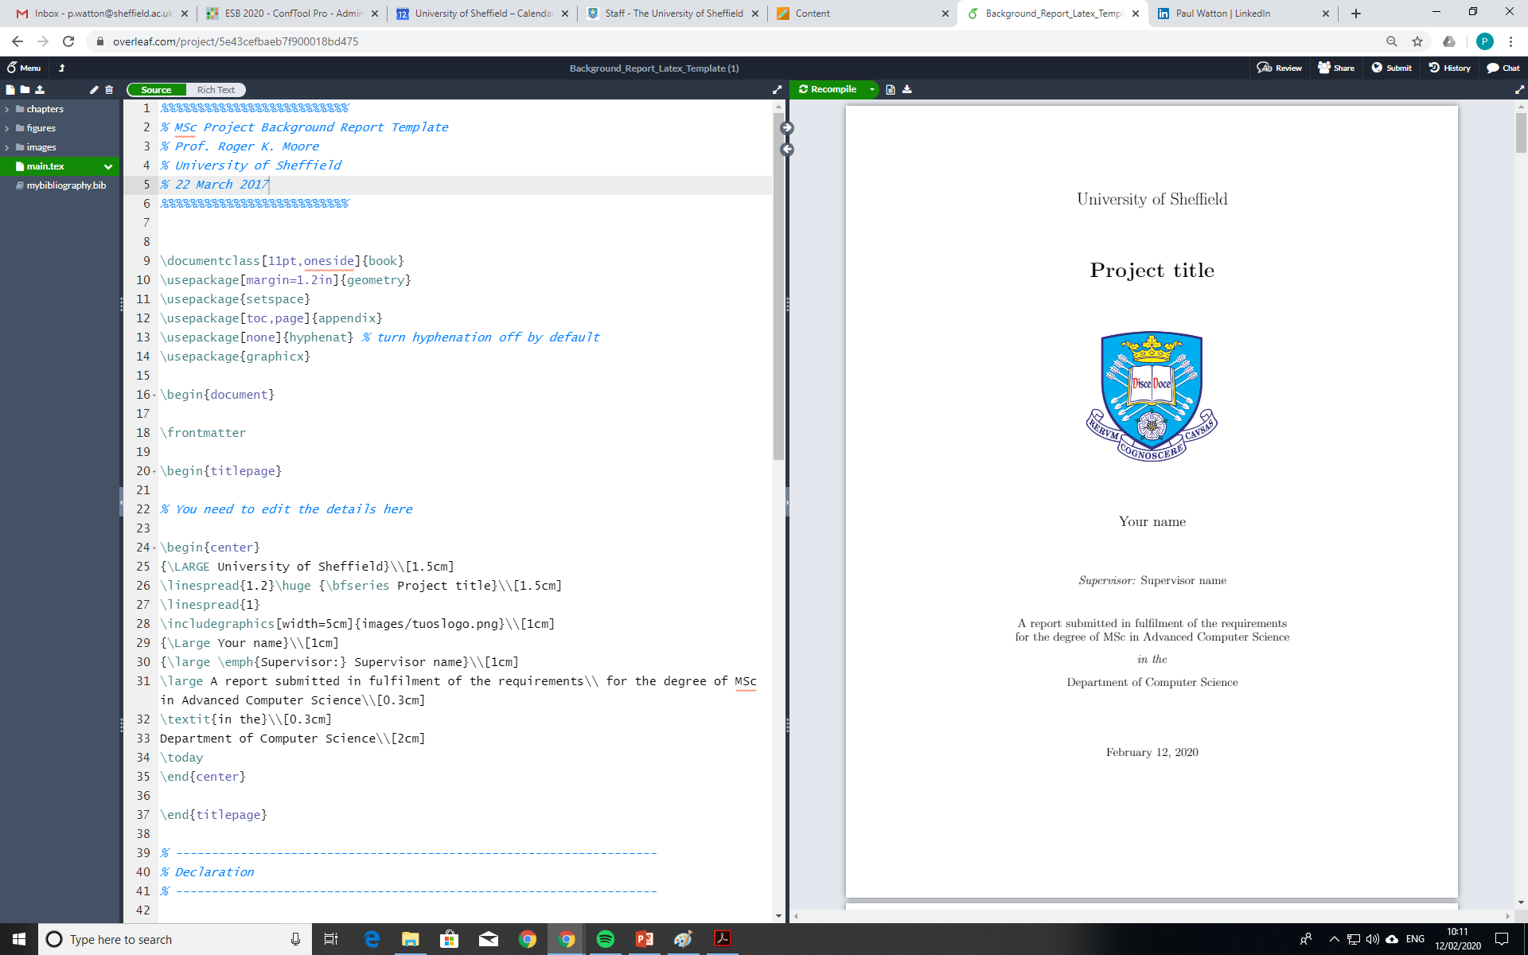
Ready to Go …

Slide 9

Title Page
\\begin{titlepage}
\begin{center}
\includegraphics[width=5cm]{images/UOSLogo_Portrait_Violet_RGB.png}\\[2cm]
\linespread{1.2}\huge {\bfseries Project title}\\[2cm]
\linespread{1}
{\Large Your name}\\[1cm]
{\large \emph{Supervisor:} Supervisor name}\\[1cm]
\large \emph{A report submitted in fulfilment of the requirements}\\ \emph{for the degree of} your degree (e.g. BSc in Computer Science)\\[0.3cm]
\textit{in the}\\[0.3cm]
School of Computer Science\\[2cm]
\today
\end{center}
\end{titlepage}

Slide 10

Title Page
\\begin{titlepage}
\begin{center}
\includegraphics[width=5cm]{images/UOSLogo_Portrait_Violet_RGB.png}\\[2cm]
\linespread{1.2}\huge {\bfseries Large Language Models for Document Processing}\\[2cm]
\linespread{1}
{\Large Your name}\\[1cm]
{\large \emph{Supervisor:} Supervisor name}\\[1cm]
\large \emph{A report submitted in fulfilment of the requirements}\\ \emph{for the degree of BSc in Computer Science}\\[0.3cm]
\textit{in the}\\[0.3cm]
School of Computer Science\\[2cm]
\today
\end{center}
\end{titlepage}

Slide 11

Comments & Text Formatting
% This is a comment - it won't appear in the document
% Text from "Nineteen Eighty-Four" by George Orwell
% Sentence containing italic and bold text
It was a \textit{bright cold day in April}, and the \textbf{clocks were striking thirteen}.
% Sentence containing underlined text
\underline{Winston Smith}, his chin nuzzled into his breast in an effort to escape the vile wind, slipped quickly through the glass doors of \underline{Victory Mansions}, though not quickly enough to prevent a swirl of gritty dust from entering along with him.

Slide 12

\emph
% \emph in normal text
On each landing, opposite the lift-shaft, the poster with the enormous face gazed from the wall. It was one of those pictures which are so contrived that the eyes follow you about when you move. \emph{BIG BROTHER IS WATCHING YOU}, the caption beneath it ran.
% \emph in italic text
\textit{On each landing, opposite the lift-shaft, the poster with the enormous face gazed from the wall. It was one of those pictures which are so contrived that the eyes follow you about when you move. \emph{BIG BROTHER IS WATCHING YOU}, the caption beneath it ran.}

Slide 13

Footnotes
Simple footnote example
This is a sentence in the main text.\footnote{This is a footnote that provides some more detail about that sentence.}
Example footnote containing URL
The program was implemented using Pytorch.\footnote{\url{https://pytorch.org/}}

Slide 14

Equations
Mathematical equations can be written either inline (using $...$) or on their own line (using \begin{equation} … \end{equation})
Bayes Theorem can be written \textit{inline} as $P(A | B ) = \frac{P(B | A) P(A)}{P(B)}$ but looks a lot nicer in \textit{display mode}:
\begin{equation}
P(A | B ) = \frac{P(B | A) P(A)}{P(B)}
\end{equation}

Slide 15
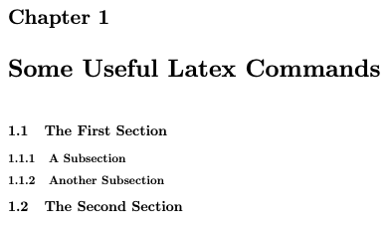
Basic document structure
\chapter{Some Useful Latex Commands}
\section{The First Section}
\subsection{A Subsection}
\subsection{Another Subsection}
\section{The Second Section}
Latex automatically handles numbering
\chapter*{.’.}, \section*{...} and \subsection*{...} add an element without incrementing the relevant counter

Slide 16
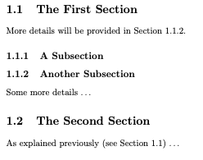
Cross referencing: \label and \ref
\section{The First Section}\label{sec:section_ref}
More details will be provided in Section~\ref{sec:key_part}.
\subsection{A Subsection}
\subsection{Another Subsection}\label{sec:key_part}
Some more details \ldots
\section{The Second Section}
As explained previously (see Section~\ref{sec:section_ref}) \ldots

Slide 17
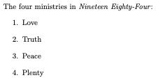
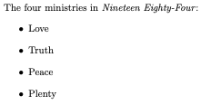
Lists (numbered and unnumbered)
The four ministries in \textit{Nineteen Eighty-Four}:
\begin{enumerate}
\item Love
\item Truth
\item Peace
\item Plenty
\end{enumerate}
The four ministries in \textit{Nineteen Eighty-Four}:
\begin{itemize}
\item Love
\item Truth
\item Peace
\item Plenty
\end{itemize}

Slide 18
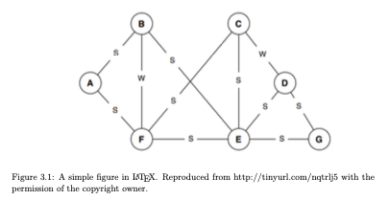
Figures
Example figure (requires graphicx package, included using “\usepackage{graphicx}” at start of main document)
\begin{figure}[ht]
\includegraphics[width=15cm]{figures/figure1.png}
\caption{A simple figure in \LaTeX. Reproduced from http://tinyurl.com/nqtrlj5 with the permission of the copyright owner.}
\label{fig:graph}
\end{figure}

Slide 19
Note on Including Images in Your Dissertation
If you include images in your dissertation, you must cite their source
  This is so unless you have produced them yourself or you find copyright free images
  This is should be done under the image itself
You must only use images (and figures)
  that you have created yourself, or
  that come from a copyright free source of images, or
  that you have permission to use
If you wish to use an image from a copyrighted source (eg. a journal publication), you must request permission from the copyright owner
See the following link:
https://sites.google.com/sheffield.ac.uk/com-programme-information/programme-information/ug-dissertation-project/including-images-in-your-dissertation

Slide 20

Tables
Example of a simple table
Note “tabular” environment (formatting text) and “table” environment (positioning)
\begin{table}[ht]
\center
\begin{tabular}{cc|c}
A & B & A XOR B\\
\hline
0 & 0 & 0\\
0 & 1 & 1\\
1 & 0 & 1\\
1 & 1 & 0\\
\end{tabular}
\caption{A simple table in \LaTeX.}
\label{tab:xor}
\end{table}

Slide 21
Positioning Floats
Figures and tables are known as floats
Floats appear where LaTeX thinks they would look best, not where you have defined them
You have some control over where floats appear
  h - place here (approximately)
  t - top of a page
  b - bottom of a page
  p - place on special page only including floats
  ! - override internal float placement rules
Examples
  \begin{table}[tb] - place this table at the top of a page, or the bottom if that’s not possible
  \begin{figure}[!htb] - place figure here, or top of page, or bottom of page; even if LaTeX wouldn’t normally do so
The additional option “H” is available to place float exactly where is appears in the code (requires \usepackage{float} at start of main document)

Slide 22
Bibtex
One of the most useful features of LaTeX is its ability to handle citations and references
Provide a list of references in a bibliography database (.bib), each of which has a key (e.g. “machinery1950computing”)
Cite the reference in the text using the \cite{...} command
The Turing Test was first proposed in 1950 \cite{machinery1950computing}.
Main body
Bibliography

Slide 23
Bibliography entries (.bib file)
@article{machinery1950computing,
title={Computing machinery and intelligence},
author={Turing, A.},
journal={Mind},
volume={59},
number={236},
pages={433},
year={1950}
}
There are many types of bibliography entry for different forms of publication
Main ones you’re likely to encounter are:
  @article - journal publications
  @inproceedings - conference paper
Almost all require at least author, title and year fields to be populated

Slide 24
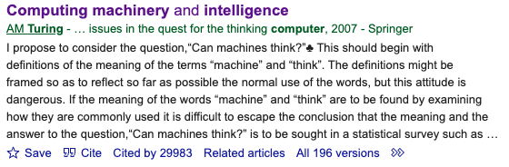
Adding Bibtex entries
You can add entries yourself, but time consuming and easy to make errors
Google Scholar can be a good source (but entries may need to be post-edited)
@article{machinery1950computing,
title={Computing machinery and intelligence-AM Turing},
author={Machinery, Computing},
journal={Mind},
volume={59},
number={236},
pages={433},
year={1950}
}
Click here

Slide 25
Adding Bibtex entries
You can add entries yourself, but time consuming and easy to make errors
Google Scholar can be a good source (but entries may need to be post-edited)
@article{machinery1950computing,
title={Computing machinery and intelligence-AM Turing},
author={Machinery, Computing},
journal={Mind},
volume={59},
number={236},
pages={433},
year={1950}
}
Click here

Slide 26


Generating the Bibliography
Two key commands:
\bibliography{mybibliography}
  Prints references, argument is bibliography file (i.e. mybibliography.bib)
\bibliographystyle{...}
  Determines the referencing style to control both how citations appear in the text and bibliography entities
  \bibliographystyle{acm} \bibliographystyle{alpha}

Slide 27
Conclusion
LaTeX well suited to producing academic documents
Using the School’s dissertation template easiest way to get started
Give yourself enough time to learn have to use LaTeX effectively
LaTeX offers a lot more than can be covered here
  See links on Blackboard and search online

