Slide 1

Modeling the Histopathology of Breast Cancer

Slide 2
Motivation and Question
Cancer is a unique disease in that it is caused solely by our own cells.
*5-year survival for Invasive Ductal Carcinoma (IDC) located:
  Only in the breast: 99%
  Distant part of the body: 27%
Can I build a convolutional neural net that can identify invasive breast cancer from images of tissue?
*Source: https://www.cancer.net/cancer-types/breast-cancer/statistics

Slide 3
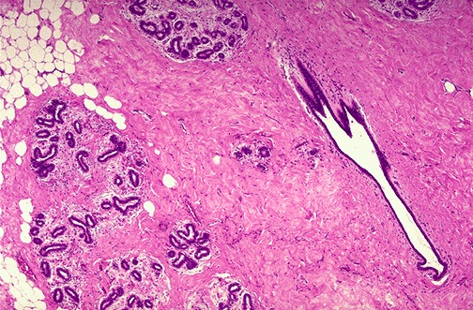
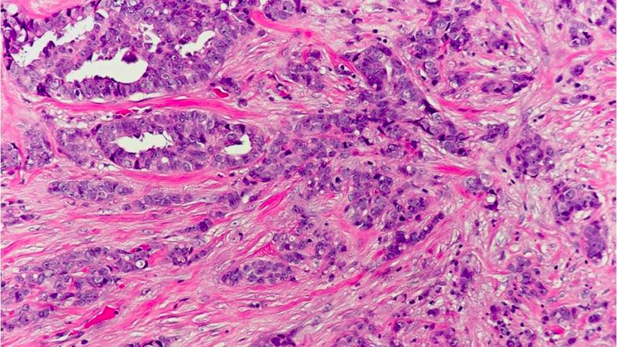
Breast Histology
Healthy Breast Histology*
IDC Breast Histology†
*https://emedicine.medscape.com/article/1954658-overview
†https://pathology.jhu.edu/breast/types-of-breast-cancer/

Slide 4
Data
277,524 breast histopathologic images
  198,738 IDC negative
  78,786 IDC positive
Training set (n = 222,020)
Validation Set (n = 55,504)
  39,672 IDC negative
  15,832 IDC positive

Slide 5
Model
Convolutional Neural Net (CNN)
  3 convolution layers with 32 nodes and 3x3 filter
    Rectified Linear Unit (ReLU) activation function
  Each followed by a 2x2 max pooling layer
  Fully connected layer
    ReLU activation function
  Fully connected layer
    Softmax activation function

Slide 6
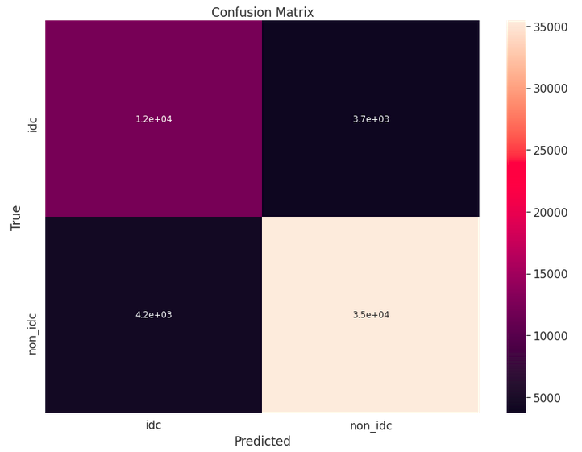
Results
Metrics and Confusion Matrix
  Accuracy: 85.7%
  Precision: 90.6%
  Recall: 91.9%
12,133
3,699
4,228
35,444

Slide 7
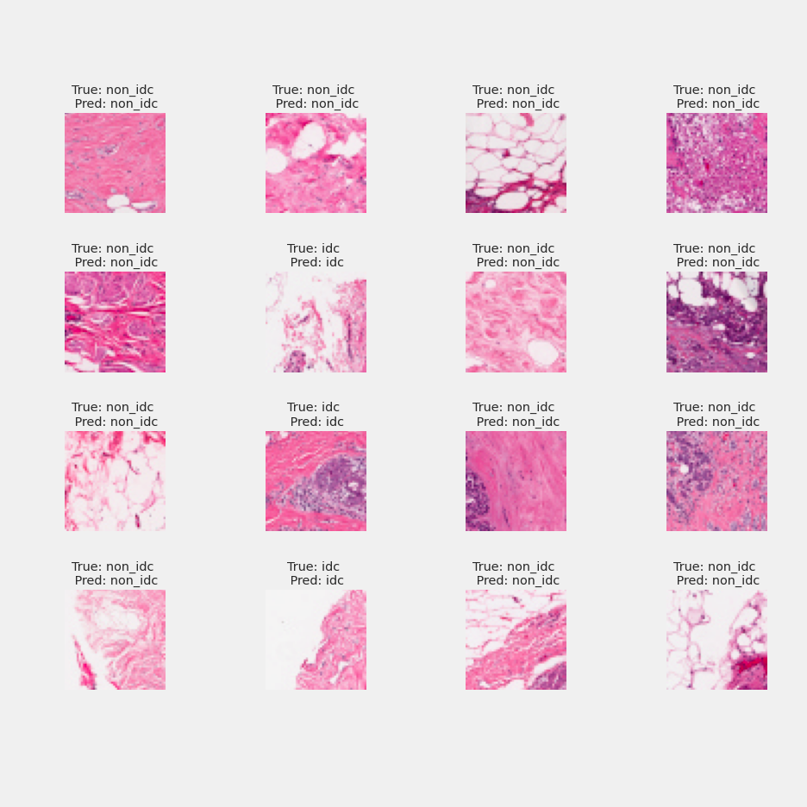
Results

Slide 8
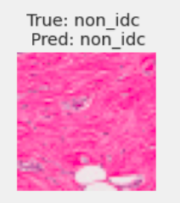
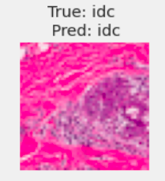
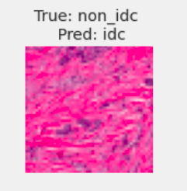
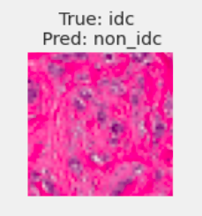
Results
Non-IDC images
IDC images
Correct Predictions
Incorrect Predictions

Slide 9
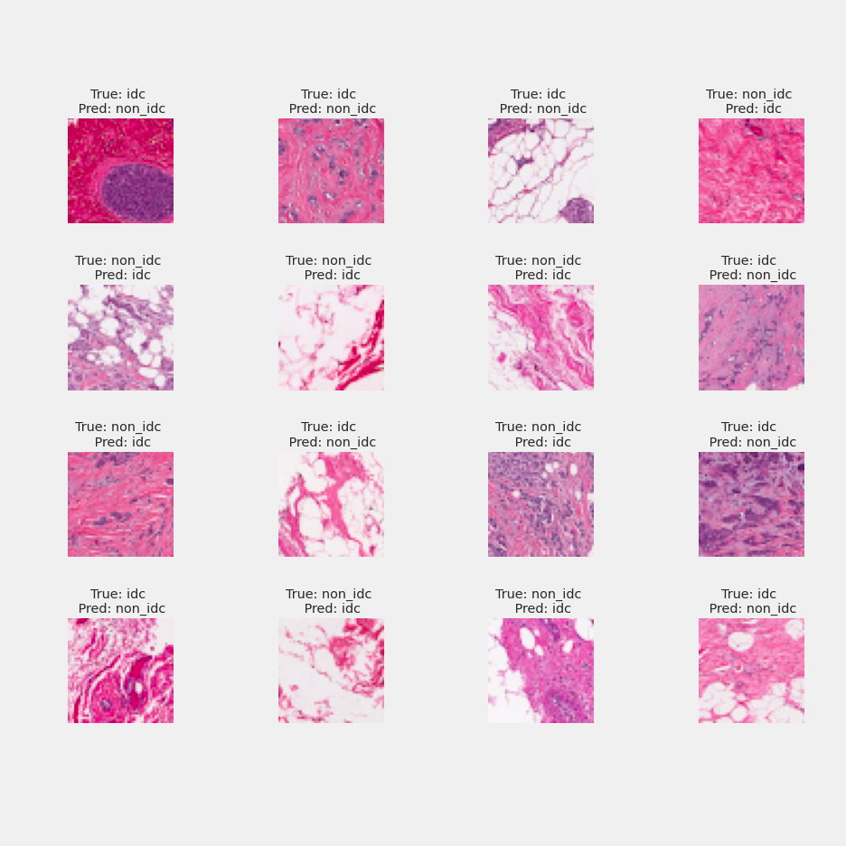
Results

Slide 10
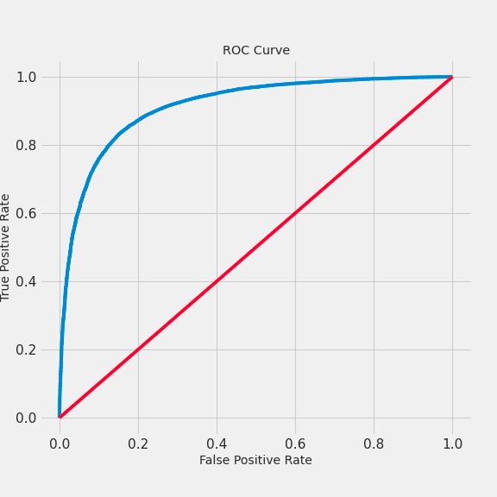
Results

Slide 11
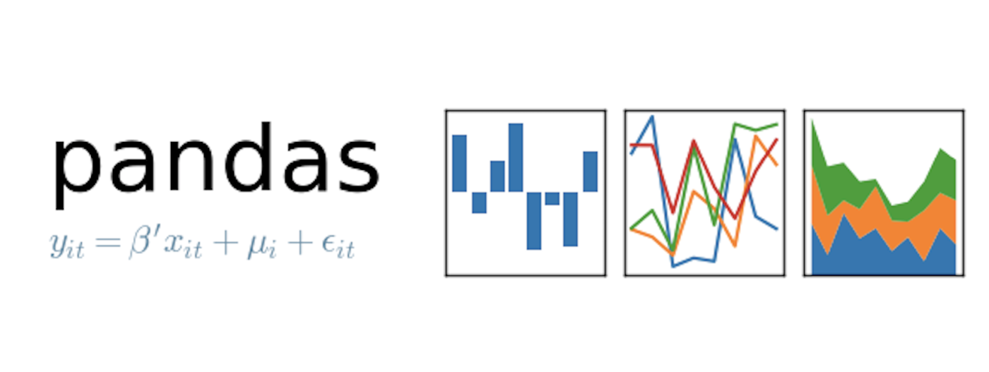






Tech Stack

Slide 12
Future Research
More complete use of big data resources like AWS
More data augmentation to vary the photos the model gets to see
More in depth analysis of where the model fails

Slide 13

Thank You
Alex Binder
  Email
    atbinder42@gmail.com
  Github
    https://github.com/Shredder42
  LinkedIn:
    https://www.linkedin.com/in/alexbinder/

