Slide 1



A “Quality” Analysis of Goodreads ratings
Alex Binder

Slide 2

Motivation & Question
Goodreads.com is a social media website that allows users to share, rate, and review books
Ratings of books appear to be all over the map
Is a book’s rating a reliable indicator of the quality of the book?

Slide 3
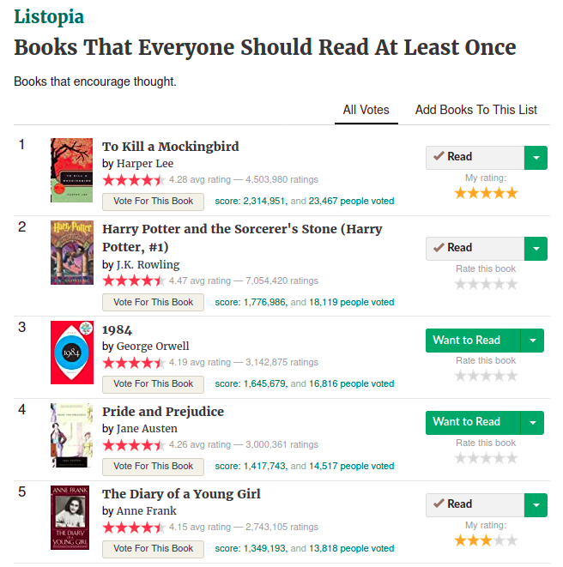
Data
Scraped data for 8,800 books
  Analyzed 6,895 books
    Received at least 2 votes
    Have at least 10 ratings
  Features including:
    Rank
    Rating
    Score
    High vs Low Quality

Slide 4
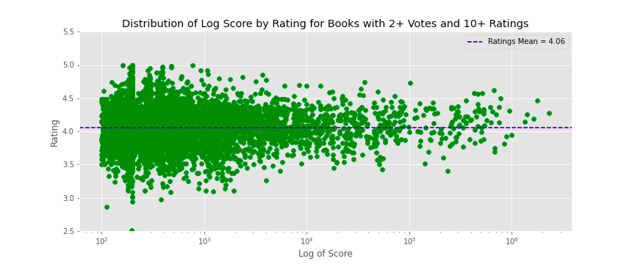
Exploratory Data Analysis
Almost every book has at least an average rating of 3-stars regardless of score
There is no discernible change in the rating as score increases

Slide 5
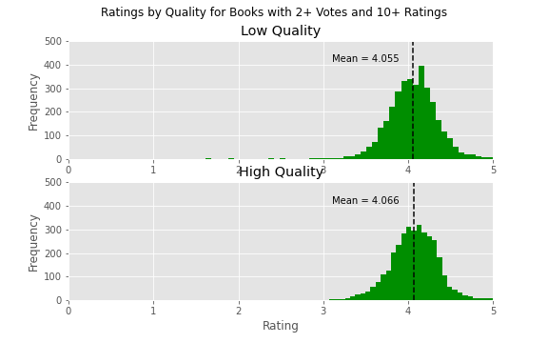
Results
Welch’s t-test
  H₀: Low quality books = High quality books
  H_{a}: Low ranked books ≠ High quality books
t-statistic: -1.71
p-value = 0.09
Insufficient evidence to reject the null hypothesis

Slide 6



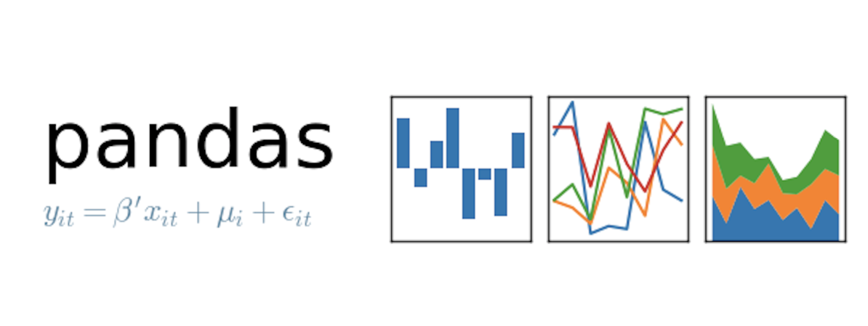



Tech Stack

Slide 7

Further Research
Is genre associated with ranking or rating?
Does publication year affect the rating of a book?
  Are highly rated books more likely to be newer?
Is length of book associated with ranking or rating?
Look into some of the low rating outliers

Slide 8

Thank You
Alex Binder
  Email:
    atbinder42@gmail.com
  Github
    https://github.com/Shredder42
  LinkedIn:
    https://www.linkedin.com/in/alexbinder/

Slide 9
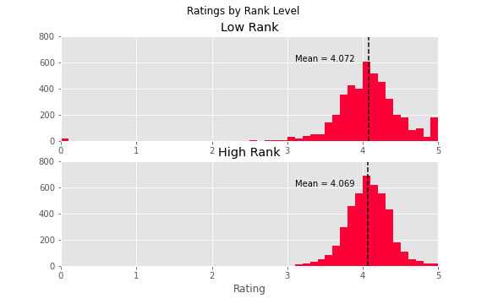
Results
For all 8,800 books, there was no statistical difference between the ratings higher in the list and lower in the list (p=0.71)
  Low Rank
    N = 4,396
  High Rank
    N = 4,404

