Slide 1
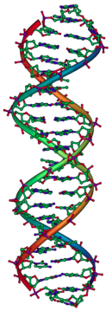

Using Scientific Literature to Classify Mutations in Tumors
Alex Binder

Slide 2
Motivation
The technological advances around genetic sequencing make personalized treatments a profound next step in medicine
Determining which genetic mutations contribute to the development of cancer and which ones are neutral is vital to the application of personalized treatments
Currently, this process requires clinical pathologists to manually review and classify mutations based on scientific literature

Slide 3

Goal
Use natural language processing to build a classification model that looks at the research literature and classifies individual mutations within a tumor
Mutation: L399V
  Gene: CBL
  Leucine to Valine
Class: Loss-of-function

Slide 4
Example data point
Mutation: L399V
  Gene: CBL (known proto-oncogene)*
  Missense mutation at position 399
    Leucine to Valine
  Class: Loss-of-function
Text
  Oncogenic mutations in the monomeric Casitas B-lineage lymphoma (Cbl) gene have been found in many tumors but their significance remains largely unknown. Several human c-Cbl (CBL) structures have recently been solved depicting the protein at different stages of its activation cycle and thus provide mechanistic insight underlying how stability-activity tradeoffs in cancer-related proteins may influence disease onset and progression. In this study...
*https://www.genecards.org/cgi-bin/carddisp.pl?gene=CBL

Slide 5
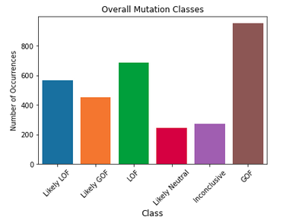
Data
Data set from Memorial Sloan Kettering Cancer Center (MSKCC) containing 3,321 sequenced mutations from 9 classes and textual literature describing them
After pre-processing 3,171 values were classified into 6 distinct classes
  Likely Loss-of-function (LOF)
  Likely Gain-of-function (GOF)
  Loss-of-function (LOF)
  Likely Neutral
  Inconclusive
  Gain-of-function (GOF)

Slide 6
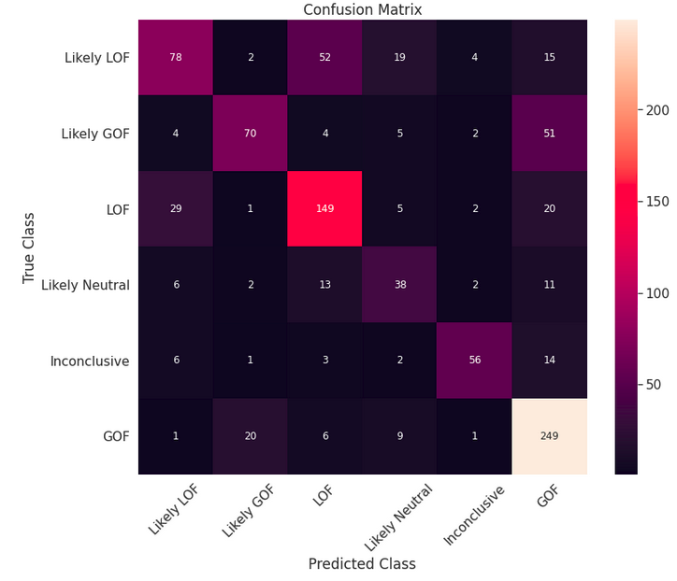
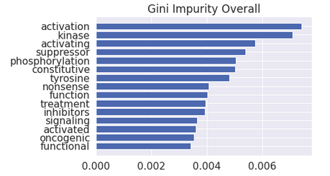
Models and Results
Random Forest Overall Classification
  Accuracy: 67.2%

Slide 7
Models and Results
Random Forest Overall Classification
  Accuracy: 67.2%

Slide 8
Models and Results
Random Forest Overall Classification
  Accuracy: 67.2%

Slide 9
Models and Results
Random Forest Overall Classification
  Accuracy: 67.2%

Slide 10
Models and Results
Random Forest Overall Classification
  Accuracy: 67.2%

Slide 11
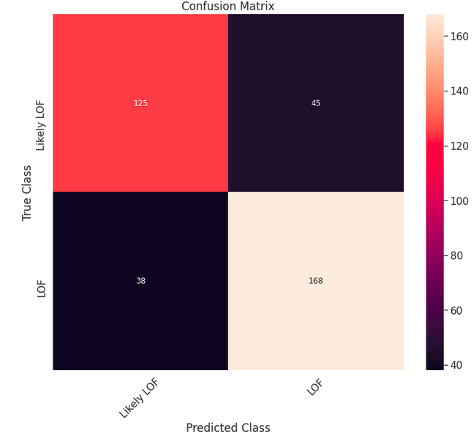
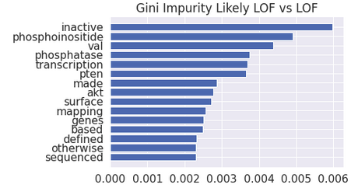
Models and Results
Random Forest Classification for confusing classes “Likely LOF” vs. “LOF”
Accuracy = 77.9%
125
45
38
168

Slide 12
Models and Results
Random Forest Classification for confusing classes “Likely LOF” vs. “LOF”
Accuracy = 77.9%
125
45
38
168

Slide 13
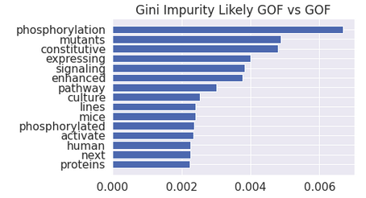
Results
Random Forest Classifications for confusing classes
Accuracy = 0.799
Accuracy = 0.779

Slide 14
Next Steps
Continue understanding the top words from the models
Focus closer in on the impacts of these mutations by re-classifying the mutations to whether or not they are cancer causing
Apply this model to other literature not included in the data set

Slide 15
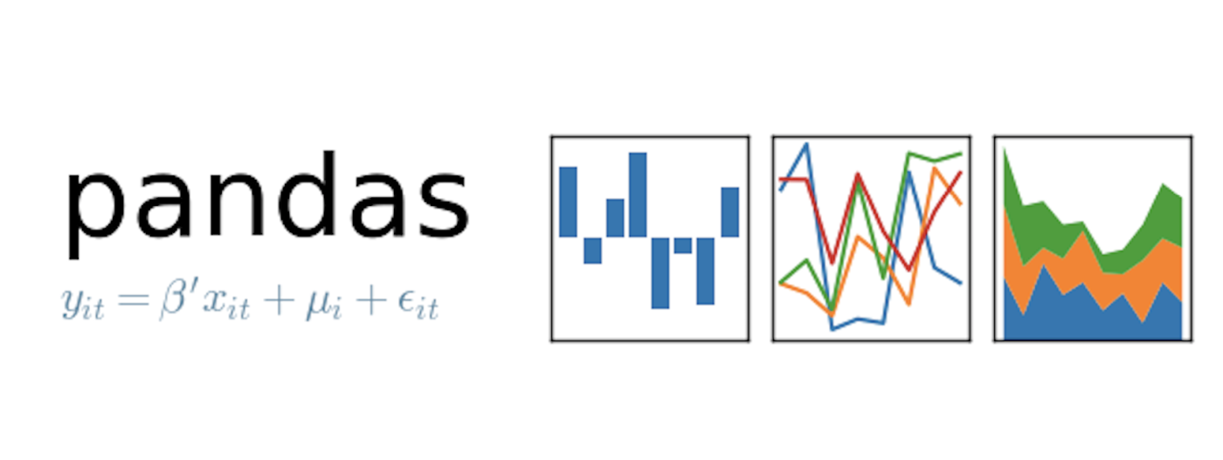






Tech Stack

Slide 16

Thank You
Alex Binder
  Email
    atbinder42@gmail.com
  Github
    https://github.com/Shredder42/mutations
  LinkedIn
    https://www.linkedin.com/in/alexbinder/

Slide 17
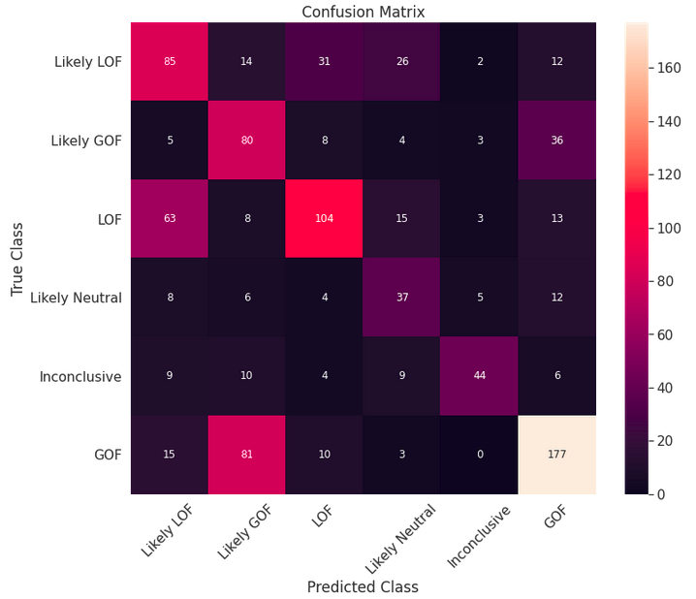
Models and Results
Naive Bayes Overall Classification
  Likely LOF
    brca1, p53
  Likely GOF
    ras, braf, egfr
  LOF
    missense, ras, p53, brca1
  Likely Neutral
    neutral
  Inconclusive
    resistance, variants, deleterious
  GOF
    flt3, ras, growth, activation

Slide 18
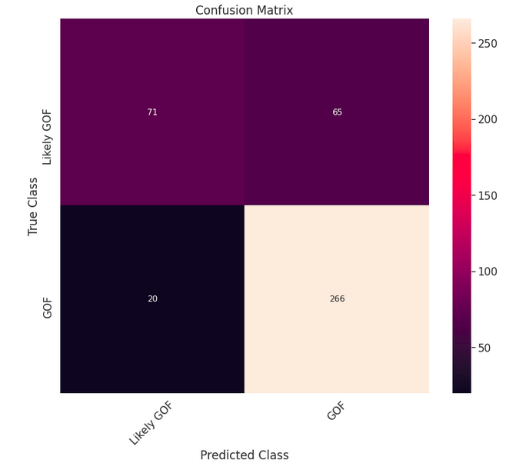
Models and Results
Random Forest Classification for confusing classes “Likely GOF” vs. “GOF”
Accuracy = 79.9%

