Slide 1







STACKOVERFLOW DEVELOPER SURVEY 2019
SUBHASHREE NATH
15 DECEMBER 2024
https://www.linkedin.com/in/subhashreenath27/

Slide 2



OUTLINE
Executive Summary
Introduction
Methodology
Results
Visualization – Charts
Dashboard
Discussion
Findings & Implications
Conclusion
Appendix

Slide 3

EXECUTIVE SUMMARY
Summary of Methodologies
• Data Collection
▪ 2019 Stack Overflow Developer Survey
▪ Kaggle Dataset
• Data Wrangling (Python)
• Identify Insights (Python)
• Dashboard (IBM Cognos Analytics)
Summary of Results
• JavaScript was found to be the most commonly used programming language.
• MySQL was found to be the most commonly used relational database management system(RDBMS)
• The majority of respondents were male (93.5%)
• Python appeared 2nd highest in the salary study and 2nd in the most popular language

Slide 4

INTRODUCTION
• In order to keep pace with changing technologies and remain competitive within the global IT and business consulting service industry, it is vital to maintain an understanding of technological trends within the software industry to help identify future skill requirements.
• This study draws from a variety of sources including job postings, training portals and surveys to answer key questions such as:
• What are the top programming languages in demand?
• What are the top database skills in demand?
• What is the distribution of data in terms of demographics such as gender and age?

Slide 5

METHODOLOGY
• Datasets used in this study - 2019 Stack Overflow Developer Survey - 90,000 developers
Kaggle Dataset – 30,000 data sample records
• Data Wrangling (Python)
Identify and remove duplicate values
Identify and remove missing values
Normalize data in the dataset
• Identify Insights (Python)
Visualize distribution, comparison and composition of data Visualize the relationship between two features
• Dashboard (IBM Cognos Analytics)

Slide 6
RESULTS
Key Findings and Significant Trends
• JavaScript was found to be the most commonly used programming language by developers and was the most desired technology to learn in the following year.
• MySQL was found to be the most commonly used relational database management system(RDBMS). However, the study revealed a possible shift towards PostgreSQL in the future.
• The majority of respondents were male (93.5%), despite efforts to encourage women into software development.
• Python appeared 2nd highest in the salary study and 2nd in the most popular language survey suggesting a growing trend towards this technology in the future.

Slide 7
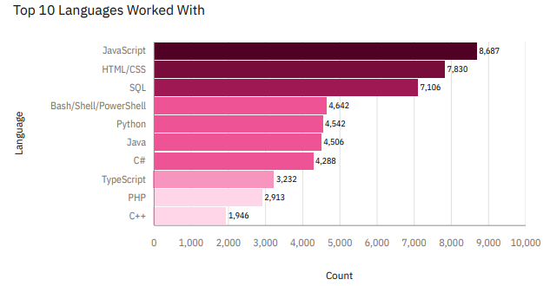
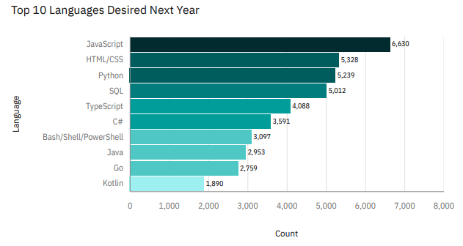
PROGRAMMING LANGUAGE TRENDS
Current Year
Next Year

Slide 8
PROGRAMMING LANGUAGE TRENDS - FINDINGS & IMPLICATIONS
Findings
JavaScript Leading In Both
C++ was found to be the least used programming language and did not appear in the Top 10 most desired language to learn next year
JavaScript, Python and HTML/CSS were the top 3 most desired languages to learn in the following year
Implications
The desire to learn Web based languages, such as JavaScript, HTML/CSS and SQL, implies that Web development is a popular career choice for software developers.
Developers are moving away from C++ in favor of more modern languages such as Kotlin and Go. This may imply that these languages are easier to learn and offer more community support and documentation.

Slide 9
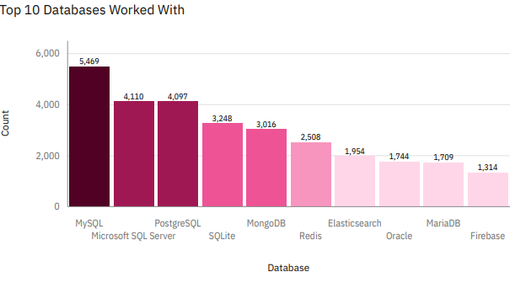
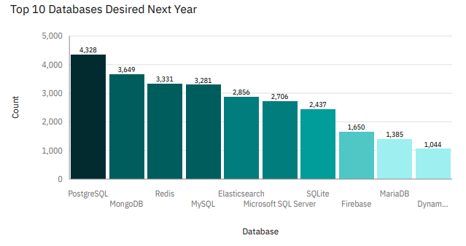
DATABASE TRENDS
Current Year
Next Year

Slide 10
DATABASE TRENDS - FINDINGS & IMPLICATIONS
Findings
MySQL as most used database.
Oracle did not feature in the Top 10 most desired RDBMS to learn next year even though it was present in the Top 10 'Worked With' results.
Increasing interest in PostgreSQL and MongoDB.
Implications
The popularity of MySQL implies that it is the most common RDBMS used within the software industry.
Interest amongst developers to learn PostgreSQL implies a possible technological shift towards this type of RDBMS.
The findings suggest that the software industry is moving away from Oracle as a viable RDBMS.

Slide 11


DASHBOARD
Git Hub Link : https://github.com/Shree-27bit/IBM-Capstone-Project/blob/f6685de04c217e4c23d4e5b4054d42184bf45729/StackOverflow-Stats-Dashboard.pdf

Slide 12
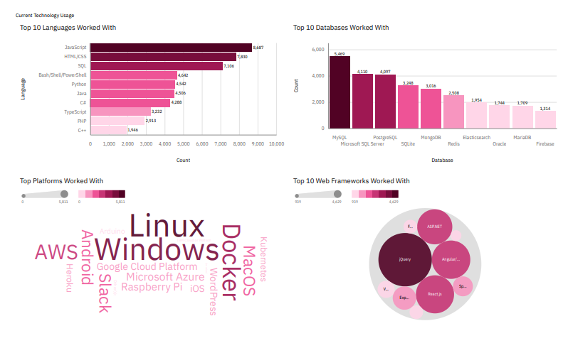
DASHBOARD TAB 1

Slide 13
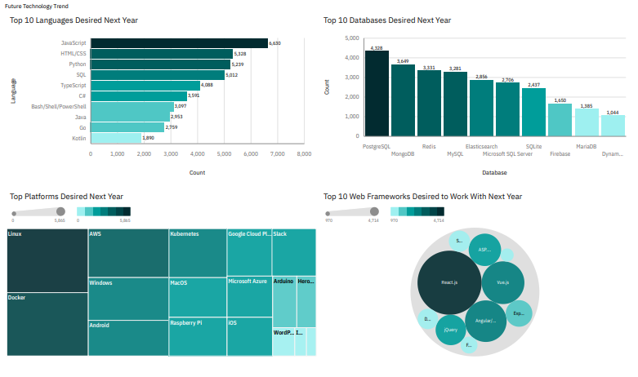
DASHBOARD TAB 2

Slide 14
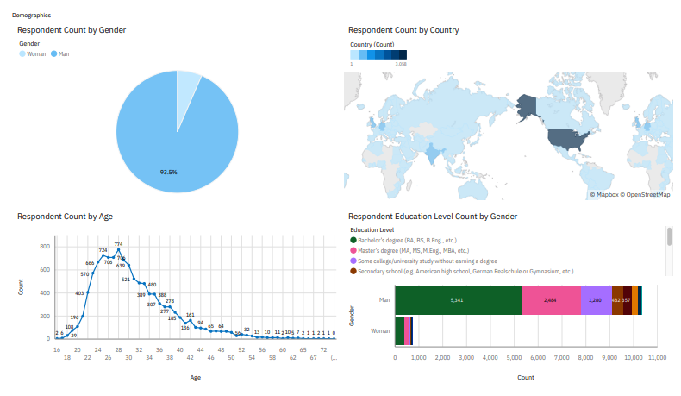
DASHBOARD TAB 3

Slide 15

DISCUSSION
Key Findings & Implications
• JavaScript was found to be the most commonly used programming language, coupled with the desire to learn other Web based languages, such as HTML/CSS and SQL, implies that Web development is a popular career choice for software developers.
• MySQL was found to be the most commonly used relational database management system(RDBMS). However, interest to learn PostgreSQL in the future implies a possible towards this technology.
• The majority of the respondents for this study were men (93.5%) aged between 24 and 30yrs. This implies an overwhelming disparity in terms of gender despite continuing attempts to encourage females into software development.
Limitations & Further Research
• This study focuses on the trends of individual technologies and is therefore somewhat limited. In reality, developers learn a variety of languages and technologies according the industry they are working in. For example, a full stack Web Developer will typically be skilled in HTML/CSS, JavaScript, SQL other skills.
• To enhance this study and address the above issue, further research should be carried out which focuses on the respondents job title/role, e.g. Web Developer, FrontEnd Developer or Mobile Developer. Correlations could then be made with this existing study and provide more accurate insights into technology and industry trends.

Slide 16
OVERALL FINDINGS & IMPLICATIONS
Findings
Python appeared 2nd highest in the salary study and 2nd in the most popular language survey.
The majority of respondents were aged 28yrs with 93.5% being male.
JQuery was found to be the most commonly used Web Frame for 2023.
A Bachelor's Degree was found to be the most common formal educational level.
Implications
Despite efforts to encourage women into software development, the industry remains a predominately male environment.
The popularity of Python in this study suggests a growing trend towards this technology in the future.
Despite the many educational options available to aspiring developers, a Bachelor's Degree remains the most common. This implies that potential recruiters still regard this path as a viable route to entry level software development.

Slide 17

CONCLUSION
• This study found that the most popular programming language and most desired language to learn in the following year was JavaScript.
• MySQL was found to be the most commonly used relational database management system(RDBMS). However, the data reveals a possible shift towards PostgreSQL.
• The majority of the respondents for this study were men (93.5%) aged between 24 and 30yrs, despite continuing efforts to encourage females into software development.
• Despite the many educational options available to aspiring developers, a Bachelor's Degree remains the most common entry point into software development

Slide 18


APPENDIX

Slide 19
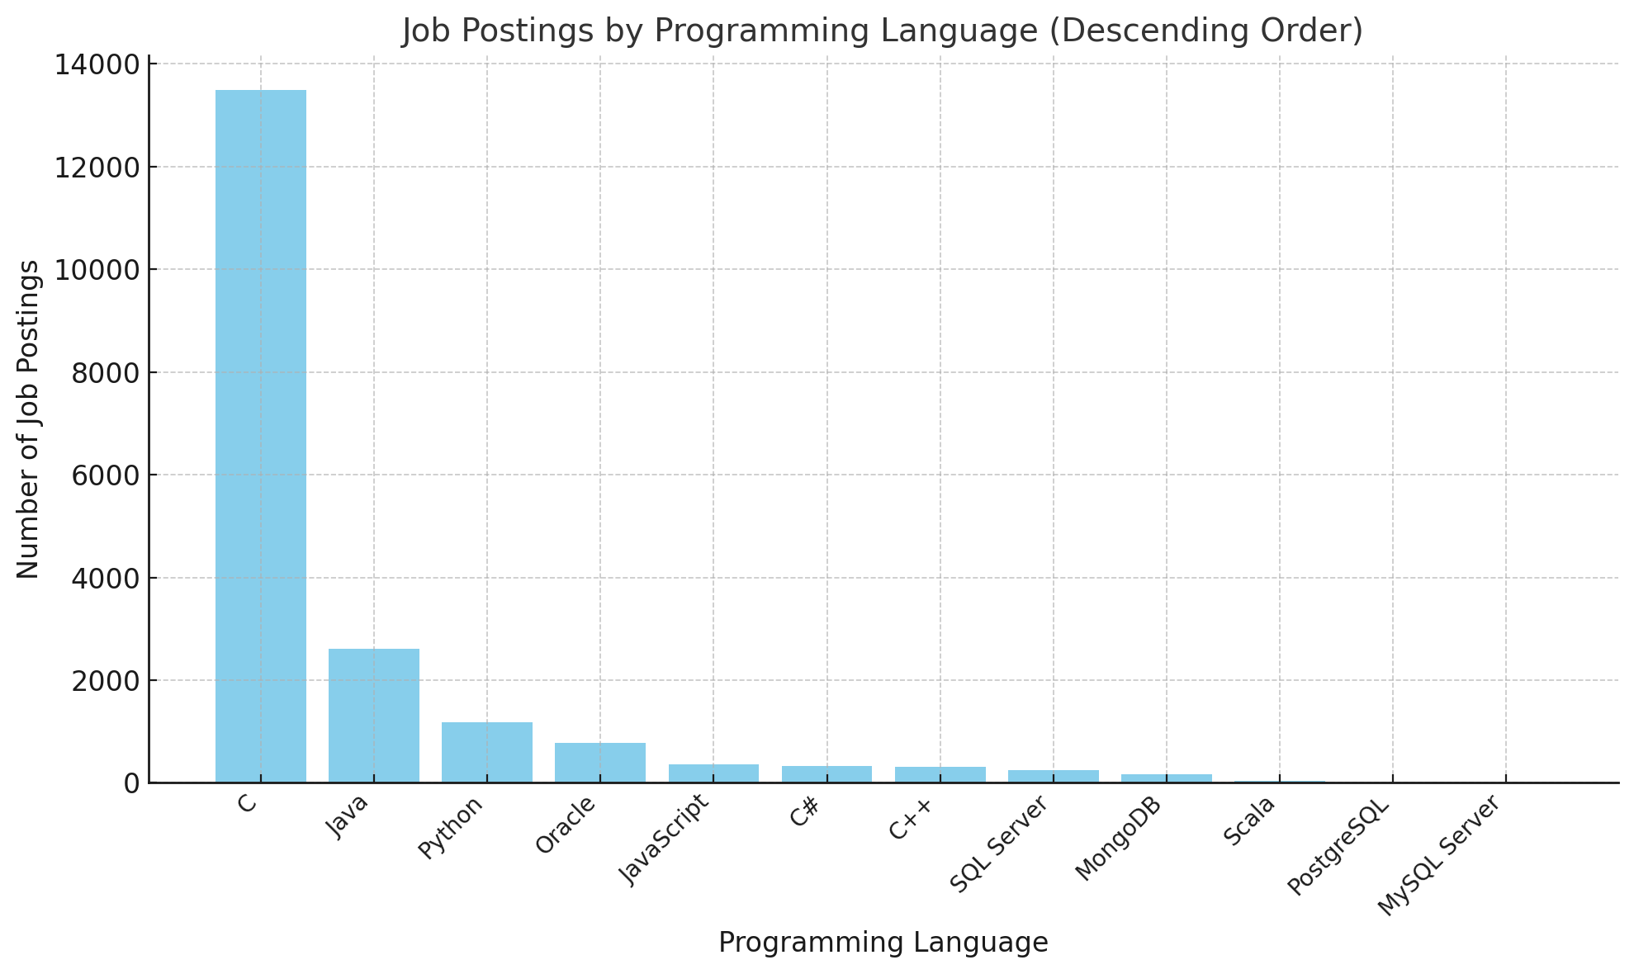
JOB POSTINGS

Slide 20
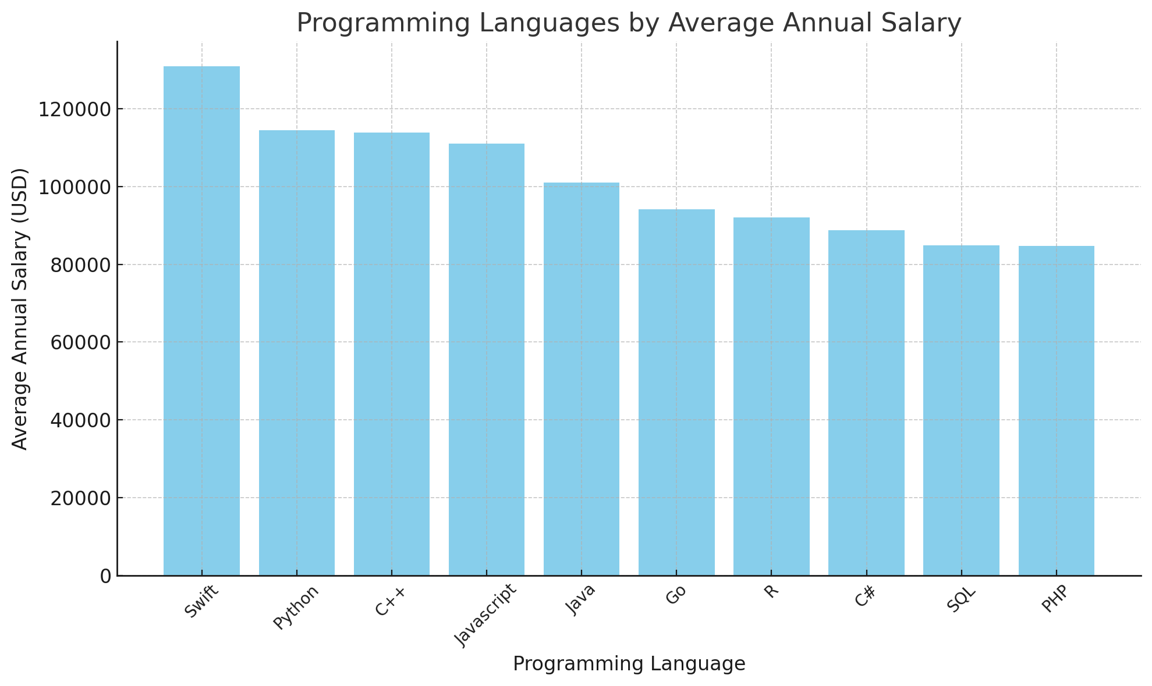
POPULAR LANGUAGES

