Slide 1
Research Paper Recommendation System using Topic Modelling
Presented by
Shree Gowri. M (22PCA023)
II MCA
Under the Guidance of
Dr. V. Srividhya
Assistant Professor(SG)

Slide 2
OUTLINE
1
2
3
Introduction
Literature Review
Problem Statement
and Objectives
6
5
4
References
Conclusion
Methodology

Slide 3
INTRODUCTION
The rapid increase in research papers results in information overload, creating challenges for researchers to find relevant work.
Effective and personalized paper suggestions are essential to reduce information overload.
Well-designed recommendation system make it easier for researchers to find important and relevant articles, improving their overall experience.
The most popular recommendation system approaches are Content-based Filtering, Collaborative-based Filtering, Hybrid Recommendation System and Knowledge based Recommendation System.
Applications of Recommendation System
News article recommendation
Research paper recommendation
E-commerce product recommendation
Restaurant or food recommendation
Book recommendation

Slide 4
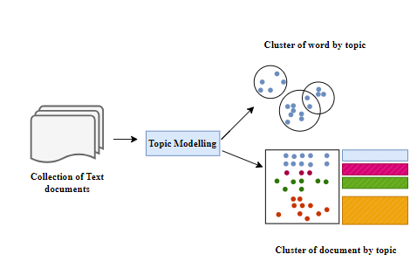
INTRODUCTION
Topic modelling is an unsupervised algorithm to classify the text documents into certain clusters.
Both recommendation system and topic modelling contribute to address the challenge of information overload.
Topic modelling in recommendation system helps to understand content, personalize suggestions, and provide users with more relevant and diverse recommendation.
The most popular topic modelling algorithms are Latent Semantic Analysis (LSA), Latent Dirichlet Allocation(LDA), Probabilistic Latent Semantic Analysis (PLSA) and Non- Negative Matrix Factorization(NMF).
Overview of Topic Modelling
Applications of Topic Modelling
Recommendation system
Sentiment analysis
Text summarization
Document clustering and categorization

Slide 5
LITERATURE REVIEW
S.No | Title of the paper | Author | Publications | Techniques
1 | Optimize Searching Using Latent Dirichlet Allocation | Mary Ann E. Ignaco1, Melvin A. Ballera | International Journal of Intelligent Systems and Applications in Engineering, 2023 | TFIDF, Latent Dirichlet Allocation, Recommendation System.
2 | Recommendation System using Machine Learning Techniques | Shailesh D. Kalkar, Prof. Pramila M. Chawan | International Research Journal of Engineering and Technology, 2022 | Content-based filtering, Collaborative-based filtering.
3 | Recommendation system based on semantic scholar mining and topic modeling on conference publications | Jelodar, H., Wang, Y., Xiao, G. et al. | Journal of Soft Computing, 2021 | Latent Dirichlet Allocation
4 | Research Paper on Recommendation System | Alka Singhal, Shivani Chauhan, Shivangi Rastogi, Nikhil Panchal | Global Scientific Journal, 2021 | Collaborative recommendation systems

Slide 6
PROBLEM STATEMENT
The problem statement is to develop a topic modelling based research paper recommendation system to suggest relevant research papers to the users based on their interests.
OBJECTIVES
Inspect and insist most suitable preprocessing and visualization techniques.
To determine the effective feature extraction method to build the topic model.
Use a suitable topic modelling technique to identify the topics.
To develop a recommendation system using suitable technique.
To evaluate the performance of recommendation system.

Slide 7
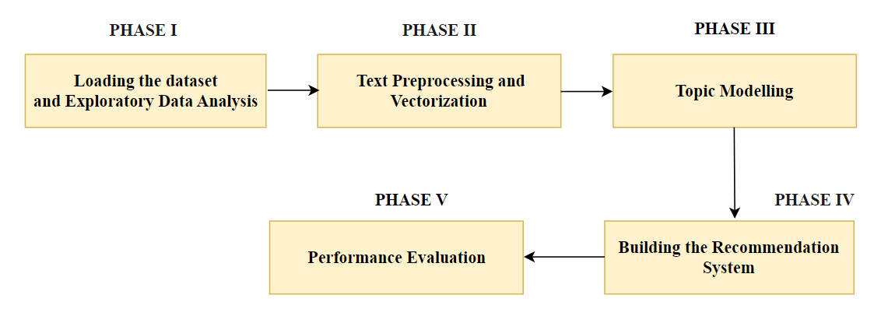
METHODOLOGY

Slide 8
PHASE I – DATASET DESCRIPTION AND EXPLORATORY DATA ANALYSIS
FEATURES | DATASET
URL | www.kaggle.com
Name | Neural Information Processing Systems(NIPS) - papers.csv
Number of records | 7241 rows, 6 columns
Attributes | id, year, title, abstract, paper _ text, author _ name.
size | 203 MB
Years | 30 years (1987 to 2017) Top Machine Learning Conference Papers
Topics | Deep Learning, Computer Vision, Cognitive Science, Reinforcement Learning

Slide 9
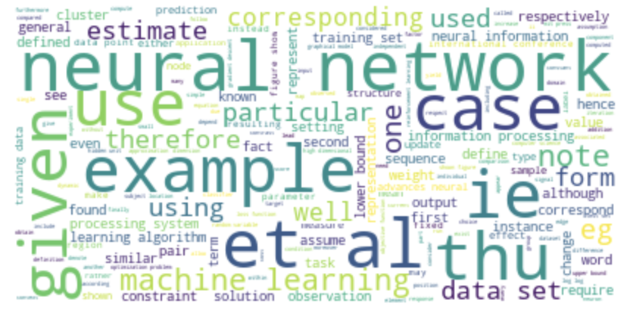
PHASE I – EXPERIMENTAL RESULT
Dataset description and Exploratory Data Analysis
Research Papers Published per Year
Word Frequency Analysis

Slide 10
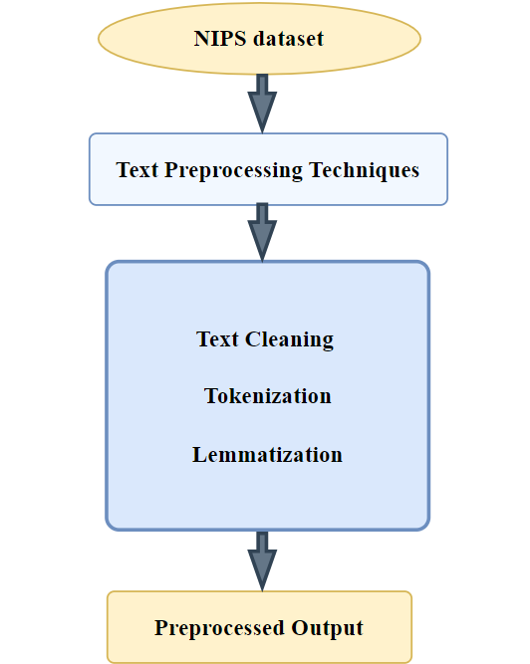
PHASE II – TEXT PREPROCESSING AND VECTORIZATION
Convert the textual data into numerical vectors, which are essential for topic modelling.
To perform Vectorization Count vectorizer, TF-IDF and word embedding algorithms are commonly used.
Count Vectorizer is a technique to convert text into numeric vectors by simply counting the occurrences of each word across all research papers.

Slide 11
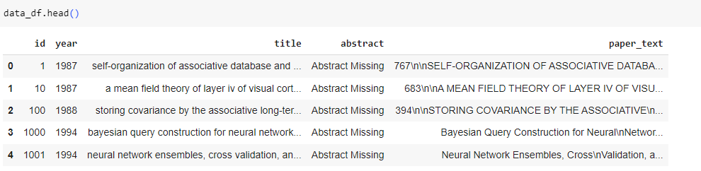
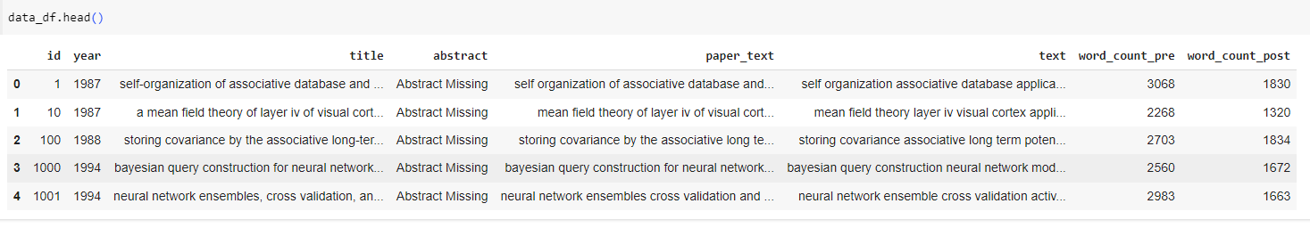
PHASE II - EXPERIMENTAL RESULT
Text Preprocessing and Vectorization
Before preprocessing
After preprocessing

Slide 12
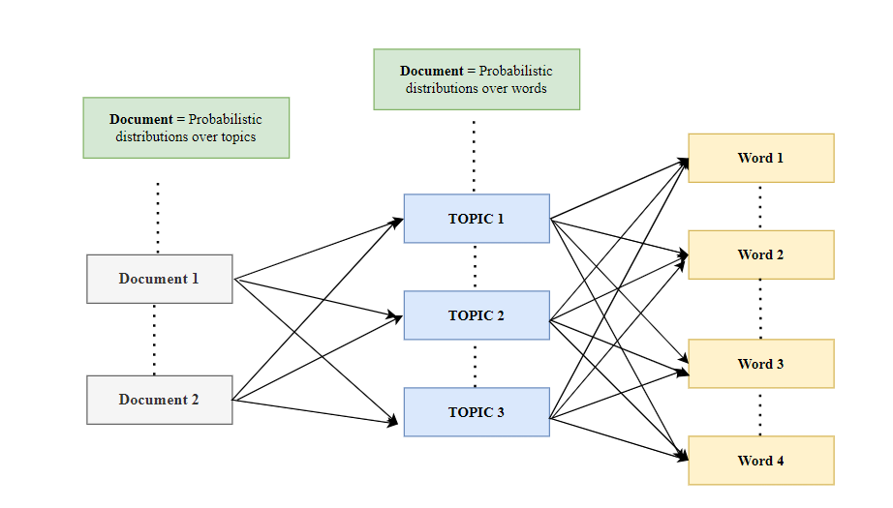
PHASE III -TOPIC MODELLING
Topic modelling is a technique for discovering latent topics within a collection of research papers
Latent Dirichlet Allocation (LDA) is applied as an unsupervised machine learning approach for topic modelling.
It identifies topics and cluster research papers into various thematic groups.
It sorts and categorize research papers by finding the main topics.
Its basic function is to take N number of words and generate K topics, word distributions for each topic, and topic distributions for each document.
LDA helps group research papers into similar topics, making it easier to recommend related papers to users.
Process of LDA

Slide 13
PHASE III -TOPIC MODELLING
A challenging step of topic modelling is determining the number of topics to extract.
Determining the optimal number of topics for clear understandable results, setting up for meaningful analysis.
Topic coherence measures the degree of semantic similarity between words in a topic.
The coherence score helps in selecting the ideal number of topics by indicating their clarity and understandability.
Topic Probability Distribution for each Research Paper helps to understand which topics are most relevant in every paper.

Slide 14
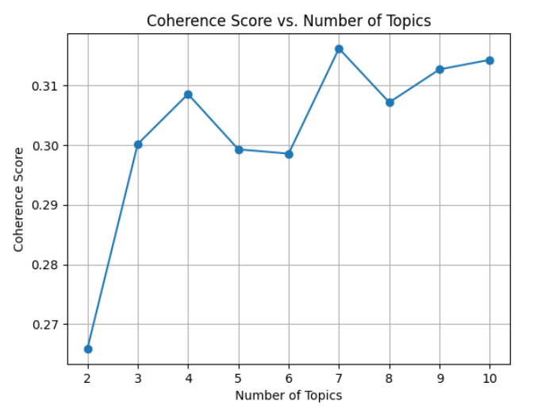
PHASE III – EXPERIMENTAL RESULT
Identify the Optimal number of topics

Slide 15
PHASE III – EXPERIMENTAL RESULT
Topic Clusters : Insights from LDA Analysis
Topic0 ['data', 'learning', 'set', 'kernel', 'feature', 'method', 'training', 'label', 'algorithm', 'classification’]
Topic1 ['algorithm', 'bound', 'function', 'problem', 'theorem', 'log', 'let', 'set', 'result', 'optimization’]
Topic2 ['image', 'network', 'model', 'layer', 'object', 'training', 'feature', 'learning', 'neural', 'using’]
Topic3 ['model', 'distribution', 'data', 'variable', 'parameter', 'inference', 'log', 'probability', 'process', 'likelihood’]
Topic4 ['state', 'learning', 'policy', 'time', 'action', 'value', 'reward', 'function', 'algorithm', 'model’]
Topic5 ['matrix', 'network', 'error', 'vector', 'data', 'function', 'method', 'linear', 'algorithm', 'sparse’]
Topic6 ['neuron', 'model', 'network', 'time', 'input', 'neural', 'cell', 'figure', 'response', 'spike']

Slide 16
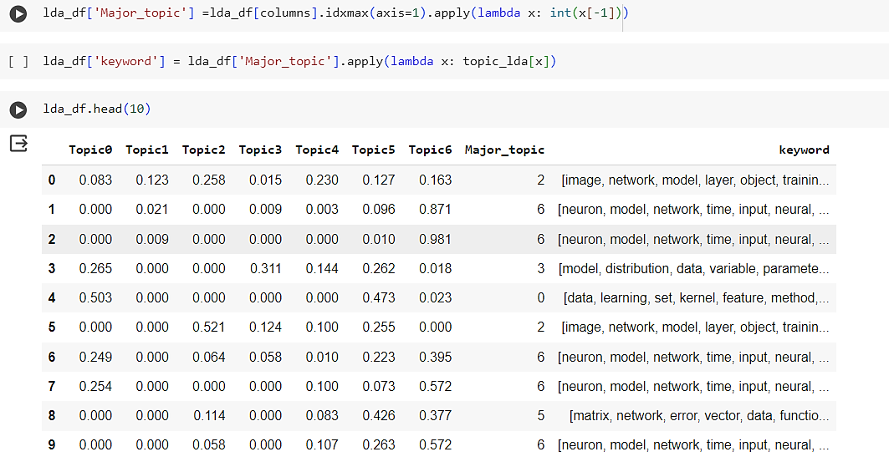
PHASE III – EXPERIMENTAL RESULT
Topic Probability Distribution for each research paper

Slide 17
PHASE IV – BUILDING THE RECOMMENDATION SYSTEM
Enhance user experience with personalized recommendations driven by Collaborative Filtering.
It is used to suggest papers based on user interactions.
Root Mean Square Error (RMSE) is a evaluation metric chosen to assess the performance of the recommended papers.
It is calculated between each selected paper and others research papers generated by the system.
Papers with lower RMSE values, indicating similar topics, are recommended.

Slide 18
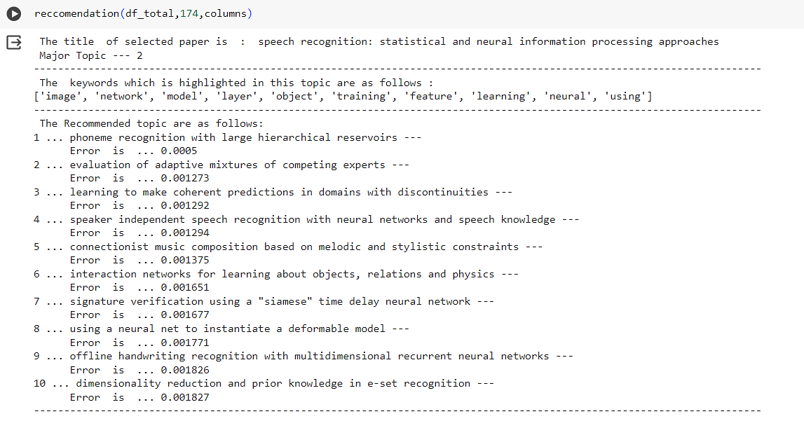
PHASE IV – EXPERIMENTAL RESULT
Recommendation System

Slide 19
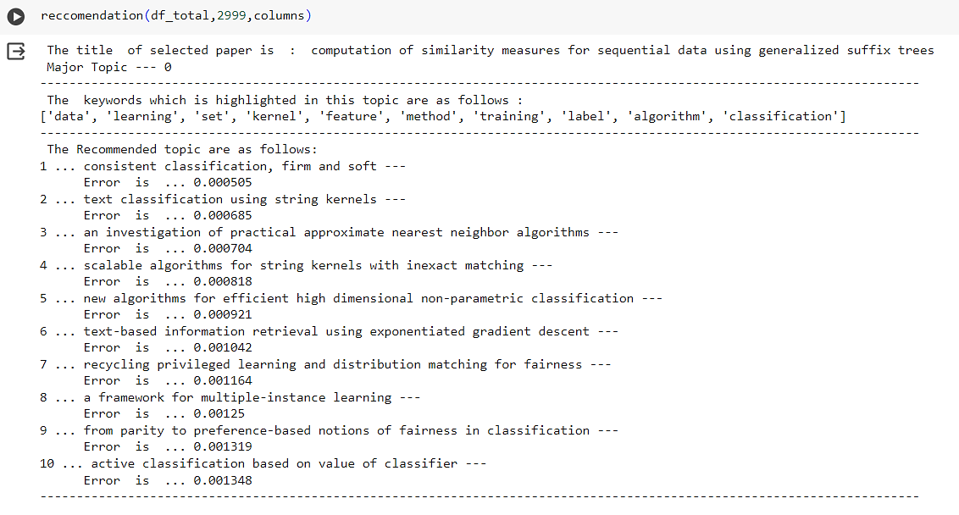
PHASE IV – EXPERIMENTAL RESULT
Recommendation System

Slide 20
PHASE V- PERFORMANCE EVALUATION
Selected top 500 research papers to evaluate the recommendations System's performance.
Calculating the correlation between a chosen topic and the recommended topics to assess the relevance of the chosen topic to the recommendations.
Evaluation metrics Precision, Recall, F1 Score to evaluate the recommendation system.

Slide 21
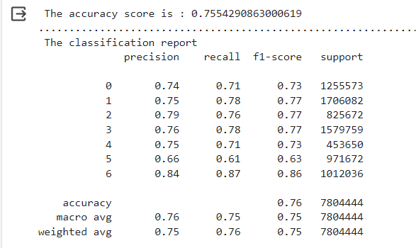
PHASE V- EXPERIMENTAL RESULT
Performance Evaluation

Slide 22
CONCLUSION
Recommendation system enhance user experience by providing personalized suggestions.
Identifying topics present in the research papers using topic modelling technique as Latent Dirichlet Allocation (LDA).
Collaborative Filtering, combined with topic modeling, enables personalized recommendations of relevant research papers based on users' interests and preferences.
Root Mean Square Error (RMSE) is an evaluation technique used to evaluate the recommended research papers. Papers with lower RMSE values, indicating similar topics, are recommended.
Finally, the evaluations are done for the recommendation system using precision, recall, F1 score.

Slide 23
REFERENCES
V. K. Garbhapu and P. Bodapati, “A comparative analysis of latent semantic analysis and latent Dirichlet allocation topic modeling methods using Bible Data,” Indian Journal of Science and Technology, vol. 13, no. 44, pp. 4474–4482, 2020. doi:10.17485/ijst/v13i44.1479
C. B. Asmussen and C. Møller, "Smart literature review: a practical topic modelling approach to exploratory literature review," Journal of Big Data, vol. 6, no. 1, 2019. doi: 10.1186/s40537-019-0255-7.
Jelodar, H., Wang, Y., Yuan, C., Feng, X., Jiang, X., Li, Y., & Zhao, L. (2019). Latent Dirichlet allocation (LDA) and topic modeling: models, applications, a survey. Multimedia tools and applications, 78, 15169-15211.
Kumar, P., & Thakur, R. S. (2018). Recommendation system techniques and related issues: a survey. International Journal of Information Technology, 10, 495-501.
Nguyen, L. V., Vo, Q. T., & Nguyen, T. H. (2023). Adaptive KNN-Based Extended Collaborative Filtering Recommendation Services. Big Data and Cognitive Computing, 7(2), 106.
Pierre Mukisa Tshomba, Md Samiul Islam, Songjiang LI “content-based recommender system for an online advertising platform,” International Research Journal of Modernization in Engineering Technology and Volume:05/Issue:06/June-2023

Slide 24
THANK YOU

