Slide 1
CUSTOMER RETENTION
ANALYSIS

Slide 2

Bhagyashree Mourya
Date
15-04-2022
Project Report

Slide 3
CONTENT
Introduction
Objectives
Data Cleaning
Graphical Representation
Univariate
Bivariate
Conclusions
Suggestions For Models and Machine Learning

Slide 4
INTRODUCTION
Customer retention refers to a company's ability to turn customers into repeat buyers and prevent them from switching to a competitor.
It indicates whether your product and the quality of your service please your existing customers. It's also the lifeblood of most subscription-based companies and service providers.

Slide 5
Objectives
To understand how and why customers churn.
Retention analysis is key to gaining insights on how to maintain a profitable customer base by improving retention and new user acquisition rates.

Slide 6
WHY CUSTOMERS ARE CHURNING?
WHEN CUSTOMERS ARE MORE LIKELY TO LEAVE?
HOW CHURN AFFECTS YOUR BOTTOM LINE?
HOW TO IMPROVE YOUR RETENTION STRATEGIES?

Slide 7


Slide 8
TYPES OF QUESTIONS:
Dichotomous Questions
Rating Questions
Categorical Questions
Multiple Choice Questions
Likert Scale Questions
Open-Ended Questions

Slide 9
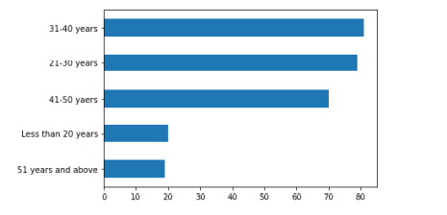
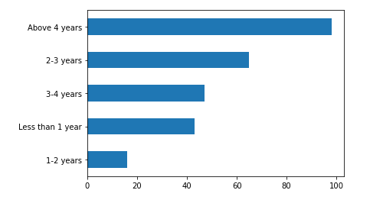
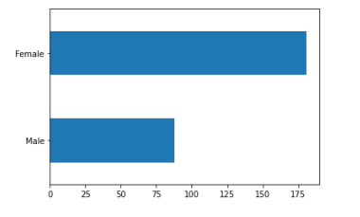
Personal information

Slide 10
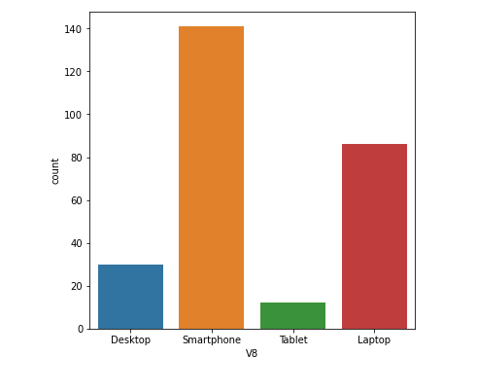
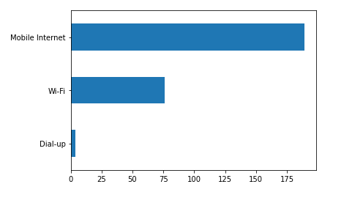
Most of the respondents are using Smartphone Operating Devices.
The maximum number of respondents are accessing through Mobile Internet.

Slide 11
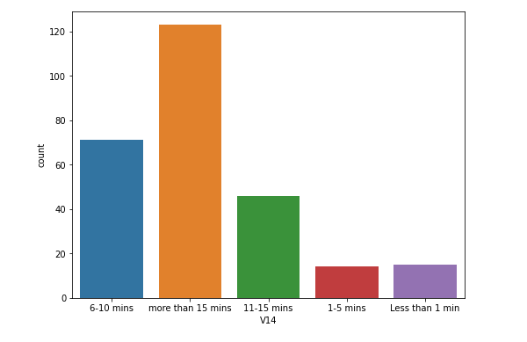
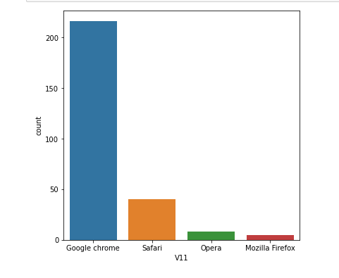
Google Chrome has the maximum respondents.
Time to explore the e- retail store before making a purchase decision.

Slide 12
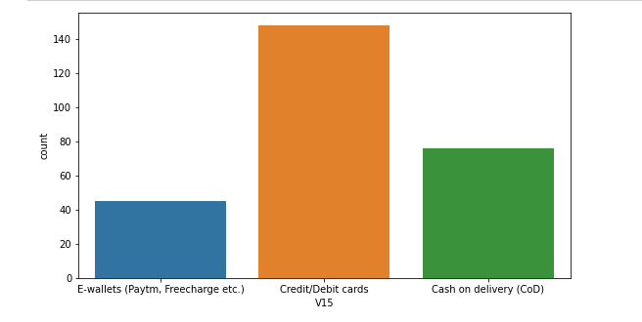
We can see that the most preferred payment is by
Credit/Debits Cards leading with COD (Cash on Delivery).

Slide 13
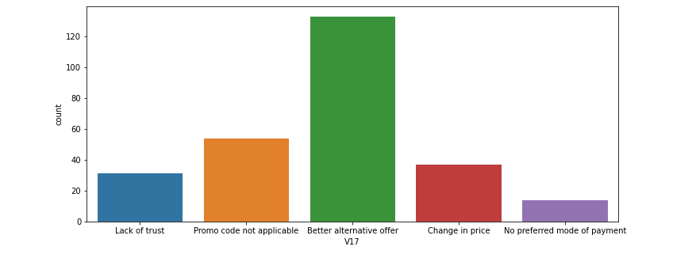
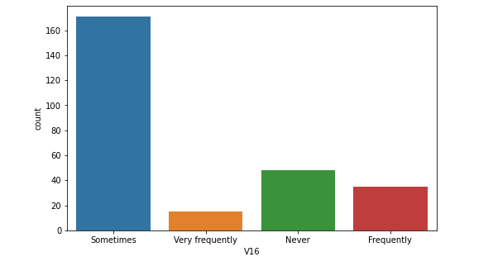
Sometimes people do abandon the product.
Because they get better alternative offer leading to promo code not applicable.

Slide 14
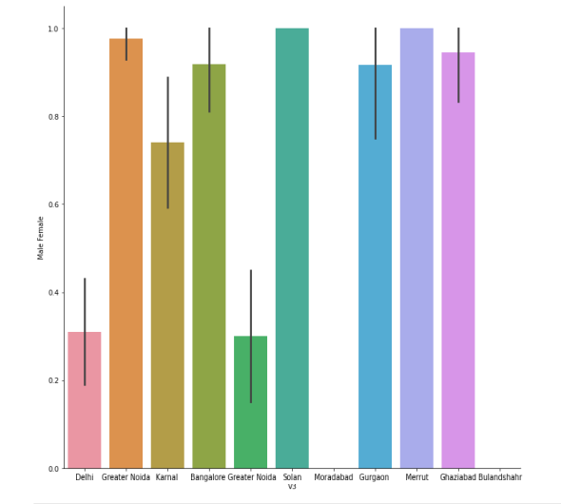
Considering Gender
Respondents against
which cities they belong to.
Since we have Female
respondents more,
here we can see that Females are
mostly from the cities,
of Noida, Bangalore, Karnal,
Gurgaon, Bulandshahr.
Male is from mostly Delhi

Slide 15
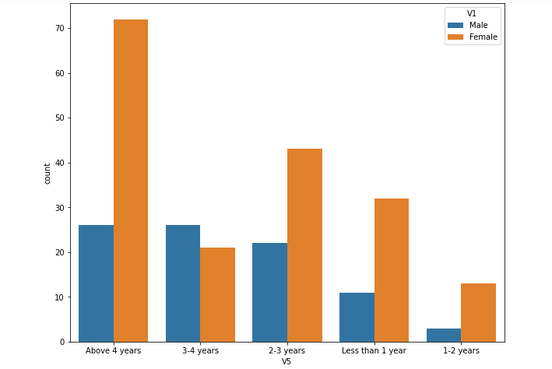
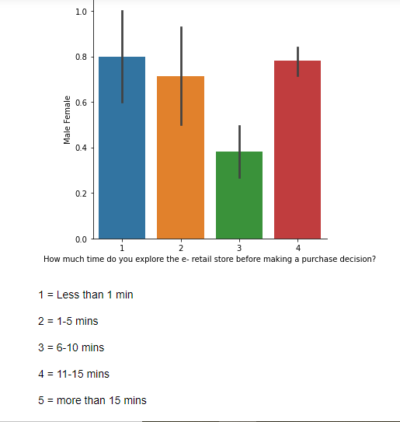
The highest number of people have been shopping
online for above 4 years except for the age group
below 20 years and above 50 years.
People who are shopping online
for 1-2 years do not include teenagers and elder people.
Male is less likely to Explore.

Slide 16
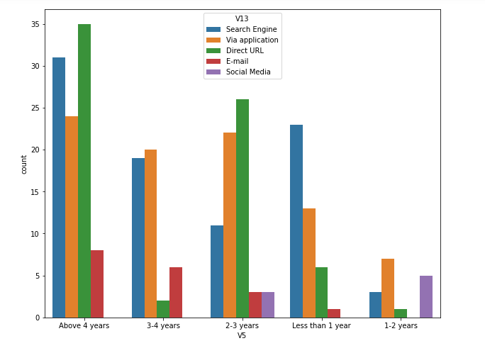
Even though people
who areshopping online
for more than 3 years
do not use the application
rather use a search engine
and directs URL’s in large
numbers which indicates
that online brands should
update all their platforms
rather than just the
Application.

Slide 17
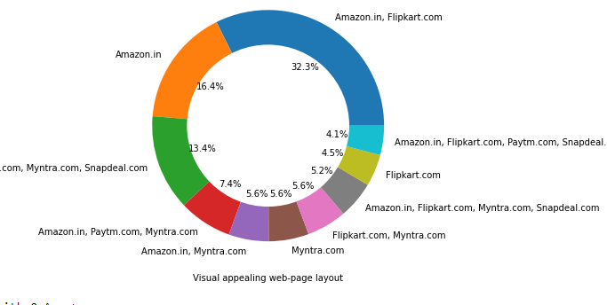
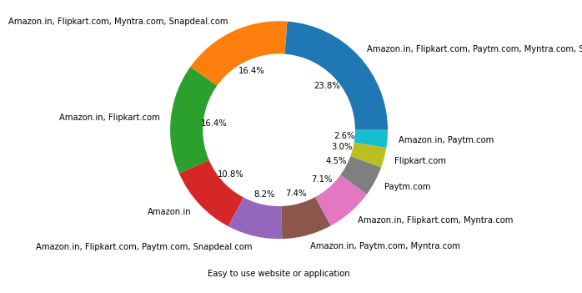
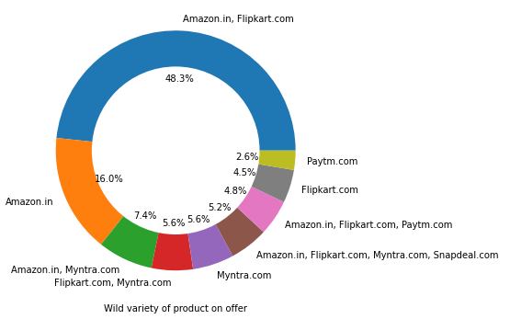

Slide 18
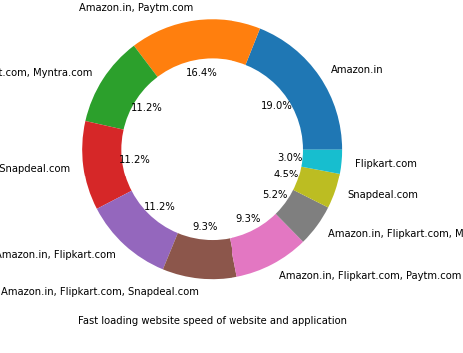
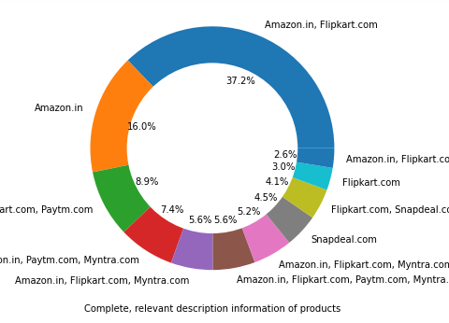
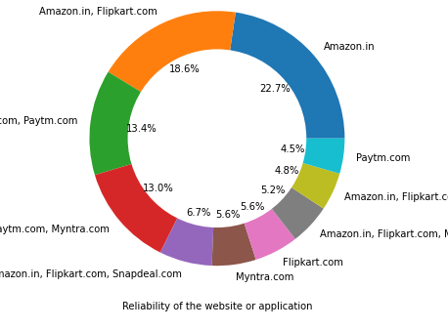

Slide 19
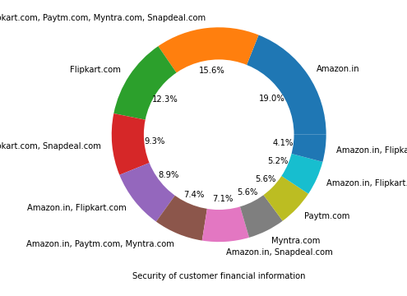

Slide 20
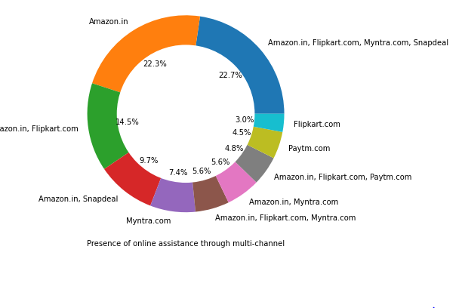
Amazon, Flip kart has had the highest votes for having all the positive points and have maintained a very good brand image followed by Paytm and myntra.

Slide 21
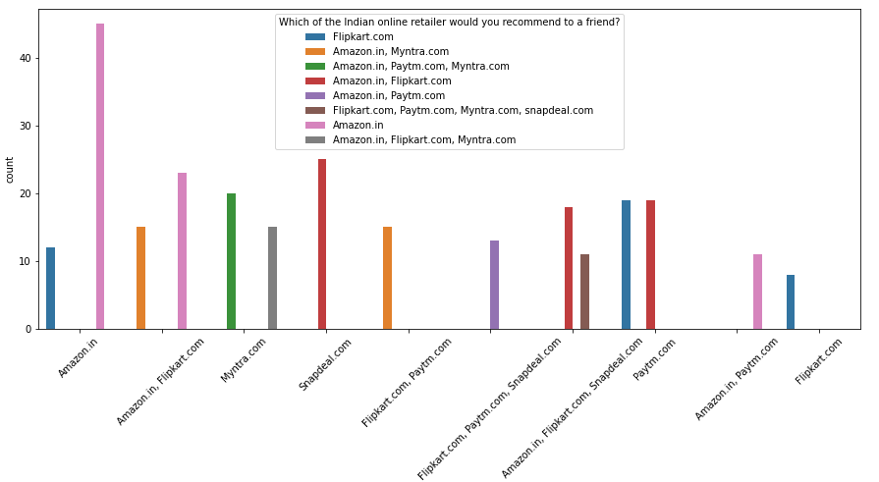
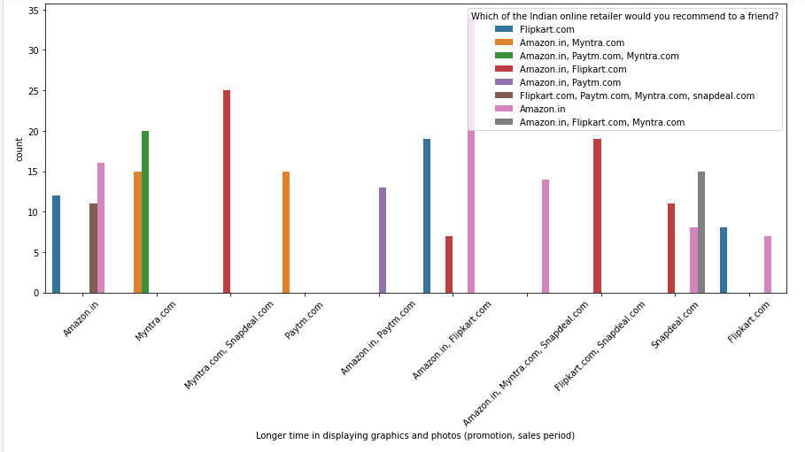

Slide 22
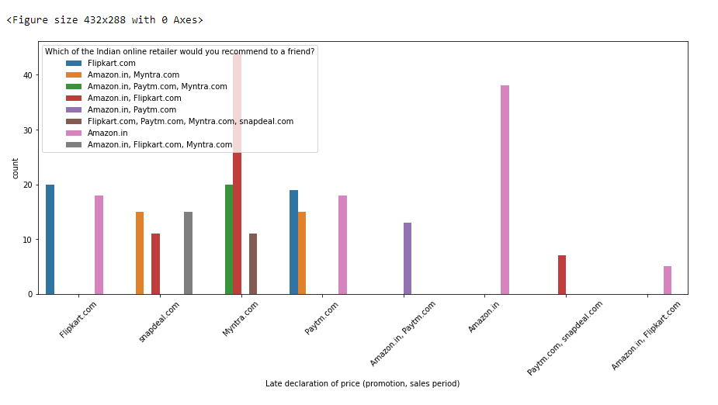
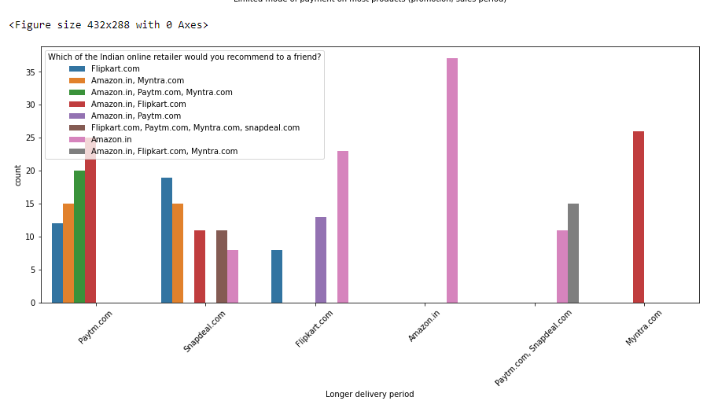

Slide 23
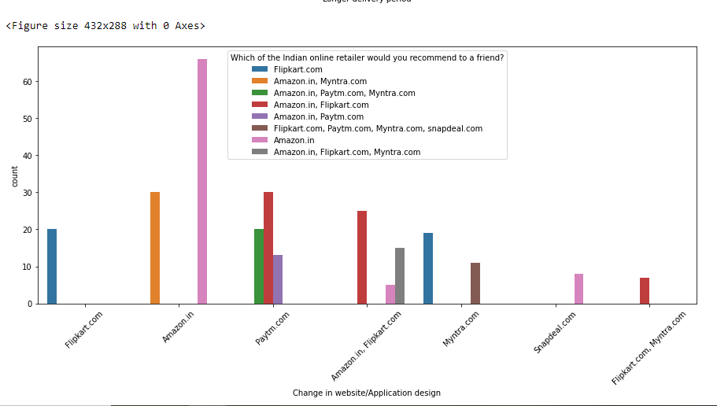
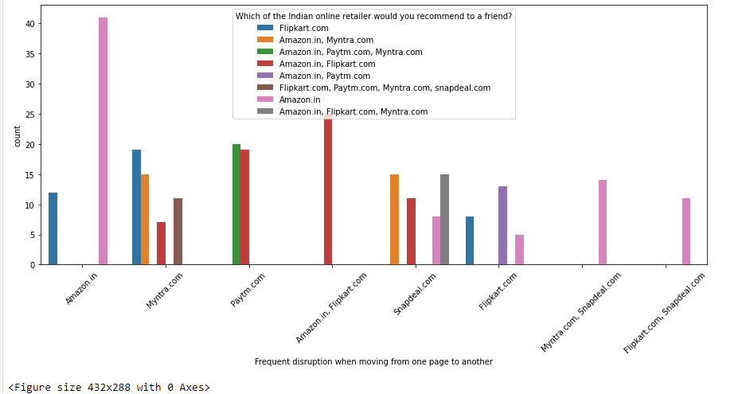

Slide 24

Customers seem to be more loyal to Amazon,
Flip kart and Paytm as even though many of them
have given negative remarks about them still they would
recommend these platforms to their friend.

Slide 25
Suggestions For Models and Machine Learning
Pareto Analysis :- Pareto Analysis is a statistical technique in decision making that is used for the selection of limited number of tasks that produce a significant overall effect.
It is basically a 80-20 rule which itself says that 80% problems are caused due to 20% of the factors.

Slide 26
Conjoint Analysis:- Conjoint analysis is a statistical marketing research technique that helps businesses measure what their consumers value most about their products and services.

Slide 27
Binary Logistic
Regression
Sentiment Analysis :- To understand the different types of views expressed by the people.

Slide 28
Word cloud :- A word cloud is a graphical representation of frequently used words in a collection of text files.
The height of each word in this picture is an indication of frequency of occurrence of the word in the entire text. It is a good way to convey the general idea of the text.

Slide 29


