Slide 1







Project Title
Budget Buddy
Team : 1. Sumedh Meshram [sumedh.meshram@mitaoe.ac.in]
2. Pratik Bangar [pratik.bangar@mitaoe.ac.in]
3. Sion Mankar [sion.mankar@mitaoe.ac.in]
4. Shreenivas Dudhate[shreenivas.dudhate@mitaoe.ac.in]
Disclaimer: The content is curated for educational purposes only.

Slide 2
Budget Buddy
OUTLINE
Abstract of the Project
Problem Statement
Proposed Solution
System Architecture
Live Demo of the Project
Embedded Video of Project
Conclusion
Future Scope

Slide 3
Budegt Buddy
Abstract
The Budget Buddy is a web site designed to help users manage their finances effectively.
By tracking income, expenses, and savings goals, the platform provides users with detailed analytics and actionable insights to ensure financial stability and growth.

Slide 4
Budget Buddy
Problem Statement
Many individuals struggle to manage their finances due to a lack of tools for tracking expenses, budgeting, and saving.
The Finance Tracker app simplifies financial management by offering real-time tracking, insights, and goal-setting features

Slide 5
Budget Buddy
Proposed Solution
Budget Buddy: Simplified Personal Financial Tracking
Offers easy-to-use tools for income and expense tracking.
Provides visual spending analytics and insights.
Helps users set and achieve savings goals effectively.

Slide 6
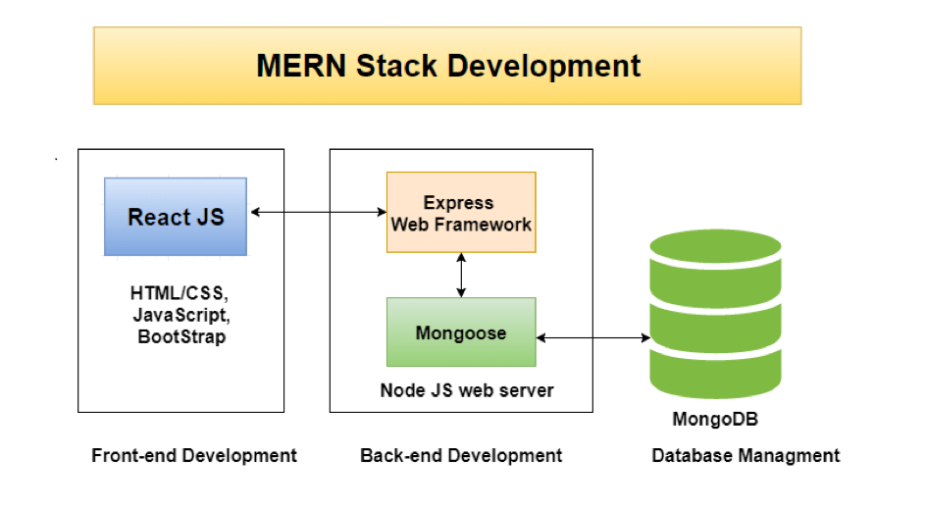
Budget Buddy
System Architecture

Slide 7
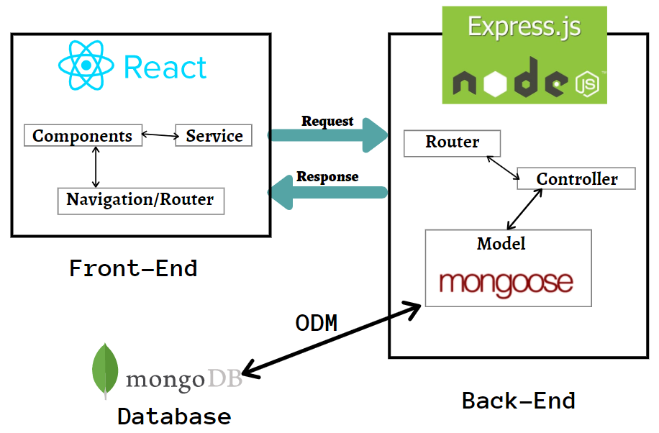
Budget Buddy
Architecture Diagram

Slide 8


Budget Buddy
Live Demo of Project
https://drive.google.com/drive/folders/1TXF4laWEkTlPw97HLcTZ1wW5TtL37CLR
Github link of Project
https://github.com/Shree740/BudgetBuddy

Slide 9
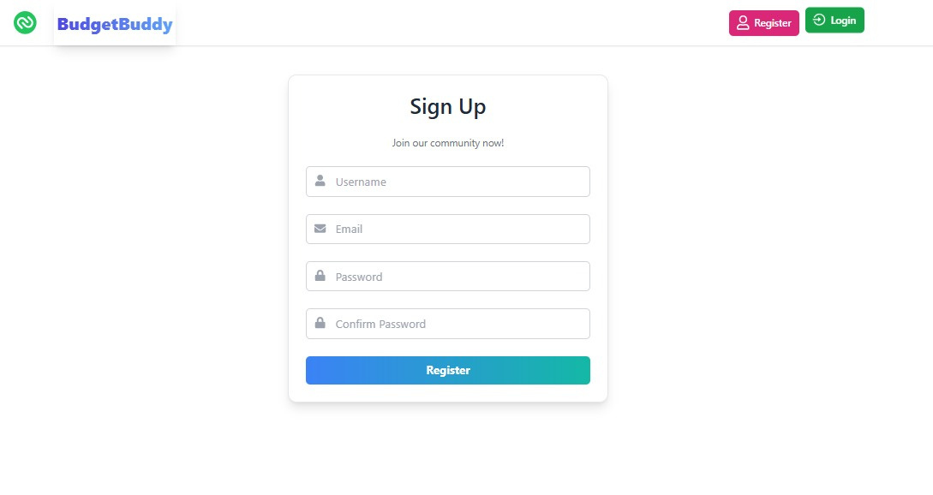
Finance Tracker

Slide 10
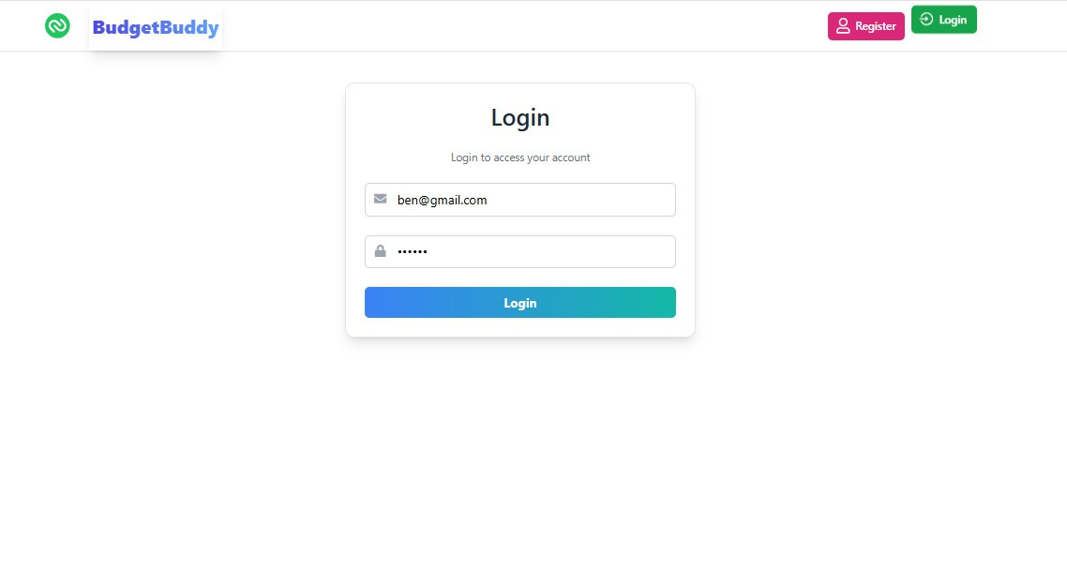
Finance Tracker

Slide 11
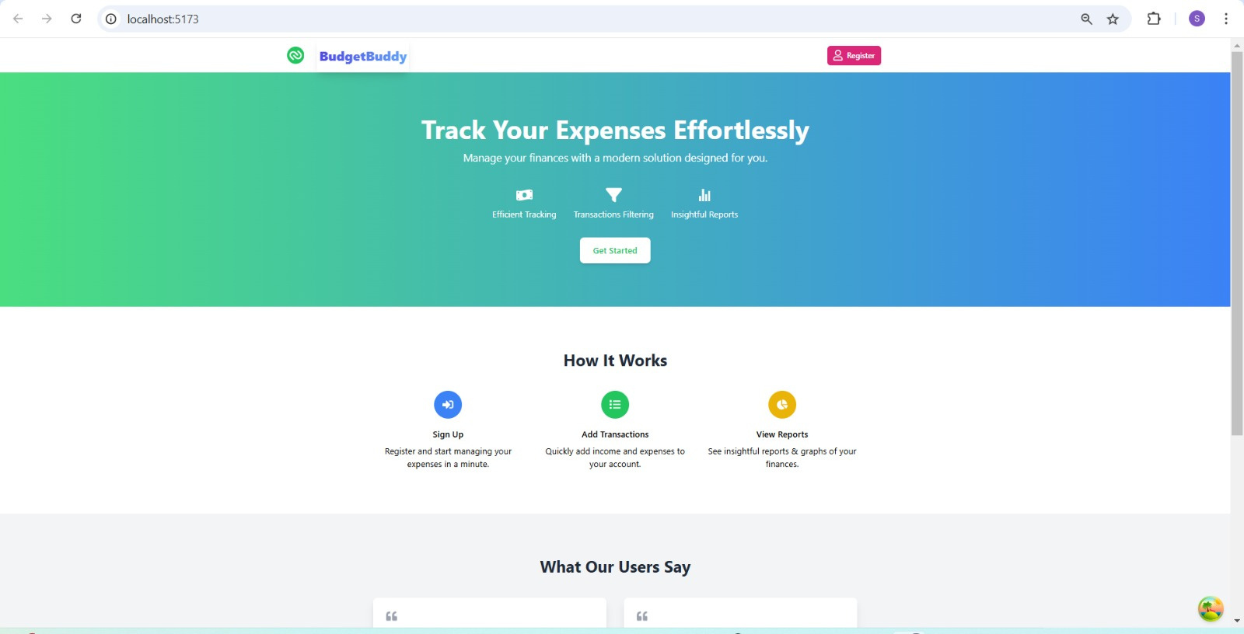
Finance Tracker

Slide 12
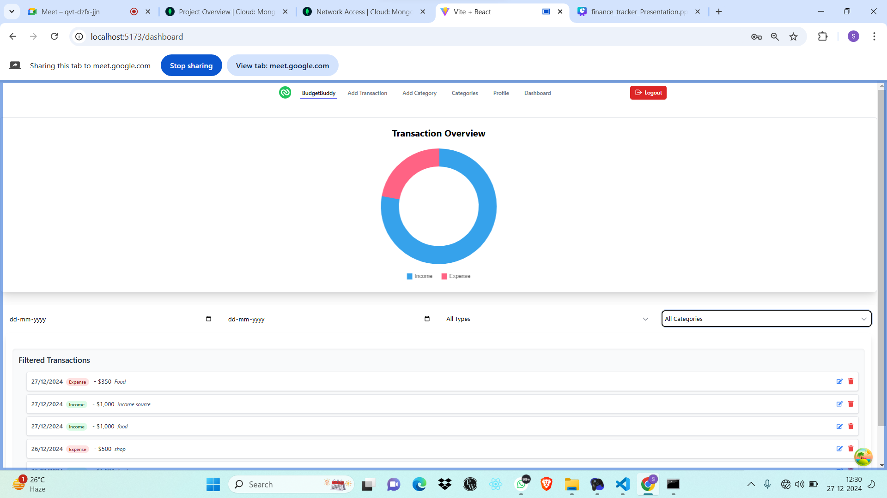
Finance Tracker

Slide 13
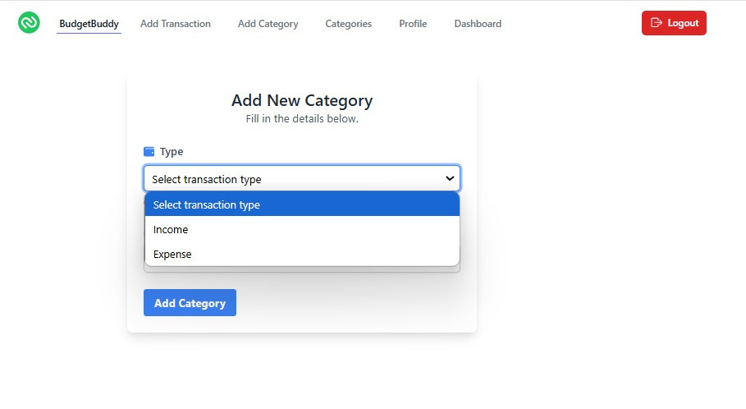
Finance Tracker

Slide 14
Budget Buddy
Conclusion
Budget Buddy empowers users to take control of their finances by simplifying budgeting, tracking expenses, and achieving savings goals. With intuitive tools and insightful analytics, it promotes better financial habits and helps users work towards a secure and organized future.

Slide 15
Budget Buddy
Future Scope
Mobile Application: Expand accessibility with an intuitive app.
AI-Driven Insights: Provide customized spending recommendations.
Collaboration Tools: Shared budgeting for families or roommates.
Gamification: Add rewards for achieving goals and sticking to budgets.

Slide 16
Finance Tracker
Thank you!

