Slide 1
Cp-301 Department Project
IMPLEMENTATION OF O-RAN IN VEHICULAR NETWORKS
-Dr.Brijesh Kumbani
Aremandla Sujesh Gnani 2022EEB1159
Lavudya Shreekar 2022EEB1187

Slide 2
Our Research Focus:
Traffic Challenge: Urban congestion, like in Edinburgh, causes delays (e.g., ~43 mins departure delay, ~412 hrs waiting for 450 vehicles).
SUMO Simulation: Models traffic flow microscopically; Edinburgh study shows inefficiencies with 10.45 km average trips.
Built a V2X simulation framework based on the 2024 IFIP WMNC paper "SMART."
Used SUMO and OMNeT++ to model mobility and networks in Edinburgh city Scotland
Defined Emergency, Fast, and Slow vehicles.
Simulated Night, Typical, and Busy traffic densities.
Analyzed speed, SINR, SNR, and delay across densities.
Studied density impact on V2X performance.
Validated SMART and emphasized adaptive delay strategies.

Slide 3
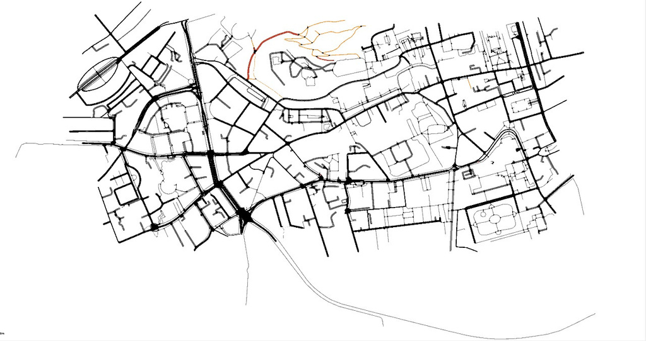
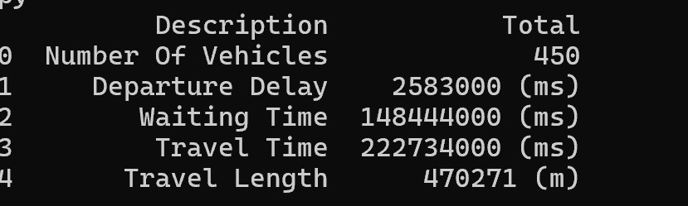
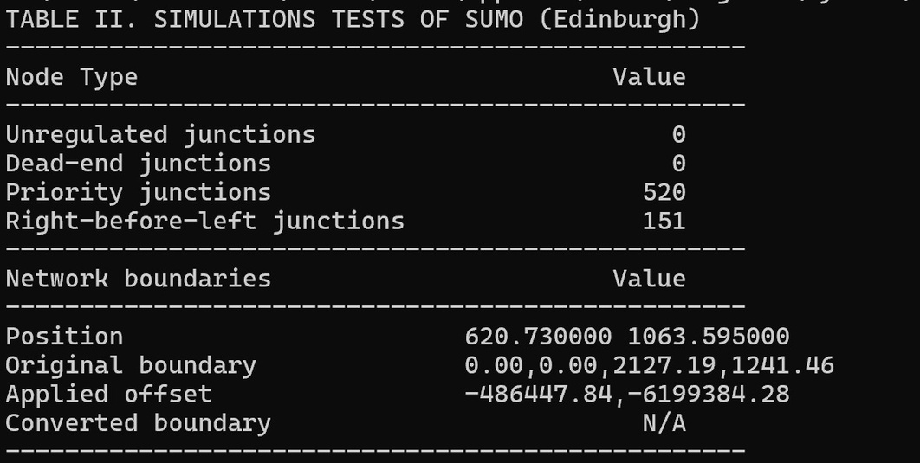
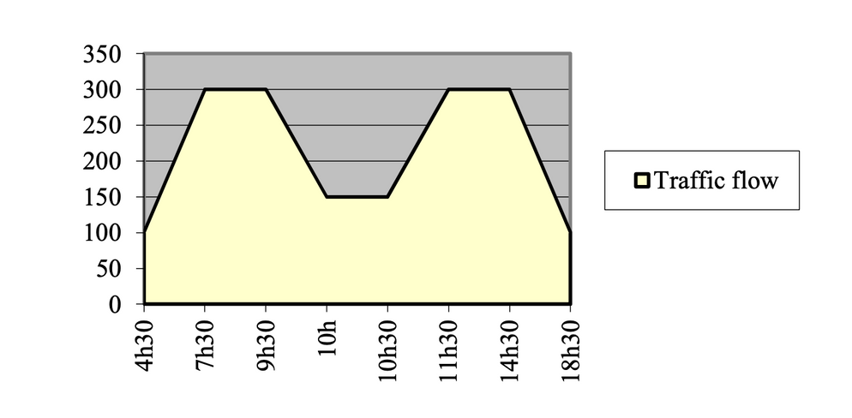
SIMULATIONS RESULTS ON SUMO

Slide 4
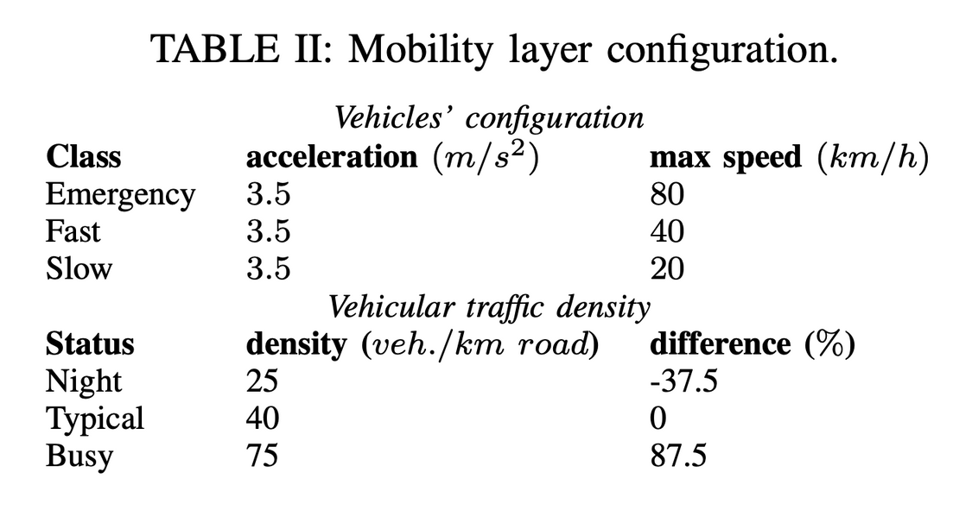
SIMULATOIONS RESULTS ON TRAFFIC DENSITIES
Defined three scenarios: Night (low density), Typical (moderate density), and Busy (high density).
Included three vehicle types: Emergency (blue line), Fast (yellow line), and Slow (gray line).
Recorded speed data (km/h) for each vehicle type across all scenarios.
Created three line graphs, one per density, with time (0-600s) on the x-axis and speed (0-60 km/h) on the y-axis.
Added a legend to identify vehicle types and labeled the figure as .Vehicles’ speed over time for different densities."
Aimed to compare how density impacts the speed of different vehicle types.

Slide 5
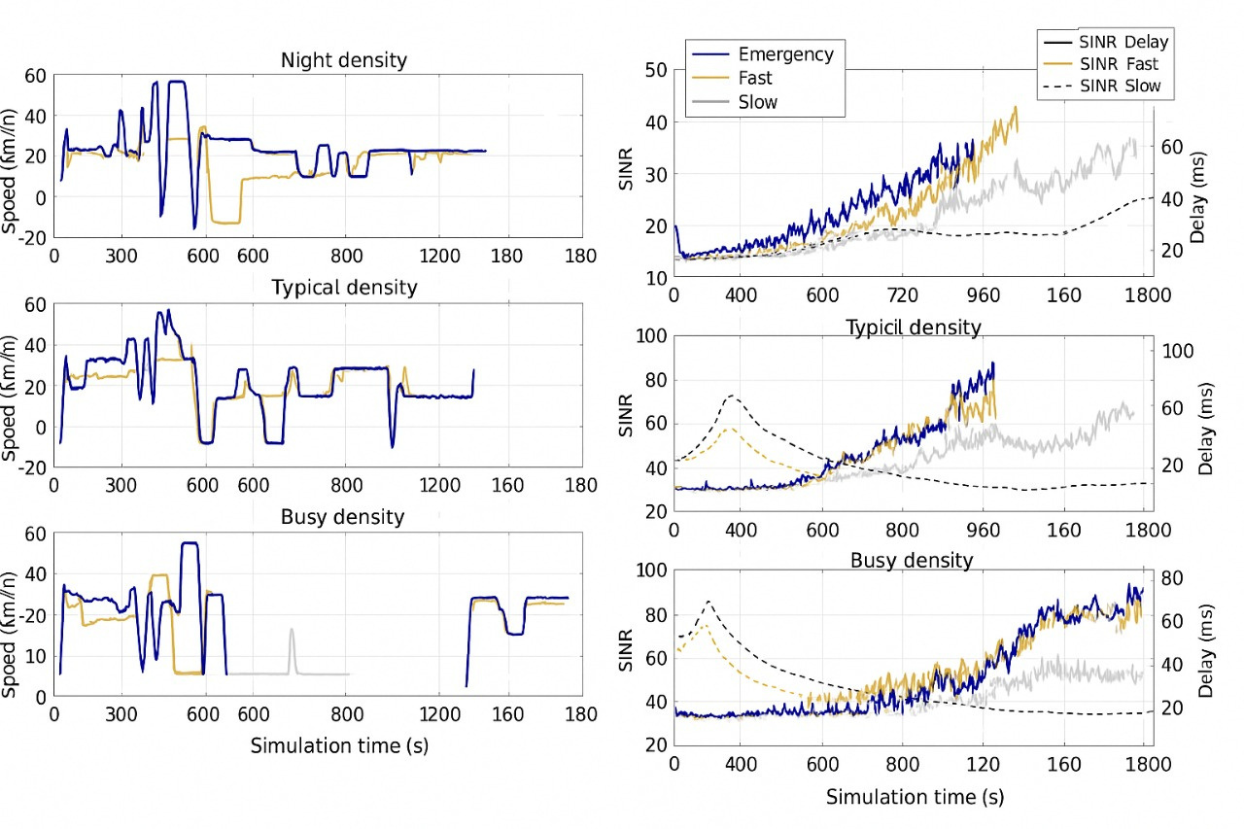
SIMULATOIONS RESULTS ON DENSITY,SNR & SINR

Slide 6
SIMULATOION RESULTS OVERVIEW
In both simulated and reference paper plots, delay generally increases over time, especially for 'Emergency' and 'Fast' vehicles, but the simulated show this trend more clearly due to the longer simulation.
Shows more extended simulation periods, potentially capturing more long-term trends and variability.
Speed plots show negative values, which may indicate reverse movement or errors.
Delay increases in V2X networks because higher vehicular density leads to more simultaneous transmissions, causing congestion, queuing, and especially more HARQ (Hybrid Automatic Repeat Request) retransmissions when packets are lost or corrupted, each adding extra delay for every retransmission cycle.
In dense traffic (Busy/Typical), more packets collide or are corrupted, so HARQ is invoked more often, compounding the overall end-to-end delay.
This is visible in the images: as density increases, the rightmost plots show delay curves rising faster and higher, especially for Emergency and Fast vehicles, tracking the increased frequency of HARQ events.
This is because, as the simulation progresses,higher traffic density causes more packet errors and HARQ retransmissions, directly increasing communication delay in V2X networks.

Slide 7
Further implementation of O-RAN
Extend the SMART framework to implement Open RAN (O-RAN) in vehicular networks for enhanced V2X communication.
Integrate O-RAN’s open architecture using SUMO and OMNeT++ to improve network flexibility and performance.
Simulate O-RAN in urban scenarios (Angers, France) with Emergency, Fast, and Slow vehicles across Night, Typical, and Busy densities.
Use O-RAN’s intelligent controllers (RIC) to optimize resource allocation, reduce delay, and improve SINR and SNR.
Focus on supporting URLLC for time-sensitive applications, targeting ultra-low latency (<20 ms) for Emergency vehicles in dense traffic.
Build on SMART’s foundation to enable scalable and adaptive V2X communication.

Slide 8
Challenges that need to be observed
Scalability: High-density simulations may strain SUMO/OMNeT++ resources, slowing performance.
Realism: Simplified models may miss real-world factors like erratic driving or hardware delays.
Interference: Dense traffic may lead to inaccurate SINR/SNR modeling.
Latency: Achieving <20 ms latency in busy scenarios may be limited by congestion.
O-RAN Integration: Compatibility issues with SUMO/OMNeT++ may hinder resource optimization.
Data: Predefined scenarios may not reflect diverse real-world conditions.

Slide 9

Thank you!

