Slide 1

Final Year Project Paper Summaries
This PPT contains the summaries of the papers in this repository:
https://github.com/ShreeHarish/StockTrendAnalysis/tree/main/Papers
Shree Harish S
Srikanth G R
Vivek Ramkumar

Slide 2
Okay, first one.
'Short – term stock market price trend prediction using a comprehensive deep learning system'
That's the title of the first paper.
Written by Jingyi Shen and M. Omair Shafiq.
It's quite a big paper, spanning around....33 pages. Good Lord.
How did they manage to concoct such stories for a thesis?
That's what we're going to find out.
I'll admit, there are plenty of terms that sound alien to me. It's up to you to Google them and find out.
Regardless, I'll try to decipher as much as I can.

Slide 3

First paper, part one.
Apparently they built the data set by themselves, using an open source API called Tushare.
They spent an awful lot of space discussing related works.
In Page 13, there seems to be a block diagram describing how they went about their stock prediction.
Of course, they’ve used an LSTM to get the actual stock prediction.

Slide 4
First paper, part two.
After getting new features, there are some useful ones and some worthless ones.
So, they decided to apply recursive feature elimination (RFE)
It eliminates features on the basis of 2 attributes - coefficient and feature importance.
Now we have useful features to work with.
After getting the data,
The first thing they tried to do was feature extraction.
Basically trying to increase the number of features.
They state that the three feature extraction methods are max-min scaling, polarizing and calculating fluctuation percentage.

Slide 5
First paper, part three.
PCA is generally used to reduce the dimensions of the input data.
I guess you would have got a question on it in your ML assignment or in the midsemester.
After this they applied the LSTM model and obtained their prediction.
After obtaining the useful features,
We notice that some features are in percentages (%) and some in verrrry large numbers.
To make them easy to work with,
They decided to apply Principal Component Analysis (PCA)

Slide 6
First paper, part four.
Seems like they attempted to analyse how the term lengths (1 day, 2 days etc.) affected the RFE....I don't get why it was needed.
Based on that they ranked the features (1st, 2nd, 3rd) corresponding to term lengths.
It's at Page 21 and 22. If you want you can try making sense out of it.
They have provided some pseudo code on their algorithms on pages 18 and 19.
It's fairly easy to understand it so I recommend reading the algos. Just 2 pages, okay? Not even the full page.
The next part describes how they evaluated their algo's performance.

Slide 7
First paper, part five.
They put a shit ton of confusion matrices to evaluate performance over random stuff.
This has effectively confused me rather than clearing stuff up.
I presume they wanted to push their performance evaluation to 10 pages, hence the stuffing.
They compared their model with other guys' models. Guess they wanted to boast it as well.
Continuing the performance evaluation,
They displayed two confusion matrices to boast how effective their feature extraction was.
Next, they showed a table to display the relationship between principal components and training efficiency.
Basically finding out which PCs take least time to train.

Slide 8
First paper, part six, end.
Page 13, 14 – Useful Diagrams.
Page 18, 19 – Pseudocode.
Do check the above. However, I recommend avoiding the below pages.
The performance evaluation starts from Page 21 until Page 30.
It's 50% boasting and 30% random metrics so I would recommend skipping for now.
That's pretty much it for the first paper.
One wonders who started this custom of stuffing paragraphs into these papers?
Regardless.
I'll list some pages which I think are relatively useful and may help in understanding the concepts.

Slide 9
Now, second one.
'Extracting Statistical Graph Features For Accurate and Efficient Time Series Classification'
This is the second paper.
The majority of this paper focusses on feature extraction as far as I can see.
However their objective is different to ours.
We are aiming to predict stock prices....
Whereas they are classifying time series data into....patterns, I think? They haven't been very clear on that.

Slide 10
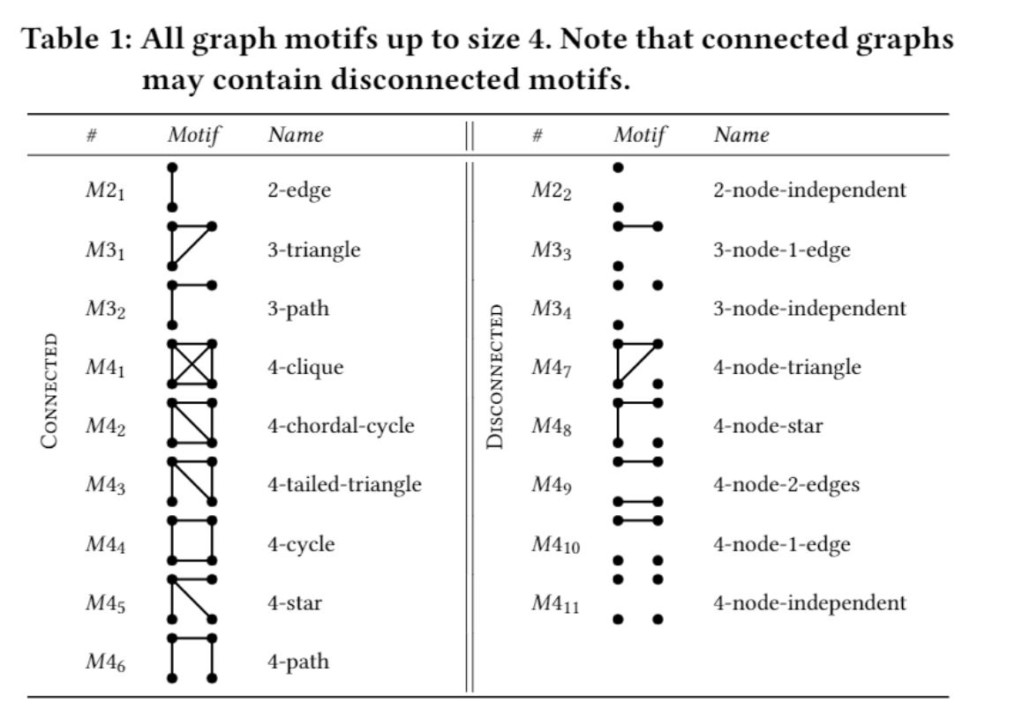
Second paper, part one.
I'm gonna put the patterns which they were trying to identify down here.
Okay, what I can understand is they are trying to identify different patterns in time series data.
Seems like they defined common graph patterns and ran some algorithms to find all instances of those patterns throughout their graph.

Slide 11
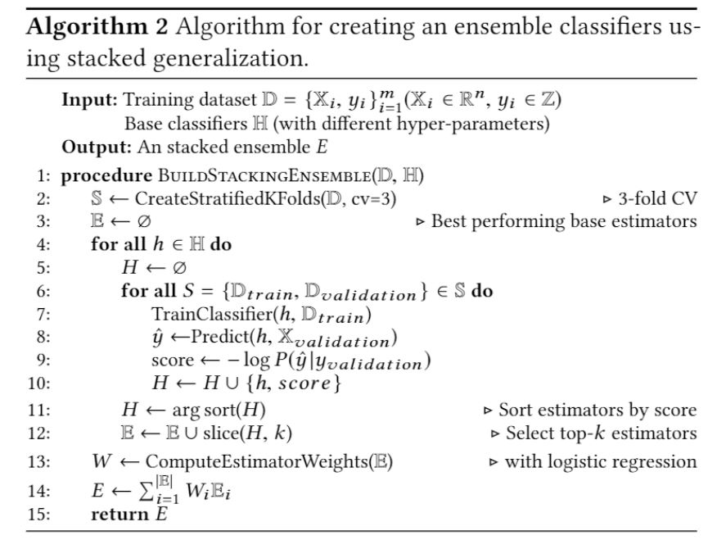
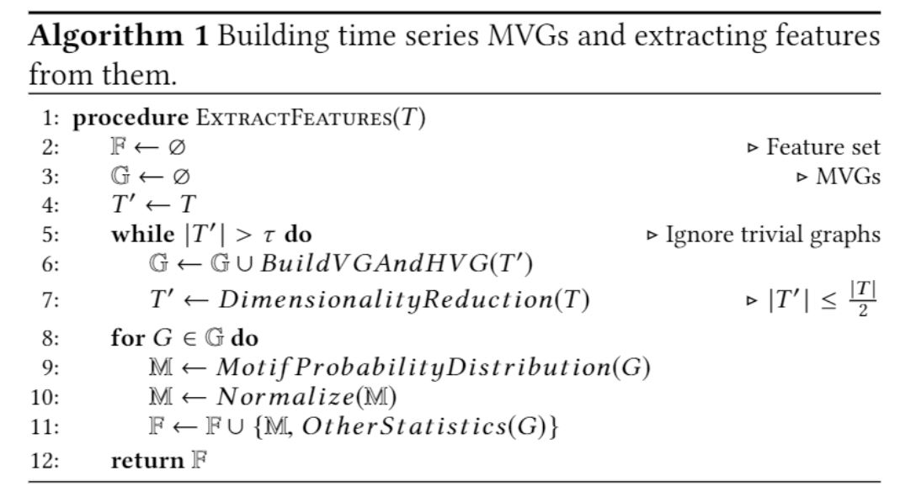
Second paper, part two.
Okay, here are the algorithms they tried to implement:
They used an ensemble of classification models (RF, SVM and XGBoost, I think) to classify the graph as patterns in the previous slide. The rest is mostly evaluation and conclusion. Let's move on to the next paper.

Slide 12
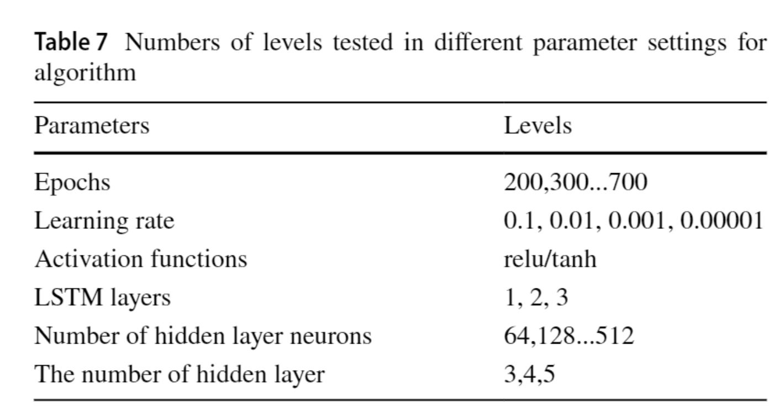
Now, third one.
'A graph-based CNN-LSTM stock price prediction algorithm with leading indicators.'
This is the third paper.
Interesting. I wonder how they managed to combine a CNN and RNN (LSTM) to predict stocks.
Their algorithm goes like this:
Input -> CNN -> LSTM -> Dense Layer -> Output
I'll show some important details of their model:

Slide 13
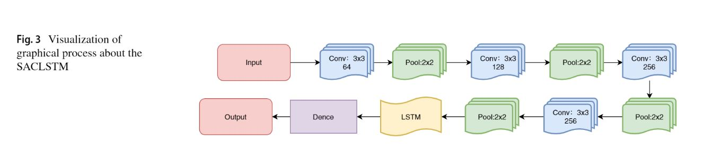
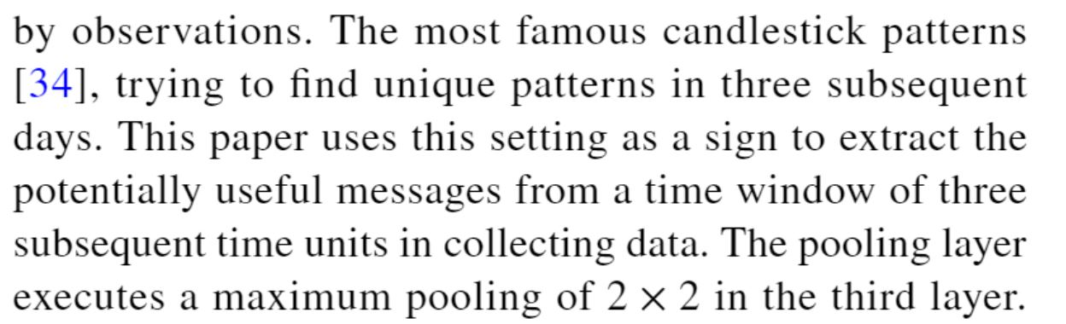
Third paper, part one.
For their combined model, I'll show the layers which they used.
You can see the yellow LSTM layer sandwiched in between the CNN layers.
For the evaluation, they've mostly shown the accuracies in tables with different historical data sets.
Apart from the technical stuff, one thing I can get is that they used a window of three days.
I guess they appended the real-time data to the csv file every three and ran their algorithm for testing.

Slide 14
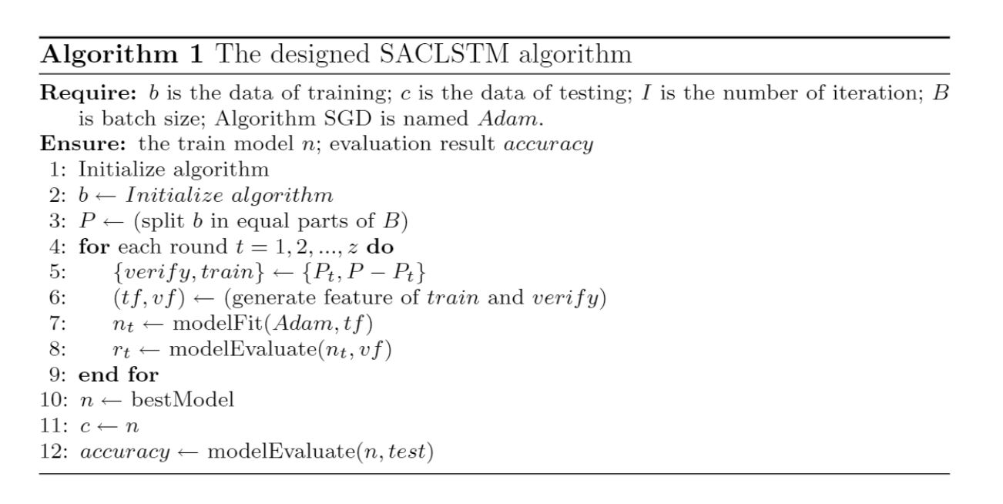
Third paper, part two.
One thing that confuses me is that they've stated "Algorithm SGD is named Adam". Look at the first line of the picture on the left.
We already know that SGD and Adam are both optimizers....separate ones too.
Which one do you think they are using??
Adding to the evaluation, they have boasted how their model is better than a CNN, SVM and a standard NN.
This is the pseudocode for their SACLSTM algorithm:

Slide 15
Now, fourth one.
'Stock Pattern Recognition with Deep Learning'
This is the fourth paper.
It's a relatively short paper.
Some of the patterns which Shree Harish was talking about in the last meet were covered here...
They even discussed the triangle pattern too.
It's not much to show...they've talked about the basics, mostly.

Slide 16
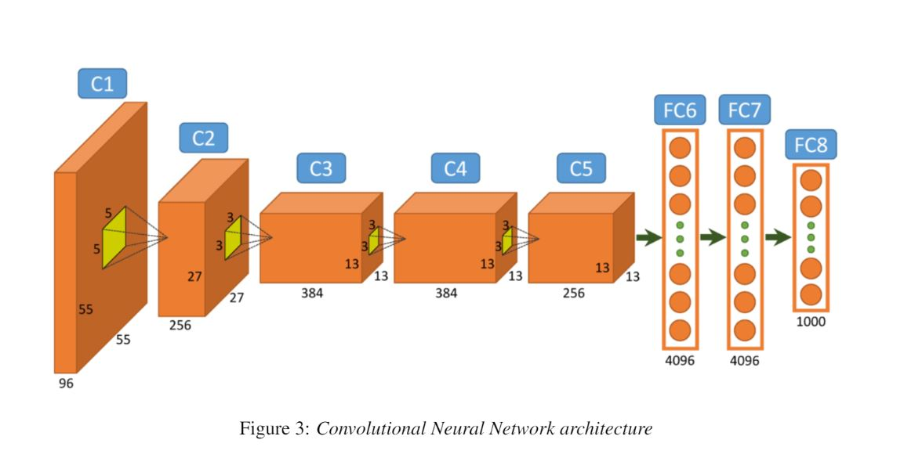
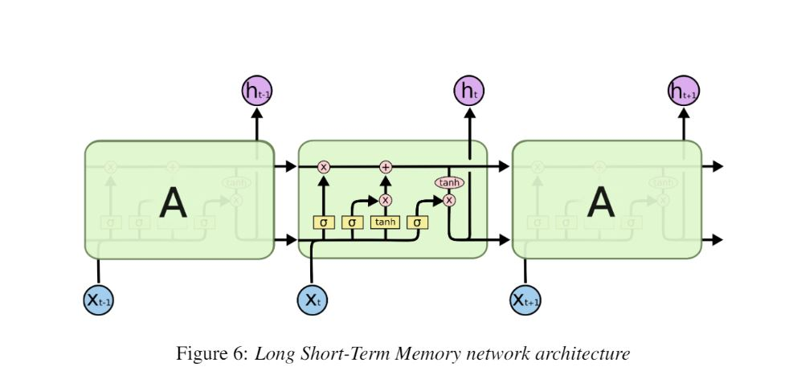
Fourth paper, part one.
Anyway, in the paper they've shown the base LSTM and CNN architecture. I'll put it here.
They've stated they used OLHC curves to train their CNN. Not sure what are OLHC curves.
They’ve also tried to find recurring instances of the bearish flag pattern. That's more or less it...it's the shortest paper here, without a doubt.

Slide 17
Now, fifth one.
'Deep Candlestick Mining'
Written by Andrew. D. Mann and Denise Gorse.
So this is the fifth paper.
It mostly focusses on the different patterns of candlesticks.
They used a dataset ranging 11 years, of hourly data to train their LSTM.
The new thing is they've used clustering (K-Means) to cluster the LSTM RNN factors.
Most of this paper's content is going above my head.....
I think we should go slowly on this one.

Slide 18
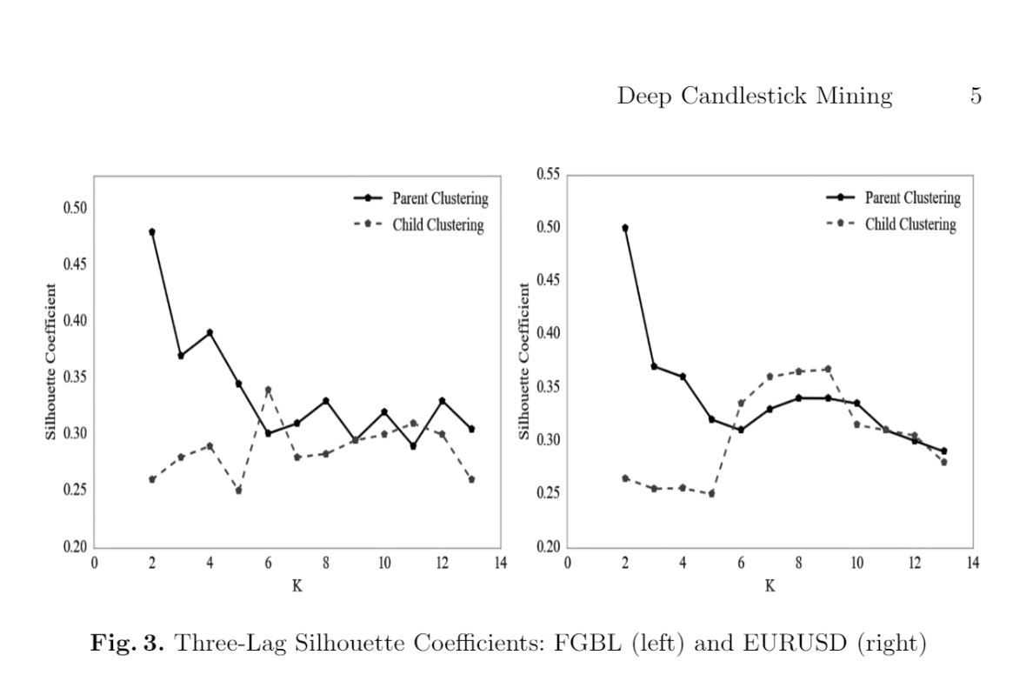
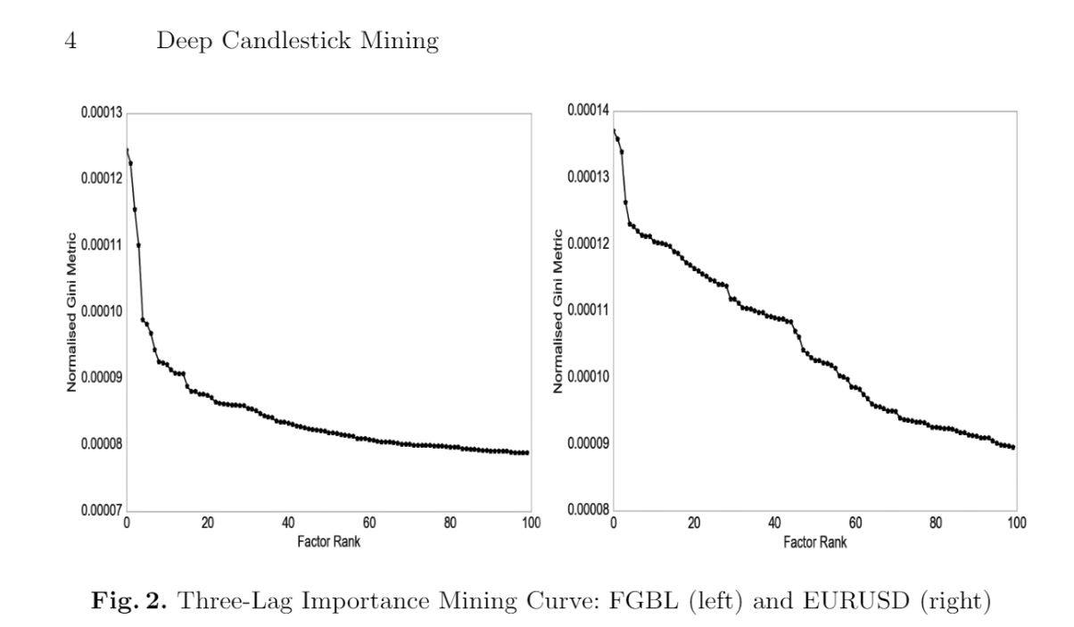
Fifth paper, part one.
Can you understand these graphs? I sure can't....
They seem to consider a "lag" of some sort....
Google says: "The lag time is the time between the two time series you are correlating."
We'll need to investigate this further later.

Slide 19
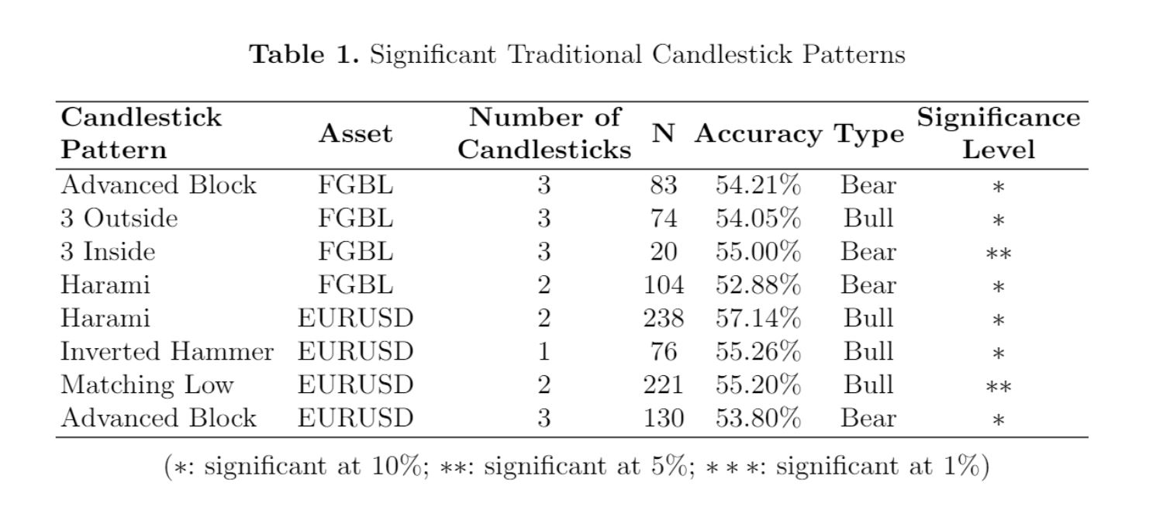
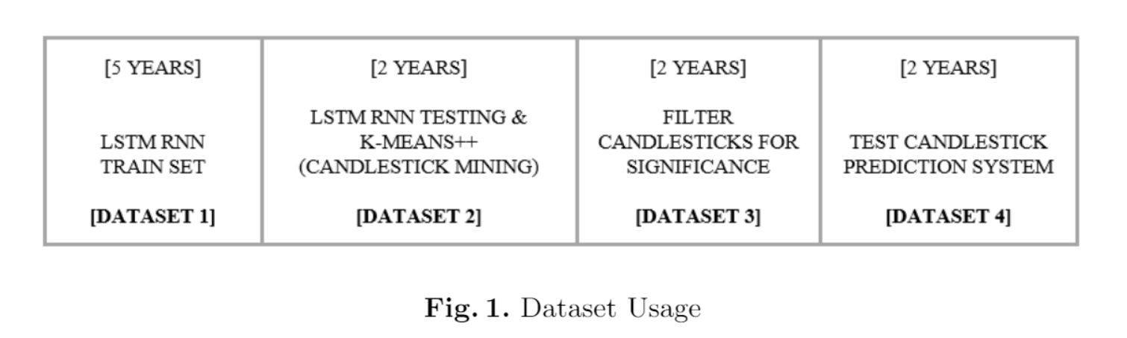
Fifth paper, part two.
And also these are the significant candlestick patterns they've obtained.
They seem to have used four data sets for different experiments.
I guess Harish would have a better idea on interpreting this table. By the way, what does Bear and Bull mean?
That's about it for now. The next slide is the last.
The question is why they mined candlesticks from data set 2 and filtered them in data set 3?
We'll have to look into that.

Slide 20

The End. Thanks for reading!

