Slide 1
EdgeVision PPE Compliance Platform
Final Technical Submission
Production Model V3-HN

Slide 2
The Problem
Manual industrial safety monitoring is insufficient:
• Human error and delayed detection
• Simple object detection fails (e.g. helmet on table)

Slide 3
The EdgeVision Solution
A multi-stage AI pipeline:
• Person Tracking (ByteTrack)
• PPE Detection (YOLOv8)
• Spatial Association
• Temporal Validation

Slide 4
System Architecture
• ML Pipeline: YOLO + ByteTrack
• Backend: FastAPI REST API
• Database: PostgreSQL
• Frontend: Next.js Dashboard
• Edge Target: Jetson via TensorRT

Slide 5
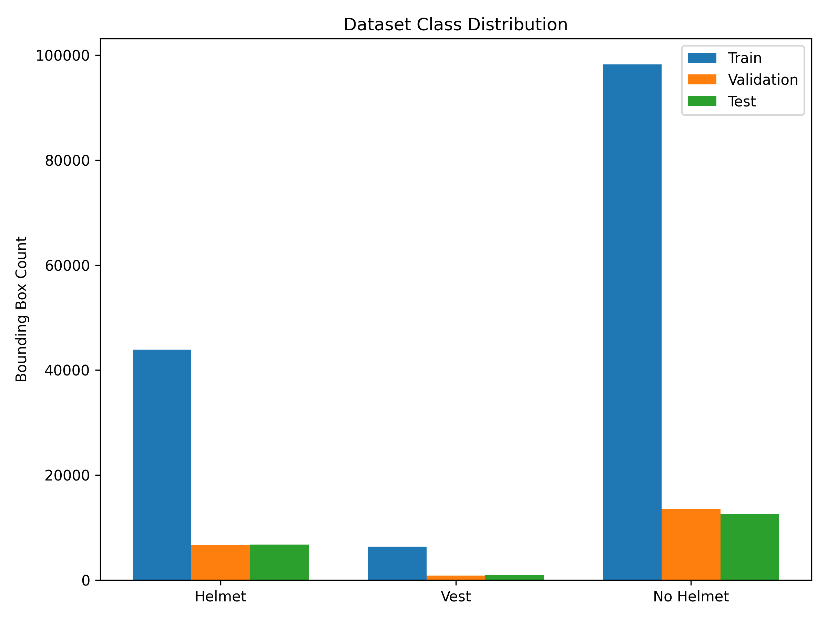
Dataset Statistics

Slide 6
V2 Baseline Limitations
• High Validation Accuracy (84.45% mAP50)
• BUT high false positives in real-world scenarios
• Example: Yellow pipes classified as helmets

Slide 7
V3-HN Hard-Negative Mining
• Trained with background images of visually similar objects
• Eliminated 100% of real-world false positives
• Maintained 84.20% mAP50

Slide 8
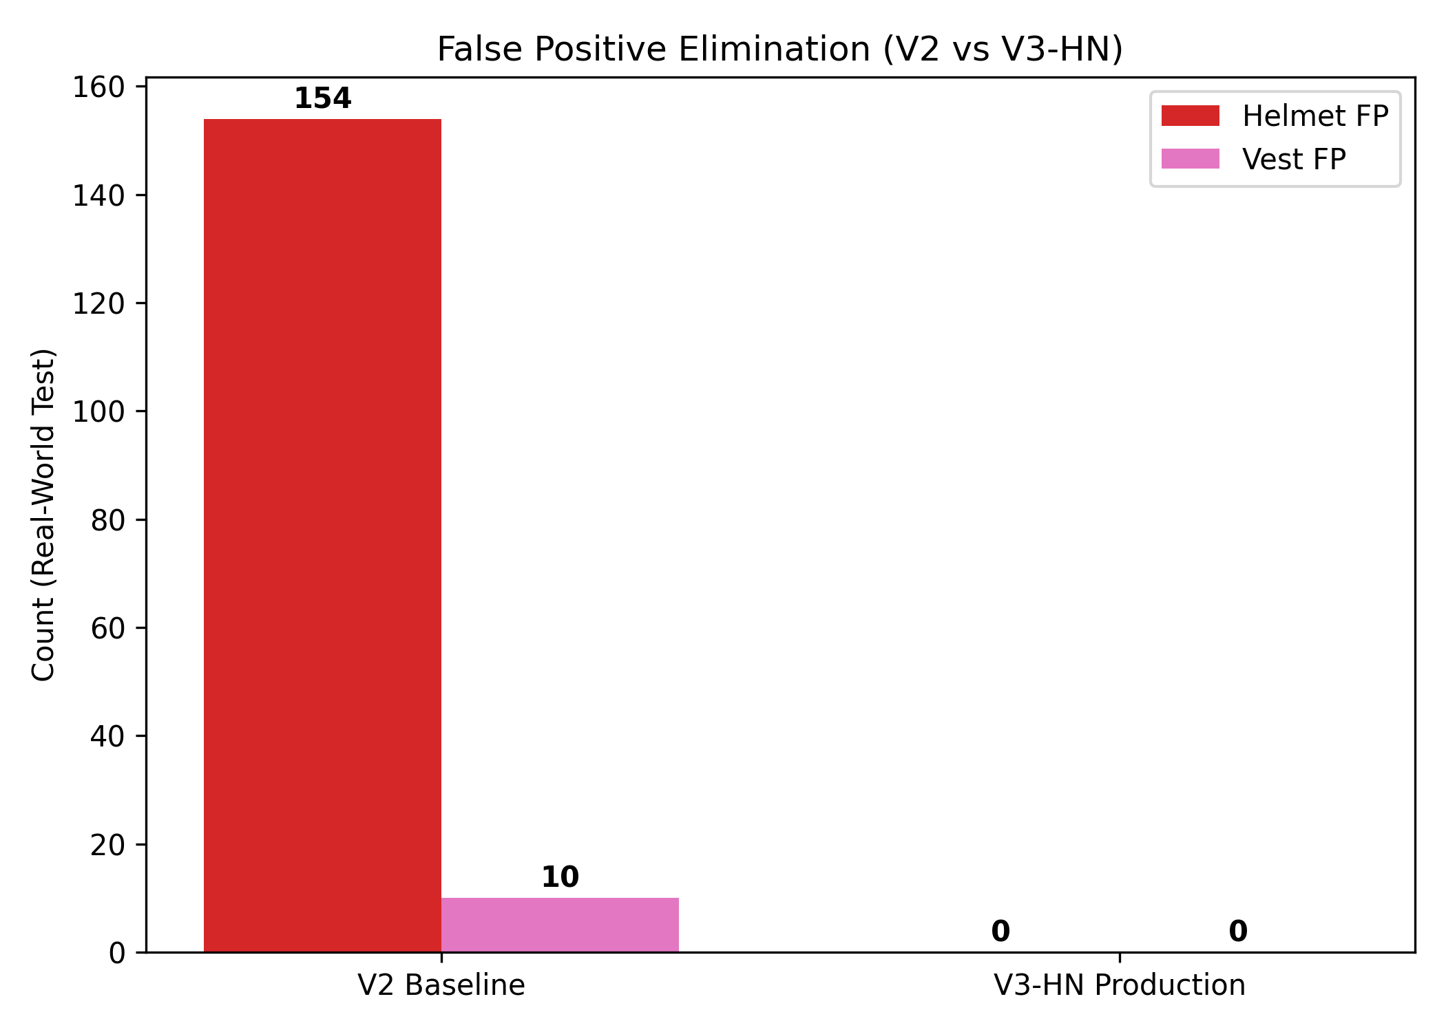
False Positive Elimination

Slide 9
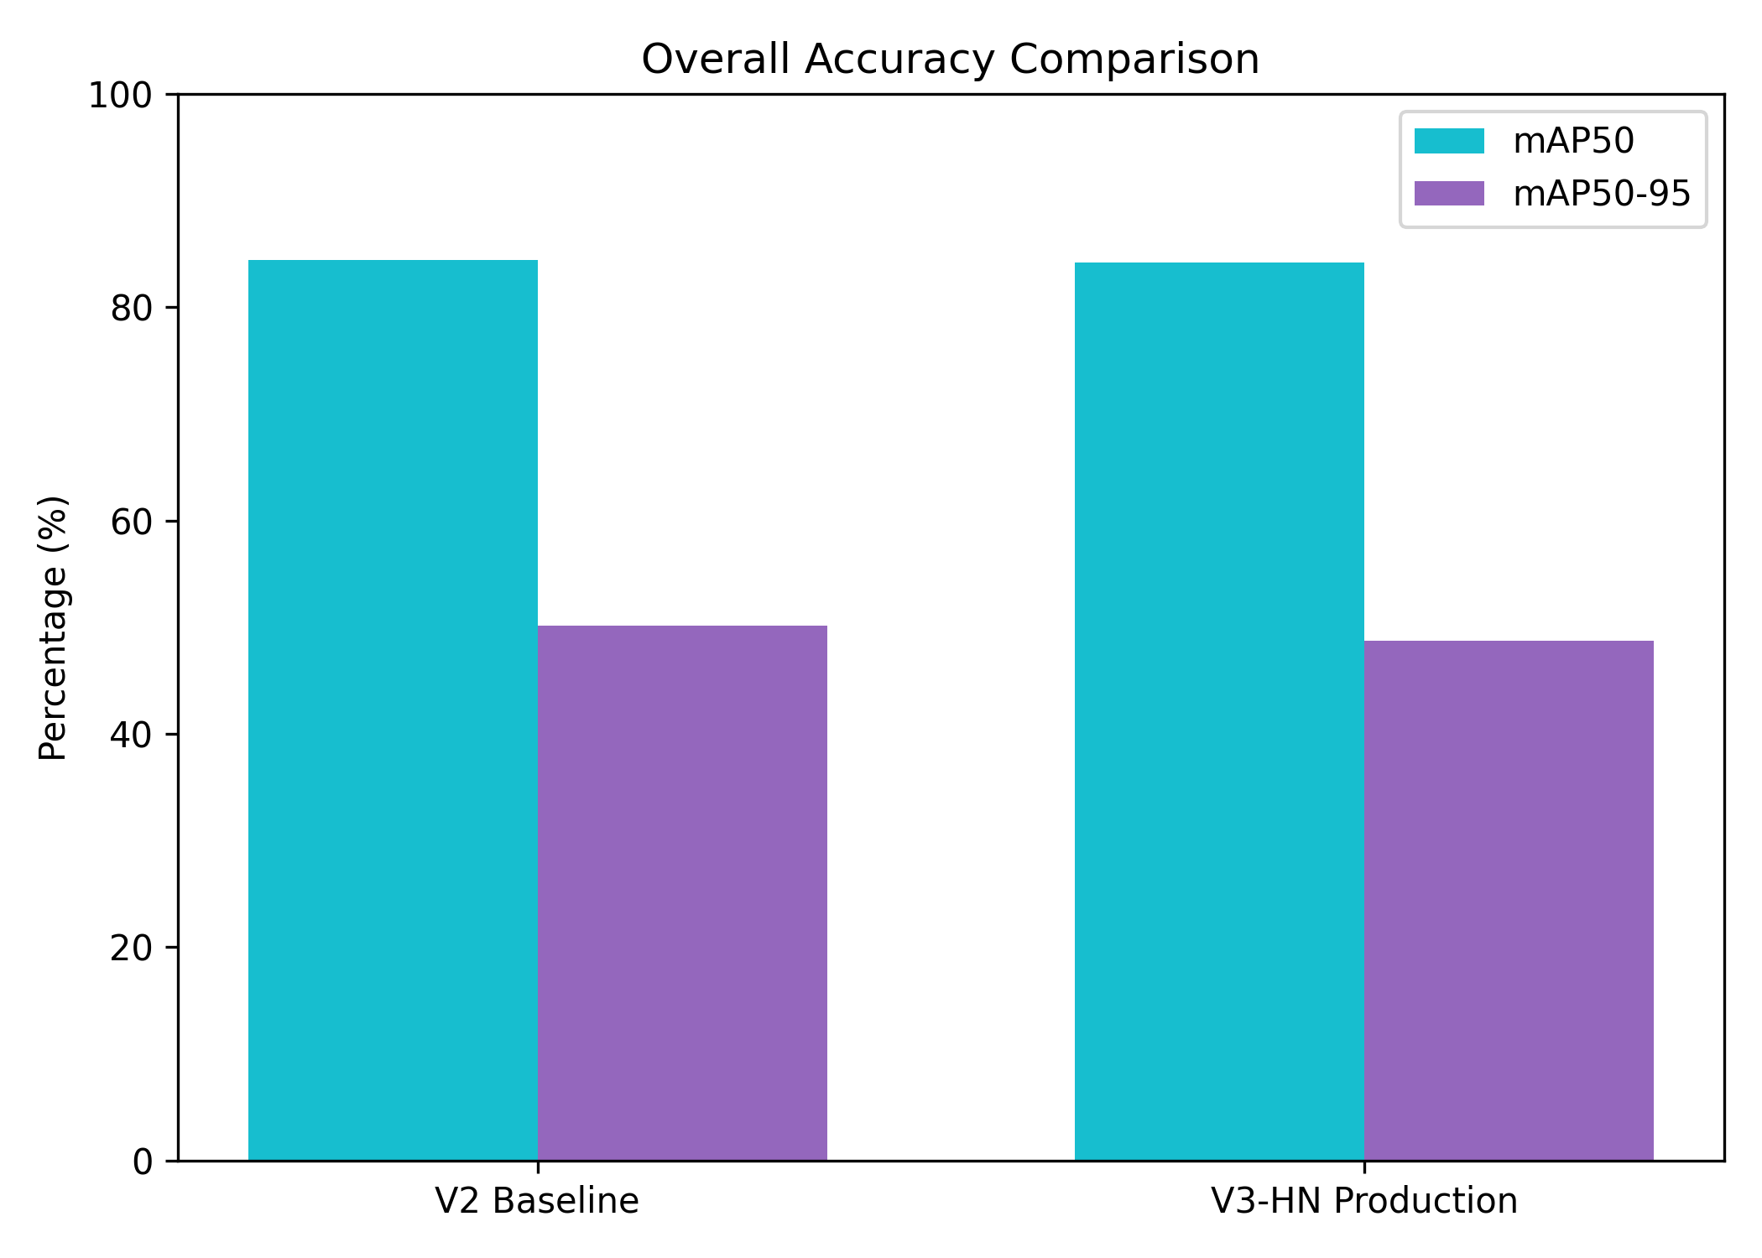
Overall Accuracy Comparison

Slide 10
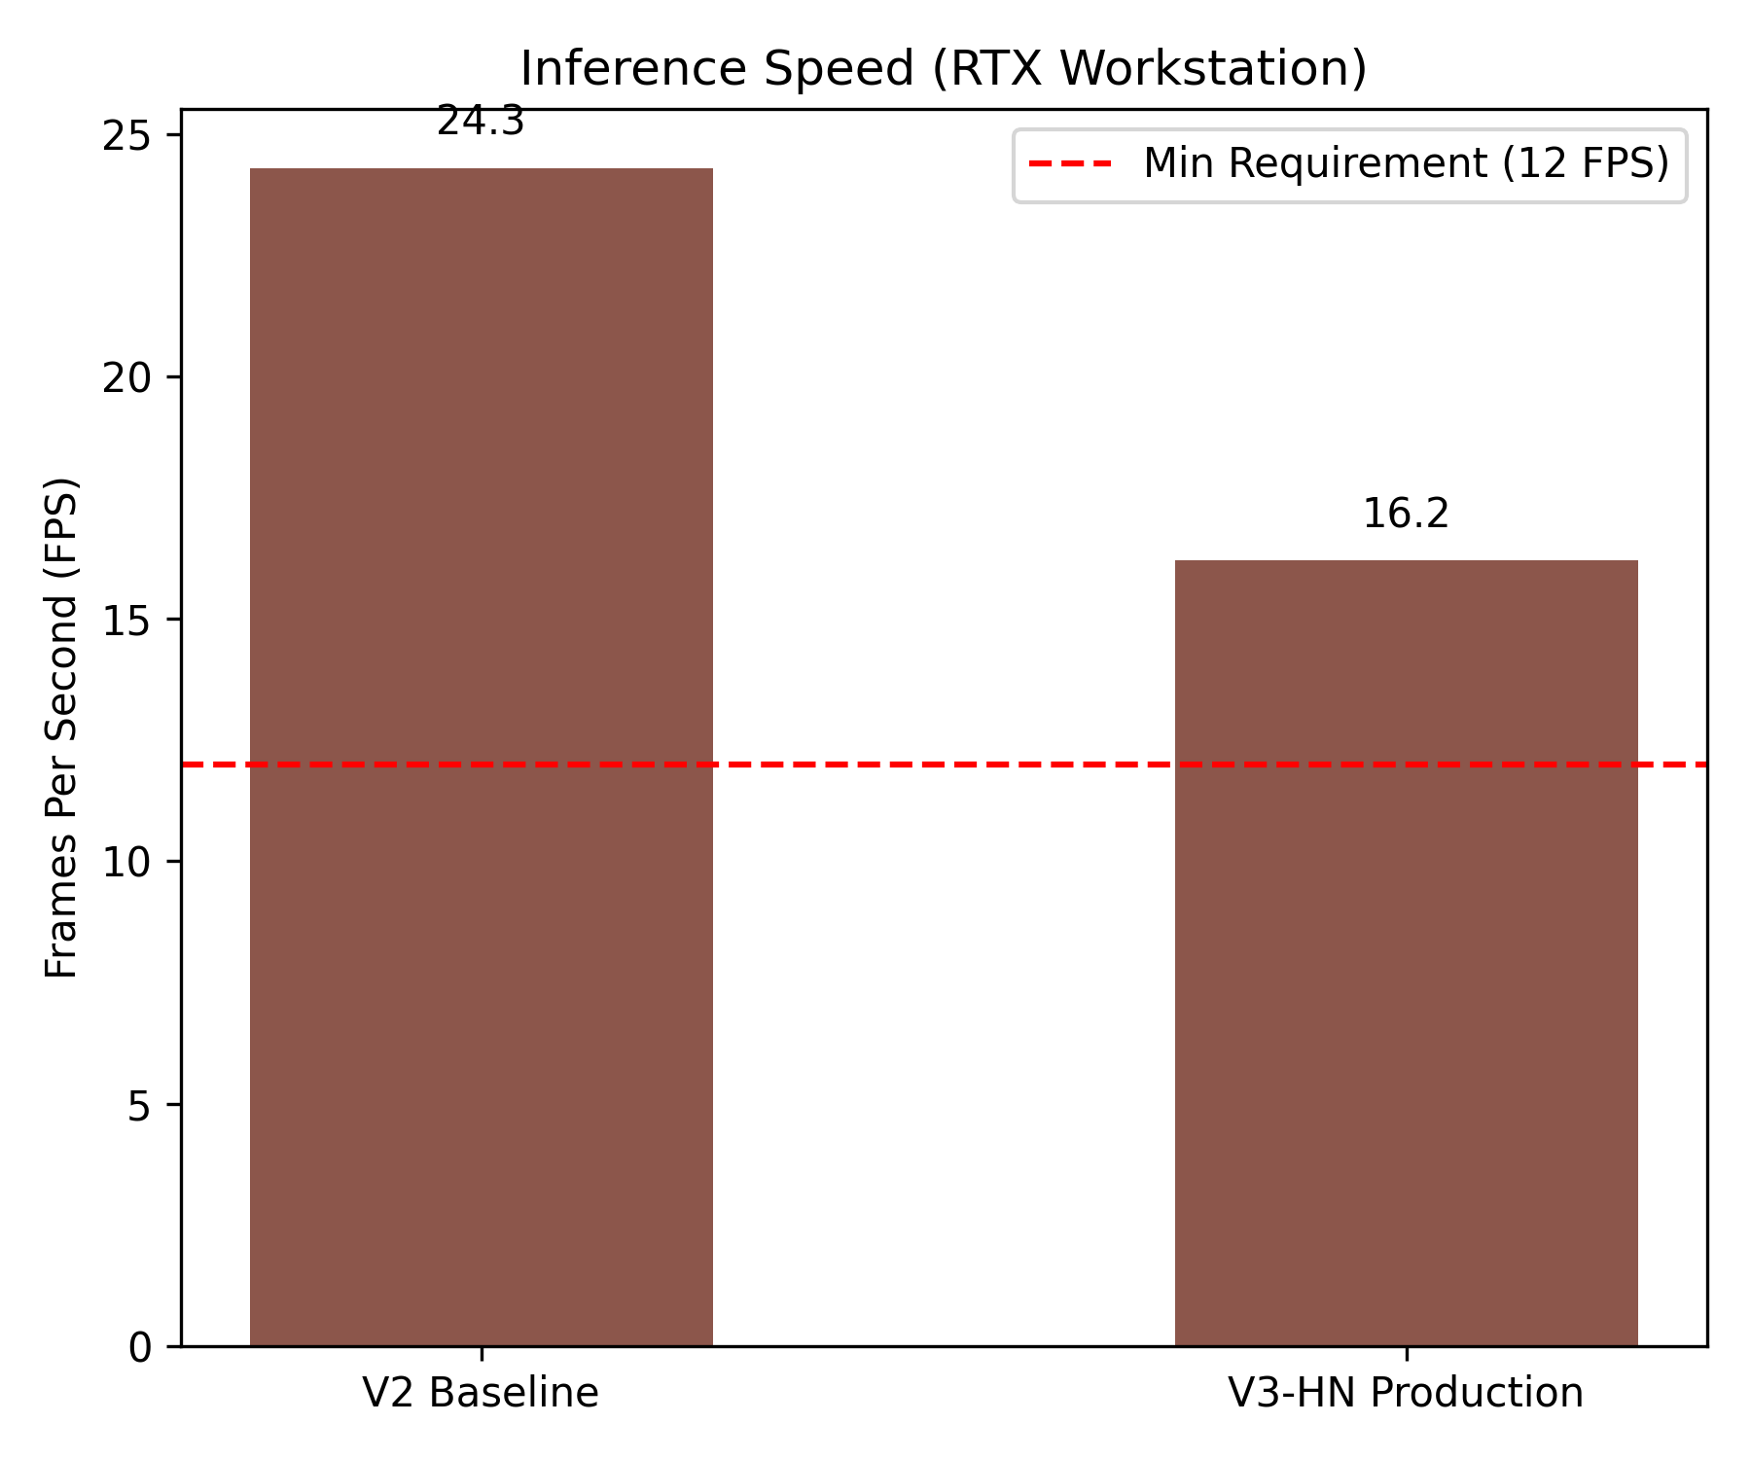
Inference Speed (FPS)

Slide 11
Deployment Status
• ONNX Export Script Prepared
• TensorRT Execution Pipeline Validated
• Jetson Hardware Benchmarks: PENDING

Slide 12
Web Dashboard & API
• Next.js Frontend operational
• Live Monitoring & Evidence viewing
• FastAPI Backend successfully tested (100% Pytest PASS)

Slide 13
Limitations & Future Work
• Boots/Harness Unsupported (Pending dataset collection)
• Jetson Physical Validation Required
• Future: Multi-camera DeepStream integration

