Slide 1
Effect of Model Compression on various DNN models for Pneumonia Classification
Submitted To Submitted By
Dr. Pravendra Singh Ritika Khurana

Slide 2
Contents
Introduction
Transfer Learning
Pruning
DNN models used
Performance measures
Dataset
Procedure
Results
References

Slide 3
Introduction
Pneumonia is a serious infection of one or both of the lungs caused by bacteria, viruses, or fungi.
It is the cause of death of around 22 percent of children every year, as per a UNICEF study.
In order for patients to obtain treatment in a timely way and fast-track the process of recovery, it is essential to have rapid and accurate pneumonia detection.
Although many machine/deep learning methods have already been investigated, still, there is a need for further improvement.
Deploying a deep learning model for portable and inexpensive, small-scale devices is a significant bottleneck. To address this issue, model compression can be used.

Slide 4
Model compression is a technique to reduce model size while minimising accuracy or performance loss. This reduction in size is significant because larger neural networks are difficult to deploy on resource-constrained devices.
One of the techniques for model compression is pruning, which has been used in our experiments. Pruning is removal of parameters from an existing model to reduce computational resources required.
The Chest X-Ray Images Pneumonia dataset from Kaggle was used for the experimentation.
The aim of the experiment is to study the effect of model compression on VGG-16, AlexNet, ResNet50 models for Pneumonia Classification.
We compare the results with the help of various performance metrics, like sensitivity, specificity, accuracy, precision, and F-1 score.

Slide 5
Transfer Learning
Transfer learning is a machine learning method in which a model developed for one task is used as the foundation for a model on a different task.
As a result, the expertise of a previously trained machine learning model is applied to a different but related problem.
For example, in our case, a pretrained model that was previously trained on large-scale ImageNet dataset containing 1000 distinct categories, is further trained to classify chest x-ray images as normal or pneumonia infected.
Previous research has demonstrated that pre-trained models outperform untrained models and have become the preferred method for training networks on other datasets rather than training the model from scratch.
Transfer learning has several advantages, but the main ones are saving training time, improving neural network performance (in most cases), and not requiring a large amount of data.

Slide 6
Pruning
Pruning is the methodical removal of parameters from a trained model, in order to cut down on the amount of computing power and time necessary to run the neural network. It is a popular model compression technique.
Individual parameters are pruned using Unstructured Pruning Methods. We call this "Weight Pruning" because we set individual weights in the weight matrix to zero.
Unstructured pruning does not take into account any relationship between the pruned weights. For the purpose of our experiments, we have used unstructured pruning.
Structured Pruning Methods look at parameters in groups, removing entire neurons, filters, or channels to take advantage of hardware and software designed for dense computation.
Structured pruning is also called Unit/Neuron Pruning because we set entire columns of the weight matrix to zero, effectively deleting the corresponding output neuron.

Slide 7
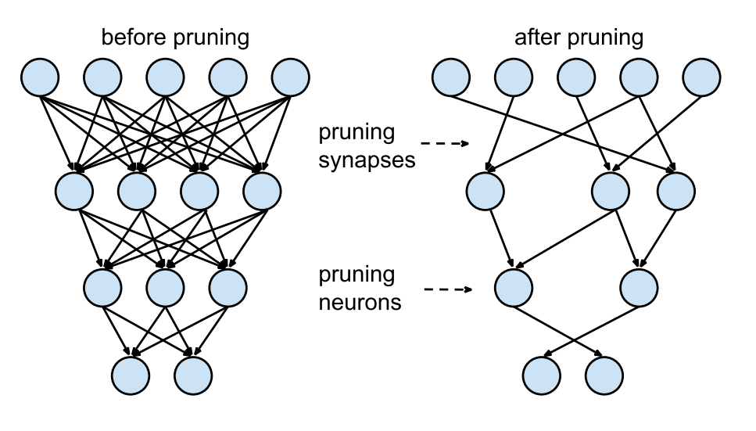
Fig. A basic structure of Pruning

Slide 8
DNN Models used
DNN models used in our experiments are as follows:
VGG-16
VGG-16 is a 16 layers weighted CNN model. It has been acknowledged as the top computer vision model available today.
Throughout the whole architecture, the convolution and max pool layers are uniformly ordered. There are 13 convolution layers, 5 max-pooling layers and 3 dense layers.
ReLU activation function is used by all hidden layers since it is effective and prevents vanishing gradient problem.
The imagenet dataset is used to train the model.
It can classify 1000 images from 1000 different categories with an accuracy of 92.7 percent, which is further easily implemented with Transfer Learning.

Slide 9
2. AlexNet
AlexNet is a convolutional neural network architecture, designed by Alex Krizhevsky in collaboration with Ilya Sutskever and Geoffrey Hinton and won the ImageNet LSVRC (Large Scale Visual Recognition Challenge) competition in 2012.
AlexNet consists of 8 weighted layers, including 5 convolution layers with a combination of max-pooling layers and 3 fully connected layers.
AlexNet also employs ReLU (Rectified Linear Unit) activation function and showed that deep CNNs can be trained significantly more quickly utilising ReLU nonlinearity than they could using saturating activation functions like tanh or sigmoid.
The imagenet dataset is used to train the model.

Slide 10
3. ResNet50
ResNet-50 is a convolutional neural network that is 50 layers deep. It has 48 Convolution layers along with 1 MaxPool and 1 Average Pool layer.
When we add more layers to NN, a typical deep learning issue known as the Vanishing/Exploding gradient arises. This results in the gradient becoming zero or being overly large. Therefore, the training and test error rate similarly increases as the number of layers is increased.
Researchers developed ResNet to solve the problem of vanishing/exploding gradient.
The skip connection bypasses some levels in between to link layer activations to subsequent layers. This creates a leftover block. These leftover blocks are stacked to create resnets.

Slide 11
Performance Measures
The following performance measures are used to compare the performance of the models before and after pruning:
Accuracy: It is the proportion of correct predictions to total number of predictions, multiplied by 100.
Accuracy= ( TP + TN )/( TP + TN + FP + FN )
Precision: Precision is defined as the proportion of correctly classified positive samples (True Positive) to the total number of positive samples classified (either correctly or incorrectly.
Precision = TP/(TP+FP)
Sensitivity: The sensitivity of a machine learning model is a measure of its ability to detect positive instances.
Sensitivity = (TP)/(TP + FN)

Slide 12
4. Specificity: The proportion of true negatives correctly identified by the model is measured as specificity. A high specificity indicates that the model correctly identifies the majority of negative results, whereas a low specificity indicates that the model incorrectly labels many negative results as positive.
Specificity = (TN)/(TN + FP)
5. F-1 score: F1 is a overall measure of a model's accuracy. A good F1 score indicates that you have a low number of false positives and false negatives. A classification model's F1-score is calculated as follows:
F-1 Score = 2 * (Precision * Recall)/(Precision + Recall)

Slide 13
Dataset
The Chest X-Ray Images Pneumonia dataset from Kaggle was used for the experimentation.
This dataset was presented by Kermany et al. in 2018.
It contains 5232 chest X-ray images from children from one to five years old.
This dataset includes 3883 images characterized as depicting pneumonia (2538 bacterial, and 1345 viral) and 1349 labeled as normal images from a total of 5856 patients.
The dataset includes its own test set with 234 normal images and 390 pneumonia images (242 bacterial and 148 viral) from the left 624 patients.
The dataset is available to download at: https://data.mendeley.com/datasets/rscbjbr9sj/2

Slide 14
Procedure
Step 1: Load the dataset.
Data loading is an essential part of any machine learning system. PyTorch provides users with the DataLoader class to efficiently load and iterate over elements in a dataset. This class is available in the torch.utils.data module as DataLoader.
Step 2: Visualize the dataset.
The graphical representation of information and data in a pictorial or graphical format is known as data visualisation (Example: charts, graphs, and maps). In our project, we made use of Matplotlib for data visualization. Matplotlib is a Python library that allows you to create static, animated, and engaging visualisations.
Step 3: Load pre-trained models.
For our experiments, we are using pre-trained models - VGG-16, AlexNet and ResNet50. These are pre-trained models that were trained on ImageNet dataset on 1000 different categories. It is a very common practice to use pre-trained models as a base model, and freeze a few initial layers, as is done in our experiment.

Slide 15
Step 4: Prune unimportant filters
In this step, 20% global unstructured pruning is applied on the models. In this, instead of specifying individual pruning parameters for individual layers, we apply pruning across the entire model as a whole. As a result, we can prune less useful (lower entropy) layers more aggressively than more useful (higher entropy) layers. Hence, all parameters are pooled together across layers and a global 20% fraction of them are pruned, rather than pruning 20% of each layer.
Step 5: Training phase
In this phase, the model is trained using Pneumonia chest xray dataset which was loaded earlier and the NNs are configured to produce the desired output. Training is done in 30 epochs.
Step 6: Testing phase
Following model training, the model is tested to determine its performance on test data which is previously unseen by the model. Performance metrics like accuracy, precision, sensitivity, specificity and f-1 score are calculated to evaluate the model's performance and generalisation.
Step 7: Compare results of pruned and unpruned models.
Finally, we compare results of pruned and unpruned models to determine the loss of model accuracy caused during pruning process.

Slide 16
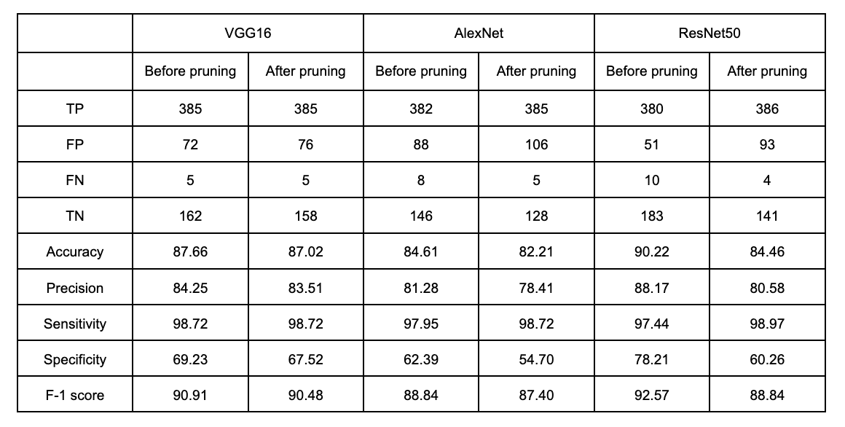
Results
The following table summarizes the results obtained from the experiments conducted on VGG-16, AlexNet and ResNet50. We can observe that pruning causes the model performance to decrease, as measured by the given performance metrics.

Slide 17
Future Prospects
Propose a novel approach for model compression that can reduce computational resources and time required, without sacrificing on model’s accuracy.
Compare its effects on model’s performance of various DNNs for pneumonia detection.
Reproduce and compare results for another dataset of chest X-rays for pneumonia detection

Slide 18
References
[1] Juan Eduardo Luján-García, Cornelio Yáñez-Márquez , Yenny Villuendas-Rey 2,and Oscar Camacho-Nieto ,"A Transfer Learning Method for Pneumonia Classification and Visualization" Appl. Sci. 2020, 10, 2908; doi:10.3390/app10082908.
[2] Tejalal Choudhary, Vipul Mishra, Anurag Goswami, Jagannathan Sarangapani "A transfer learning with structured filter pruning approach for improved breast cancer classification on point-of-care devices" Computers in Biology and Medicine 134 (2021) 104432
[3] [Compressing BERT: Studying the Effects of Weight Pruning on Transfer Learning](Gordon et al., RepL4NLP 2020)
[4] Bingyan Liu, Yifeng Cai, Yao Guo, Xiangqun Chen "TransTailor: Pruning the Pre-trained Model for Improved Transfer Learning" arXiv:2103.01542
[5] SIVARAMAKRISHNAN RAJARAMAN ,PHILIP O. ALDERSON,LUCAS S. FOLIO4,5, LES R. FOLIO6, AND SAMEER K. ANTANI "Iteratively Pruned Deep Learning Ensembles
for COVID-19 Detection in Chest X-Rays"

Slide 19
THANK YOU

