Slide 1
WealthFactor
Shree, Harsh, Dennis, Aixa

Slide 2
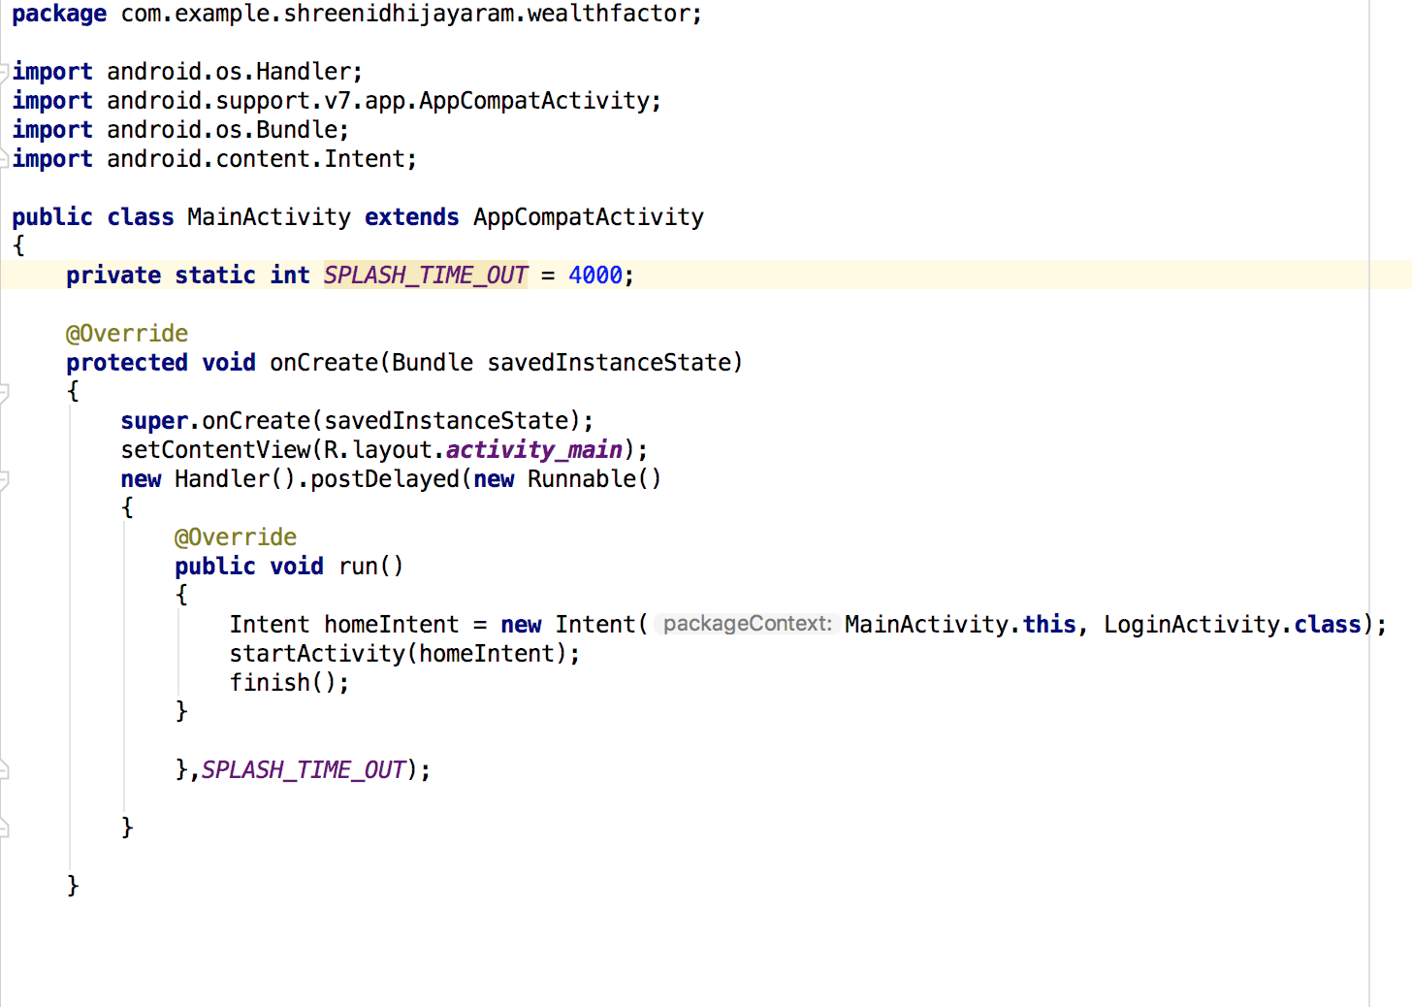
Main Activity
This section opens the app. It also has a four second delay. This displays the App name and initial background.

Slide 3
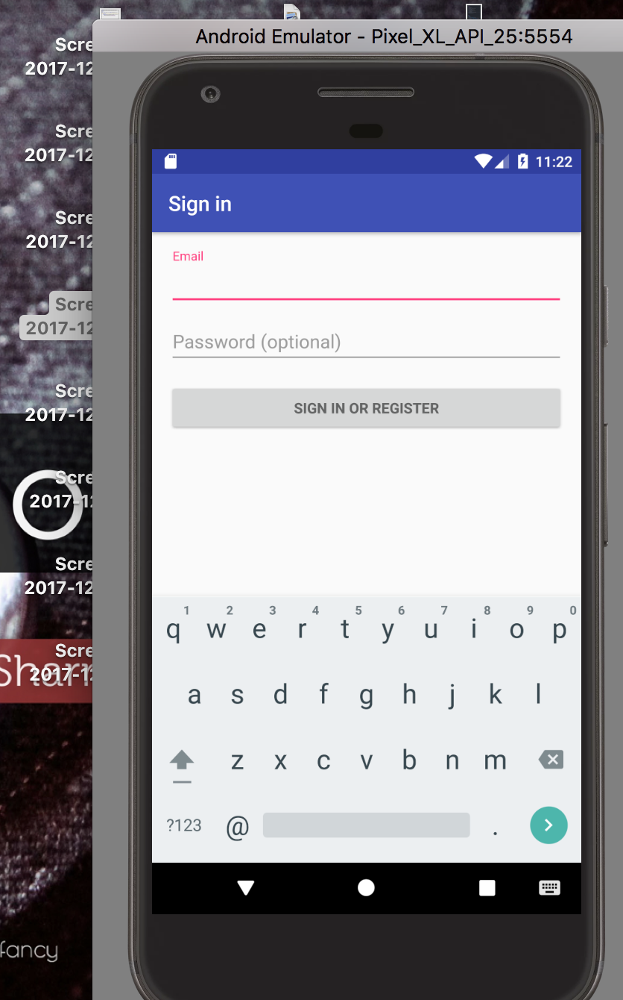
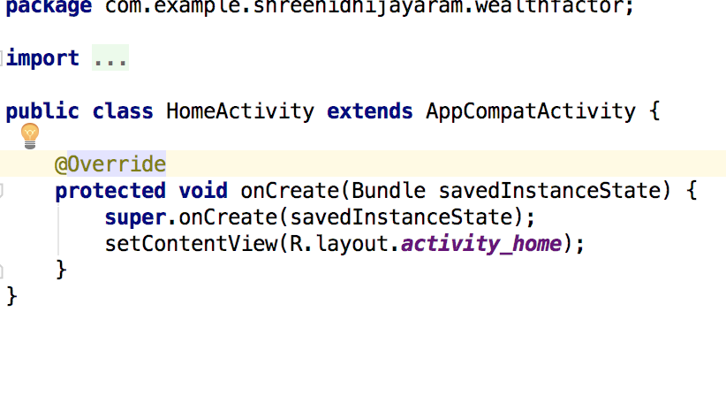
Home Activity
This does nothing, it is just a landing page that can be linked to.

Slide 4
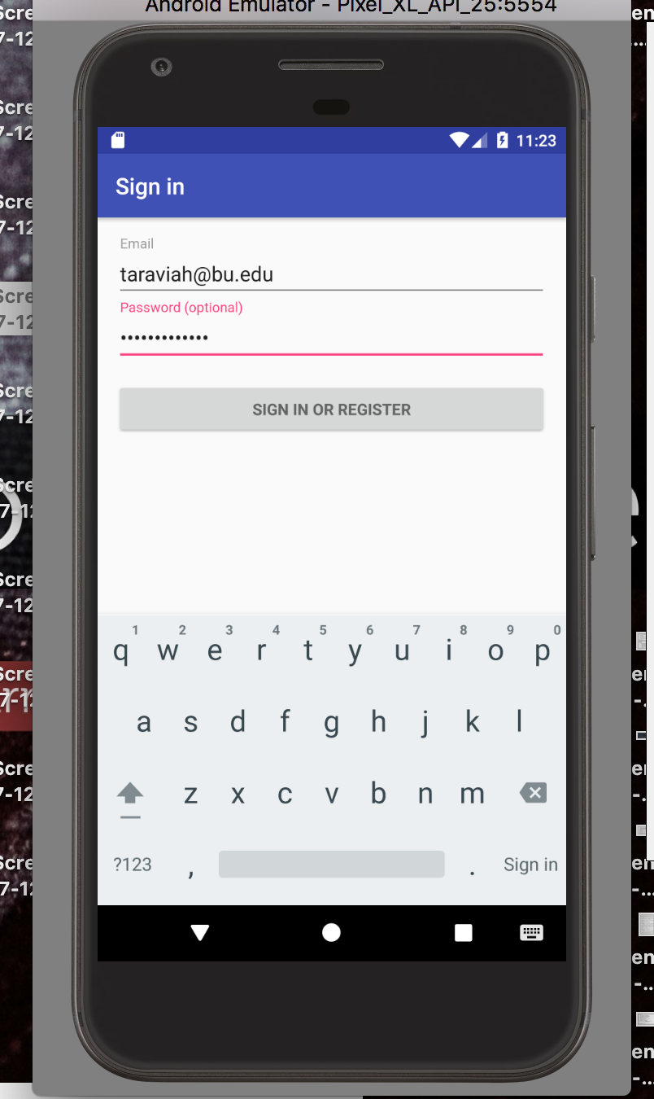
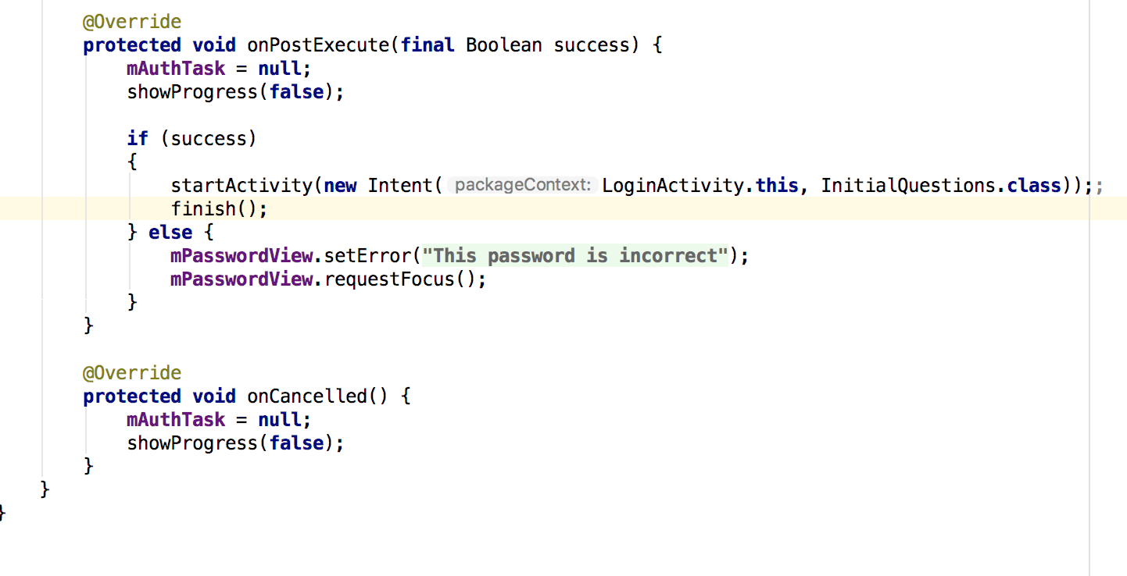
Login Activity
This prompts the user to enter in an email and a password. If either the email or the password is in the wrong syntax, it shows an error and you can’t continue.

Slide 5
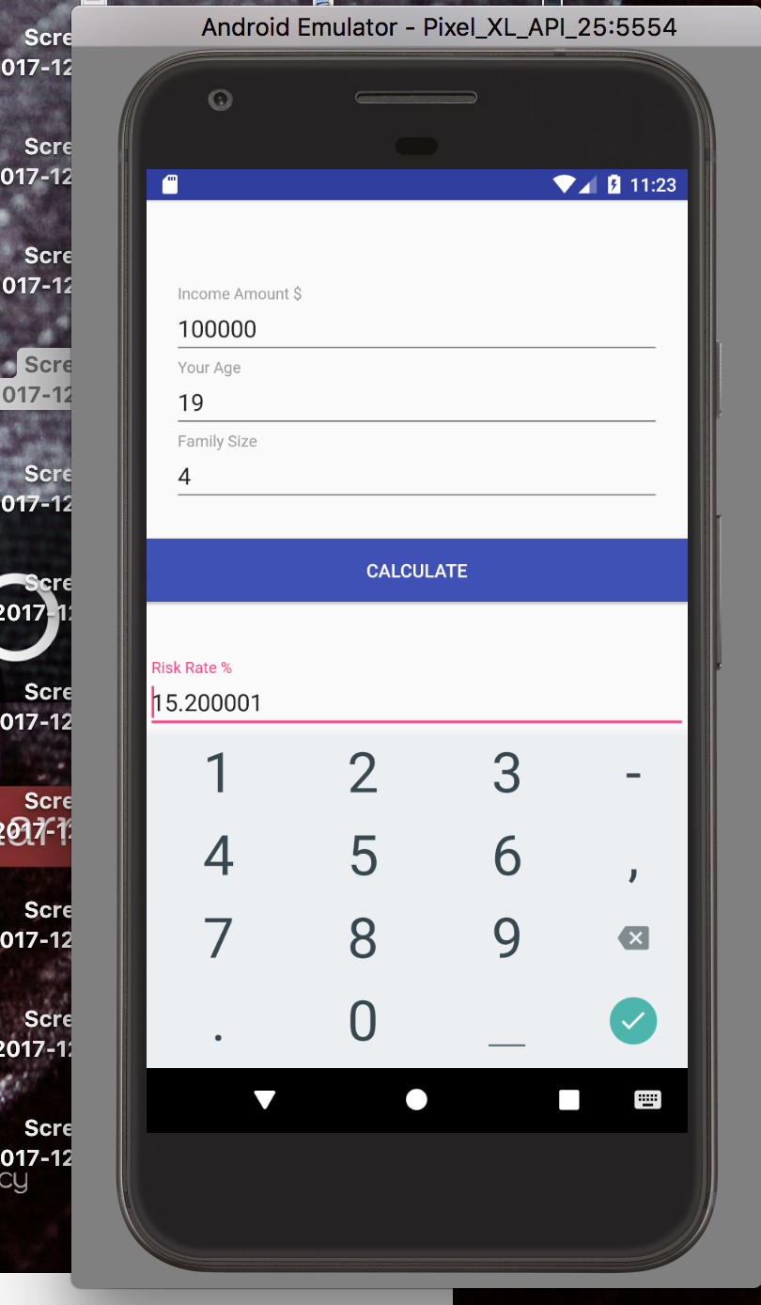
Initial Questions
This is the page after the login page. When you see this page it prompts the user to enter their income, their age, and their household size. If all three values are not of the integer type, the app doesn’t continue, and it prompts the user to reenter the values. After the first three are entered, the user’s risk factor is displayed, and they have the option to click next.

Slide 6
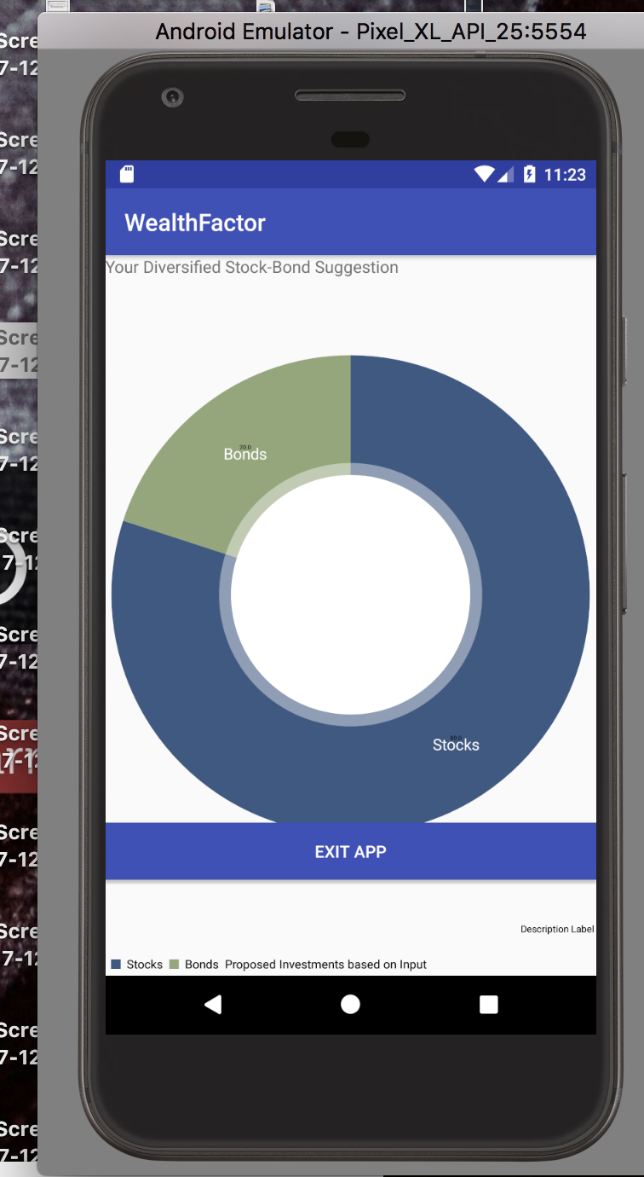
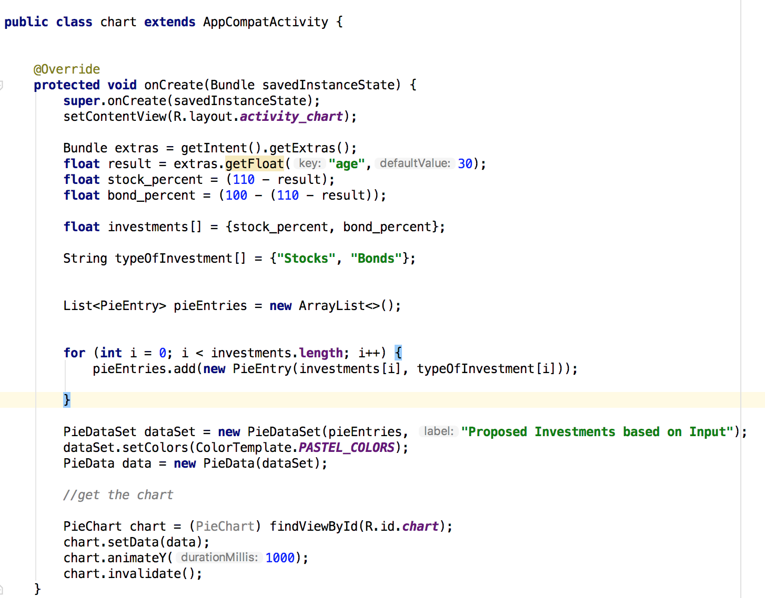
Chart
By clicking next, the app displays a pie chart graph of the calculated investment percentage the user should put in stocks and in bonds. Lastly, the app just exits.

