Slide 1

HACKATHON 1.0 2025
Title: Rural Healthcare AI Bot
Problem Statement:
Rural India faces severe healthcare access gaps due to doctor shortages and poor infrastructure.
Team Members:
Shree Nath Mahato
Arjun Chaudhary
Aditya Singh Baghel
Suraj Kumar

Slide 2
Problems & Challenges
Infrastructure and Access Gaps
80% shortfall in Community Health Centers (CHCs) Limited doctors and specialists in Tier 2/3 towns
Poor hospital infrastructure and emergency care
Time & Cost Barriers
Long travel times to reach hospitals High cost of private consultations
Long waiting periods for basic treatment
Digital Divide
Low-bandwidth and unstable internet in rural areas
Lack of healthcare content in local languages
Missed Opportunities
425M+ rural smartphone users, but no trusted health interface WhatsApp widely used, yet underutilized for healthcare
No centralized system for verified guidance or tele-consultation

Slide 3
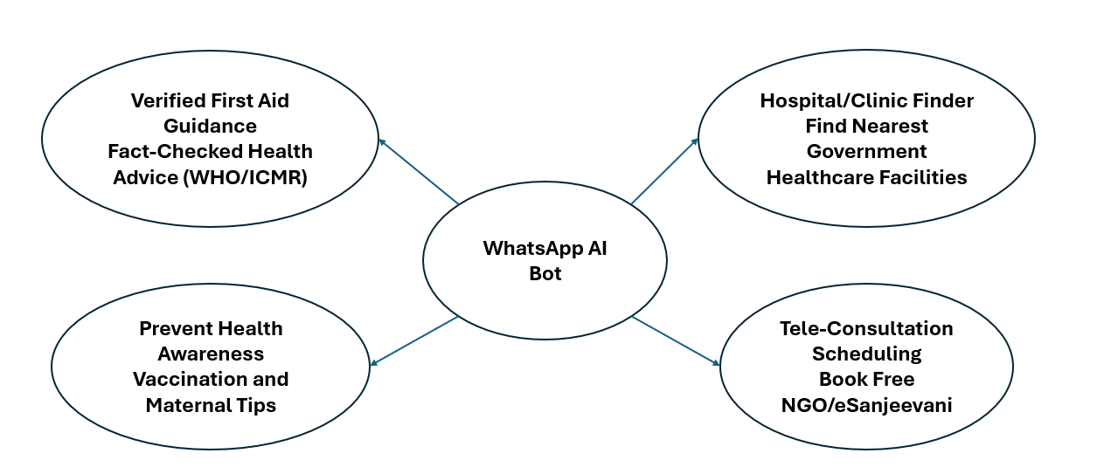
Our Solutions
AI-Powered Chatbot (via WhatsApp/Telegram):
Conversational interface for easy access.
Local language support using NLP + Speech-to-Text.
Handles low-bandwidth environments.
Verified First-Aid Guidance:
Based on WHO/ICMR knowledge base.
Delivers fact-checked responses instantly.
Hospital & Clinic Finder:
Uses government APIs + Google Maps.
Locates nearest public healthcare facilities.
Tele-Consultation Scheduling:
Connects to eSanjeevani or NGO doctors.
Enables free or low-cost virtual consultations.
Preventive Health Awareness:
Shares tips on vaccination, maternal health, hygiene.
Promotes community health literacy.

Slide 4
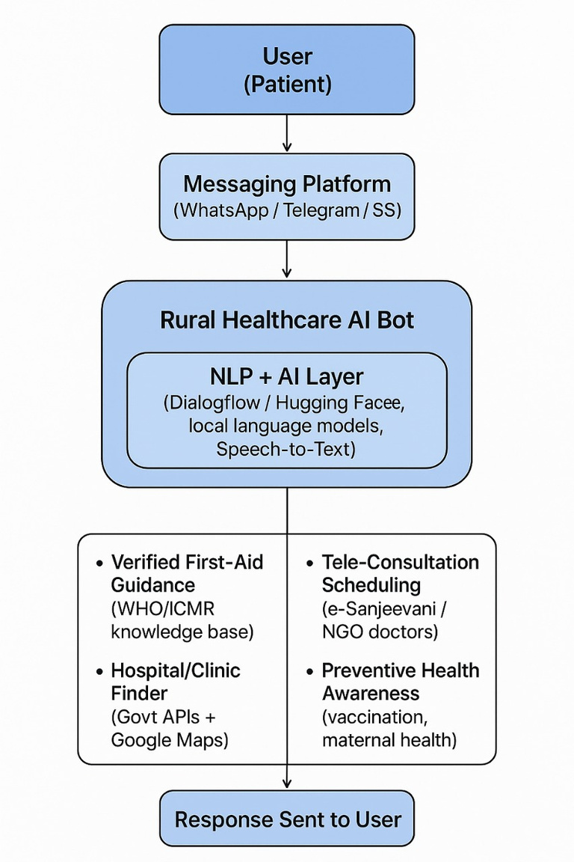
System Architecture
Rural Healthcare AI Bot
User Input:
Via WhatsApp / Telegram / Signal (Text/Voice).
NLP + AI Layer:
Dialog flow / Hugging Face / STT / Translation.
Core Services:
First-Aid Guidance (WHO/ICMR KB).
Hospital Finder (Govt + Maps API).
Tele-Consultation (eSanjeevani / NGOs).
Preventive Health Alerts (Vaccines, Maternal Care).
Response Delivery: Multilingual reply via same platform.
Tech Stack
Messaging & AI: WhatsApp (Twilio), Telegram API, Dialog flow, Hugging Face, Google STT. Backend & DB: Python (Flask), Firebase, PostgreSQL. APIs & Hosting: Google Maps, eSanjeevani, Render/AWS, Secure HTTPS.

Slide 5
Innovation And Impact
Multilingual AI Bot on WhatsApp/Telegram for rural accessibility
Integrated First-Aid + Hospital Finder + Tele-Consultation in one flow
Local Language NLP + Speech-to-Text for voice-based interaction
Verified Health Guidance using WHO/ICMR sources
API-Driven Automation for real-time hospital mapping and doctor scheduling
Accessible Healthcare for Tier 2/3 regions via familiar messaging apps
Reduced Burden on Clinics through remote triage and guidance
Improved Maternal & Preventive Care via awareness modules
Faster Emergency Response with location-based hospital info
NGO & Govt Integration for scalable, ethical deployment
Impact
Innovation

Slide 6
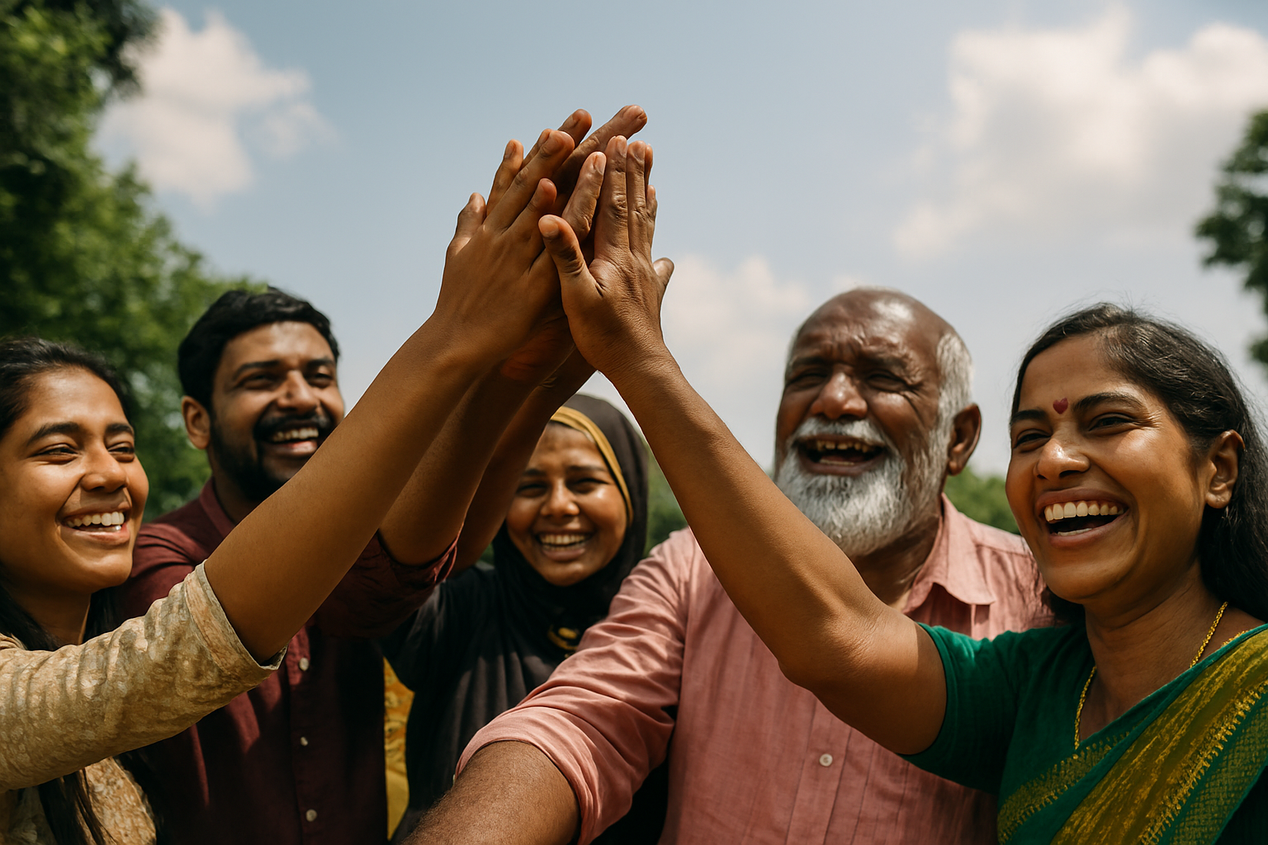
Outcomes And Conclusion
Outcomes
70%+ faster triage for rural patients via AI-guided first aid.
Increased access to verified clinics and tele-consultations.
Multilingual engagement boosts inclusivity across regions.
Improved maternal & preventive care through timely alerts.
Scalable model for NGO and government health programs.
Conclusion
The Rural Healthcare AI Bot bridges the gap between underserved communities and essential healthcare services using familiar tech, ethical AI, and verified data. It’s not just a chatbot—it’s a scalable, impact-driven solution for inclusive health access.

