Slide 1
FL Algorithm Comparison on
SAML-D
Nicolas Ordonez — UTS Master of AI
May 04, 2026

Slide 2
Index
Title ............................................. Slide 1
Overview .......................................... Slide 2
Methodology ....................................... Slide 3
Results ........................................... Slide 4
Analysis .......................................... Slide 7
FL Convergence .................................... Slide 12
Alpha Analysis .................................... Slide 13
Repository Changes ................................ Slide 14
Conclusions ....................................... Slide 15
References ........................................ Slide 16

Slide 3
Overview
Dataset: SAML-D (4 banks, 1,697 fraud instances in test set)
Algorithms: FedAvg, FedProx, FedNova, Scaffold, PersFL
Heterogeneity sweep: α ∈ {0.05, 0.1, 0.5} (Dirichlet)
Model types: MLP, LGB, XGB
Total configurations: 15 (5 algos × 3 alpha values)
Primary metric: AUPRC (Area Under Precision-Recall Curve)
Best AUPRC: 0.0676 (FEDAVG_LGB / TREE, α=0.5)

Slide 4
Methodology
• FedAvg: weighted average of client updates (McMahan et al., 2017)
• FedProx: proximal regularisation for heterogeneous clients (Li et al., 2020)
• FedNova: normalised averaging to correct objective inconsistency (Wang et al., 2020)
• Scaffold: control variates to reduce client drift (Karimireddy et al., 2020)
• PersFL: personalised per-client model adaptation
Training: 20 rounds · 4 clients · Base learners: MLP / LGB / XGB

Slide 5
Results: FEDAVG
Model | Alpha | F1 | AUPRC | MCC | Specificity
FEDAVG_MLP / TREE | 0.1 | 0.0254 | 0.0318 | 0.0322 | 0.7633
FEDAVG_LGB / TREE | 0.1 | 0.0028 | 0.0454 | 0.0085 | 0.1722
FEDAVG_XGB / TREE | 0.1 | 0.0029 | 0.0477 | 0.0094 | 0.1911
FEDAVG_MLP / TREE | 0.5 | 0.0215 | 0.0279 | 0.0439 | 0.9729
FEDAVG_LGB / TREE | 0.5 | 0.0032 | 0.0676 | 0.0113 | 0.4202
FEDAVG_XGB / TREE | 0.5 | 0.0031 | 0.0358 | 0.0114 | 0.5057
FEDAVG_MLP / TREE | 0.05 | 0.0137 | 0.0042 | 0.0164 | 0.9717
FEDAVG_LGB / TREE | 0.05 | 0.0059 | 0.0078 | 0.0043 | 0.6352
FEDAVG_XGB / TREE | 0.05 | 0.0028 | 0.0059 | 0.0060 | 0.2771

Slide 6
Results: FEDPROX
Model | Alpha | F1 | AUPRC | MCC | Specificity
FEDPROX_MLP / TREE | 0.1 | 0.0234 | 0.0329 | 0.0322 | 0.7644
FEDPROX_LGB / TREE | 0.1 | 0.0028 | 0.0454 | 0.0085 | 0.1722
FEDPROX_XGB / TREE | 0.1 | 0.0029 | 0.0477 | 0.0094 | 0.1911
FEDPROX_MLP / TREE | 0.5 | 0.0187 | 0.0272 | 0.0373 | 0.9722
FEDPROX_LGB / TREE | 0.5 | 0.0032 | 0.0676 | 0.0113 | 0.4202
FEDPROX_XGB / TREE | 0.5 | 0.0031 | 0.0358 | 0.0114 | 0.5057
FEDPROX_MLP / TREE | 0.05 | 0.0179 | 0.0418 | 0.0246 | 0.9805
FEDPROX_LGB / TREE | 0.05 | 0.0059 | 0.0078 | 0.0043 | 0.6352
FEDPROX_XGB / TREE | 0.05 | 0.0028 | 0.0059 | 0.0060 | 0.2771

Slide 7
Results: PERSFL
Model | Alpha | F1 | AUPRC | MCC | Specificity
PERSFL_MLP / TREE | 0.1 | 0.0141 | 0.0205 | 0.0184 | 0.7115
PERSFL_PERSONAL / TREE | 0.1 | 0.0141 | 0.0205 | 0.0184 | 0.7115
PERSFL_LGB / TREE | 0.1 | 0.0028 | 0.0454 | 0.0085 | 0.1722
PERSFL_XGB / TREE | 0.1 | 0.0029 | 0.0477 | 0.0094 | 0.1911
PERSFL_MLP / TREE | 0.5 | 0.0126 | 0.0208 | 0.0178 | 0.9901
PERSFL_PERSONAL / TREE | 0.5 | 0.0134 | 0.0206 | 0.0203 | 0.9854
PERSFL_LGB / TREE | 0.5 | 0.0032 | 0.0676 | 0.0113 | 0.4202
PERSFL_XGB / TREE | 0.5 | 0.0031 | 0.0358 | 0.0114 | 0.5057
PERSFL_MLP / TREE | 0.05 | 0.0120 | 0.0365 | 0.0147 | 0.9900
PERSFL_PERSONAL / TREE | 0.05 | 0.0121 | 0.0240 | 0.0146 | 0.9922
PERSFL_LGB / TREE | 0.05 | 0.0059 | 0.0078 | 0.0043 | 0.6352
PERSFL_XGB / TREE | 0.05 | 0.0028 | 0.0059 | 0.0060 | 0.2771

Slide 8
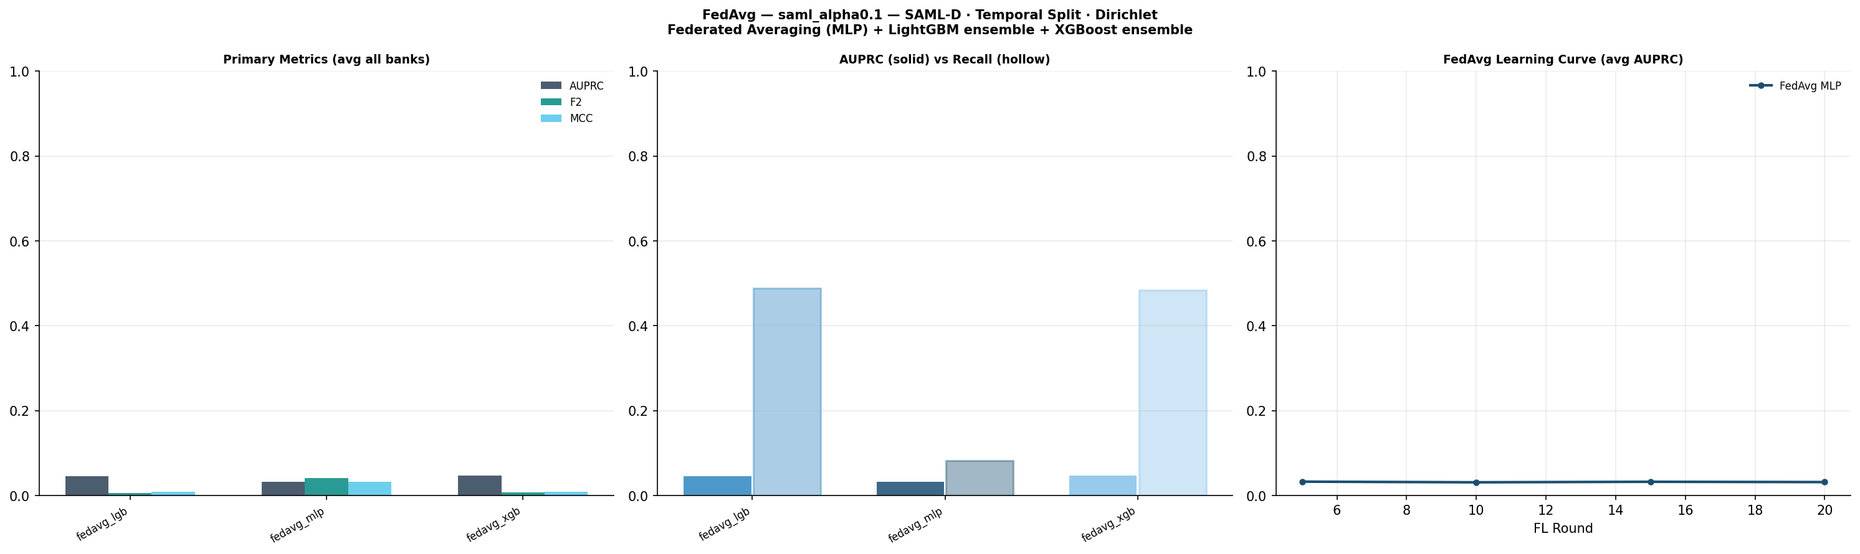
FEDAVG (α=0.1)

Slide 9
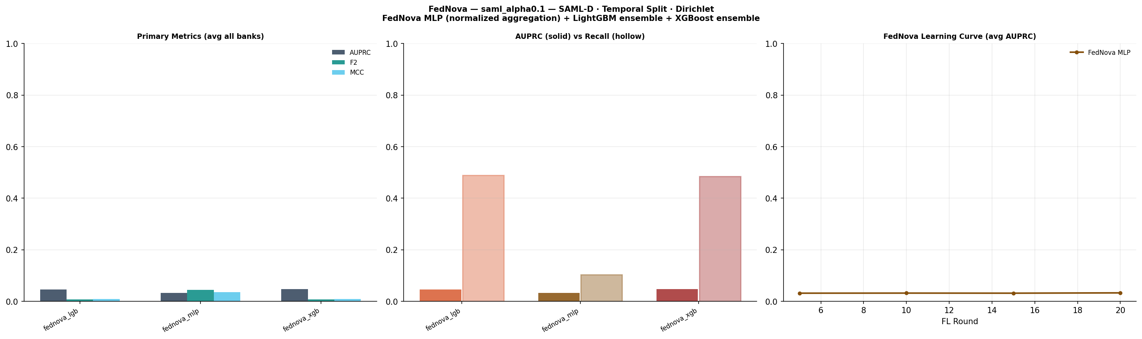
FEDNOVA (α=0.1)

Slide 10
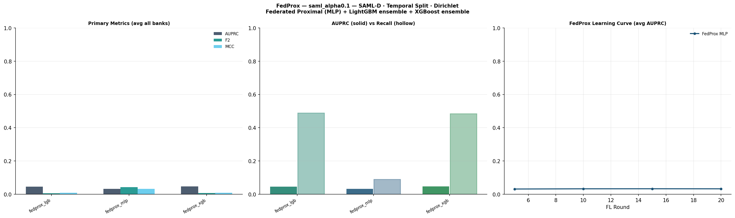
FEDPROX (α=0.1)

Slide 11
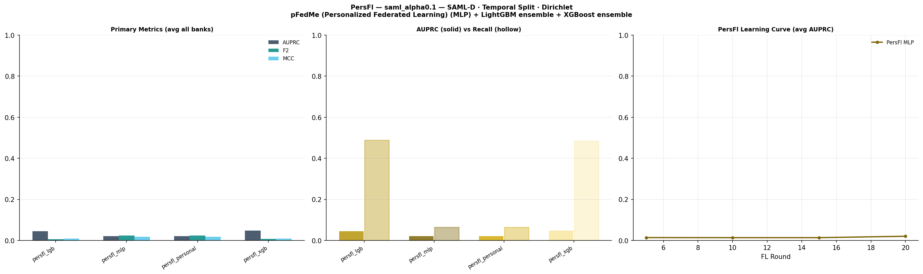
PERSFL (α=0.1)

Slide 12
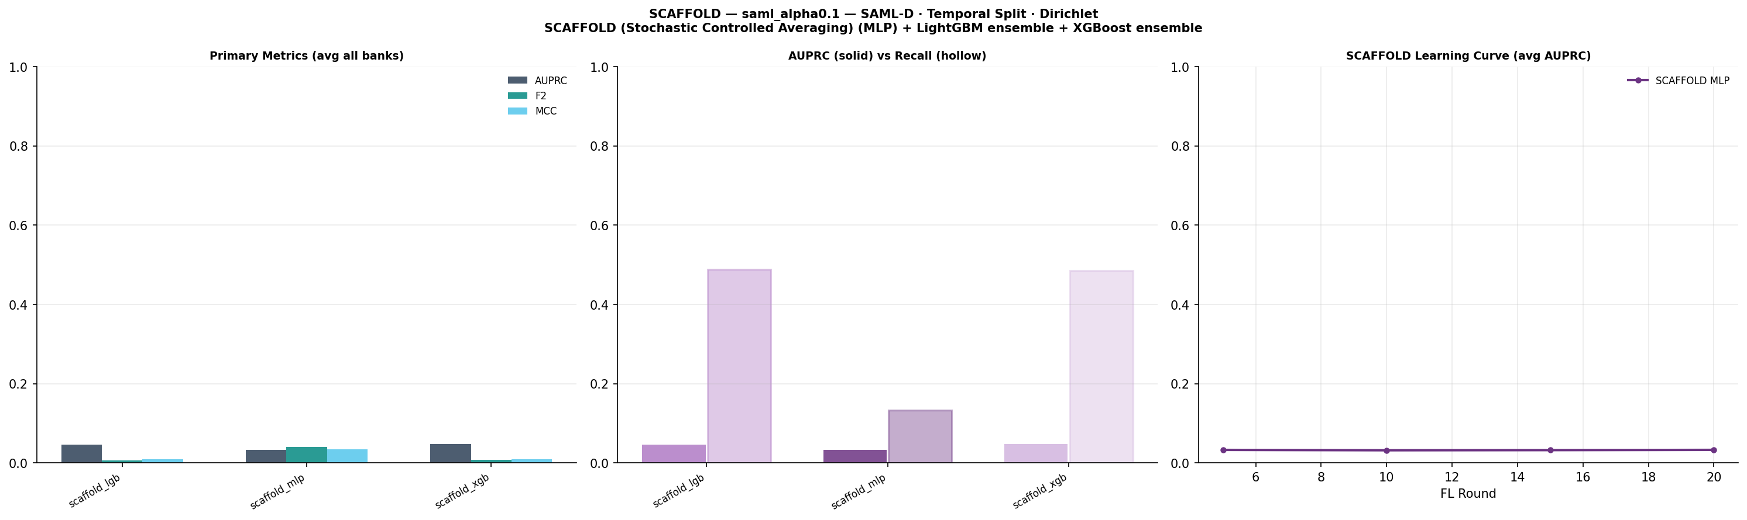
SCAFFOLD (α=0.1)

Slide 13
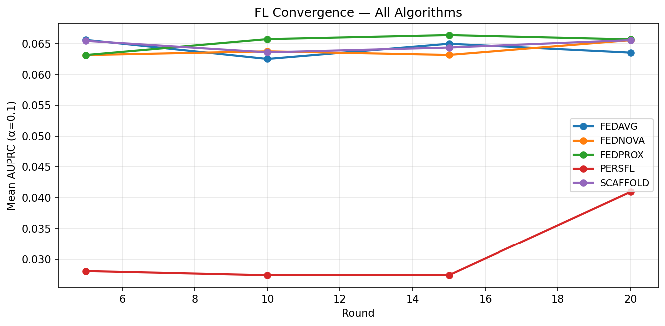
FL Convergence (α=0.1)

Slide 14
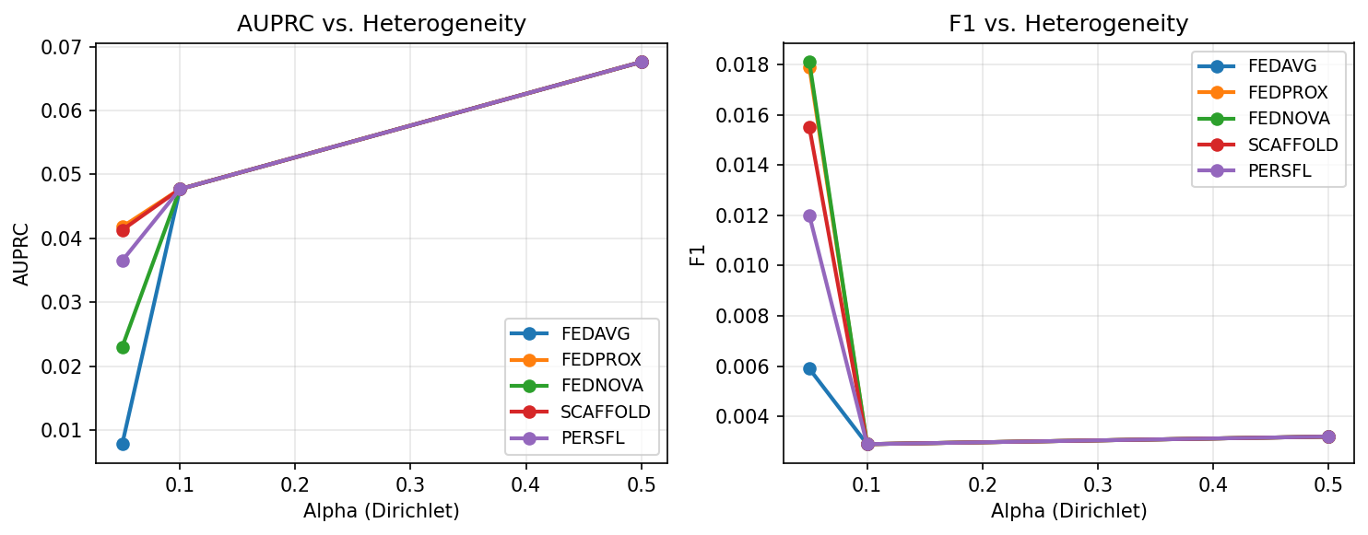
Alpha Heterogeneity Analysis

Slide 15
Conclusions
• Federated fraud detection on SAML-D with 5 FL algorithms benchmarked
• Higher α (IID) consistently improves AUPRC — non-IID is the key challenge
• PersFL shows better per-bank fairness metrics at low α
• MLP tends to outperform LGB/XGB in the FL setting on this dataset

Slide 16
References
Various (2025). A Comprehensive Survey of Mixture-of-Experts: Algorithms, Theory, and Applications. *arXiv 2025*. https://arxiv.org/abs/2503.07137
Cai, W. et al. (2024). A Survey on Mixture of Experts in Large Language Models. *IEEE TKDE 2025*. https://arxiv.org/abs/2407.06204
Various (2024). AdapMoE: Adaptive Sensitivity-based Expert Gating and Management for Efficient MoE Inference. *arXiv 2024*. https://arxiv.org/abs/2408.10284
Various (2025). CryptoMoE: Privacy-Preserving and Scalable Mixture of Experts Inference via Balanced Expert Routing. *arXiv 2025*. https://arxiv.org/abs/2511.01197
Hosseini Chagahi, M., Delfan, N., Mohammadi Dashtaki, S., Moshiri, B., Piran, M.J. (2024). Explainable AI for Fraud Detection: An Attention-Based Ensemble of CNNs, GNNs, and A Confidence-Driven Gating Mechanism. *arXiv 2024 (q-fin.RM)*. https://arxiv.org/abs/2410.09069

Slide 17
References (cont.)
Gao, S., Zhang, S., Jing, S., Zhang, S., Zhou, X., Wang, Y., Cai, Z. (2026). Towards Efficient Federated Learning of Networked Mixture-of-Experts for Mobile Edge Computing. *arXiv 2026*. https://arxiv.org/abs/2511.01743
Various (2026). Geometric Routing Enables Causal Expert Control in Mixture of Experts. *arXiv 2026*. https://arxiv.org/abs/2604.14434
Oksuz, K., Kuzucu, S., Joy, T., Dokania, P.K. (2023). MoCaE: Mixture of Calibrated Experts Significantly Improves Object Detection. *arXiv 2023 / CVPR 2024*. https://arxiv.org/abs/2309.14976
Shazeer, N., Mirhoseini, A., Maziarz, K., Davis, A., Le, Q., Hinton, G., Dean, J. (2017). Outrageously Large Neural Networks: The Sparsely-Gated Mixture-of-Experts Layer. *ICLR 2017*. https://arxiv.org/abs/1701.06538
Various (2024). Routers in Vision Mixture of Experts: An Empirical Study. *arXiv 2024*. https://arxiv.org/abs/2401.15969

