Slide 1
Part 9: LSTM
Presented By: T.E. Shree Ram Khaitu

Slide 2
Content
LSTM Basics
Example

Slide 3
Why LSTM

Slide 4
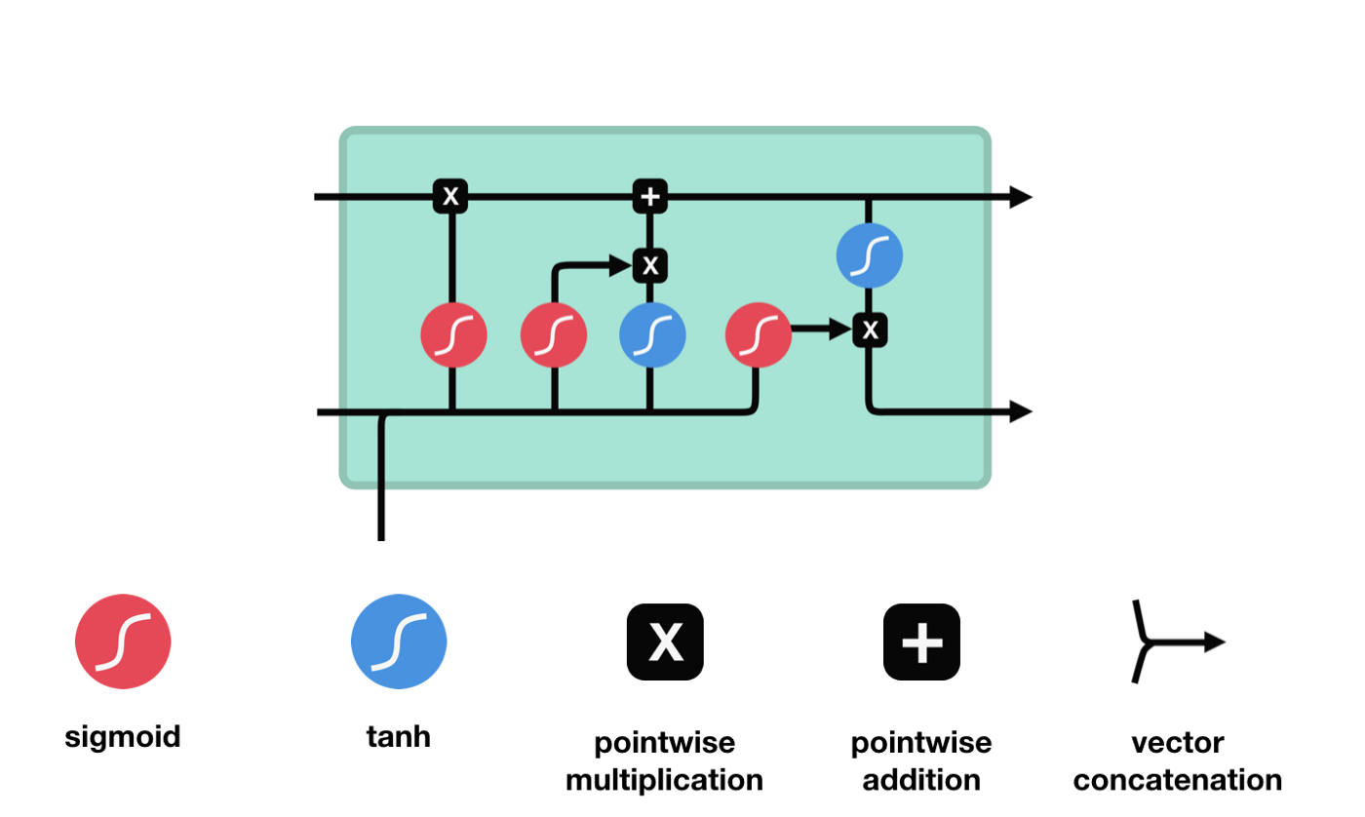

Slide 5
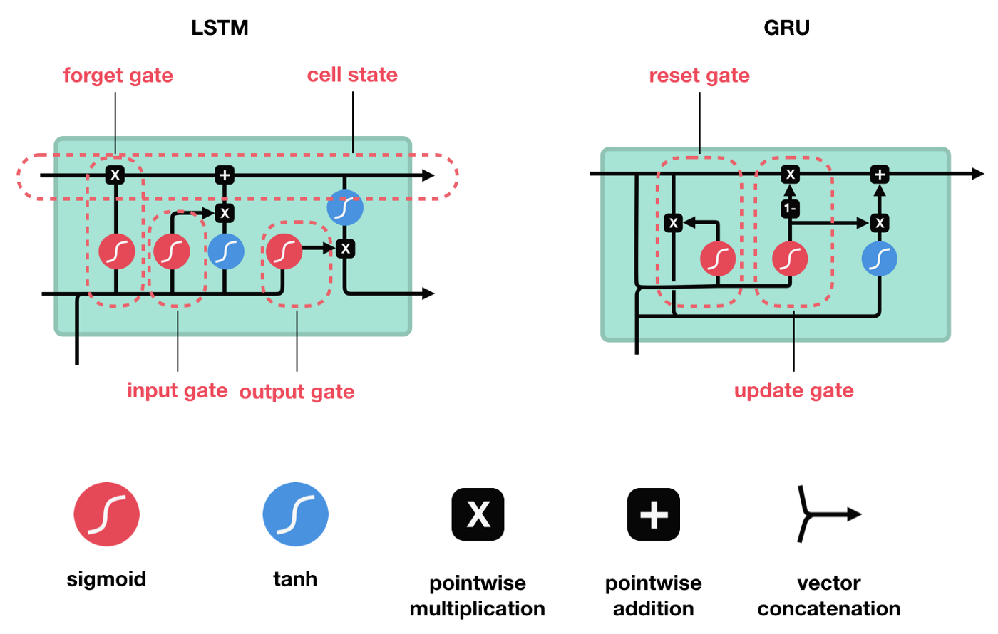

Slide 6
Sigmoid

Slide 7
Forget Gate

Slide 8
Input Gate

Slide 9
Cell State

Slide 10
Output Gate

