Slide 1
Part 9: Recurrent Neural Network
Presented By: T.E. Shree Ram Khaitu

Slide 2
Content
RNN Basics
Simple RNN,GRU

Slide 3
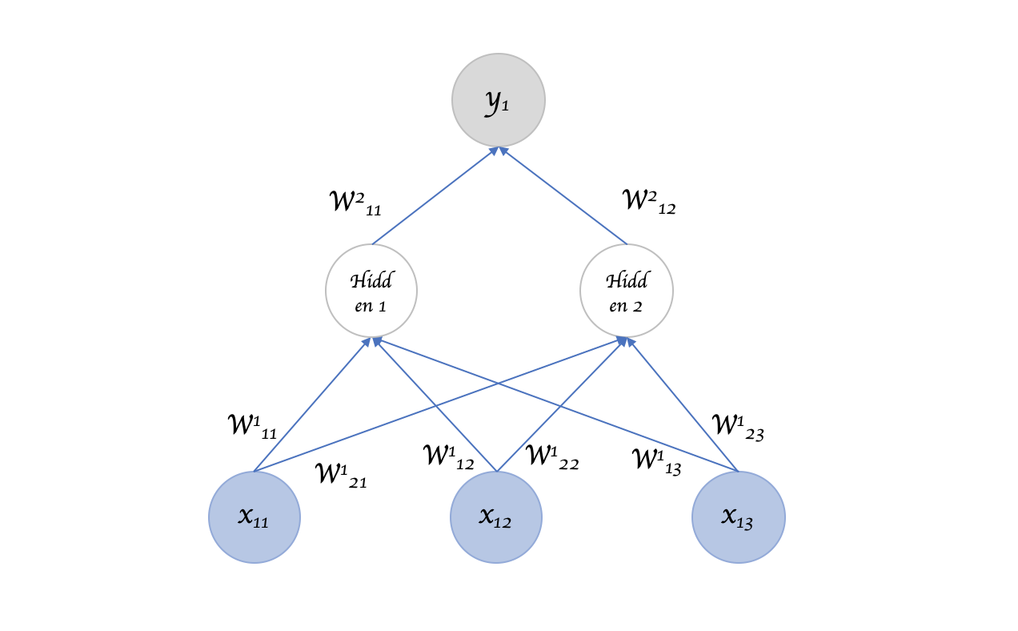

Slide 4
