Slide 1

Case Diagram

Slide 2
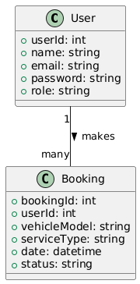
Class Diagram

Slide 3
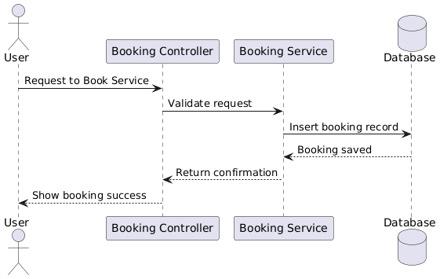
Sequence Diagram

