Slide 1

VISVESVARAYA TECHNOLOGICAL UNIVERSITY
“JNANA SANGAMA”, BELAGAVI - 590018
K.R PET KRISHNA GOVERNMENT ENGINEERING COLLEGE,
K.R PET -571426
Department of Computer Science & Engineering
“Efficient Machine Learning Technique for Weather Forecasting”
Presented by
Basavaraj Belur
(4GK22CS400)
Under the Supervision of
Dr Devika G Head of the Department
Assistant Professor Dr. Hareesh K
Department of CSE Associate Professor and HOD

Slide 2
CONTENTS
Abstract.
Introduction.
SARIMA.
Literature Survey
Current and previous state of art
Problem Statement
Proposed methodology
SARIMA model parameters
Model parameters
Limitations
Advantages
Disadvantages
Future Work towards using SARIMA model for Weather Forecasting.
Conclusion
Reference

Slide 3
Abstract
Weather forecasting is a critical tool for many different applications, from agriculture and transportation to disaster preparedness and response.
While weather forecasts are not always perfect, they provide valuable information that can help people make decisions and take appropriate actions to protect themselves and their property from the impacts of extreme weather events.
In this project, to forecast the weather we are using the SARIMA model and analyze how it forecast the weather with high accuracy.
To account for periodic changes in the data, the SARIMA model augments the ARIMA model with a seasonal component.
The SARIMA model is trained on historical weather data and can be used to predict future weather patterns. It is a powerful tool for weather forecasting as it can accurately predict both short-term and long-term weather trends.
The quality of the input data determines how accurate the SARIMA model will be, and the model can be adjusted to perform better.

Slide 4
Introduction
Making forecasts or projections about future events or conditions based on historical and current data is the process of forecasting.
It is an important tool for decision-making in many fields, s, including business, economics, finance, and weather forecasting, among others. The goal of forecasting is to reduce uncertainty about the future.
There are various methods of forecasting, ranging from simple extrapolation of trends to complex statistical models that incorporate multiple variables and factors.
The type of data and the application's particular requirements will determine the approach to use.
Regression analysis, time series analysis, and ML algorithms are a few of the techniques that are often used. Forecasting can be both challenging and rewarding.

Slide 5
SARIMA
Seasonal Component: The “S” in SARIMA represents seasonality, which refers to repeating patterns in the data. This could be daily, monthly, yearly, or any other regular interval. Identifying and modelling the seasonal component is a key strength of SARIMA.
AUTOREGRESSIVE(AR)
In an autoregression model, we forecast the variable of interest using a linear combination of past values of that variable. The term autoregression indicates that it is a regression of the variable against itself.
The autocorrelation function (ACF) is the correlation between the current and the past values of the same variable. It also considers the translative effect that values carry over with time apart from a direct effect.
INTEGRATED(I)
Integrated represents any differencing that has to be applied in order to make the data stationary. the data to check for stationarity and then experiment with different differencing factors. A differencing factor, d=1 means a lag of i.e.mt-mt-1. Let’s look at a plot of original vs differenced data.
MOVING AVERAGE(MA)
Moving average models uses past forecast errors rather than past values in a regression-like model to forecast future values
A data becomes a time series when it’s sampled on a time-bound attribute like days, months, and years inherently giving it an implicit order. Forecasting is when we take that data and predict future values.

Slide 6
Literature Survey
Narasimha Murthy proposed that they forecast the rainfall southwest monsoon in North East India. The pattern and amount of rainfall are critical elements influencing agricultural systems. The monsoon season of Southwest lasts four months in India, from June to September. The current study provides an empirical analysis for predicting and forecasting rainfall patterns associated with the Southwest monsoon in North-East India. For this region, model selection, diagnostic analysis, and forecasting have all been done using the Box-Jenkins Seasonal Autoregressive Integrated Moving Average (SARIMA) method.
Peng Chen et.al investigates in Time Series Forecasting of Temperatures using SARIMA: An Example from Time series modelling and forecasting, which predicts future values by analyzing previous values, is useful in many practical applications.
Afan Galih Salman proposed the auto-regressive integrated moving average (ARIMA) model in this article uses the grid approach to predict greater clarity for the varied value of the parameters p, d, and q. ARIMA has lowest MSE value which is 0.00029 and the lowest coefficient of variation value which is 0.00315. The MSE value grows as the quantity of estimating data in the ARIMA model increases.

Slide 7
Current And Previous State Of Art
Previous State of Art
Early Applications: This model has been used in weather forecasting for several decades. They were initially implemented as an improvement over simpler time series models due to their ability to capture both trend and seasonality in historical weather data.
Manual Tuning: In the previous era, this model required significant manual tuning of hyperparameters, such as the order of differencing, autoregressive, moving average, and seasonal components. This made them somewhat cumbersome to use effectively.
Current State of Art
High-Performance Computing: This model uses large data and high-resolution datasets with advances in computational power and access to cloud resources, which allows for more accurate and detailed weather forecasting
Ensemble Methods: This model is integrated into ensemble forecasting systems, where it works in conjunction with other models, such as neural networks and numerical weather prediction models. This ensemble approach can improve forecasting reliability. •
Probabilistic Forecasting: This model is increasingly used to generate probabilistic weather forecasts, providing not only point predictions but also uncertainty estimates. Hence, this model is more important for risk assessment and decision-making in various applications, such as agriculture and emergency management.

Slide 8
Problem statement
weather forecasting is important application of machine learning. Accurate weather forecasts are important for a wide range of sectors, including agriculture, transportation, energy management, and disaster preparedness. One popular ML technique used for weather forecasting is Seasonal Autoregressive Integrated Moving Average (SARIMA) model. The problem definition for using SARIMA model for weather forecasting typically involves the following:
Time series data: The problem requires a time series dataset, which is a collection of observations recorded at regular time intervals. In the case of weather forecasting, this could be historical data of weather variables such as temperature, humidity recorded at hourly, daily, or monthly intervals.
Seasonal and trend components: Weather data often exhibits seasonal and trend components, such as daily or yearly patterns, which need to be considered in the forecasting model. It specifies the nature of the seasonal component, such as daily, monthly, or yearly, and the expected trend, weather it is linear, exponential, or none.
Data preprocessing: It include details on how the time series data will be pre-processed before fitting it to the SARIMA model. It also includes data cleaning, handling missing values, transforming variables if needed, and splitting the dataset into training, validation, and testing sets.

Slide 9
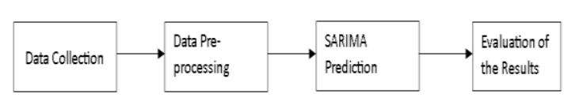
Methodology
SARIMA is a standard time series forecasting model which is used to predict future values based on historical data. It is an elongation of the ARIMA model, which is widely used for time series analysis. SARIMA models are useful when the time series being analysed exhibits seasonality, which is a repeating pattern in the data that occurs at fixed intervals. This can include, for example, weekly, monthly, or yearly patterns.
SARIMA models consider both the seasonality of the data as well as any trend or irregularities in the time series. To estimate a SARIMA model, the first step is to define the values of p, d, and q, as well as P, D, and Q, by analysing the partial autocorrelation and autocorrelation functions of time series. These functions help identify the lag values that are significant and should be incorporated in the model. Once parameters are determined, the model can be fitted to the data with maximum likelihood estimation.
fig 1-steps involved in machine learning techniques

Slide 10
After the model is fitted, it can be used to generate forecasts of future values. Measures like mean squared error (MSE) or mean absolute error (MAE) can be used to assess the forecasts' accuracy. SARIMA models can be useful in a wide range of applications, such as predicting demand for products, forecasting stock prices, or predicting traffic patterns. However, like any model, SARIMA has limitations and assumptions, and its effectiveness based on quality and relevance of historical data used to estimate the model.
It is always important to assess the accurateness and reliability of the model before making any important decisions based on its forecasts . In addition to the basic SARIMA model, there are variations and extensions which can be used to address types of time series data or forecasting problems. For example, the SARIMAX model includes additional exogenous variables that can be used to increase the accurateness of the forecasts. Another variation is the Vector Autoregression (VAR) model, which allows for the modelling of multiple time series that are interrelated. Note that SARIMA models can also be combined with ML techniques, such as neural networks or random forests, to improve forecasting accuracy and incorporate more complex patterns in the data.

Slide 11
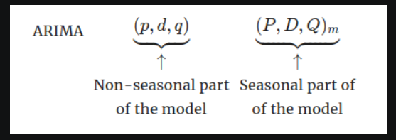
SARIMA Model Parameters
SARIMA models are determined by three parameters: p, d, and q. Parameter p represents the number of autoregressive terms, or number of past values used to predict future values. The d parameter indicates how many differences must be made to the time series in order to eliminate trend and seasonality. Parameter q represents the number of moving average terms, or number of past forecasting errors used to predict future values.
The seasonal element of the ARIMA model is called SARIMA (Seasonal Auto Regressive Integrated Moving Average). The parameters for these kinds of models are given by SARIMA (p, d, q) x (P, D, Q, s) as follows: • p and seasonal P: indicates the number of autoregressive terms (lags of stationarized series) .
d and seasonal D: indicates the differencing that must be done to stationaries the series.
q and seasonal Q: indicates the number of moving average terms (lags of the forecast errors).

Slide 12
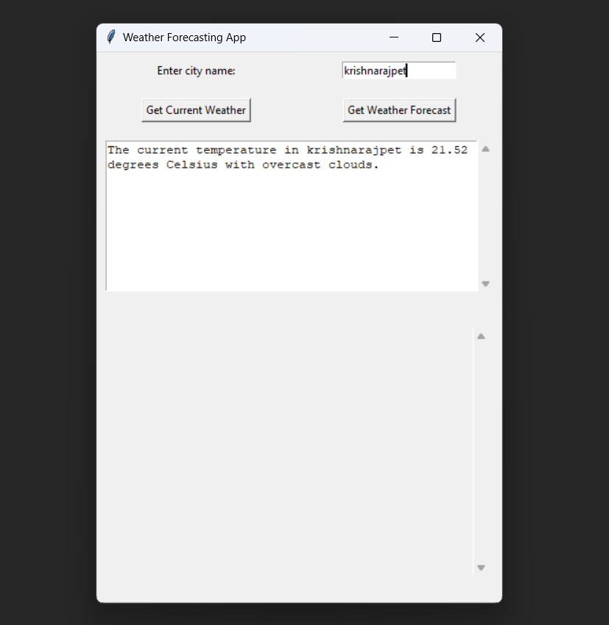
Implementation results

Slide 13
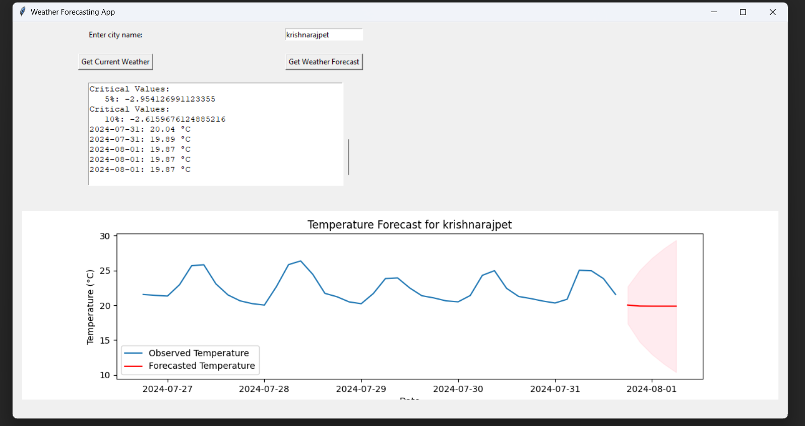

Slide 14
Limitations
SARIMA model is an important and efficient algorithm/ tool for time series forecasting, including weather forecasting, but it also has few limitation Here are some limitations of SARIMA models in the context of weather forecasting:
Assumption of Linearity: This model assumes that the underlying relationships in the time series data are linear. Weather data often exhibit nonlinear behaviour, especially during extreme weather events or sudden shifts in conditions. SARIMA may struggle to capture such nonlinear patterns.
Sensitivity to Model Order Selection: This model requires the selection of appropriate orders for autoregressive (p), differencing (d), and moving average (q) components. Hence, selecting the right orders can be challenging, and different choices can lead to significantly different forecasts. Automated methods, like grid search or cross-validation, can help but are not foolproof.
Limited Handling of Seasonal Patterns: While this model is designed to capture seasonal patterns, they may struggle with irregular or complex seasonality. Seasonal patterns in weather data can be influenced by various factors, and SARIMA model may not always capture these intricacies accurately.
Data Quality Issues: This model is sensitive to data quality issues such as missing values and outliers. Weather data often have missing observations, especially in remote areas or during extreme weather events. Handling missing data appropriately can be challenging.
Limited Long-Term Forecasting: This model is more suited for short- to medium-term forecasting. When it comes to long-term climate predictions or forecasts beyond the observed historical data, SARIMA models may not perform well.

Slide 15
Advantages
Accurate predictions: SARIMA models can capture complex seasonal patterns and trends, leading to accurate temperature, precipitation, and wind forecasts.
Handling seasonality: SARIMA models explicitly account for seasonality, which is crucial in weather forecasting, where patterns repeat annually or semi-annually.
Flexibility: SARIMA models can be tailored to specific weather variables and locations by adjusting parameters.
Handling non-stationarity: SARIMA models can address non-stationarity in weather data, where patterns change over time.
Efficient: SARIMA models are computationally efficient, allowing for rapid forecasting
Interpretability: SARIMA models provide clear insights into the underlying weather patterns.
Anomaly detection: SARIMA models can detect unusual weather events.
Long-term forecasting: SARIMA models can generate forecasts for extended periods.

Slide 16
Disadvantages
Assumes linearity: SARIMA models assume a linear relationship between variables, which might not always hold true in complex weather systems.
Ignores non-linear relationships: SARIMA models can't capture non-linear relationships between variables, potentially leading to inaccurate forecasts.
Sensitive to parameter selection: SARIMA models require careful selection of parameters (p, d, q, P, D, Q), which can be time-consuming and prone to errors.
Requires large datasets: SARIMA models need extensive historical data to accurately capture patterns and trends.

Slide 17
Future Work towards using SARIMA model for Weather Forecasting
Hybrid Models and Ensembles: We need to continue to explore the integration of this model with other forecasting techniques, including ML algorithms like neural networks and deep learning models. Also, hybrid and ensemble approaches can potentially capture complex weather patterns more effectively.
Multivariate SARIMA: We need to develop multivariate SARIMA models that can handle multiple weather variables simultaneously. It will allow a basic understanding of the interrelationships between different meteorological factors.
Real-Time Data Assimilation: We need to improve real-time data assimilation techniques to continuously update SARIMA models with the latest observations, satellite data, and other sources. It will enhance the model's ability to provide up-to-date forecasts.
Extreme Weather Events Prediction: We need to focus on improving the prediction of extreme weather events, such as hurricanes, tornadoes, and heavy rainfall, by developing specialized SARIMA models or incorporating additional features and data sources.
Long-Term Forecasting: We need to extend SARIMA models to handle long-term weather forecasting, such as seasonal and yearly predictions. It will benefit agriculture, water resource management, and climate research.

Slide 18
Conclusion
SARIMA model is a powerful ML technique for weather forecasting, used as a time-series model which can identify seasonal trends and patterns in weather data and provide precise forecasts for future time periods. Through the analysis of historical weather data and the application of SARIMA model, we can gain valuable information in the patterns and trends in weather patterns. This information can be used to develop effective strategies for managing weather-related risks and enhancing public safety. In terms of future work, there are several directions that could be pursued. Firstly, SARIMA model can be further optimized by incorporating more sophisticated ML methods like deep learning, ensemble models, or hybrid models. Secondly, incorporating more data sources, such as satellite data or weather station data, can lead to even more accurate predictions. Finally, the application of SARIMA model can be extended to other domains beyond weather forecasting,. such as finance, marketing, or healthcare.

Slide 19
References
Ardabili, S., Mosavi, A., Dehghani, M., & Várkonyi-Kóczy, A. R. “Deep learning and machine learning in hydrological processes climate change and earth systems a systematic review.” International conference on global research and education, (2019).
Cifuentes, J., Marulanda, G., Bello, A., & Reneses, J. J. E. “Air temperature forecasting using machine learning techniques: a review.” 13(16), 4215, (2020).
Derbentsev, V., Datsenko, N., Stepanenko, O., & Bezkorovainyi, V. “Forecasting cryptocurrency prices time series using machine learning approach.” SHS Web of Conferences, (2019).
Narasimha Murthy, K.V., Saravana, R. & Vijaya Kumar K. “Modeling and forecasting rainfall patterns of southwest monsoons in North–East India as a SARIMA process.” Meteorol Atmos Phys 130, 99–106 (2018).

Slide 20
THANK YOU

