Slide 1
CAR RACING 1.O! -Parn Desai(18BCP149D) -Shreedhar Bhatt(18BCP150D)

Slide 2
Developed By.
Name | Roll No
Parn Niraj Desai | 18BCP149D
Shreedhar Manish Bhatt | 18BCP150D
Leader Name - | Parn Niraj Desai

Slide 3
ABSTRACT
The java program “Game.java” is programmed, initiated and designed for the beginner lever gamers who wants to play at the cost of ease. The crux of this java program is multi-purpose. Digital games are part of our technologically driven lives. Today not only games constitute marginal time of humans but also engage with them. We have provided ‘key driven’ game which helps to control the game and make a good gaming experience. The main pillar of our java program is that it is not only small in size but also platform independent, simple and robust. Because of these features, we provide clean and lament user interface and as a result - user can reduce stress , improve decision making and coordinate his/her strategy while playing the game.

Slide 4
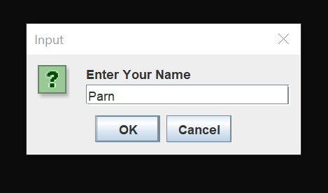
Roadmap.
1. Once the game is launch , this screen will appear
the user has to write his/her name.
2. After writing the game the user has to click OK &
game will begin.

Slide 5
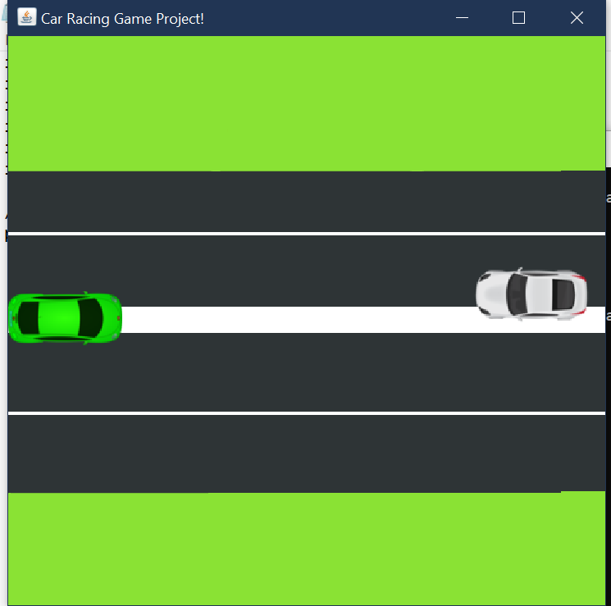
Roadmap.
3. The game has started, the user has to save
his/her car from collision with other car.
4. Randomly after some time the speed of the
others car will increase & decrease automatically.
5. The user has to try his/her best to save car
from collision.
6. The user can control his/her car by four arrow keys.

Slide 6
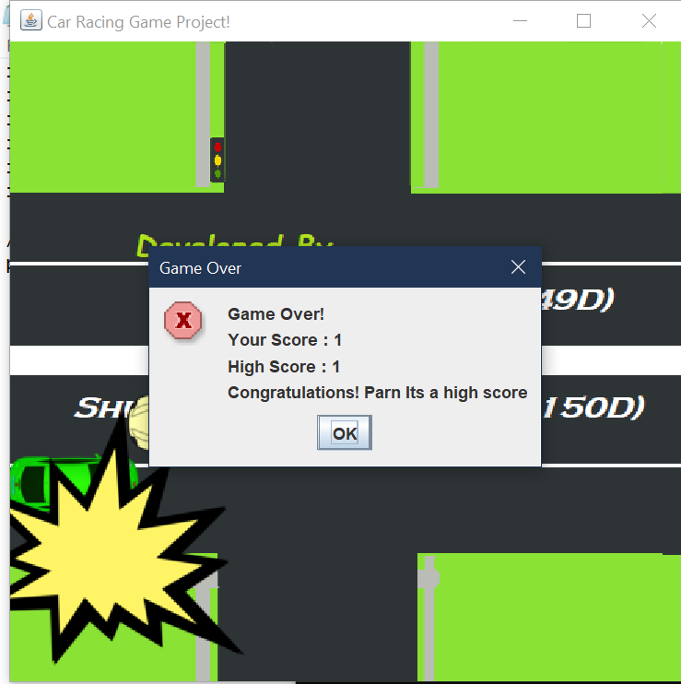
Roadmap.
7. The below screen will appear, once the user’s
car collides.
8. The score of the user will be shown in the
dialog box.
9. The “Congratulations” message will be displayed
with the name that user entered at the starting of
game.

Slide 7
Functionality Implemented
JAVA Jpanel - The JPanel is a simplest container class. It provides space in which an application
can attach any other component. It inherits the JComponents class.
JAVA AWT - AWT (Abstract Window Toolkit) is an API to develop GUI or window-based
applications in java.
Java AWT components are platform-dependent i.e. components are displayed
according to the view of operating system. AWT is heavyweight i.e. its components
are using the resources of OS.
JAVA Jframe - JFrame works like the main window where components like labels, buttons,
textfields are added to create a GUI.

Slide 8
Functionality Implemented
JAVA awt image - Provides classes for creating and modifying images.
JAVA Multithreading - A multi-threaded program contains two or more parts that can run
concurrently and each part can handle a different task at the same time
making optimal use of the available resources specially when your
computer has multiple CPUs.

Slide 9
Functionality Implemented
JAVA awt event (Keyevent) - On entering the character the Key event is generated.There are
three types of key events which are represented by the integer
constants. These key events are following,
KEY_PRESSED
KEY_RELASED
KEY_TYPED

Slide 10
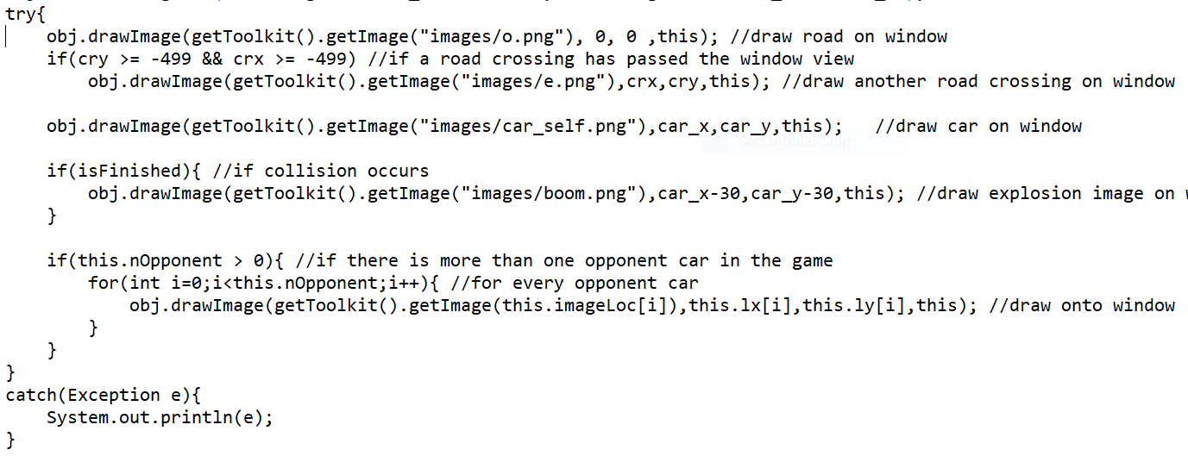
Exception Handling.
Type of Exception | Task for which exception handled
(Exception e) | If the images are not loaded then it will raise exception.

Slide 11
Implementations Details.
Component | Declared as | Use
Jpanel | It is extended. | JPanel, a part of Java Swing package, is a container that can store a group of components.
Graphics | Graphics g | It is abstract base class that is used for all graphics contexts that allow an application to draw onto components.
Graphics2D | Graphics2D obj | It is used to draw 2D shapes.
Jframe | Jframe f | . JFrame works like the main window where components like labels, buttons, textfields are added to create a GUI.

Slide 12
Implementations Details.
Component | Decalred As | Use
Key Event e | - | It is used for receiving key strokes.
JOptionPane | showInputDialog() | It is used to take name as input from user.
JOptionPane | showMessageDialog() | Used from displaying the message.

Slide 13
Applications.
Gamification
Arcade
Electronic play
Consoles.

Slide 14
Thank You.
Parn Desai(18BCP149D)
Shreedhar Bhatt(18BCP150D)

