Slide 1


SWI Prolog
Freely available Prolog interpreter
Works with
Linux,
Windows, or
Mac OS
There are many more Prolog interpreters
Not all are ISO compliant/free

Slide 2
Prolog
"Programming with Logic"
Very different from other programming languages
Declarative (not procedural)
Recursion (no “for” or “while” loops)
Relations (no functions)
Unification

Slide 3
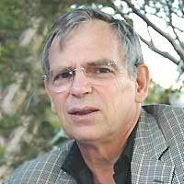
History of Prolog
first Prolog interpreter by Alain Colmerauer and Philippe Roussel
1972
1977
1980
1980s/1990s
2005

Slide 4
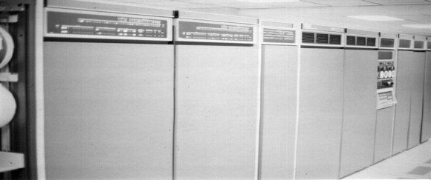
History of Prolog
implementation of DEC10 compiler by David H.D. Warren
1972
1977
1980
1980s/1990s
2005

Slide 5
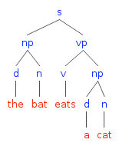
History of Prolog
Definite Clause Grammars implementation by Pereira and Warren
1972
1977
1980
1980s/1990s
2005

Slide 6
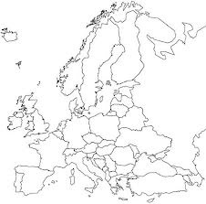
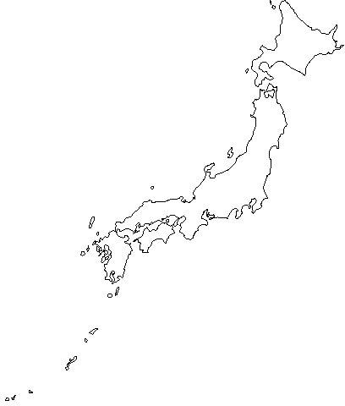
History of Prolog
Prolog grows in popularity especially in Japan and Europe
1972
1977
1980
1980s/1990s
2005

Slide 7
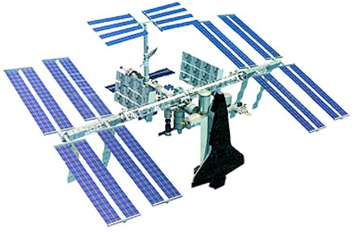
History of Prolog
Prolog used to program natural language interface in International Space Station by NASA
1972
1977
1980
1980s/1990s
2005

Slide 8
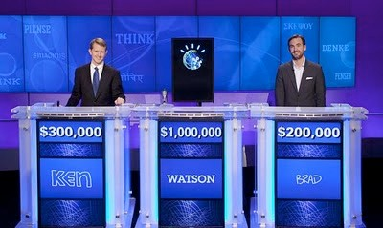
History of Prolog
Parts of IBM’s Watson QA supercomputer
were coded in Prolog
1972
1977
1980
1980s/1990s
2011

Slide 9
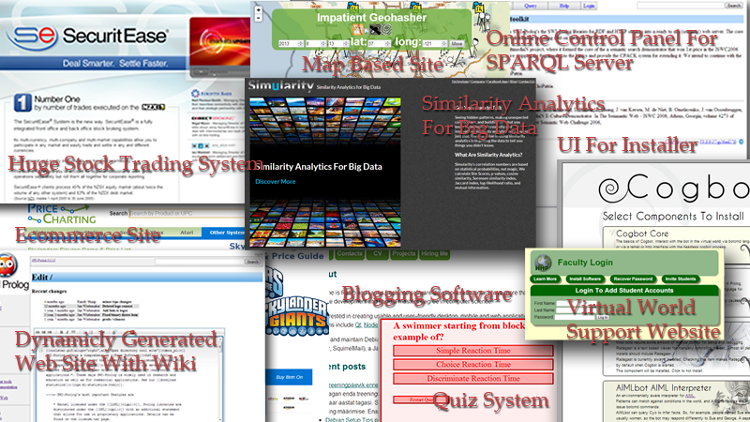
Prolog and Web Applications
prolog programs are often smaller
smallness encourages well written code
hence, easier to maintain
Source:
http://www.pathwayslms.com/swipltuts/

Slide 10
Basic idea of Prolog
Describe the situation of interest
Ask a question
Prolog:
logically deduces new facts about the situation we described
gives us its deductions back as answers

Slide 11
Consequences
Think declaratively, not procedurally
Challenging
Requires a different mindset
High-level language
Not as efficient as, say, C
Good for rapid prototyping
Useful in many AI applications (knowledge representation, inference)

Slide 12
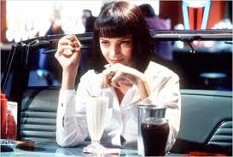
Knowledge Base 1
woman(mia).
woman(jody). woman(yolanda). playsAirGuitar(jody). party.

Slide 13
Knowledge Base 1
woman(mia).
woman(jody). woman(yolanda). playsAirGuitar(jody). party.
?-

Slide 14
Knowledge Base 1
woman(mia).
woman(jody). woman(yolanda). playsAirGuitar(jody). party.
?- woman(mia).

Slide 15
Knowledge Base 1
woman(mia).
woman(jody). woman(yolanda). playsAirGuitar(jody). party.
?- woman(mia). yes
?-

Slide 16
Knowledge Base 1
woman(mia).
woman(jody). woman(yolanda). playsAirGuitar(jody). party.
?- woman(mia). yes
?- playsAirGuitar(jody).

Slide 17
Knowledge Base 1
woman(mia).
woman(jody). woman(yolanda). playsAirGuitar(jody). party.
?- woman(mia). yes
?- playsAirGuitar(jody).
yes
?-

Slide 18
Knowledge Base 1
woman(mia).
woman(jody). woman(yolanda). playsAirGuitar(jody). party.
?- woman(mia). yes
?- playsAirGuitar(jody).
yes
?- playsAirGuitar(mia).

Slide 19
Knowledge Base 1
woman(mia).
woman(jody). woman(yolanda). playsAirGuitar(jody). party.
?- woman(mia). yes
?- playsAirGuitar(jody).
yes
?- playsAirGuitar(mia). no

Slide 20
Knowledge Base 1
woman(mia).
woman(jody). woman(yolanda). playsAirGuitar(jody). party.
?- tattoed(jody).

Slide 21
Knowledge Base 1
woman(mia).
woman(jody). woman(yolanda). playsAirGuitar(jody). party.
?- tattoed(jody). no
?-

Slide 22
Knowledge Base 1
woman(mia).
woman(jody). woman(yolanda). playsAirGuitar(jody). party.
?- tattoed(jody).
ERROR: predicate tattoed/1 not defined.
?-

Slide 23
Knowledge Base 1
woman(mia).
woman(jody). woman(yolanda). playsAirGuitar(jody). party.
?- party.

Slide 24
Knowledge Base 1
woman(mia).
woman(jody). woman(yolanda). playsAirGuitar(jody). party.
?- party. yes
?-

Slide 25
Knowledge Base 1
woman(mia).
woman(jody). woman(yolanda). playsAirGuitar(jody). party.
?- rockConcert.

Slide 26
Knowledge Base 1
woman(mia).
woman(jody). woman(yolanda). playsAirGuitar(jody). party.
?- rockConcert. no
?-

Slide 27
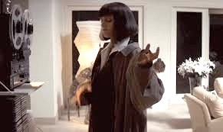
Knowledge Base 2
happy(yolanda). listens2music(mia).
listens2music(yolanda):- happy(yolanda).
playsAirGuitar(mia):- listens2music(mia). playsAirGuitar(yolanda):- listens2music(yolanda).

Slide 28
Knowledge Base 2
happy(yolanda). listens2music(mia).
fact
listens2music(yolanda):- happy(yolanda). playsAirGuitar(mia):- listens2music(mia). playsAirGuitar(yolanda):- listens2music(yolanda).

Slide 29
Knowledge Base 2
happy(yolanda). listens2music(mia).
fact
fact
listens2music(yolanda):- happy(yolanda). playsAirGuitar(mia):- listens2music(mia). playsAirGuitar(yolanda):- listens2music(yolanda).

Slide 30
Knowledge Base 2
happy(yolanda). listens2music(mia).
fact
fact
listens2music(yolanda):- happy(yolanda). playsAirGuitar(mia):- listens2music(mia).
rule
playsAirGuitar(yolanda):- listens2music(yolanda).

Slide 31
Knowledge Base 2
happy(yolanda). listens2music(mia).
fact
fact
listens2music(yolanda):- happy(yolanda). playsAirGuitar(mia):- listens2music(mia).
rule rule
playsAirGuitar(yolanda):- listens2music(yolanda).

Slide 32
Knowledge Base 2
happy(yolanda). listens2music(mia).
fact
fact
listens2music(yolanda):- happy(yolanda). playsAirGuitar(mia):- listens2music(mia).
rule rule
playsAirGuitar(yolanda):- listens2music(yolanda).
rule

Slide 33
Knowledge Base 2
happy(yolanda). listens2music(mia).
listens2music(yolanda):- happy(yolanda). playsAirGuitar(mia):- listens2music(mia). playsAirGuitar(yolanda):- listens2music(yolanda).
head
body

Slide 34
Knowledge Base 2
happy(yolanda). listens2music(mia).
listens2music(yolanda):- happy(yolanda).
playsAirGuitar(mia):- listens2music(mia). playsAirGuitar(yolanda):- listens2music(yolanda).
?-

Slide 35
Knowledge Base 2
happy(yolanda). listens2music(mia).
listens2music(yolanda):- happy(yolanda).
playsAirGuitar(mia):- listens2music(mia). playsAirGuitar(yolanda):- listens2music(yolanda).
?- playsAirGuitar(mia). yes
?-

Slide 36
Knowledge Base 2
happy(yolanda). listens2music(mia).
listens2music(yolanda):- happy(yolanda).
playsAirGuitar(mia):- listens2music(mia). playsAirGuitar(yolanda):- listens2music(yolanda).
?- playsAirGuitar(mia). yes
?- playsAirGuitar(yolanda).
yes

Slide 37
Clauses
happy(yolanda). listens2music(mia).
listens2music(yolanda):- happy(yolanda).
playsAirGuitar(mia):- listens2music(mia). playsAirGuitar(yolanda):- listens2music(yolanda).
There are five clauses in this knowledge base: two facts, and three rules.
The end of a clause is marked with a full stop.

Slide 38
Predicates
happy(yolanda). listens2music(mia).
listens2music(yolanda):- happy(yolanda).
playsAirGuitar(mia):- listens2music(mia). playsAirGuitar(yolanda):- listens2music(yolanda).
There are three predicates in this knowledge base:
happy, listens2music, and playsAirGuitar

Slide 39
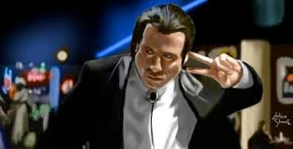
Knowledge Base 3
happy(vincent). listens2music(butch).
playsAirGuitar(vincent):- listens2music(vincent), happy(vincent).
playsAirGuitar(butch):- happy(butch). playsAirGuitar(butch):- listens2music(butch).

Slide 40
Expressing Conjunction
happy(vincent). listens2music(butch).
playsAirGuitar(vincent):- listens2music(vincent), happy(vincent).
playsAirGuitar(butch):- happy(butch). playsAirGuitar(butch):- listens2music(butch).
The comma “," expresses conjunction in Prolog

Slide 41
Knowledge Base 3
happy(vincent). listens2music(butch).
playsAirGuitar(vincent):- listens2music(vincent), happy(vincent).
playsAirGuitar(butch):- happy(butch). playsAirGuitar(butch):- listens2music(butch).
?- playsAirGuitar(vincent).

Slide 42
Knowledge Base 3
happy(vincent). listens2music(butch).
playsAirGuitar(vincent):- listens2music(vincent), happy(vincent).
playsAirGuitar(butch):- happy(butch). playsAirGuitar(butch):- listens2music(butch).
?- playsAirGuitar(vincent). no
?-

Slide 43
Knowledge Base 3
happy(vincent). listens2music(butch).
playsAirGuitar(vincent):- listens2music(vincent), happy(vincent).
playsAirGuitar(butch):- happy(butch). playsAirGuitar(butch):- listens2music(butch).
?- playsAirGuitar(butch).

Slide 44
Knowledge Base 3
happy(vincent). listens2music(butch).
playsAirGuitar(vincent):- listens2music(vincent), happy(vincent).
playsAirGuitar(butch):- happy(butch). playsAirGuitar(butch):- listens2music(butch).
?- playsAirGuitar(butch). yes
?-

Slide 45
Expressing Disjunction
happy(vincent). listens2music(butch).
playsAirGuitar(vincent):- listens2music(vincent), happy(vincent).
playsAirGuitar(butch):- happy(butch). playsAirGuitar(butch):- listens2music(butch).
happy(vincent). listens2music(butch).
playsAirGuitar(vincent):- listens2music(vincent), happy(vincent).
playsAirGuitar(butch):- happy(butch); listens2music(butch).

Slide 46
Prolog and Logic
Clearly, Prolog has something to do with logic...
 | Prolog | Logic
Implication | A :- B | B → A
Conjunction | A,B | A ∧ B
Disjunction | A;B | A ∨ B
Use of inference (modus ponens)
Negation (?)

Slide 47

Knowledge Base 4
woman(mia). woman(jody).
woman(yolanda).
loves(vincent, mia). loves(marsellus, mia). loves(pumpkin, honey_bunny). loves(honey_bunny, pumpkin).

Slide 48
Prolog Variables
woman(mia). woman(jody).
woman(yolanda).
loves(vincent, mia). loves(marsellus, mia). loves(pumpkin, honey_bunny). loves(honey_bunny, pumpkin).
?- woman(X).

Slide 49
Variable Instantiation
woman(mia). woman(jody).
woman(yolanda).
loves(vincent, mia). loves(marsellus, mia). loves(pumpkin, honey_bunny). loves(honey_bunny, pumpkin).
?- woman(X). X=mia

Slide 50
Asking Alternatives
woman(mia). woman(jody).
woman(yolanda).
loves(vincent, mia). loves(marsellus, mia). loves(pumpkin, honey_bunny). loves(honey_bunny, pumpkin).
?- woman(X). X=mia;

Slide 51
Asking Alternatives
woman(mia). woman(jody).
woman(yolanda).
loves(vincent, mia). loves(marsellus, mia). loves(pumpkin, honey_bunny). loves(honey_bunny, pumpkin).
?- woman(X).
X=mia;
X=jody

Slide 52
Asking Alternatives
woman(mia). woman(jody).
woman(yolanda).
loves(vincent, mia). loves(marsellus, mia). loves(pumpkin, honey_bunny). loves(honey_bunny, pumpkin).
?- woman(X).
X=mia;
X=jody;
X=yolanda

Slide 53
Asking Alternatives
woman(mia). woman(jody).
woman(yolanda).
loves(vincent, mia). loves(marsellus, mia). loves(pumpkin, honey_bunny). loves(honey_bunny, pumpkin).
?- woman(X).
X=mia; X=jody; X=yolanda; no

Slide 54
Knowledge Base 4
woman(mia). woman(jody).
woman(yolanda).
loves(vincent, mia). loves(marsellus, mia). loves(pumpkin, honey_bunny). loves(honey_bunny, pumpkin).
?- loves(marsellus,X), woman(X).

Slide 55
Knowledge Base 4
woman(mia). woman(jody).
woman(yolanda).
loves(vincent, mia). loves(marsellus, mia). loves(pumpkin, honey_bunny). loves(honey_bunny, pumpkin).
?- loves(marsellus,X), woman(X).
X=mia yes
?-

Slide 56
Knowledge Base 4
woman(mia). woman(jody).
woman(yolanda).
loves(vincent, mia). loves(marsellus, mia). loves(pumpkin, honey_bunny). loves(honey_bunny, pumpkin).
?- loves(pumpkin,X), woman(X).

Slide 57
Knowledge Base 4
woman(mia). woman(jody).
woman(yolanda).
loves(vincent, mia). loves(marsellus, mia). loves(pumpkin, honey_bunny). loves(honey_bunny, pumpkin).
?- loves(pumpkin,X), woman(X). no
?-

Slide 58
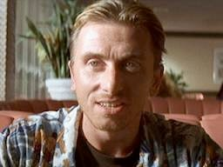
Knowledge Base 5
loves(vincent,mia).
loves(marsellus,mia). loves(pumpkin, honey_bunny). loves(honey_bunny, pumpkin).
jealous(X,Y):- loves(X,Z), loves(Y,Z).

Slide 59
Knowledge Base 5
loves(vincent,mia).
loves(marsellus,mia). loves(pumpkin, honey_bunny). loves(honey_bunny, pumpkin).
jealous(X,Y):- loves(X,Z), loves(Y,Z).
?- jealous(marsellus,W).

Slide 60
Knowledge Base 5
loves(vincent,mia).
loves(marsellus,mia). loves(pumpkin, honey_bunny). loves(honey_bunny, pumpkin).
jealous(X,Y):- loves(X,Z), loves(Y,Z).
?- jealous(marsellus,W). W=vincent
?-

Slide 61
Syntax of Prolog
Q: What exactly are facts, rules and queries built out of?
A: Prolog terms

Slide 62

Prolog terms
Terms
Simple
Terms
Complex
Terms
Constants
Variables
Atoms
Numbers

Slide 63
Atoms
A sequence of characters of upper-case letters, lower-case letters, digits, or underscore, starting with a lowercase letter
– Examples: butch, big_kahuna_burger, playGuitar

Slide 64
Atoms
A sequence of characters of upper-case letters, lower-case letters, digits, or underscore, starting with a lowercase letter
Examples: butch, big_kahuna_burger, playGuitar
An arbitrary sequence of characters enclosed in single quotes
Examples: 'Vincent', 'Five dollar shake', '@$%'

Slide 65
Atoms
A sequence of characters of upper-case letters, lower-case letters, digits, or underscore, starting with a lowercase letter
Examples: butch, big_kahuna_burger, playGuitar
An arbitrary sequence of characters enclosed in single quotes
Examples: 'Vincent', 'Five dollar shake', '@$%'
A sequence of special characters
Examples: : , ; . :-

Slide 66
Numbers
Integers:
12, -34,
Floats:
22342
34573.3234, 0.3435

Slide 67
Variables
A sequence of characters of upper- case letters, lower-case letters, digits, or underscore, starting with either an uppercase letter or an underscore
Examples:
X, Y, Variable, Vincent, _tag

Slide 68
Complex Terms
Atoms, numbers and variables are building blocks for complex terms
Complex terms are built out of a functor directly followed by a sequence of arguments
Arguments are put in round brackets, separated by commas
The functor must be an atom

Slide 69
Examples of complex terms
Examples we have seen before:
playsAirGuitar(jody)
loves(vincent, mia)
jealous(marsellus, W)
Complex terms inside complex terms:
hide(X,father(father(father(butch))))

Slide 70
Arity
The number of arguments a complex term has is called its arity
Examples:
woman(mia) is a term with arity 1
loves(vincent,mia) father(father(butch))
has arity 2
arity 1

Slide 71
Arity is important
You can define two predicates with the same functor but with different arity
Prolog would treat this as two different predicates!
In Prolog documentation, arity of a predicate is usually indicated with the suffix "/" followed by a number to indicate the arity

Slide 72
Example of Arity
happy(yolanda). listens2music(mia).
listens2music(yolanda):- happy(yolanda).
playsAirGuitar(mia):- listens2music(mia). playsAirGuitar(yolanda):- listens2music(yolanda).
This knowledge base defines
happy/1
listens2music/1
playsAirGuitar/1

