Slide 1

Paradigms and Computer
Programming Fundamentals
ITC305
Ms. Manya Gidwani
Assistant Professor
IT Department(SAKEC)

Slide 2
Objectives of today’s lecture
To introduce Different programming paradigms
Understand overview of compilation steps

Slide 3
Module 1
Introduction to Programming Paradigms and Core Language Design Issues

Slide 4


Programming Paradigms
Paradigm can also be termed as method to solve some problem or do some task.
Programming paradigm is an approach to solve problem using some programming language or also we can say it is a method to solve a problem using tools and techniques that are available to us following some approach.

Slide 5
Programming Languages
C
Assembly
C++
Concurrent programming – that’s not a language, that’s just a paradigm
Scheme
Python
[“Wow, I’m going to be able to legitimately put all of these languages on my resume,”]
[To really study the paradigms that they represent]

Slide 6
The Programming Language Spectrum The top-level division distinguishes
Imperative programming paradigms. --> (how to do)
Declarative programming paradigms. --> (what to do)

Slide 7
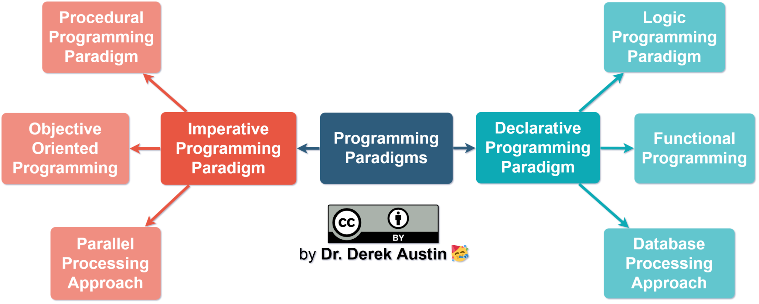
Programming Paradigm is divided into 2 category

Slide 8
Imperative programming is divided into three broad categories: ,
Programming | Task | Language
Procedural | program =algorithms + data Good for decomposition | C C++ Java
Object Oriented | program =objects + messages Good for encapsulation | C++ Java Pascal Visual Basic .NET : Python
Parallel processing | A parallel processing system posses many numbers of processor with the objective of running a program in less time by dividing them. | NESL C/C++ also supports because of some library function.

Slide 9
Declarative programming paradigm
Declarative programming is a style of building programs that expresses logic of computation without talking about its control flow.

Slide 10
Declarative programming paradigm: is divided into three broad categories:
Programming | Task | Language
Logic programming | program =facts + rules good for searching | Prolog
Functional programming | program =functions * functions good for reasoning | JavaScript Lisp lambda calculus
Database/Data driven programming approach | based on data and its movement | SQL

Slide 11
Alternative Paradigms
Concurrency
Example:
1)Watching two movies at the same time
2)ATM machines
Scripting Languages

Slide 12
Thankyou

