Slide 1
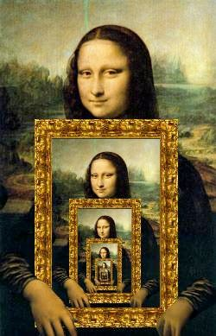

Chapter 3: Recursion

Slide 2
Recursive definitions
Prolog predicates can be defined recursively
A predicate is recursively defined if one or more rules in its definition refers to itself

Slide 3


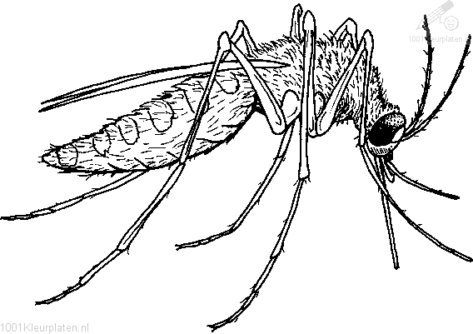

Example 1: Eating

Slide 4
Example 1: Eating
isDigesting(X,Y):- justAte(X,Y). isDigesting(X,Y):- justAte(X,Z), isDigesting(Z,Y).
justAte(mosquito,blood(john)). justAte(frog,mosquito). justAte(stork,frog).
?-

Slide 5
Picture of the situation
justAte
X
Y
isDigesting
justAte
isDigesting
X
Z
Y
isDigesting

Slide 6
Example 1: Eating
isDigesting(X,Y):- justAte(X,Y). isDigesting(X,Y):- justAte(X,Z), isDigesting(Z,Y).
justAte(mosquito,blood(john)). justAte(frog,mosquito). justAte(stork,frog).
?- isDigesting(stork,mosquito).

Slide 7
Example 1: Eating
isDigesting(X,Y):- justAte(X,Y). isDigesting(X,Y):- justAte(X,Z), isDigesting(Z,Y).
justAte(mosquito,blood(john)). justAte(frog,mosquito). justAte(stork,frog).
?- isDigesting(stork,mosquito). yes
?-

Slide 8
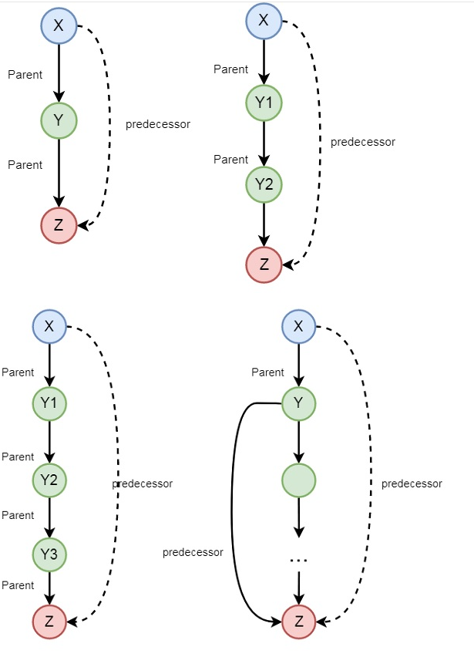
Example

Slide 9
Example 2: Decendant
child(bridget,caroline). child(caroline,donna).
descend(X,Y):- child(X,Y). descend(X,Y):- child(X,Z), child(Z,Y).

Slide 10
Example 2: Decendant
child(anna,bridget).
child(bridget,caroline). child(caroline,donna). child(donna,emily).
descend(X,Y):- child(X,Y). descend(X,Y):- child(X,Z), child(Z,Y).

Slide 11
Example 2: Decendant
child(anna,bridget).
child(bridget,caroline). child(caroline,donna). child(donna,emily).
descend(X,Y):- child(X,Y). descend(X,Y):- child(X,Z), child(Z,Y).
?- descend(anna,donna). no
?-

Slide 12
Example 2: Decendant
child(anna,bridget). child(bridget,caroline).
child(caroline,donna). child(donna,emily).
descend(X,Y):- child(X,Y). descend(X,Y):- child(X,Z), child(Z,Y).
descend(X,Y):- child(X,Z), child(Z,U), child(U,Y).
?-

Slide 13
Example 2: Decendant
child(anna,bridget).
child(bridget,caroline). child(caroline,donna). child(donna,emily).
descend(X,Y):- child(X,Y). descend(X,Y):- child(X,Z), descend(Z,Y).
?-

Slide 14
Example 2: Decendant
child(anna,bridget).
child(bridget,caroline). child(caroline,donna). child(donna,emily).
descend(X,Y):- child(X,Y). descend(X,Y):- child(X,Z), descend(Z,Y).
?- descend(anna,donna).

Slide 15
Search tree
Draw search tree for
?- descend(anna,donna).

Slide 16

Example 3: Successor

Slide 17
Example 3: Successor
Suppose we use the following way to write numerals:
0 is a numeral.
If X is a numeral, then so is succ(X).

Slide 18
Example 3: Successor
numeral(0).
numeral(succ(X)):- numeral(X).

Slide 19
Example 3: Successor
numeral(0).
numeral(succ(X)):- numeral(X).
?- numeral(succ(succ(succ(0)))). yes
?-

Slide 20
Example 3: Successor
numeral(0).
numeral(succ(X)):- numeral(X).
?- numeral(X).

Slide 21
Example 3: Successor
numeral(0).
numeral(succ(X)):- numeral(X).
?- numeral(X). X=0;
X=succ(0);
X=succ(succ(0));
X=succ(succ(succ(0))); X=succ(succ(succ(succ(0))))

Slide 22
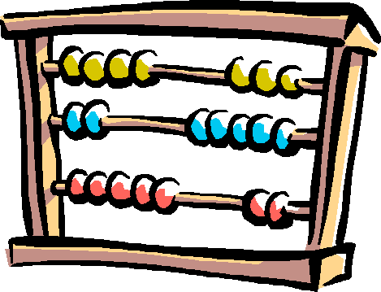
Example 4: Addition

Slide 23
Example 4: Addition
?- add(succ(succ(0)),succ(succ(succ(0))), Result). Result=succ(succ(succ(succ(succ(0)))))
yes

Slide 24
Example 4: Addition
add(0,X,X). %%% base clause
?- add(succ(succ(0)),succ(succ(succ(0))), Result). Result=succ(succ(succ(succ(succ(0)))))
yes

Slide 25
Example 4: Addition
add(0,X,X).
%%% base clause
add(succ(X),Y,succ(Z)):- add(X,Y,Z).
%%% recursive clause
?- add(succ(succ(0)),succ(succ(succ(0))), Result). Result=succ(succ(succ(succ(succ(0)))))
yes

Slide 26

Search tree
Draw the search tree!

Slide 27
Prolog and Logic
Prolog was the first reasonable attempt to create a logic programming language
Programmer gives a declarative specification of the problem, using the language of logic
The programmer should not have to tell the computer what to do
To get information, the programmer simply asks a query

Slide 28
Prolog and Logic
Prolog does some important steps in this direction
Nevertheless, Prolog is not a full logic programming language!
Prolog has a specific way of answering queries:
Search knowledge base from top to bottom
Processes clauses from left to right
Backtracking to recover from bad choices

Slide 29
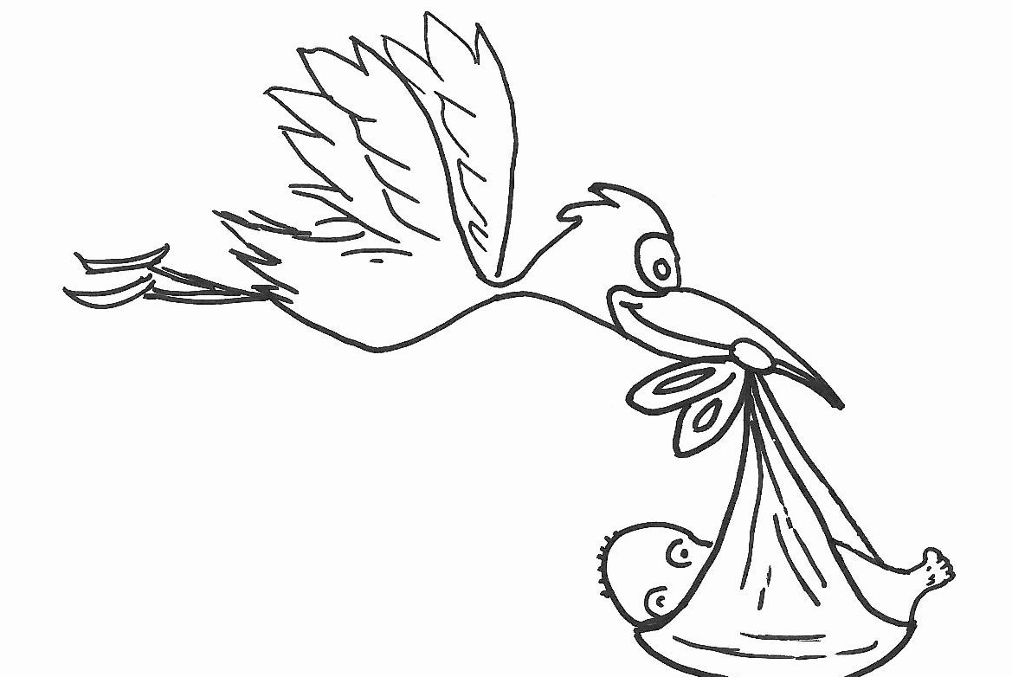
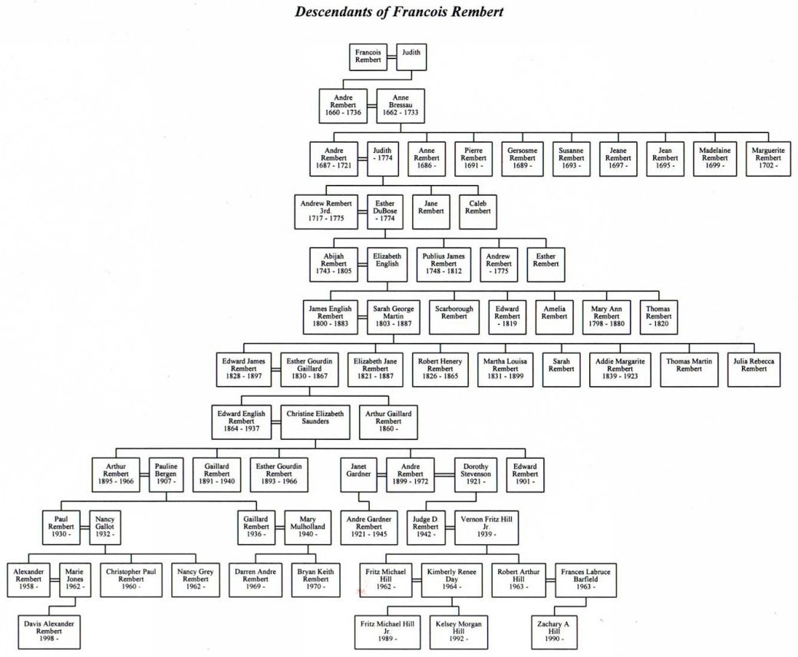
Four different descend/2

Slide 30
descend1.pl
child(anna,bridget).
child(bridget,caroline). child(caroline,donna). child(donna,emily).
descend(X,Y):- child(X,Y). descend(X,Y):- child(X,Z), descend(Z,Y).
?- descend(A,B).

Slide 31
descend1.pl
child(anna,bridget).
child(bridget,caroline). child(caroline,donna). child(donna,emily).
descend(X,Y):- child(X,Y). descend(X,Y):- child(X,Z), descend(Z,Y).
?- descend(A,B).
A=anna B=bridget
FIRST
SOLUTION

Slide 32
descend2.pl
child(anna,bridget).
child(bridget,caroline). child(caroline,donna). child(donna,emily).
descend(X,Y):- child(X,Z), descend(Z,Y). descend(X,Y):- child(X,Y).
?- descend(A,B).

Slide 33
descend2.pl
child(anna,bridget).
child(bridget,caroline). child(caroline,donna). child(donna,emily).
descend(X,Y):- child(X,Z), descend(Z,Y). descend(X,Y):- child(X,Y).
?- descend(A,B). A=anna
B=emily
FIRST
SOLUTION

Slide 34
descend3.pl
child(anna,bridget).
child(bridget,caroline). child(caroline,donna). child(donna,emily).
descend(X,Y):- descend(Z,Y), child(X,Z). descend(X,Y):- child(X,Y).
?- descend(A,B).

Slide 35
descend3.pl
child(anna,bridget).
child(bridget,caroline). child(caroline,donna). child(donna,emily).
descend(X,Y):- descend(Z,Y), child(X,Z). descend(X,Y):- child(X,Y).
?- descend(A,B).
ERROR: OUT OF LOCAL STACK

Slide 36
descend4.pl
child(anna,bridget).
child(bridget,caroline). child(caroline,donna). child(donna,emily).
descend(X,Y):- child(X,Y). descend(X,Y):- descend(Z,Y), child(X,Z).
?- descend(A,B).
HOW
^{MANY SOLUTIONS} WILL THIS
QUERY
^{GENERATE} BEFORE
RUNNING
^{OUT} OF MEMORY?

Slide 37
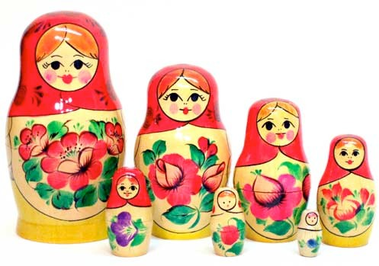
Exercise 3.2: Matryoshka dolls

Slide 38
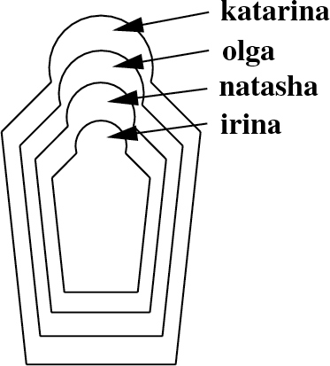
Exercise 3.2: Matryoshka dolls
First, write a knowledge base using the predicate directlyIn/2 which encodes which doll is directly contained in which other doll.
Then, define a recursive predicate in/2, that tells us which doll is (directly or indirectly) contained in which other dolls.

