Slide 1


Shah & Anchor Kutchhi Engineering College
Mahavir Education Trust's
Chembur, Mumbai 400 088
UG Program in Information Technology
Object Lifetime and Storage Management
Seema Jadhav
Assistant Professor IT-SAKEC

Slide 2
Learning Objective
Object
To understand Object Lifetime
To understand different Storage Management
Differentiate among Storage Management techniques.

Slide 3
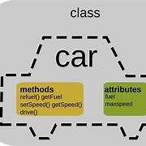
Object
An object is an entity containing
Data members arranged as a set of named fields similar to a record/struct.
Methods, which are routines that take the associated object as an argument. they are called member functions in C++.

Slide 4
example
public class car {
int fuel = 5;
}
public static void main(String[] args) {
car obj1 = new car(); System.out.println(obj1.x);
}
}

Slide 5
Object Lifetime and Storage Management
To identify several key events:
Creation of objects
Creation of bindings
References to variables, subroutines, types, and so on, all of which use bindings
Deactivation and reactivation of bindings that may be temporarily unusable
Destruction of bindings
Destruction of objects

Slide 6
The period from creation to destruction is called the LIFETIME of a binding
Allocation: process of taking the memory cell to which a variable is bound from a pool of available memory
Deallocation: process of placing the memory cell that has been unbound from a variable back into the pool of available memory
Lifetime of a variable: Time during the variable is bound to a specific memory location
When a program is loaded into memory, it is organized into three areas of memory, called segments:
-text segment (code segment)
-stack segment, and
-heap segment

Slide 7
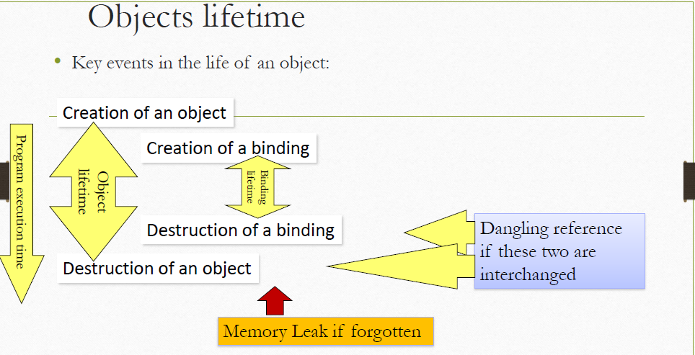

Slide 8
1.Dangling reference:
•no object for a binding (e.g., a pointer refers to an object that has already been deleted)
2.Memory leak:
•no binding for an object (preventing the object from being deallocated)

Slide 9
Dangling reference
A dangling reference is a reference to an object that no longer exists
•Dangling reference arise during object destruction, when an object that has an incoming reference is deleted or deallocated, without modifying the value of the pointer, so that the pointer still points to the memory location of the deallocated memory.
•In languages with manual memory management, like C or C++, can encounter dangling pointers, by doing this for instance:
int * p = new int;
delete p;
int i = *p; // error, p has been deleted

Slide 10
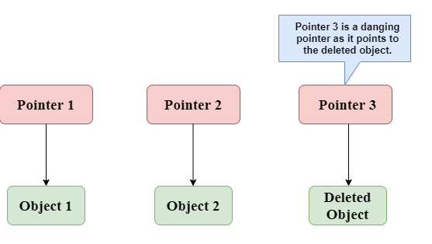
Dangling Reference

Slide 11
#include <stdio.h>
int main()
{ int *ptr=(int *)malloc(sizeof(int));
int a=560;
ptr=&a;
free(ptr);
return 0; }
In the above code, we have created two variables, i.e., *ptr and a where 'ptr' is a pointer and 'a' is a integer variable. The *ptr is a pointer variable which is created with the help of malloc() function. As we know that malloc() function returns void, so we use int * to convert void pointer into int pointer.

Slide 12
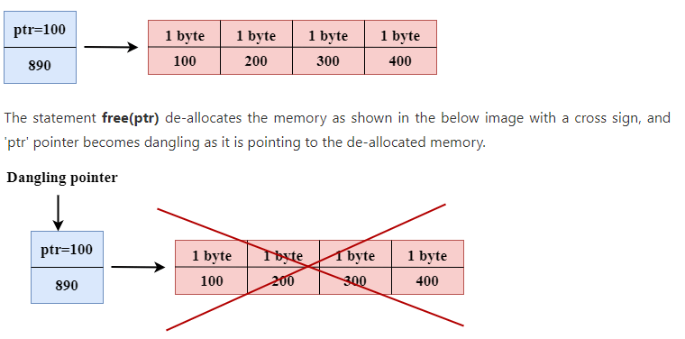
The statement int *ptr=(int *)malloc(sizeof(int)); will allocate the memory with 4 bytes shown in the below image:

Slide 13
Memory Leak
void f()
{
int *ptr = (int *) malloc(sizeof(int));
/* Do some work */
return; /* Return without freeing ptr*/
}

Slide 14
Storage Allocation Management
Storage Management
Storage Management Phases:
Initial Allocation
Recovery
Compaction & reuse.
Storage Management Areas:
Static
Stack
Heap
Static Area
Stack Area
Heap
Area

Slide 15
Storage Management
Segments in Memory
Static: global variable storage, permanent for the entire run of the program.
Stack: local variable storage (automatic, continuous memory).
Heap: dynamic storage (large pool of memory, not allocated in contiguous order).

Slide 16
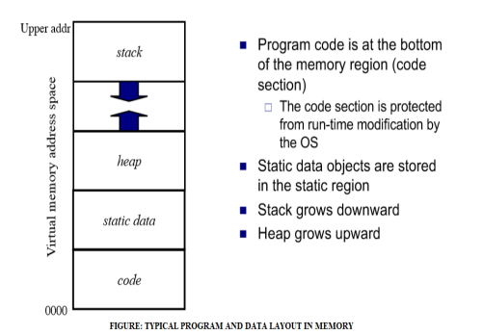

Slide 17
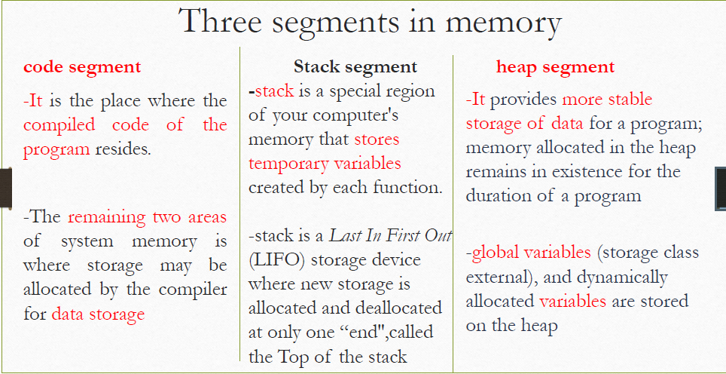

Slide 18
3 principal Storage Allocation mechanisms
Static Allocation is appropriate when the storage requirements are known at compile time.
Stack Allocation is appropriate when the storage requirements are not known at compile time,uses last-in, first-out discipline.
Heap Allocation is appropriate where storage cells are allocated and deallocated dynamically.

Slide 19
1.Static Allocation
Static storage allocation is appropriate when the storage requirements are known at compile time.
Static allocation for
•code
•globals
•Static & own variables
•explicit constants (including strings, sets, etc)
•scalars may be stored in the instructions
Examples:
- code in languages without dynamic compilation
- all variables in FORTRAN IV
- global variables in C, Ada, Algol
- constants in C, Ada, Algol

Slide 20
Static Allocation -Activation record
For each program unit such as the main program, a function or a subroutine (procedure), there is a code segment and an activation record.
•Activation records keep track of values as a program executes.
•In Static Allocation Static Variables bound to memory cells before execution begins and remains bound to the same memory cell throughout execution.
•Each procedure or function, as well as the main program and a few other program structures, may be compiled separately and associated with an activation record that can be entirely allocated by the compiler.

Slide 21
Static Allocation of static variables
For FORTRAN and other languages which allow static storage allocation,the amount of storage required to hold each variable is fixed at translation time. Such languages have no nested procedures or recursion
Advantages:
• Efficiency: All addressing of static can be direct.
•No run-time overhead is incurred for allocating and deallocating variables.
• History-sensitive: variables retain their values between separate executions Disadvantage:
Storage cannot be shared among variables.
• Ex: if two large arrays are used by two subprograms, which are never active at the same time, they cannot share the same storage

Slide 22
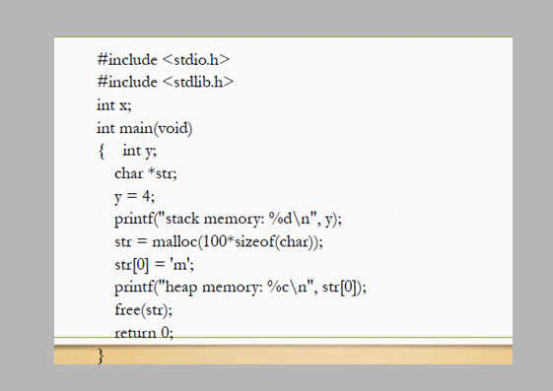

Slide 23
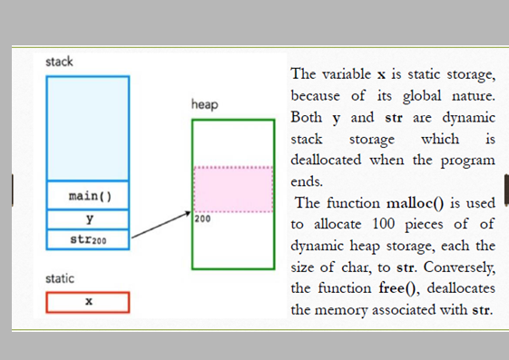

Slide 24
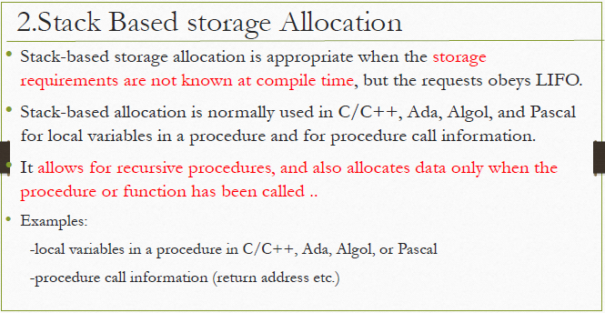

Slide 26
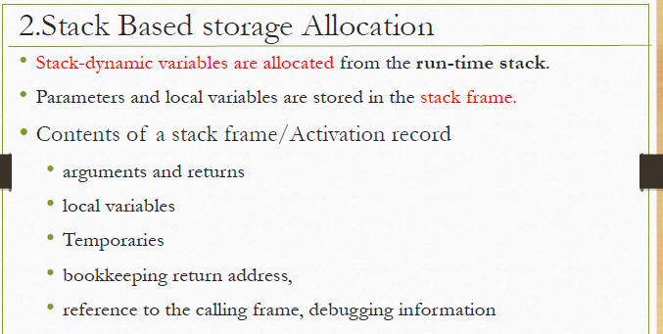

Slide 27
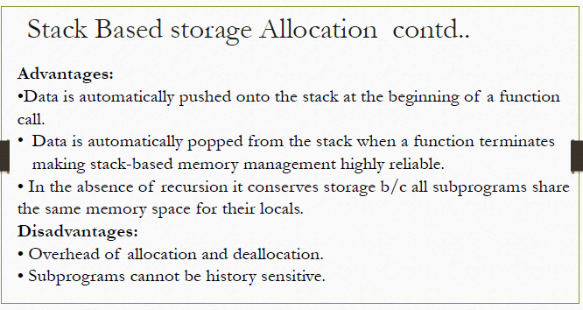

Slide 28
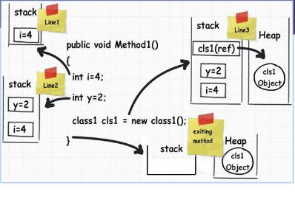

Slide 29
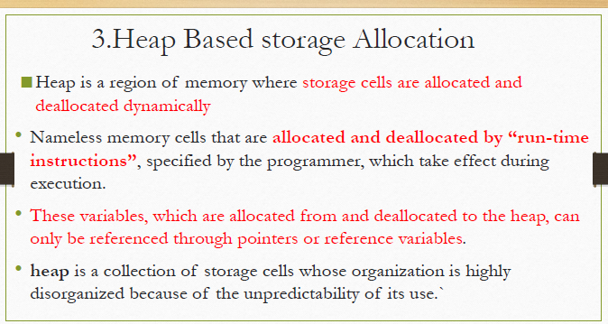

Slide 30
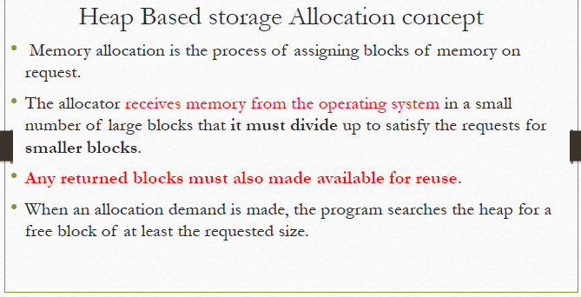

Slide 31
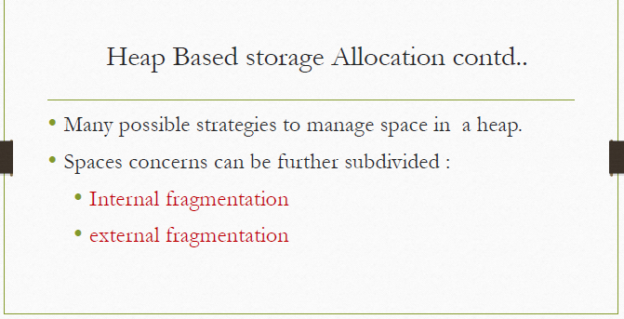

Slide 32
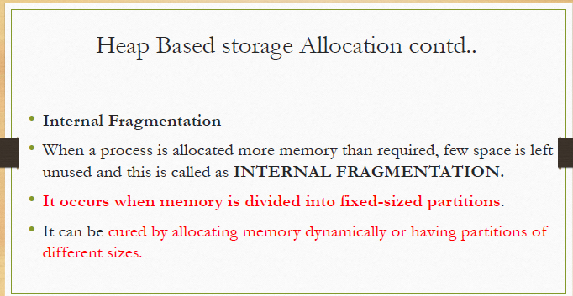

Slide 33
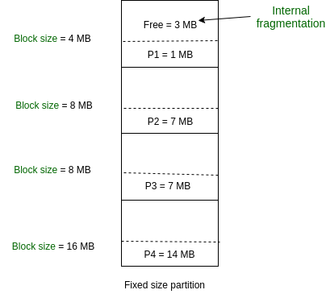
Fixed Partitioning

Slide 34
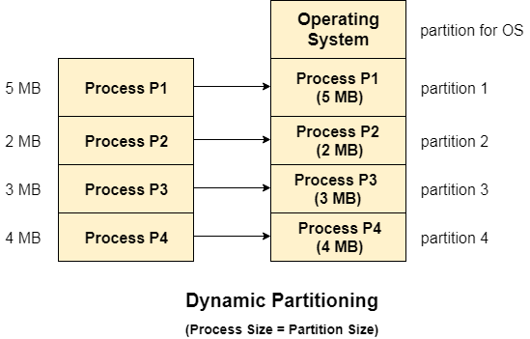
Variable Partitioning

Slide 35
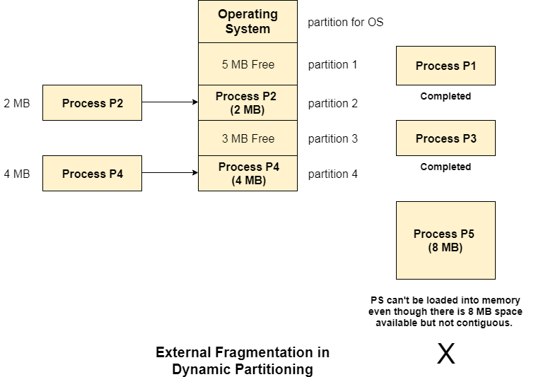
Variable Partitioning

Slide 36
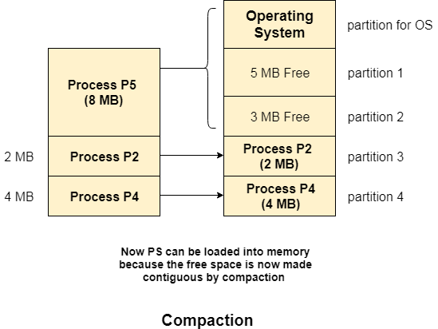
Compaction
In compaction, all the free partitions are made contiguous and all the loaded partitions are brought together.

Slide 37
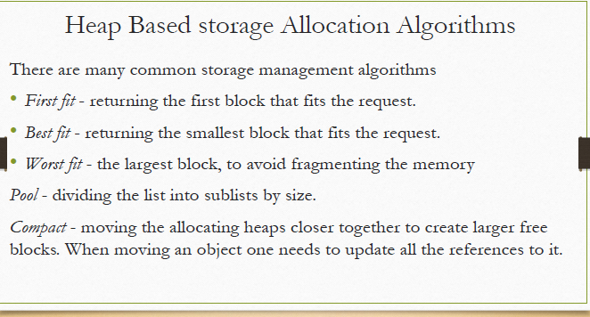

Slide 38
Advantages of Heap Allocation
1. Heap allocation is useful when we have data whose size is not fixed and can change during the run time.
2. We can retain the values of variables even if the activation records end.
3. Heap allocation is the most flexible allocation scheme.
Disadvantages of Heap Allocation
1. Heap allocation is slower as compared to stack allocation.
2. There is a chance of memory leaks.

Slide 39
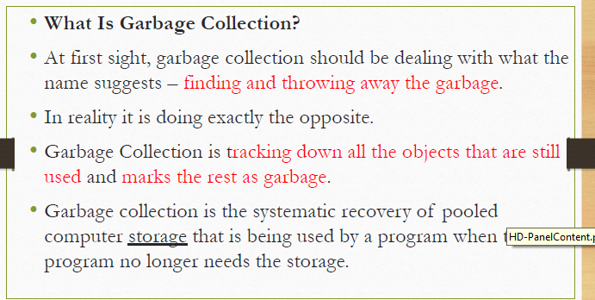

Slide 40
Thank you

