Slide 1


Shah & Anchor Kutchhi Engineering College
Mahavir Education Trust's
Chembur, Mumbai 400 088
UG Program in Information Technology
Imperative Languages: Names, Scoping, and Bindings
Ms.Seema Jadhav

Slide 2
Learning Objective
To understand the basic constructs that underline any programming language.
To explain different binding time
Differentiate between early binding & late binding

Slide 3
Programming paradigms in programming languages:
1) Imperative programming languages
2) Functional programming languages
3) Logic programming languages
4) Object-oriented programming languages
Others are:
5) Event-Driven programming languages
6) Concurrent / parallel programming languages
7) Special purpose programming languages

Slide 4
Imperative Programming Languages
It is also known as procedural languages.An imperative language uses a sequence of statements to determine how to reach a certain goal. Means here you will get the answer how to do a task not what to do.For example in C,
int a = 4;
int b = 5;
int sum = 0;
sum = a + b;
From assigning values to each variable to the final addition of those values, each statement changes the state of the program. Using a sequence of five statements the program shows how to add the numbers 4 and 15.
Example of Imperative language is: C, C++

Slide 5
Functional Programming Languages
It is also known as applicative languages.
Functional programming is a form of declarative programming (mathematical function).Programming consists of building the function that computes the answer.
There are two types:
Pure Functional languages: It supports only functional paradigm. Ex. Haskell.
Impure Functional languages: It supports both functional and imperative paradigm. Ex. Lisp.
Example of Functional language is: Lisp, Python, Haskell.

Slide 6
Logic Programming Languages
This type of languages concentrate on what is the expected outcome for the program instead of how the outcome is achieved.
Logical programming is something like math .
Logic program statements express facts and rules about problems.
To understand the rules, lets take an example like, “A is true if B and C is true”.And to understand facts we can say that “A is true”.
Example of Logic language is: Prolog.

Slide 7
Object-oriented programming languages
Object oriented programming language based on object instead of just functions and procedures.
It involves concepts of oops programming languages.
For example: C++, Java.

Slide 8
Event Driven programming languages:
These languages are execute various operations based on user activities like mouse click and other events.For example: Visual Basic, Java.
Concurrent or Parallel programming languages:
These are used to build various distributed programs.For example: SR, Linda.
Special purpose programming languages:
These programming languages are used for special task.
For example: SQL, HTML.

Slide 9
Imperative programming is like giving detailed instructions to your friend on how to reach your address from their current location. You tell them exactly what to do and where to go.
Imperative programming is a paradigm describing HOW the program should do something by explicitly specifying each instruction (or statement) step by step, which mutate the program's state.
Declarative programming, on the other hand, is similar to just giving your actual address. Your friend can then figure out how to get there (maybe using advanced tools like Google Maps or taking a taxi and letting the driver do the work).
Declarative programming is a paradigm describing WHAT the program does, without explicitly specifying its control flow.

Slide 10
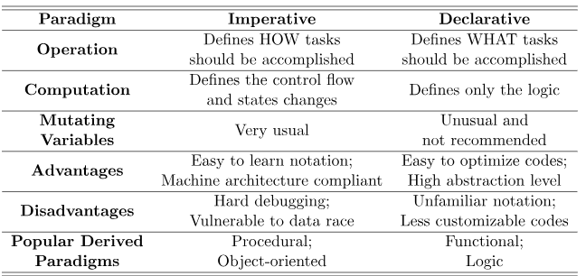

Slide 11
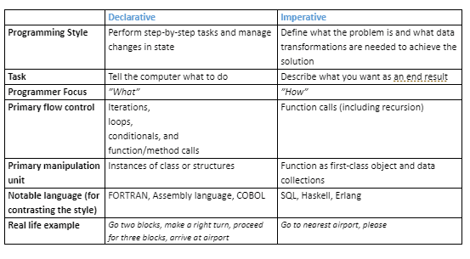

Slide 12
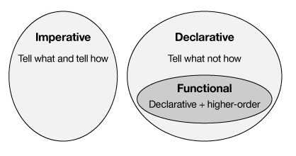

Slide 13
Introduction
A programming language is an artificial language designed to communicate instructions to a machine, particularly a computer.
They can be used to create programs that control the behavior of a machine and to express algorithms precisely.
The description of a programming language is usually split into the two components of syntax (form) and semantics (meaning).

Slide 14
Names are identifiers (mnemonic character strings used to represent something in the program - instead of low-level concepts like addresses):
A name can also represent an abstraction of a complicated program fragment (e.g., name of a method (control abstraction), class (data abstraction), module). Some symbols (like '+') can also be names.

Slide 15
Name in programming languages
A name is a mnemonic character string used to represent something else.
Names are a central feature of all programming languages.
Earlier, numbers were used for all purposes, including machine addresses.
Replacing numbers by symbolic names was one of the first major improvements to program notation
e.g. variables, constants, executable code, data types, classes, etc.
In general, names are of two different types:
1. Special symbols: +, -, *
2. Identifiers: sequences of alphanumeric characters (in most cases beginning with a letter), plus in many cases a few special characters such as '_' or '$'.

Slide 16
Names
Variables, subprograms, labels, user defined types, formal parameters have names.
Design Issues
Maximum length of a name
Case sensitive or case insensitive
Special words (reserved words, keywords or predefined names)

Slide 17
Name forms
Name is a string of characters
Every language has a different string size.
Earliest languages : single character
Fortran 77 : up to 6 characters
Fortran 95 : 31 characters
C89 : no limit but only first 31 are significant
Java, C#, Ada : no limit
C++ : no limit , but sometimes implementors have
Names in most PL have the same form:
– A letter followed by a string consisting of letters, digits, and underscore characters Today “camel” notation is more popular for C-based languages (e.g. myStack)

Slide 18
Case sensitivity
In many languages (e.g. C-based languages) uppercase and lowercase letters in names are distinct
– e.g. rose, ROSE, Rose
Problem for readability – names look very similar denote different entities
Also bad for writability since programmer has to remember the correct cases
– e.g. Java method parseInt for converting a string into integer, not ParseInt or parseint

Slide 19
Special words
Reserved words (special words that cannot be used as names):
Can’t define for or while as function or variable names.
Good design choice

Slide 20
Binding
A binding is an association between two things, such as a name and the thing it names
eg.the binding of a class name to a class
a variables name to a variable.
Static and Dynamic binding:
A binding is static if it first occurs before run time and remains unchanged throughout program execution.
A binding is dynamic if it first occurs during execution or can change during execution of the program.

Slide 21
A binding is an association between two things, such as a name and the thing it names
In general, binding time refers to the notion of resolving any design decision in a language implementation (e.g., an example of a static binding is a function call: the function referenced by the identifier cannot change at runtime)
The textual region of the program in which a binding is active is its scope

Slide 22
Binding Time
Binding Time is the point at which a binding is created or, more generally, the point at which any implementation decision is made
✔
language design time-program structure, possible type, built-in features such as keywords
language implementation time
I/O, arithmetic overflow, type equality (if unspecified in manual)
implementation dependent semantics such as bit width of an integer

Slide 23
Binding time is the time when an association is established. In programming, a name may have several attributes, and they may be bound at different times.
Example1:
int n;
n = 6;

Slide 24
Types of Binding Time
Language design time: During the design of the programming languages, the programmers decides what symbols should be used to represent operations .
e.g. .Binding of operator symbols to operations.
( * + …) (Multiplication, addition …)
Language Implementation Time: Most language manuals leave a variety of issues to the language implementor. Typical examples include the precision of the fundamental types, the coupling of I/O to the operating systems notion of files etc. Bind data type, such as int in C to the range of possible values.
Example: the C language does not specify the range of values for the type int.
Program writing time: Programmers choose algorithms, data structures and names. While writing programs, programmers bind certain names with procedure, class etc.
Example: many names are bound to specific meanings when a person writes a program

Slide 25
Compile Time:
The time when a single compilation unit is compiled, while compiling the type of a variable can be identified. Example: int c; [at compile time int, c forms an association]
Link time:
The time when all the compilation units comprising a single program are linked as the final step in building the program. [The separate modules of a single program will be bound only at link time]
Load time:
Load time refers to the point at which the operating system loads the program into memory so that it can run.
Run time:
Run time is a very broad term that covers the entire span from the beginning to the end of execution. If we give the value of a variable during runtime, it is known as runtime binding

Slide 26
Early vs. Late Binding Time Advantages
Static or early binding- : if binding occurs before runtime and remains unchanged throughout the program execution. Compiled languages tend to have early binding times
Dynamic or Late binding: if binding occurs during runtime or can change during program execution. Interpreted languages tend to have later
binding times
Note: early binding-->greater efficiency , Ease of implementation Late binding-->greater flexibility,

Slide 27
Interpreted vs Compiled Programming Languages: What's the Difference?

Slide 28
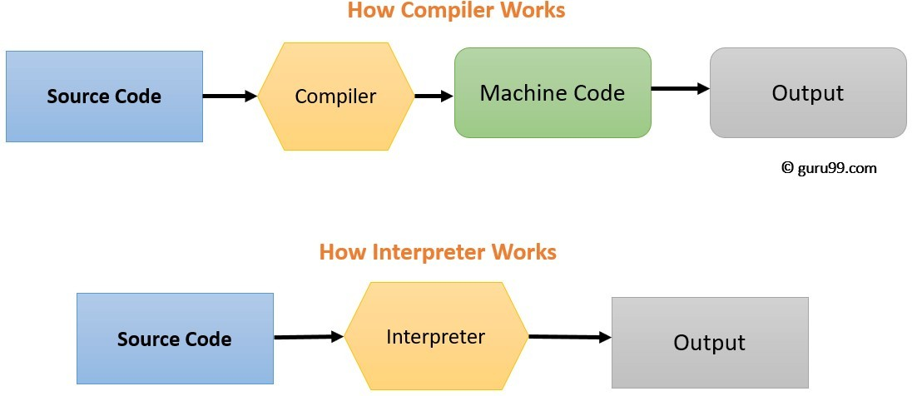
Compiler :a program that converts instructions into a machine-code or lower-level form so that they can be read and executed by a computer.
Interpreter:a program that can Analyze and execute a program line by line.

Slide 29
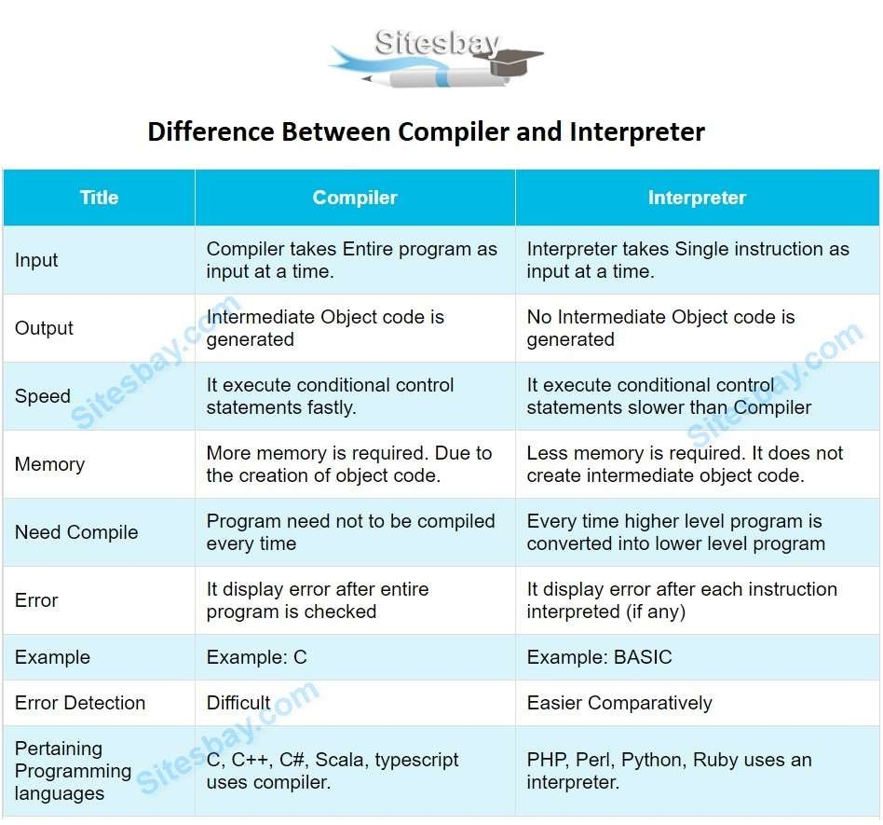

Slide 30
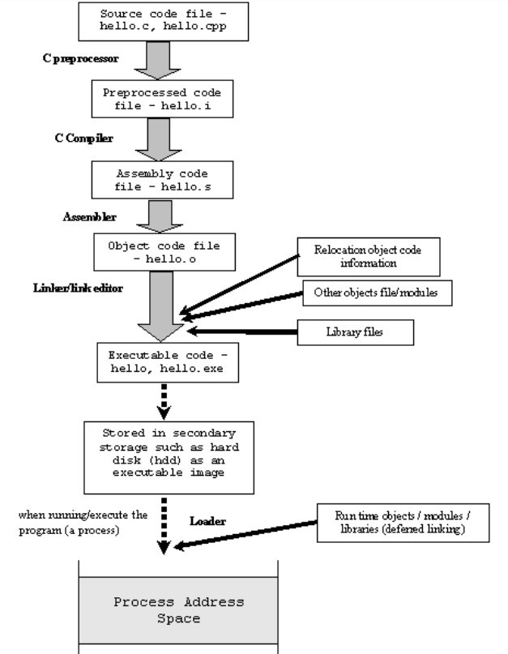
Summary

Slide 31
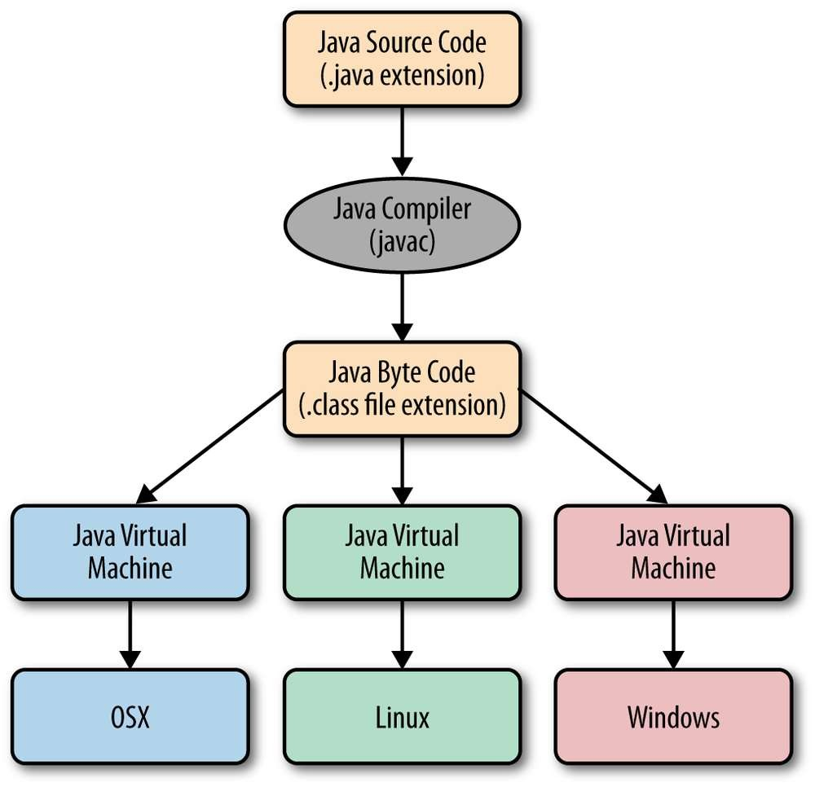

Slide 32
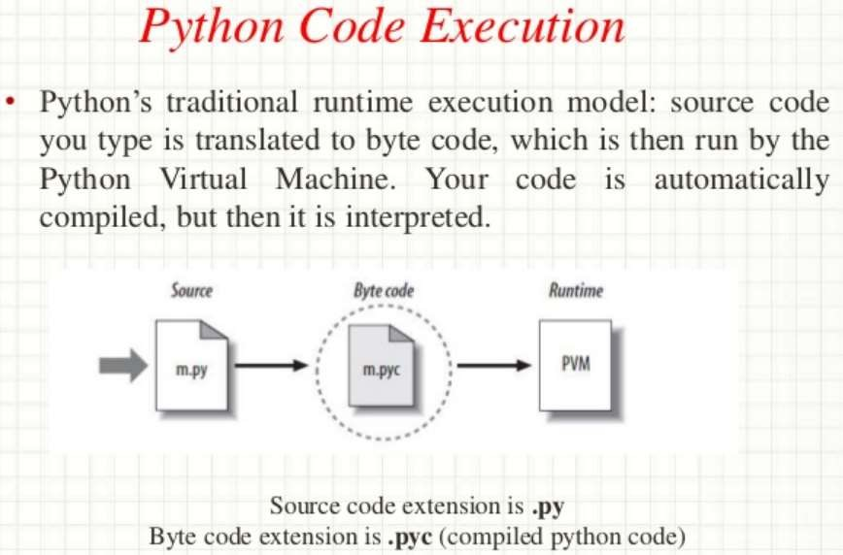

Slide 33
Thank You

