Slide 1
Scope & Scope Rules
Ms.Seema Jadhav

Slide 2
Scope
Name: name is a string of characters used to identify some entity. Allow us to refer to variables, constants, functions, types, operations etc .
Binding: An association of a name with an object .
Scope: The part of the program in which the binding is active.

Slide 3
Binding Time is the time at which a binding is created
1.Language design time
2. Language implementation time
3. program writing time
4. compile time
5. link time
6. load time
7. Runtime

Slide 4
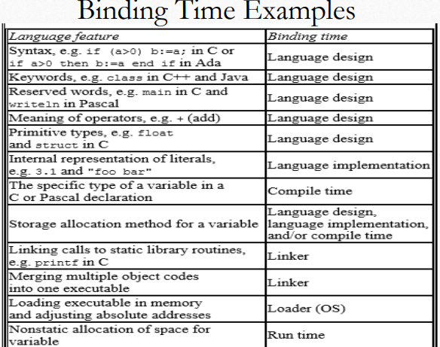
Binding Time :Example

Slide 5
The scope of a name N means all places in the program where N denotes the same object.
Scope of a variable is the range of statements in which the variable is visible
Scope: The textual region of the program in which a binding is active is its scope.
A var is visible in a statement if it can be referenced in that statement.
– Local var is local in a program unit or block if it is declared there.
– Non-local var of a program unit or block are those that are visible within the program unit or block but are not declared there
Scope rules of a language determine how a particular occurrence of a name is associated with a variable

Slide 6
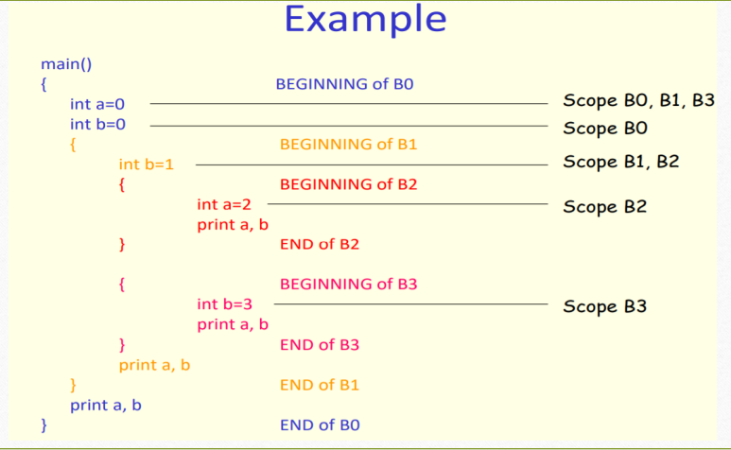

Slide 7
Static scoping:
It allows us to determine the use of every variable in a program statically, without executing it at compile time.
In static scope rules the bindings are defined by the physical (lexical) structure of the program.
Dynamic scoping :
With dynamic scope rules, bindings depend on the current state of program execution
The idea is to search for a name in a chain of called procedures, starting from the main program.
This chain is built according to the visibility rules

Slide 8
Static Scope Rules
In a language with static(lexical) scoping , the bindings between names and objects can be determined at compile time by examining the text of the program , without consideration of the flow of control at run time .
The simplest static scope rule is probably that of early versions of Basic
Scope rules are somewhat more complex in (pre-Fortran 90) Fortran
Static scope refers to the scope of the container

Slide 9
Example
int a=10;
fun1(int b)
{
printf(“%d”,(a*b));
}
fun2()
{
int a=20;
fun1(30);
}
main()
{
fun2();
}

Slide 10
Output
Static=300
Dynamic =600

Slide 11
Example
x:real
procedure show()
begin
printf(x);
end
procedure small
begin
x:real
x=1.25
show();
end
begin
x=2.5
show();
small();
end

Slide 12
Output
Static:2.5 2.5
Dynamic-2.5 1.25

Slide 13
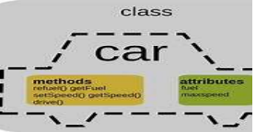
Object
An object is an entity containing
Data members arranged as a set of named fields similar to a record/struct.
Methods, which are routines that take the associated object as an argument. they are
called member functions in C++.

Slide 14
Example
public class car {
int fuel = 5;
}
public static void main(String[] args) {
car obj1 = new car();
System.out.println(obj1.fuel);
}
}

Slide 15
Object Lifetime and Storage Management
To identify several key events:
Creation of objects
Creation of bindings
References to variables, subroutines, types, and so on, all of which use bindings
Deactivation and reactivation of bindings that may be temporarily unusable
Destruction of bindings
Destruction of objects

Slide 16
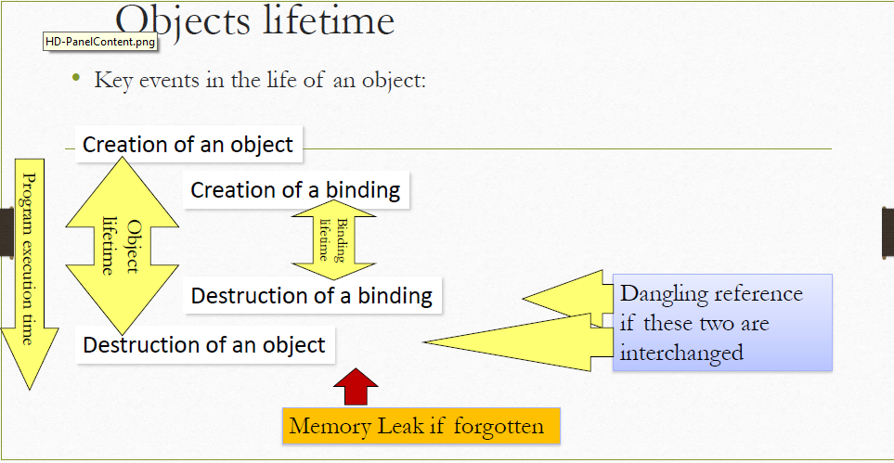

Slide 17
Storage Bindings and Lifetime
The period from creation to destruction is called the LIFETIME of a binding
• Allocation: process of taking the memory cell to which a variable is bound from a pool of available memory
• Deallocation: process of placing the memory cell that has been unbound from a variable back into the pool of available memory
• Lifetime of a variable: Time during the variable is bound to a specific memory location

Slide 18
Thank You

