Slide 1
Parameter Passing
Coroutines
Ms.Seema Jadhav

Slide 2
Most subroutines are parameterized:
❑ Parameter names that appear in the declaration of a subroutine are known as formal parameters.
❑ Variables and expressions that are passed to a subroutine in a particular call are known as actual parameters.
❑ actual parameters are also known as arguments.

Slide 3
Parameter Passing Modes :
Call by value: In the pass by value concept, the method is called by passing a value. So, it is called pass by value. It does not affect the original parameter.
Call by reference (aliasing): aIn the pass by reference concept, the method is called using an alias or reference of the actual parameter. So, it is called pass by reference.

Slide 4
public class PBVDemo {
int a=100;
void change(int a){
a=a+100;//Changing values It will be locally)
}
public static void main(String args[]){
PBVDemo p=new PBVDemo(); //Creating object
System.out.println(" Value (before change)="+p.a); p.change(500); //Passing value
System.out.println(" Value (after change)="+p.a);
} }

Slide 5
Value (before change)= 100
Value (after change)= 100

Slide 6
#include<stdio.h>
void main(){
void swap(int,int);
int a,b;
printf("enter 2 numbers");
scanf("%d%d",&a,&b);
printf("Before swapping a=%d b=%d",a,b);
swap(a,b);
printf("after swapping a=%d, b=%d",a,b);
}
void swap(int a,int b){
int t; // all these statements is equivalent to
t=a; // a = (a+b) – (b =a);
a=b; // or
b=t; // a = a + b;
} // b = a – b;
//a = a – b;

Slide 7
enter 2 numbers 10 20
Before swapping a=10 b=20
After swapping a=10 b=20

Slide 8
Generic modules or classes are particularly valuable for creating containers: data abstractions that hold a collection of objects.
Generic subroutines (methods) are needed in generic modules (classes), and may also be useful in their own right.
Examples of containers include stack , queue, heap, set, dictionary ,lists , arrays, trees, or hash tables.
A generic or polymorphic subroutine is one that takes parameters of different types on different activations
Generic subroutines are needed in generic classes.
They allow a method to be parameterised by a single type.

Slide 9
public <T> add ( T a, T b)
return a + b;
we now have a generic type T passed as a parameter to the add method.
Hence we can now call the code:
int c = add( 5 , 7 );
double d = add ( 4.5, 6.9 );
String concat = add( “gen” , “erics” );

Slide 10
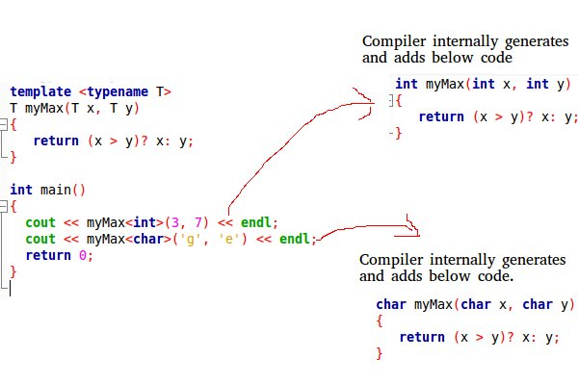

Slide 11
A generic add method in C++:
template <typename T> add (T a, T b)
{
return a+b;
}
This allows any number ( int, float, short, double etc ) to be added together.
• To call the method
add(5,6);
add(5.6 , 7.8);

Slide 12
Exception Handling
Exception-a hardware-detected run-time error or unusual condition detected by software.
Examples :
arithmetic overflow
end-of-file on input
wrong type for input data
user-defined conditions, not necessarily errors

Slide 13
An exception can be defined as an unexpected—or at least unusual— condition that arises during program execution, and that cannot easily be handled in the local context.
It may be detected automatically by the language implementation, or the program may raise it explicitly .
Exception-handling mechanisms address these issues by moving error checking code “out of line,” allowing the normal case to be specified simply, and arranging for control to branch to a handler when appropriate.

Slide 14
code executed when exception occurs may need a different handler for each type of exception .
Purpose of an exception handler:
1.Recover from an exception to safely continue execution
2.If full recovery is not possible, print error message(s)
3.If the exception cannot be handled locally, clean up local resources and raise the exception to propagate it to another handler

Slide 15
public class JavaExceptionExample{
public static void main(String args[]){
try{
//code that may raise exception
int data=100/0;
}catch(ArithmeticException e){System.out.println(e);}
//rest code of the program
System.out.println("rest of the code...");
}
}

Slide 16
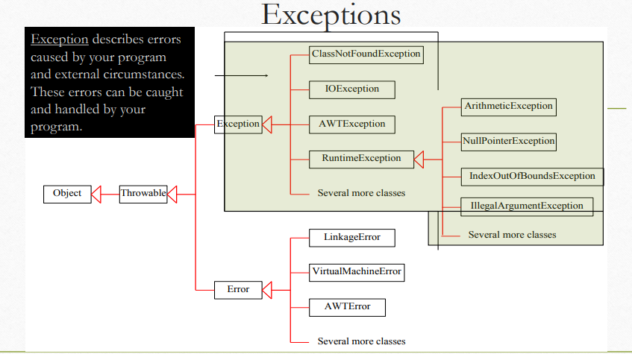

Slide 17
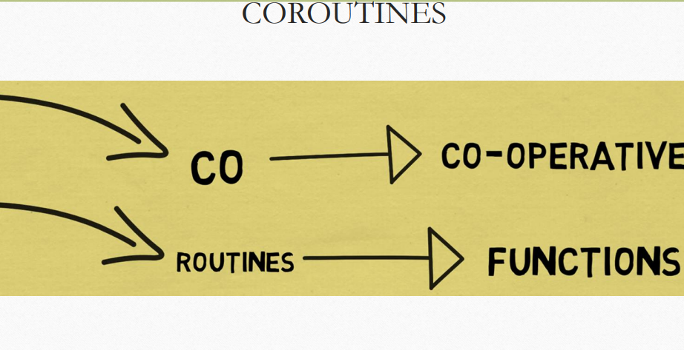

Slide 18
Coroutines are execution contexts that exist concurrently, but that execute one at a time, and that transfer control to each other explicitly, by name
coroutines can be used to implement
– iterators
– threads
– because they are concurrent (i.e., simultaneously started but not completed), coroutines cannot share a single stack

Slide 19
A coroutines is a subprogram that has multiple entries and controls them itself. Also called symmetric control
❑ A coroutine call is named a resume
❑ coroutines repeatedly resume each other, possibly forever
❑ Coroutines provide concurrent execution of program units (the coroutines)
❑ Their execution is interleaved, but not overlapped

Slide 20
In computer programming, a subroutine is a sequence of program instructions that perform a specific task.
For example a program for addition, subtraction. Subroutines is also known as function.
Coroutines are generalizations of the subroutines.
A subroutine has the same starting point and the same endpoint all the time, while a coroutine has multiple entry points for suspending and resuming execution.
Coroutines are cooperative, that means if a coroutine consume input data, another coroutine can consume it, and another coroutine can be used to display the output.
Coroutines are nothing but cooperative functions.

Slide 21
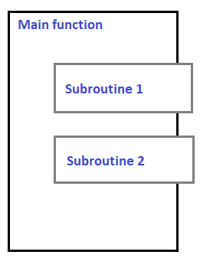
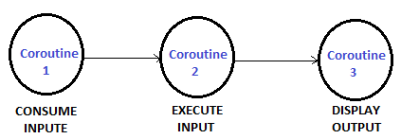
https://www.youtube.com/watch?v=tqay-vzqSN0

Slide 22
EVENT
Something to which a program needs to respond
– occurs outside of program at unpredictable time
• GUI events: keystrokes, mouse motions, button clicks
• network operations: message arrival
typically I/O performed synchronously with blocking
for events, usually want a handler – event handler or callback function.

Slide 23
traditionally, events were handled by interrupts
– an asynchronous event would trigger an interrupt
– registers saved
– jump to predefined address in OS kernel
in modern systems, most events handled by threads
– lightweight process
– threads can be synchronous

Slide 24
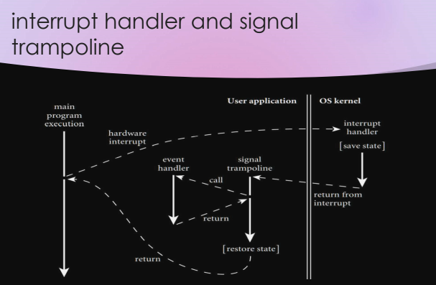

Slide 25
Thank You

