Slide 1

Mahavir Education Trust's
Shah & Anchor Kutchhi Engineering College Chembur, Mumbai 400 088 UG Program in Information Technology
MODULE 2- IMPERATIVE PARADIGM: DATA ABSTRACTION IN OBJECT ORIENTATION
Manya Gidwani
Assistant Professor
IT-SAKEC

Slide 2
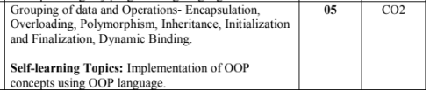

Slide 3
Learning Objective
To understand Features of object orientated programming
To understand inheritance concept

Slide 4
Object-oriented programming (OOP) is a programming paradigm based on the concept of "objects", which may contain data, in the form of fields, often known as attributes or data members; and code, in the form of procedures, often known as methods or member functions.
The main aim of OOP is to bind together the data and the functions that operate on them so that no other part of the code can access this data except that function.

Slide 5
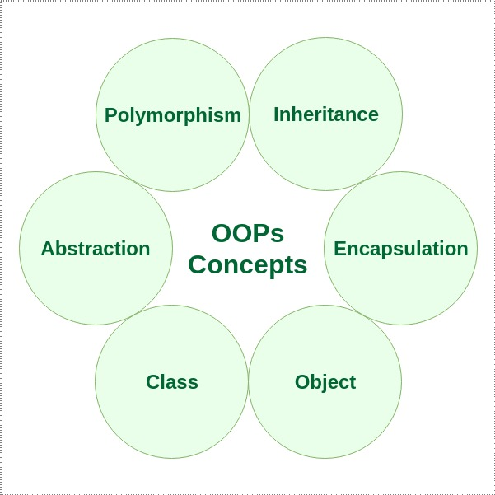
Characteristics of an Object Oriented Programming language

Slide 6
Inheritance
The capability of a class to derive properties and characteristics from another class is called Inheritance.

Slide 7

Why and when to use inheritance?

Slide 8
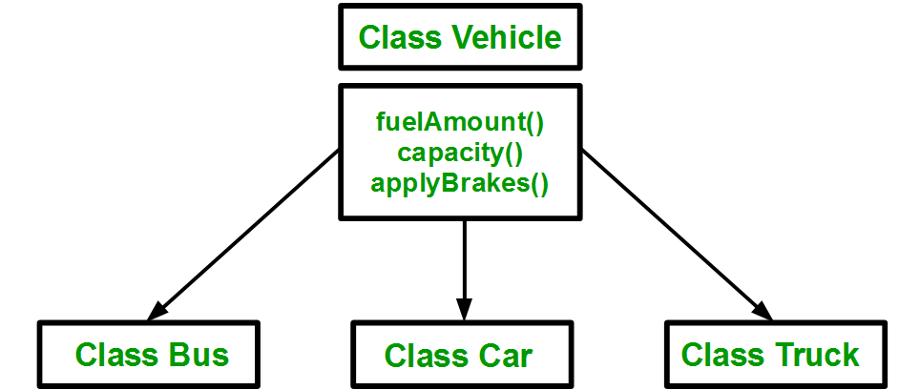
Using inheritance, we have to write the functions only one time instead of three times as we have inherited rest of the three classes from base class(Vehicle).

Slide 9
Terminology
Sub Class: The class that inherits properties from another class is called Sub class or Derived Class.
Super Class: The class whose properties are inherited by sub class is called Base Class or Super class.

Slide 10
Implementing inheritance in C++:
class subclass_name : access_mode base_class_name
{
//body of subclass
};
Example:
class Bus:public Vehicle
{
};
Access mode

Slide 11
Access Specifiers
In C++, there are three access specifiers:
public - members are accessible from outside the class
private - members cannot be accessed (or viewed) from outside the class
protected - members cannot be accessed from outside the class, however, they can be accessed in inherited classes.

Slide 12
Example
inheritance example1.txt
single inheritance.docx

Slide 13
Modes of Inheritance
Public mode: If we derive a sub class from a public base class. Then the public member of the base class will become public in the derived class and protected members of the base class will become protected in derived class.
Protected mode: If we derive a sub class from a Protected base class. Then both public member and protected members of the base class will become protected in derived class.
Private mode: If we derive a sub class from a Private base class. Then both public member and protected members of the base class will become Private in derived class.

Slide 14
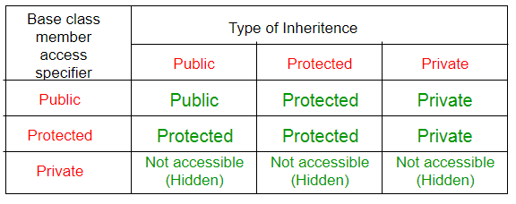

Slide 15
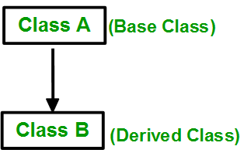
Type of inheritance
Single Inheritance:In single inheritance, a class is allowed to inherit from only one class. i.e. one sub class is inherited by one base class only.

Slide 16

Multiple Inheritance:
Multiple Inheritance is a feature of C++ where a class can inherit from more than one classes. i.e one sub class is inherited from more than one base classes.

Slide 17
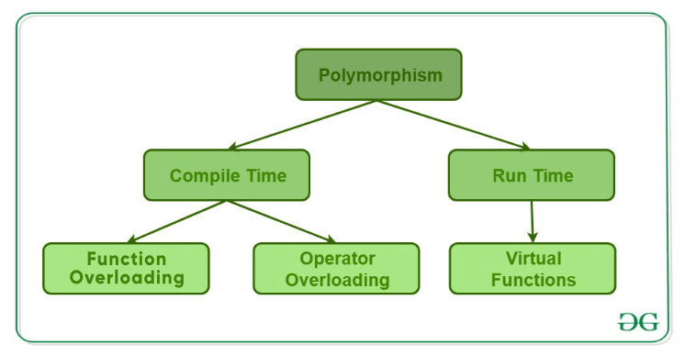
The word “polymorphism” means having many forms. In simple words, we can define polymorphism as the ability of a message to be displayed in more than one form.

Slide 18
Multiple Inheritance:
Syntax:
class subclass_name : access_mode base_class1, access_mode base_class2
{
//body of subclass
};

Slide 19
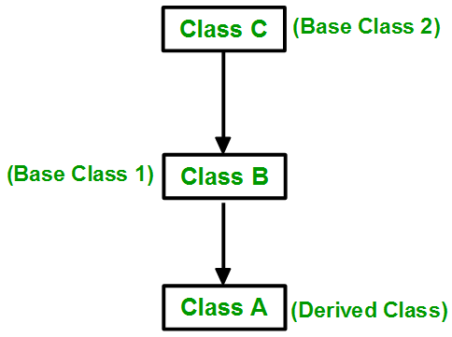
Multilevel Inheritance:
In this type of inheritance, a derived class is created from another derived class.

Slide 20
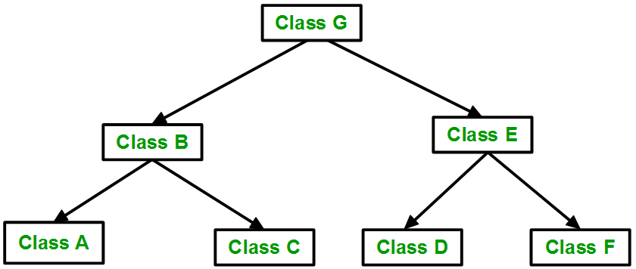
Hierarchical Inheritance:
In this type of inheritance, more than one sub class is inherited from a single base class. i.e. more than one derived class is created from a single base class.

Slide 21
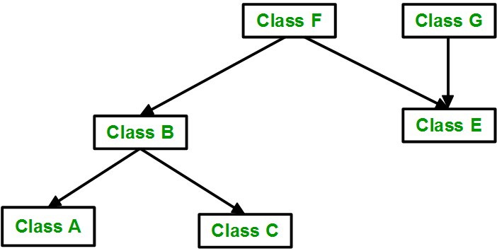
Hybrid Inheritance:
Hybrid Inheritance is implemented by combining more than one type of inheritance. For example: Combining Hierarchical inheritance and Multiple Inheritance.

Slide 22
Thankyou

