Slide 1
Haskell Programming
Haskell Programming

Slide 2
So what's Haskell?
Purely functional programming language.
Haskell is lazy: Haskell won't execute functions and calculate things until it's really forced to show you a result.
Haskell is statically typed: When you compile your program, the compiler knows which piece of code is a number, which is a string and so on.
Haskell is elegant and concise. Because it uses a lot of high level concepts, Haskell programs are usually shorter than their imperative equivalents.

Slide 3
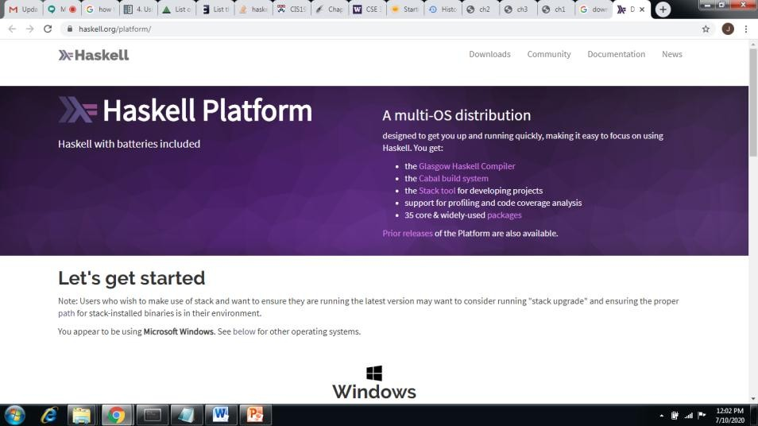
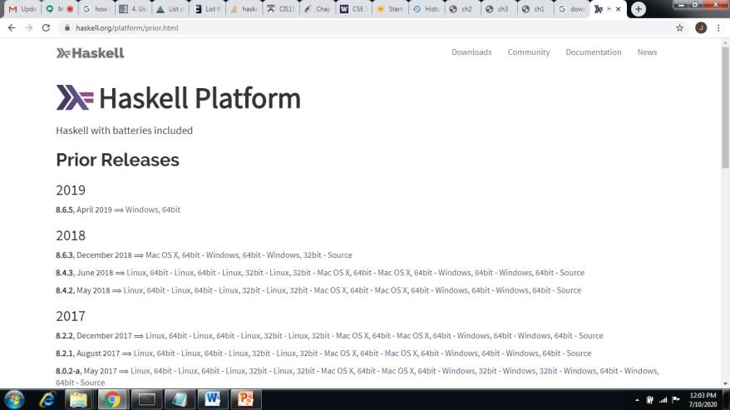
Installation of Haskell
https://www.haskell.org/platform/
………………………………………………………………………………………………………………………………………………………………………………………………………………………………………………………………………………………………………………………………………………………………………………………………………………………………………………………………………………………………….

Slide 4
How to Start
Open cmd
Type ghci to start ghc compiler
> ghci Prelude>
^d to quit
Now you are ready to type haskell commands

Slide 5
Arithmetic and Logical
2 + 3
2 – 3
2 * 3
2 * (-3)
2 / 3
it (result)
50 * 100 - 4999
50 * (100 – 4999)
40*100-3000+50/5
(40*100-3000+50)/5
2 + “hi”
1 + True
False
True
True && False
True && True
False || True
not False
not (True && False)
not (True || False)

Slide 6
Comparative operators
2 == 3
2 == 0
2 /= 2
2 /= 0
2 < 3
2 > 3
2 ^ 3
not (2 < 3)
“hi” = = “hi”
“hi” = = “Hi”

Slide 7
Data Types
Bool
Char
Int
Float
Double
List
Tuple
Function
:type True
:type 5
a = 4
:type “hi”
:type 5.34
(True, False)
:type (True, False)
(True, 5)
:type (True, 5)

Slide 8
List and Range
List
[]
[[]]
[1,2,3,4]
[“a”,”b”,”c”,”d”]
[‘a’,’b’,’c’,’d’]
Range
[‘a’..’z’]
[’J’..’M’]
[1..10]
[0,2..10]
[1,3..10]
[‘a’,’c’..’z’]
[2,4..10*2]
take 10 [2,4..]
take 10 [1,1..]
take 10 [0,0..]
replicate 5 2
take 10 (repeat 0)
take 10 (cycle [1,2,3])
take 10 (cycle “hi ”)

Slide 9
Build in Functions
sum [1,2,3]
succ 6
succ 7 * 8
succ (7 * 8)
min 4 9
max 4 9
div 4 3
div 3 4
4/3
mod 3 2
reverse “hello”
x = 45
print x
return True
x <- return 35
print x
y = return 35
print y
putStrLn "hello“

Slide 10
References
http://users.umiacs.umd.edu/~hal/docs/dau me02yaht.pdf
http://www.cs.nott.ac.uk/~pszgmh/ch2.pdf
http://www.cs.nott.ac.uk/~pszgmh/ch3.pdf
https://www.cmi.ac.in/~madhavan/courses/pl 2009/lecturenotes/lecture-notes/node70.html

Slide 11
Thank You

