Slide 1

AN ENGINEERING MAJOR PROPOSAL REPORT ON AIRLINES DATABASE WEBSITE Submitted By: Shreedhar Risal (120346) Kabin Ghimire (120325) Kam Chandra Gautam (120320) Niranjan Basnet (120304)
Notes:
<number>

Slide 2
INTRODUCTION
Main purpose of this Project is to list the requirements of the Airline Database Website.
The document being prepared is the first version of vision document for the Airline Database Website.
Certain things that have been added to our Program:
Fuel calculation monthly.
Easy editing the recorded data.
Modify the data.

Slide 3
PROBLEM STATEMENT
Early system of record keeping and making transaction is tedious and troublesome to handle with ease.
Writing down the every transaction and maintaining the data safely was a great risk.
Hard copy records and its updating and editing may accidentally interchanged
Keeping for reference for a considerable period of time may result in the wearing and tearing of pages

Slide 4
This website system provides the better solution for keeping records of Airline as the website has the privilege for :
Adding record,
Showing the record,
Updating the records and
Deleting the unwanted records

Slide 5
OBJECTIVES
Objective & goals of the proposed system are:
To record the detail information of flight.
To reduce time as most of the work done by computer.
To provides greater speed.
To manage increased number of possible data in order to reduce manual work load.
*Website needs some basic training but easy to learn
Notes:
<number>

Slide 6
SCOPE
As the number of new data keep is growing it is feasible for :
Future reference
Airline database website is more easier and reliable way of recording information
Provide user a unique and friendly environment to work on.
Projected to use queries and provide faster access to the data.

Slide 7
LITERATURE REVIEW
At earlier times, the records were kept in hard copy file which is a great risk as it is prone to many calamities, wearing and tearing of pages etc.
This loss of data due to physical deterioration provides less security to the result.
Over viewing the history of website development, the software on this system was hard to find and most of them was hard to use and static type ans which is also not accepted for official purpose.
The project has been designed in C#.NET technology and consists of a SQL server which acts as the database for the project using visual studio.
This approach is fruitful to every organization to keep the records of day to day daily record of data in Airline Database system.

Slide 8
METHODOLOGY
Designed in C#.NET technology
Consists of a SQL server which acts as the database for the project using visual studio
Airline Database website is a database system where SQL server acts as the database
Done using the database insert, update, and delete method where required database is linked using connection string.
CSS is used in design
Microsoft word for the documentation and block daigram for the beginning to end of the project.

Slide 9
EXPECTED OUTPUT
Has simple login home page where firstly administrator can only login using unique password.
To create the user account administrator should give permission.
Entry can be viewed by local user.
Can be login by anyone who has necessary key.
Administrator is responsible for editing, deleting and updating the database..

Slide 10
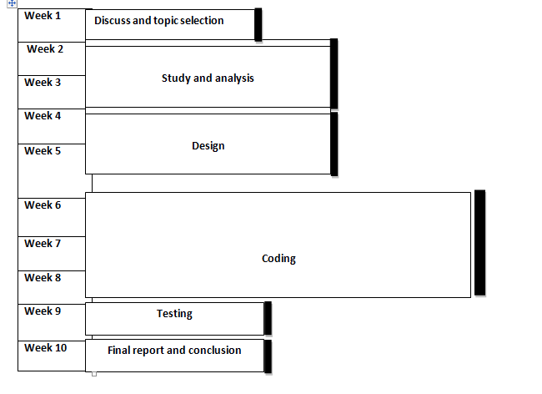
WORKING SCHEDULE

Slide 11
REFERENCES
The following references have been used
during all the phases of the Airline database
website project:
http://www.c-sharpcorner.com/
http://en.wikibooks.org/wiki/C_Sharp_Programming

