Slide 1





Kahawa Roots
Proof: I’ve Built This Before
Traceability Platform
Tracking Coffee from Kenya’s Farms to the UK
My live full-stack project on the same GCP infrastructure I’m proposing:
Shree Hari Anbazhagan
shreeharianbazhagan@gmail.com 07721046613
DeltaEd — Live on GCP Cloud Run
GCP Cloud Run, europe-west2
(London)
Dockerized, full stack
React + Python + BigQuery
Pre-Interview Task — Developer Intern — April 2026
happy to walk through the architecture if interested.

Slide 2





How I’d Build This
How Data is Stored & Recorded
every shipment gets a unique ID when first recorded
raw data (form/CSV) → Cloud Storage as immutable backup
Cloud Function auto-triggers, cleans & validates
clean data → Cloud SQL (PostgreSQL) — 3 tables: farmers, shipments,
shipment stages
each stage (farm → processing → export →
UK) is a row with timestamps and GPS
QR Code → Webpage
QR generated per shipment, encodes URL like
/trace/SH-2026-001
Non-Technical Data Entry
Option 1: Web Form
simple form on admin dashboard one shipment at a time
no coding, no terminal, no SQL
Option 2: CSV/Excel Upload
drag and drop a spreadsheet
bulk import for cooperative batch data
auto-validates every row
both feed into same REST API → same validation → same DB.
scan opens public page: map (Kenya → UK)

Slide 3



Technology Choices + Bonus
Tech Stack & Why
Component Choice & Why
Medallion Architecture
Bronze Layer
Raw CSV/JSON in Cloud Storage
Cloud
GCP — London region, $200K credits, GDPR, scales to zero
Silver Layer
Clean data in PostgreSQL
Backend
Python + REST API on Cloud Run
Frontend
Next.js (React) — SSR, fast QR loads
Gold Layer
QR Pages + BigQuery (future)
Database
Cloud SQL (PostgreSQL) — sub- 10ms reads
Cloud Storage — immutable raw backup
Storage
Bonus: Database Schema
CREATE TABLE farmers (
id UUID PK, name VARCHAR, region VARCHAR, farm size DECIMAL, lat/lon DECIMAL(9,6), cooperative VARCHAR );
CREATE TABLE shipments (
id UUID PK, batch id VARCHAR UNIQUE, farmer id UUID FK→farmers, grade VARCHAR, weight kg DECIMAL, status VARCHAR, created at TIMESTAMP DEFAULT NOW() );
CREATE TABLE shipment stages (
id UUID PK, shipment id UUID FK→shipments,
Processing
Cloud Functions — event-driven
IaC
Terraform — repeatable infra
CI/CD
GitHub Actions — auto deploy
Maps
Google Maps API — native to GCP
stage VARCHAR, location VARCHAR, notes TEXT );

Slide 4
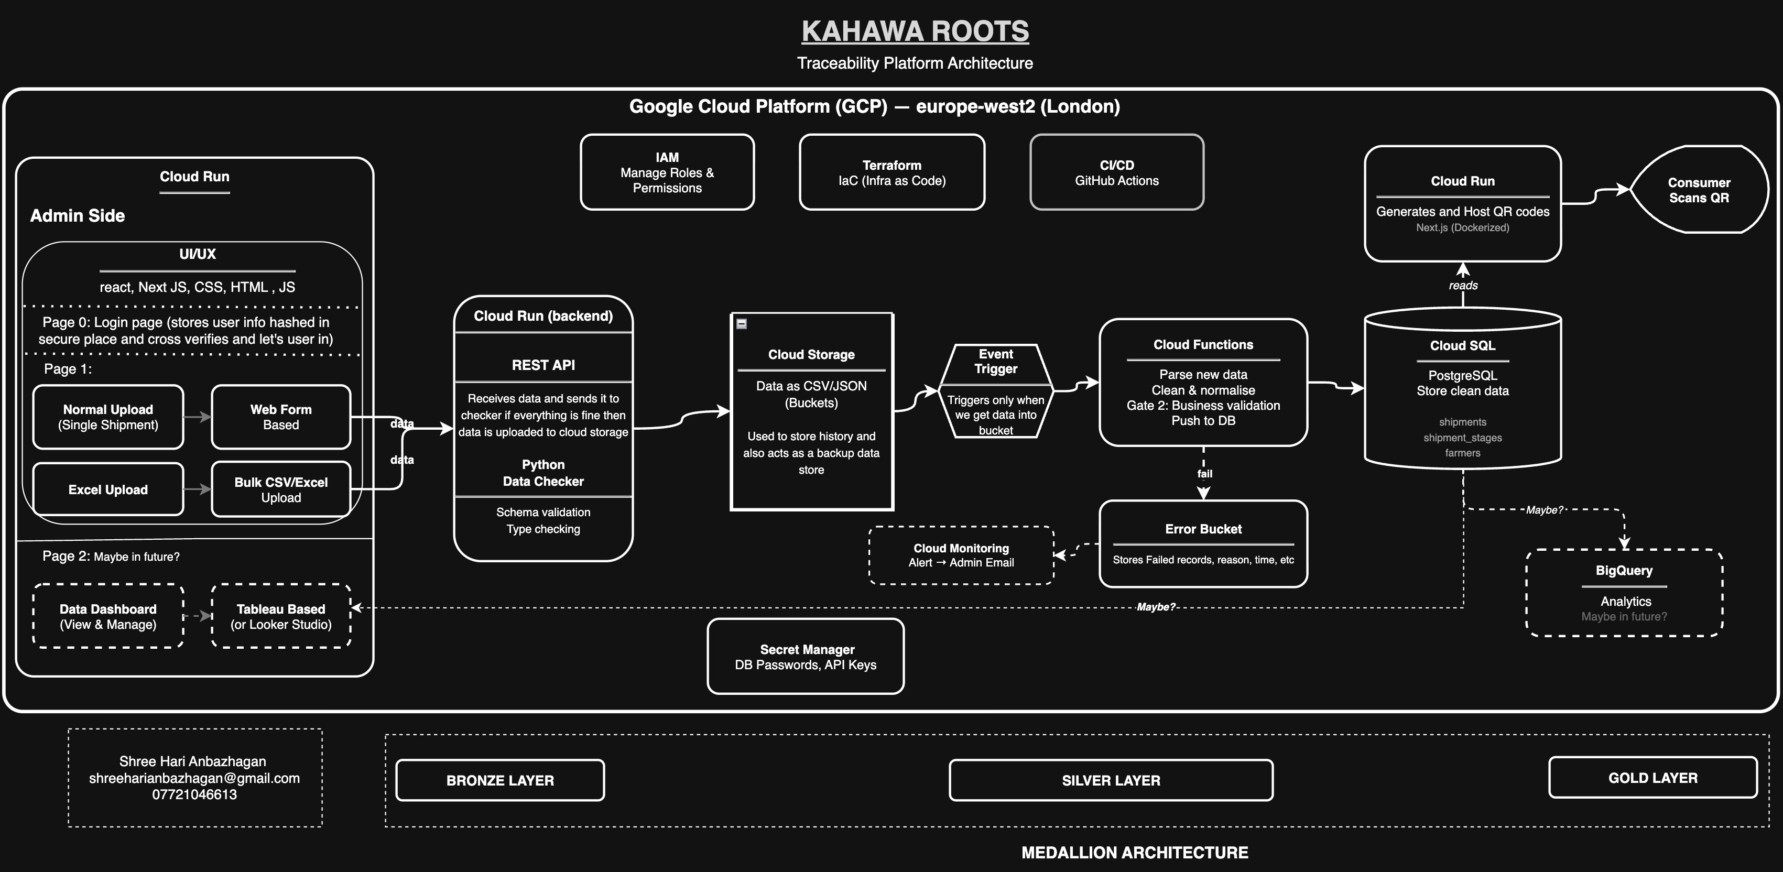

System Architecture
Click here for interactive architecture diagram

Slide 5
What Does All This Actually Mean?
Architecture Concepts
Microservices — instead of one big app, we split into 3 small independent ones (admin, API, QR page). if one breaks, the others keep running.
Cloud Functions — code that runs only when new data arrives. no server to manage, no cost when idle.
REST API — the “messenger” between the admin form and database. checks, cleans, and passes data along.
PostgreSQL — a database like a smart spreadsheet. stores shipments in organised tables with relationships.
Medallion Architecture — data flows through 3 layers: Bronze (raw backup) → Silver (cleaned) → Gold (customer-facing). no bad data reaches the QR page.
Operations & Security
IAM — controls who can do what. admins add shipments, public can only view QR pages.
Terraform (IaC) — infra defined in code, not clicked manually. one command rebuilds the whole system.
CI/CD — every code push is auto-tested and deployed. no manual uploads, no “works on my laptop” issues.
Secret Manager — stores passwords & API keys securely. no accidental credential leaks.
Future Plans
BigQuery — analytics when we have enough data. “fastest shipping regions?” “transit time trends?”
Dashboard — Tableau/Looker Studio for founders to see charts without touching the database.

