Slide 1



Kahawa Roots
Traceability Platform
Track coffee from a Kenyan farm to a UK cup allowing anyone to scan a QR code and view its full journey.
Transparent traceability builds buyer trust and enables premium pricing.
Proof of Concept
I’ve already built a live system on the same stack I’m proposing:
DeltaEd — Live on GCP Cloud Run GCP • React • Python • BigQuery (Built on a similar stack)
Shree Hari Anbazhagan
shreeharianbazhagan@gmail.com
07721046613
Pre-Interview Task — Developer Intern — April 2026
1/5

Slide 2




How Kahawa Roots Tracks Coffee, End to End
The Journey in 4 Steps
Non-Technical Data Entry
Designed for non-technical users:
1
Data Ingestion — Farmers or admins submit data via a web form or CSV upload.
Validation & Cleaning — Every field is automatically validated. Invalid rows are rejected and logged for review.
Secure storage — Raw data is preserved as an immutable backup. Cleaned data is stored in the Database with timestamps & GPS Coordinates at each stage.
Customer Visibility — Each shipment is assigned a QR code linking to a public page displaying its journey- map, timeline & farmer details.
Web Form
2
Input one shipment at a time via the admin dashboard.
No technical knowledge needed.
3
CSV/Excel Upload
Drag-and-drop bulk upload.
Automatic row-level validation.
Both methods feed the same pipeline, ensuring constant validation and storage. Access: Admins manage data, public users access information via QR.
4
FLOW:
Data flows in → Validated → stored → visible via QR.

Slide 3



Technology Choices + Bonus
Tech Stack & Why
Component Choice & Why
Medallion Architecture
Bronze
Raw CSV/JSON → Cloud Storage
Cloud GCP(London europe-west2), GDPR- compliant, eligible for $200K startup credits, scales to zero.
Silver
Cleaned data → PostgreSQL
Backend
Python + REST API on Cloud Run - reliable. Next.js is widely adopted, easy to hire server-side rendering ensures fast QR pages load.
Cloud SQL (Postgres) — reliable, free-
tier, low latency.
Cloud Storage — cost-effective, immutable raw data backup.
Cloud Functions — event-driven, pay-per-use.
Terraform + GitHub Actions — infra as code with automated deployment.
Google Maps API — native integration with GCP for visualising.
Gold (future)
QR Pages + BigQuery Analytics
Frontend
Bonus: Database Schema
CREATE TABLE farmers (
id UUID PK, name VARCHAR, region VARCHAR, farm size DECIMAL, lat/lon DECIMAL(9,6), cooperative VARCHAR );
CREATE TABLE shipments (
id UUID PK, batch id VARCHAR UNIQUE, farmer id UUID FK→farmers, grade VARCHAR, weight kg DECIMAL, status VARCHAR, created at TIMESTAMP DEFAULT NOW() );
CREATE TABLE shipment stages (
id UUID PK, shipment id UUID FK→shipments, stage VARCHAR, location VARCHAR,
timestamp TIMESTAMP, notes TEXT );
Database
Storage
Processing
IaC / CI
Maps

Slide 4
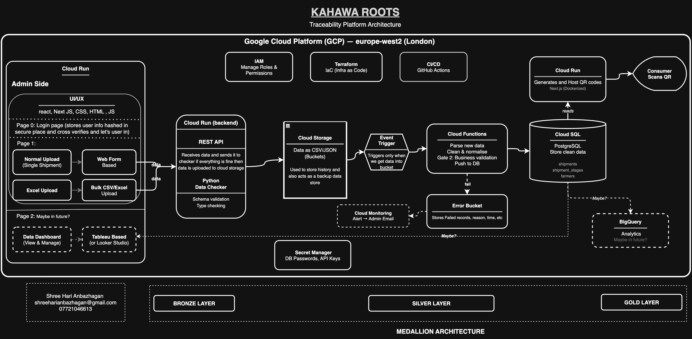

System Architecture
Click here for full-resolution architecture diagram

Slide 5

Why These Choices Work for Kahawa Roots
Cost effective at Small Scale
Cloud Run scales to zero — Pay only for run, no cost when idle.
Cloud Functions run only on demand — a few pence per execution, not a monthly server bill.
GCP — eligible for startup credits (up to
$200K). The platform could run for months before costing anything.
PostgreSQL — offers a robust, free-tier-friendly solution, no licensing fees.
Easy to Maintain
Modular design: 3 small apps instead of one monolith.
Infrastructure as code — Full system reproducible via configuration.
Safe & Reliable
Raw data is never deleted — every CSV and form submission is backed up untouched. If anything goes wrong, the original data is present as backup.
Two-step validation — data is checked at entry and again before it is stored in the database. Bad rows are rejected with clear error messages.
Passwords stored securely — database credentials and API keys stored securely in the vault, and not in code.
UK data centre — runs in London region (europe-west2). Data stays in the UK, GπDPR-compliant data handling.
Scales When You’re Ready
BigQuery ready — when there’s enough data, plug in analytics without rebuilding anything.
Dashboard — Looker Studio for business insights
Auto-deploy: push code tested and deployed instantly.

