Slide 1
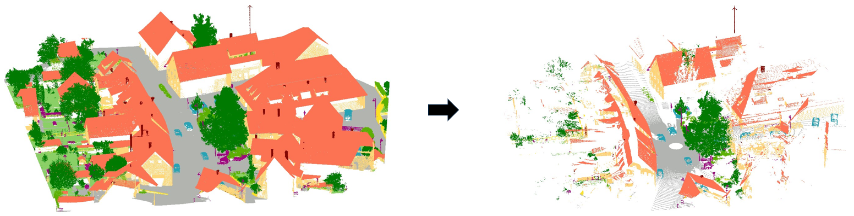
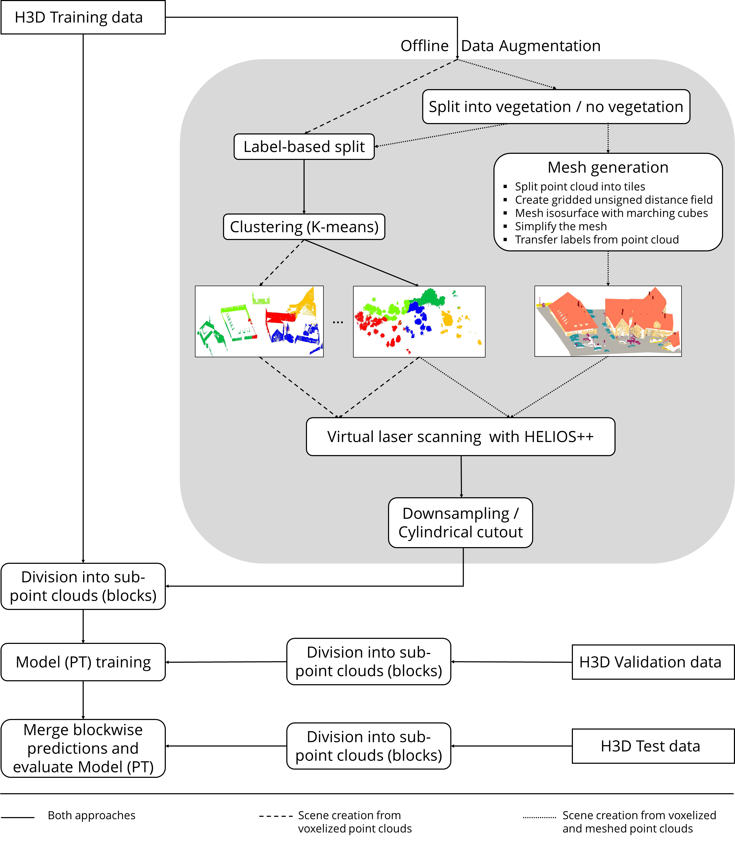
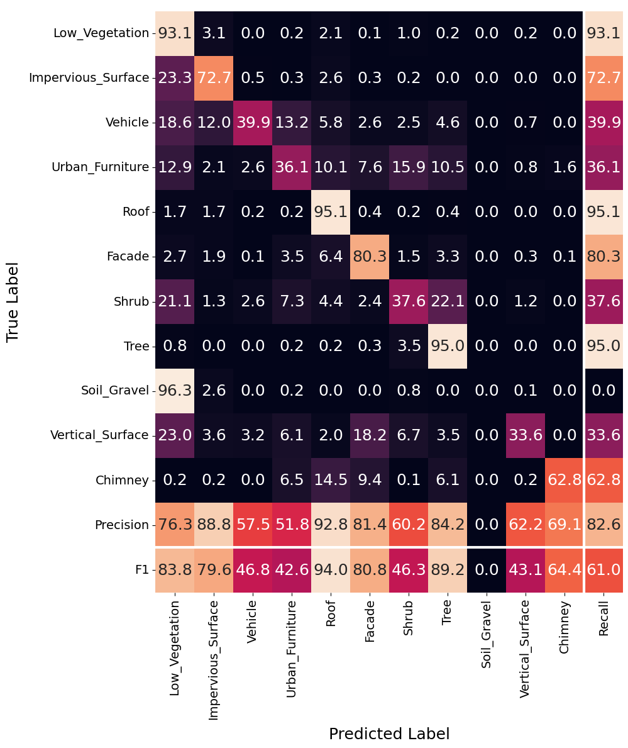
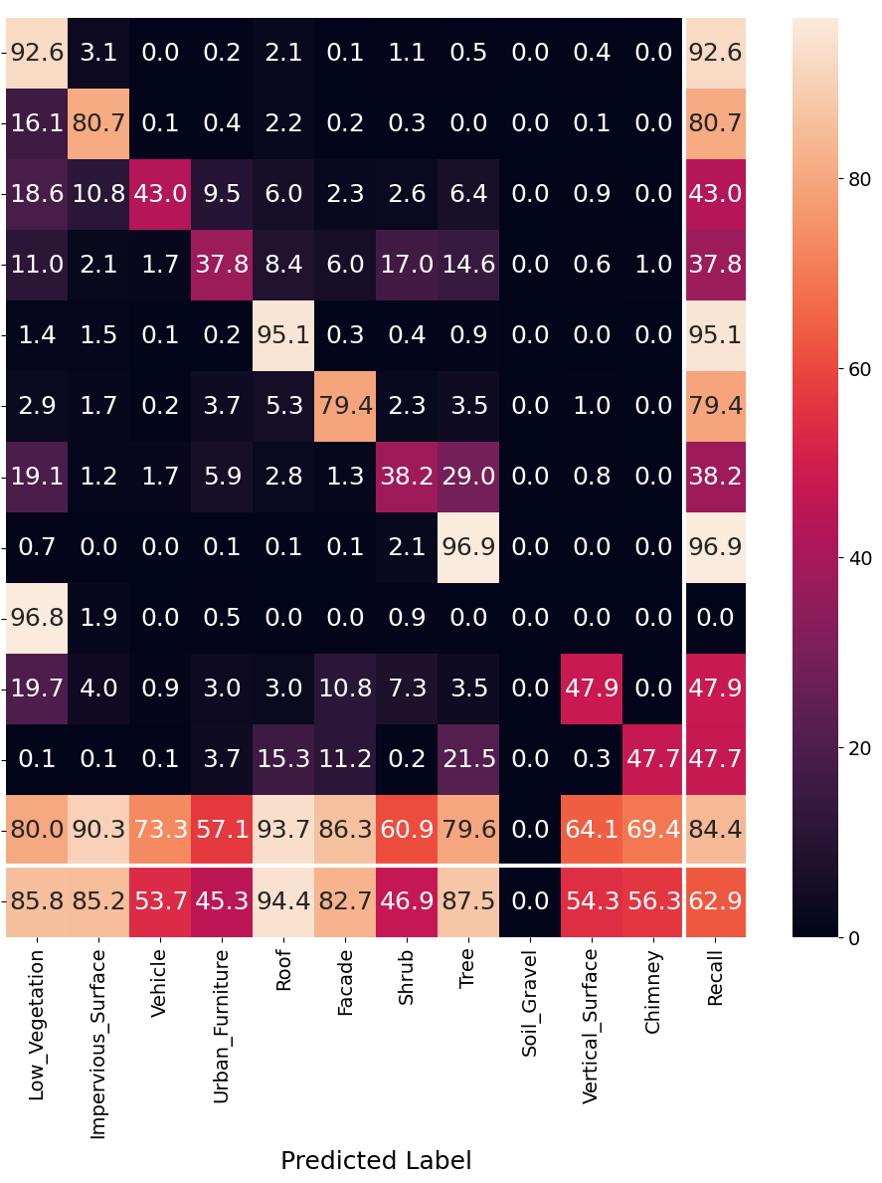
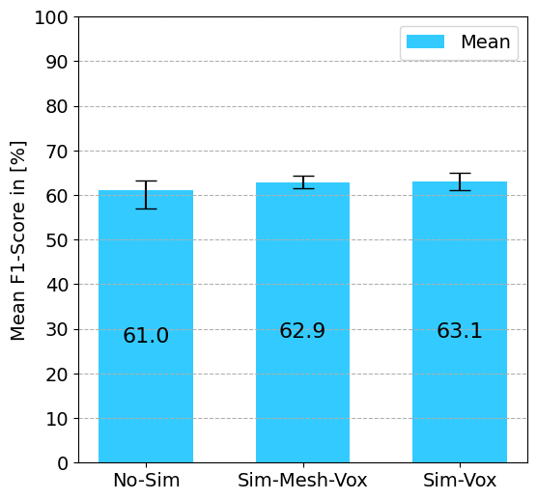
Data augmentation to enhance semantic segmentation of 3D point clouds
Felix Matzke, Anette Eltner
TU Dresden, Institute of Photogramme­try and Remote Sensing, Germany
1 Introduction
Supervised deep learning for semantic segmentation of 3D point cloud requires extensive labeled data
Virtual laser scanning (VLS) is typically used to create training data from synthetic scenes, but could also be a useful tool for data augmentation
Idea:
Modify training data in a physically meaningful way through using VLS
Virtual scan a 3D scene created from labelled real point clouds from different perspectives and with complementary LiDAR techniques to simulate shadow effects and different point distributions
2 Methods
Figure 1: Data augmentation with VLS
2.1 Data
Experiments are conducted using the Hessigheim 3D dataset from March 2019¹
The original validation area is used for testing
A subset of the training area is divided into a training set (approx. 37 M points) and a validation set
2.2 Offline Data Augmentation with VLS
Virtual laser scanning is carried out with HELIOS++²
To create a scene, real point cloud data must be converted into supported data formats
.xyz for point clouds, which are split by labels to assign the respective object class via .mtl files
.obj for meshes
Two approaches are being followed (see Figure 2):
Using point clouds (label-wise) , which are voxelized within HELIOS++ to construct the scene
Meshing all non-vegetation classes while using point clouds (label-wise) for vegetation
The scene is scanned virtually using the RIEGL VZ400 terrestrial laser scanner from manually defined viewpoints
2.3 Semantic Segmentation
For Semantic Segmentation, the Point Transformer³ architecture (with original settings) is used
Input point clouds are divided into 10 m block-shaped sub-clouds
Only point coordinates are used, making training harder but improving transferability
A simple training strategy was chosen after testing and applied in all experiments (see Table 1)
2.4 Experiments
Three training scenarios were compared to evaluate the data augmentation method:
No-Sim: without simulated data
Sim-Vox: with simulated data from a voxelized scene
Sim-Mesh-Vox: with simulated data from a meshed and voxelized scene
Three models were trained per scenario to account for variability in weight initialization and gradient descent
Blocks were sampled rigidly for consistency, despite the potential accuracy gain from random sampling
Optimizer | AdamW⁴
Weight decay | 0.01
Learning rate | 0.001
Batch size | 4 and 5
Table 1: Training settings
Figure 2: Schematic workflow
3 Results and Outlook
The proposed data augmentation (both approaches) improves training and results (see Figures 3 & 4), except for tree and chimney classes
All models fail to differentiate soil/gravel and low vegetation, and vehicle misclassification mainly occurs with water vessels
Future research questions:
Effectiveness for other deep learning approaches (e.g., voxel-based) and domains (e.g., forests).
Sensor-agnostic capability of trained models
Integration with other data augmentation strategies
Figure 3: Average, maximum and minimum of Mean F1-Score
Figure 4: Average confusion matrices (left: No-Sim, right: Sim-Mesh-Vox)
References:
Kölle, M., Laupheimer, D., Schmohl, S., Haala, N., Rottensteiner, F., Wegner, J. D., & Ledoux, H. (2021). The Hessigheim 3D (H3D) benchmark on semantic segmentation of high-resolution 3D point clouds and textured meshes from UAV LiDAR and Multi-View-Stereo. ISPRS Open Journal of Photogrammetry and Remote Sensing, 1, 100001. https://doi.org/10.1016/j.ophoto.2021.100001
Winiwarter, L., Esmorís Pena, A. M., Weiser, H., Anders, K., Martínez Sánchez, J., Searle, M., & Höfle, B. (2022). Virtual laser scanning with HELIOS++: A novel take on ray tracing-based simulation of topographic full-waveform 3D laser scanning. Remote Sensing of Environment, 269, 112772. https://doi.org/10.1016/j.rse.2021.112772
Zhao, H., Jiang, L., Jia, J., Torr, P., & Koltun, V. (2021). Point Transformer. 2021 IEEE/CVF International Conference on Computer Vision (ICCV), 16239–16248. https://doi.org/10.1109/ICCV48922.2021.01595
Loshchilov, I., & Hutter, F. (2019). Decoupled Weight Decay Regularization (arXiv:1711.05101). arXiv. http://arxiv.org/abs/1711.05101

