Slide 1


LLM-Powered Job & Resume Matching System
Harnessing Advanced AI to Revolutionize Talent Acquisition
Live presentation of the powerpoint: https://www.youtube.com/watch?v=y_6_A5GtRrA
Sébastien Levesque

Slide 2


The Hiring Challenge Today
1
2
Resume Overload
Brittle Keyword Matching
Recruiters face thousands of resumes per role, often in diverse, unstructured formats.
Traditional ATS rely on keyword matching, missing nuanced candidate fit.
3
Slow & Biased Screening
Manual screening is slow, inconsistent, and prone to unconscious bias.

Slide 3

Our Solution: Intelligent Resume & Job Matching with LLMs
Leverages Large Language Models to understand context, skills, and experience beyond keywords.
Combined with vector embedding to study semantic similarity between text.
Automates parsing, normalization, ranking, and provides clear reasoning explanations.
Designed to reduce bias and significantly improve candidate-job fit accuracy.

Slide 4





System Architecture Overview
Data Ingestion
Pipelines for PDFs, DOCX, and plain text resumes and job descriptions.
LLM Parsing & Normalization
LLM extracts structured data: skills and required skills, experience, education, etc.
Semantic Embedding
Nomic or BGE embeddings.
Scoring & Ranking
Euclidean distance or cosine similarity to rank matched elements.
Reasoning Explanation
Natural-language explanations highlight key strengths and gaps.

Slide 5



Design Choices & Innovations
Multi-Agent Approach
Output Verification
Multiple Embeddings
Specialized LLM agents handle normalization, matching, and explanation tasks.
Robust verification and normalization mechanisms mitigate LLM hallucinations.
Utilizing different embeddings (Nomic, BGE) for comprehensive comparison and accuracy.

Slide 6

Why Ollama with Llama 3?
State-of-the-Art Performance: Llama 3 offers unparalleled language understanding with open weights for deep customization.
Local Deployment & Privacy: Ollama ensures seamless local deployment, guaranteeing data privacy and minimal latency.
Customization & Tuning: Supports fine-tuning and prompt engineering for better tailoring.
Cost-Effectiveness: A more economical solution compared to exclusive cloud-only LLM providers, while offering scalable inference.

Slide 7
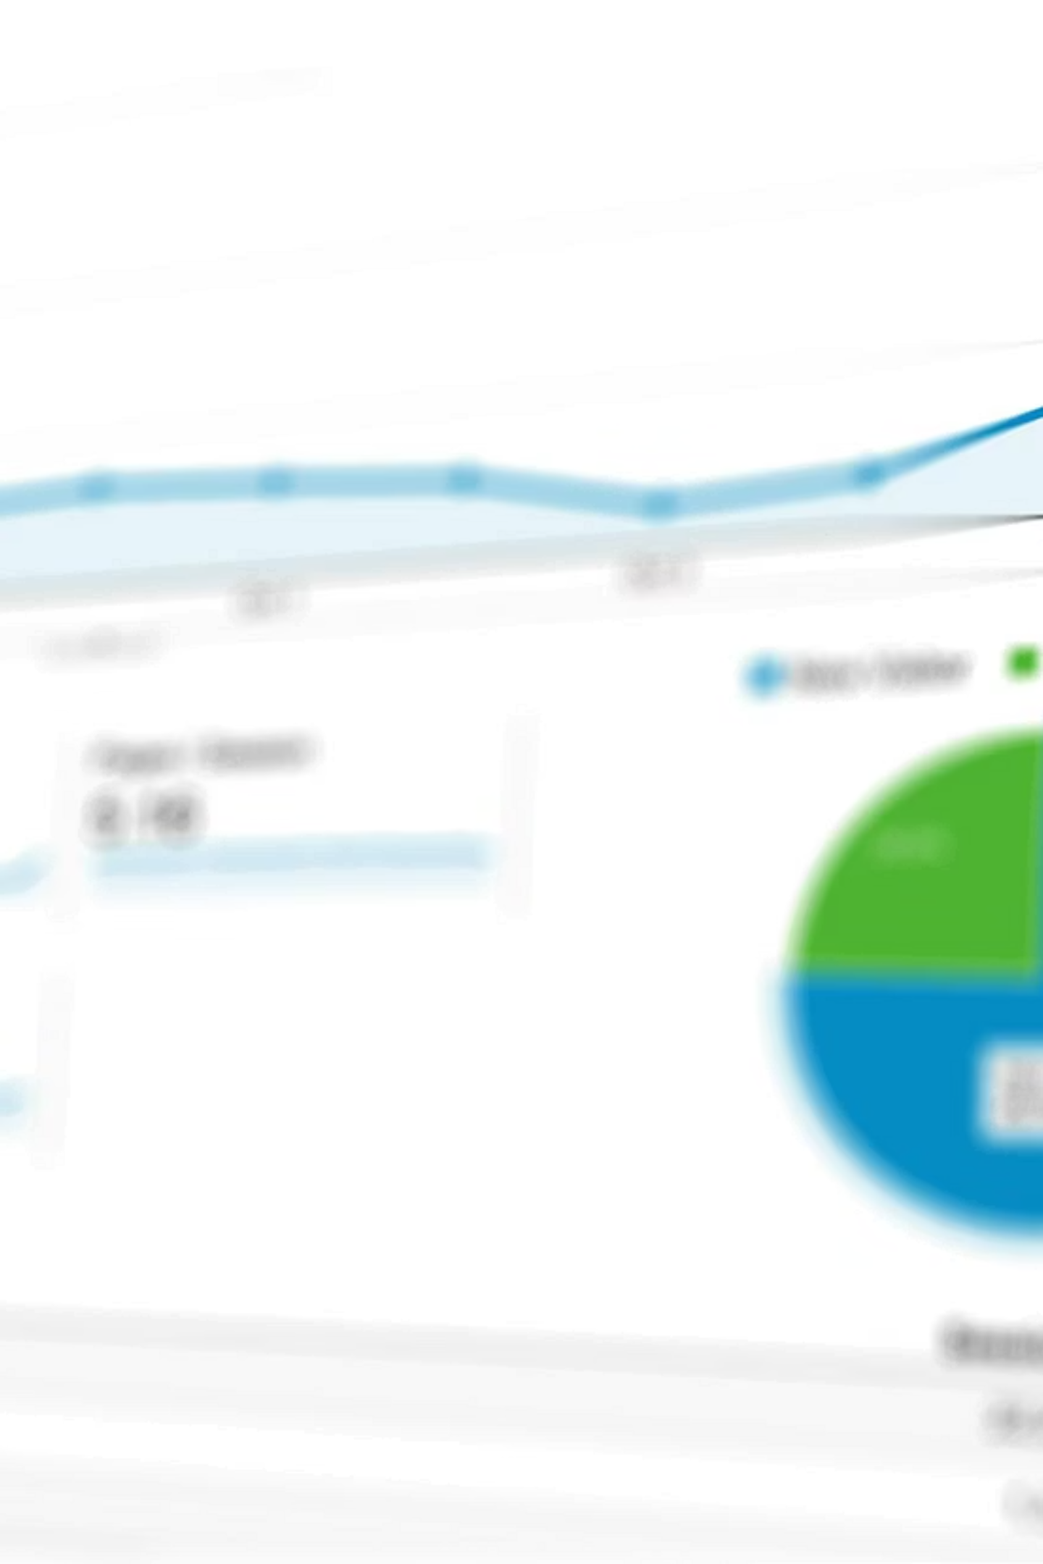
Evaluation of Ranking
& Explanation Quality
Goal : Measuring whether the LLM-driven matching ranks items in a human-like way
Methodology (Human VS Machine) :
Select a resume -> Manually classify 5 jobs
Select a job -> Manually classify 5 resumes
Metrics :
Direction | Spearman correlation | Explanation accuracy (qualitative)
Resume -> 5 Jobs | -0.5 | Few hallucinations, but related to the input
Job -> 5 Resumes | -0.5 | Obvious hallucinations of skillls to match requirements

Slide 8
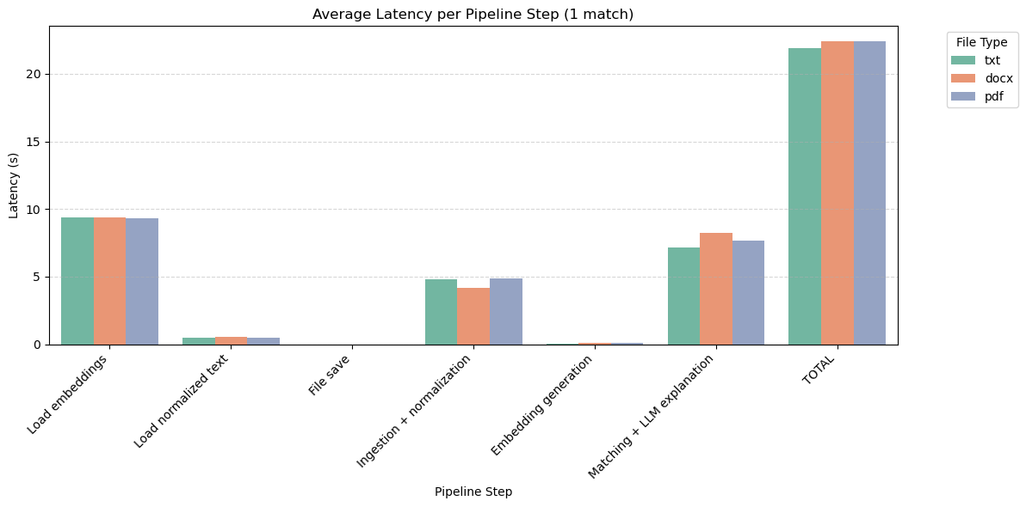
Processing time per step
Dominated by:
Embedding loading, mostly due to the amount of files
LLM explanation, because LLM calls are obviously more costly
File format:
mainly affects ingestion
may also be confused with file size
has a minimal impact on latency

Slide 9
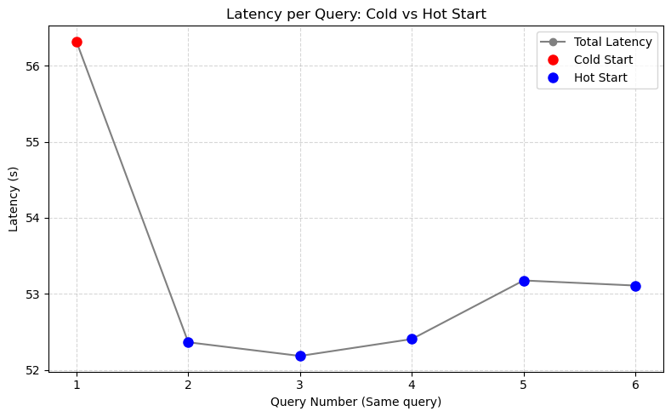
Cold VS Hot starts
First query incurs a cold start penalty (+ 4s), driven by model/embedding initialization
While subsequent queries run at a stable hot latency (~52-53s)
Conclusion:
Cold start affects interactive workloads
But it is largely negligible for batch queries

Slide 10

Challenges Encountered
Quality VS Quantity
Continuous Prompt Tuning
Finding a realistic dataset that combined volume and quality of the data was complicated
Finding the optimal prompt configurations required extensive and continuous iteration to achieve desired results.
LLM Output Normalization
Performance Bottlenecks
Ensuring consistently normalized output from the LLM via prompt engineering alone was impossible with large datasets.
The sheer volume of data processed significantly impacted system speed, necessitating further optimization.

Slide 11


Future Improvements & Roadmap
Advanced Agent Collaboration
Expand multi-agent LLM collaboration for deeper skill and personality assessments.
Multi-Modal Input
Incorporate video resumes, LinkedIn profiles, and coding samples for richer candidate insights.
Explainability Dashboards
Develop intuitive explainability dashboards with comprehensive candidate and job insights for users.
Dynamic Market Insights
Integrate real-time labor market data for dynamic job requirement updates and trend analysis.

Slide 12

Conclusion: Transforming Hiring with AI-Powered Matching
Our LLM-based system effectively bridges the critical gap between recruiting at scale and maintaining high-quality talent acquisition.
Scale & Quality
Fairer Process
Our system enables a significant improvement in both the volume and precision of candidate matching.
By reducing human bias, we foster a more equitable and inclusive recruitment environment.
Explainability
LLM explanation allows for a better insight into the potential reason as to why a rejection was made.

Slide 13

Live demonstration
of the app
https://youtu.be/WF9D-Tiwn_Y

