Slide 1
JavaDoc
CSD-3464
Java

Slide 2
The Plan
What is Javadoc?
Writing Javadoc comments
Using the Javadoc tool

Slide 3
What is Javadoc?
Javadoc is a way to comment your code that enables automatic generation of web pages that document your code.
Why use Javadoc?
It's much faster than generating webpages documenting your code.
It's standard documentation which means it's easy to use and the structure is given.

Slide 4
Writing Javadoc Comment
Javadoc comments start with /** and end with */
The placement of the comment is important.
The following can be commented:
  classes
  methods
  instance variables
  static variables

Slide 5
Writing Javadoc Comment
package tipgame;
/**
* Used to enable timed events.
* @author N.G.
*/
public interface Alarm
{
/** creates alarm */
public void alarm();
}
Javadoc
Comments

Slide 6
Commenting a Class
Put the comment immediately before the class declaration.
Briefly describe the purpose of the class in 2-3 sentences.
Optionally include
  @author tag
  @version tag
  others

Slide 7
Commenting a Class
/**
* This class uses polling rather
* than events for keyboard input.
*
* @author N.G. */
public class Keyboard implements

Slide 8
Commenting a Method
Put the comment immediately before the method declaration.
Briefly describe the purpose of the method in a short phrase or 2-3 sentences. Include more detail if necessary
Include these tags if needed
  @param name – describes parameter
  @return – describes the return value

Slide 9
Commenting a Method
/** Simulates the surface normal used for
* bouncing the moving object off of the
* stationary object. Normal is in the
* direction from the surface of the
* stationary object to the center of the
* moving shape's bounding box.
* @param stationary the object not in motion
* @param moving the object that will bounce
* of the stationary object
* @return the radians of the normal vector
*
public static double getNormalVector(Shape stationary, Shape moving)

Slide 10
Commenting
Instance and Static Variables
Put the comment immediately before the variable declaration.
Briefly describe the purpose of the variable in a short phrase. Include more detail only if absolutely necessary.
No tags needed.

Slide 11
Commenting
Instance and Static Variables
/** shape should initially be centered at (0, 0) */
private GeneralPath shape;
/** transformed shape */
private GeneralPath shapeTransformed;
/** applied to the shape prior to drawing it */
private AffineTransform transform;
/** the fill color of the shape, black by default */
protected Color color;

Slide 12
For more information...
Visit the article:
How to Write Doc Comments for the Javadoc Tool
http://www.oracle.com/technetwork/java/javase/documentation/index-137868.html

Slide 13
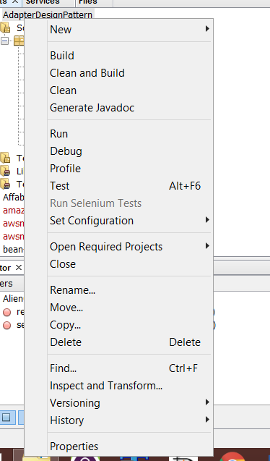
Generating HTML using the Javadoc Tool in NetBeans
Right-click the project name and then choose Generate Javadoc
http://www.itcsolutions.eu/2010/12/23/tutorial-java-62-2-how-to-generate-javadoc-in-eclipse-or-netbeans/

Slide 14
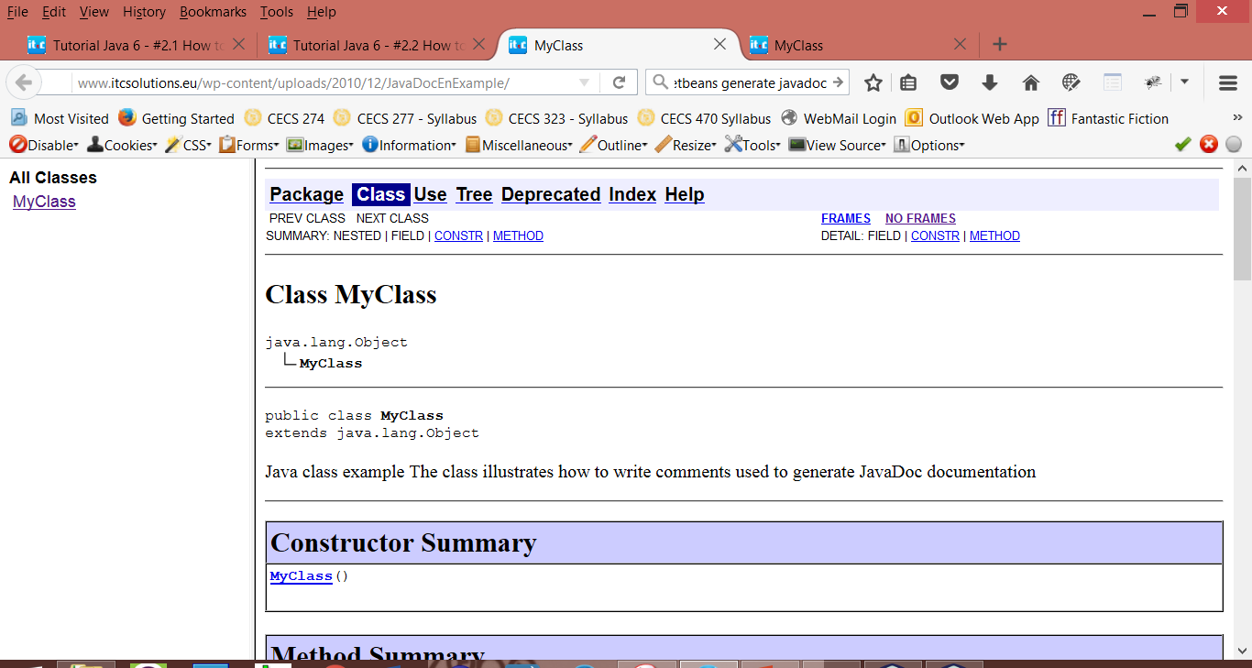
JavaDoc Results
JavaDoc documentation for this project is automatically generated in the project subfolder dist/javadoc and will look like this

