Slide 1
AGENDA: Arrays
LEARNING OUTCOME/OBJECTIVE: 2.1 to 2.5

Slide 2
Arrays Part 2

Slide 3
Arrays: in-class program 1 Sort array of numbers
Write a program SortNumbersArray.java to sort a set of numbers from smallest to largest
In the main method, Randomly get 10 integers between 100 and 1000 and store it in an integer array.
In the main method, Print the numbers in the array as it is stored
Write a method to sort the numbers in the array
In the main method, Print the numbers in the array to show it sorted

Slide 4
Arrays: in-class program 2 Sort array of numbers (reverse)
Write a program ReverseSortNumbersArray.java to sort a set of numbers from largest to smallest
In the main method, Randomly get 10 doubles between 100.00 and 1000.00 and store it in a double array.
In the main method, Print the numbers in the array as it is stored
Write a method to sort the numbers in the array
In the main method, Print the numbers in the array to show it sorted

Slide 5
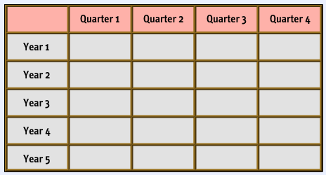
2D Arrays
Declare a multi-dimensional Array
(Below is a 2D Array)
int [] [] yearlySales = new int [5][4];
The 1st number 5 indicates the number of rows in the array (number of sub-arrays)
The 2nd number 4 indicates the number of columns in each row (length of each sub-array)

Slide 6

2D Arrays
When you allocate memory for a multidimensional array, you need only specify the memory for the first (leftmost) dimension.
You can allocate the remaining dimensions separately.
For example, this following code allocates memory for the first dimension of twoD when it is declared. It allocates the second dimension manually.

Slide 7
2D Arrays
Initializing a two-dimensional array requires enclosing each row’s initialization list in its own set of braces.
int[][] numbers = { {1, 2, 3}, {4, 5, 6}, {7, 8, 9} };
Java automatically creates the array and fills its elements with the initialization values.
row 0 {1, 2, 3}
row 1 {4, 5, 6}
row 2 {7, 8, 9}
Declares an array with three rows and three columns.
column 0
column 1
column 2
Address
row 0
1
2
3
row 1
4
5
6
row 2
7
8
9

Slide 8
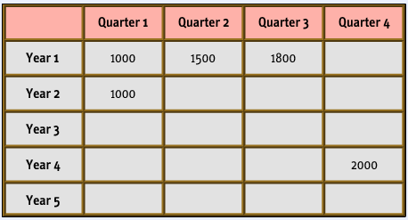
2D Arrays
When setting or getting values in a two-dimensional array, you need to indicate the index number in the array by using a number to represent the row, followed by a number to represent the column.
This example contains five assignments of values to elements of the yearlySales array.
yearlySales[0][0] = 1000;
yearlySales[0][1] = 1500; yearlySales[0][2] = 1800; yearlySales[1][0] = 1000; yearlySales[3][3] = 2000;
This is how the array looks after the values are assigned

Slide 9
The Arrays class
The Arrays class in package java.util has several useful static methods for manipulating arrays:
Method name | Description
binarySearch(array, value) | returns the index of the given value in this array (< 0 if not found)
equals(array1, array2) | returns true if the two given arrays contain exactly the same elements in the same order
fill(array, value) | sets every element in the array to have the given value
sort(array) | arranges the elements in the array into ascending order
toString(array) | returns a string representing the array, such as "[10, 30, 17]"

Slide 10
Command line arguments
A Java program can receive arguments from the operating system command-line.
The main method has a header that looks like this:
public static void main(String[] args)
The main method receives a String array as a parameter.
The array that is passed into the args parameter comes from the operating system command-line.

Slide 11
Command line arguments
Example:
public static void main(String[] args) {
for (int i = 0; i < args.length; i++) {
System.out.println(args[i]);
}
}
java CommandLine How does this work?
args[0] is assigned "How"
args[0] is assigned "does"
args[0] is assigned "this"
args[0] is assigned "work?"
It is not required that the name of main’s parameter array be args.

Slide 12
Variable-Length Argument Lists
Special type parameter – vararg parameter
simplifies the creation of methods that need to take a variable number of arguments
An argument type followed by an ellipsis (three periods) in a method’s parameter list indicates that the method receives a variable number of arguments of that particular type.
Vararg parameters are actually arrays
At most only one vararg in a parameter list is allowed
If placed along with other parameters, the vararg parameter must be placed at the end of the parameter list
public static int sum(int z, String s,int... numbers)
{
int total = 0;
// Add all the values in the numbers array.
for (int val : numbers)
total += val;
return total;
}
Notes:
Beginning with JDK 5, Java has included the var-arg feature.

Slide 13
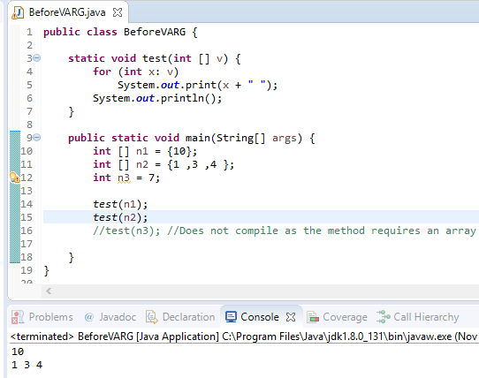
Variable-Length Argument Lists
Before vararg, you had to package every input as an array before passing to method

Slide 14
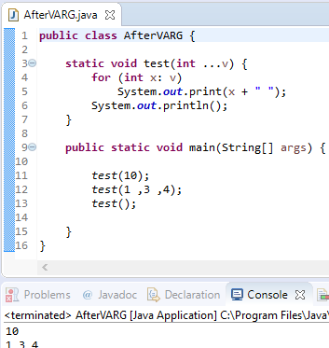
Variable-Length Argument Lists
After vararg, you can pass 0 to any number of values and Java will convert it to array

